Slide 1
Prediction Challenge 2
By Jarlin Almanzar

Slide 2
About our Prediction
About: Predict the grades in the testing file and add it to GRADE attribute with predicted grades, using ‘rpart’.
For this program I have multiple files to use:
I must use cross_validate(), Rpart, and Predict
I will use the same dataset that was used on Prediction 1
Data provided by Rutgers Data 101 class.
The code used for prediction is code provided by the professors example

Slide 3
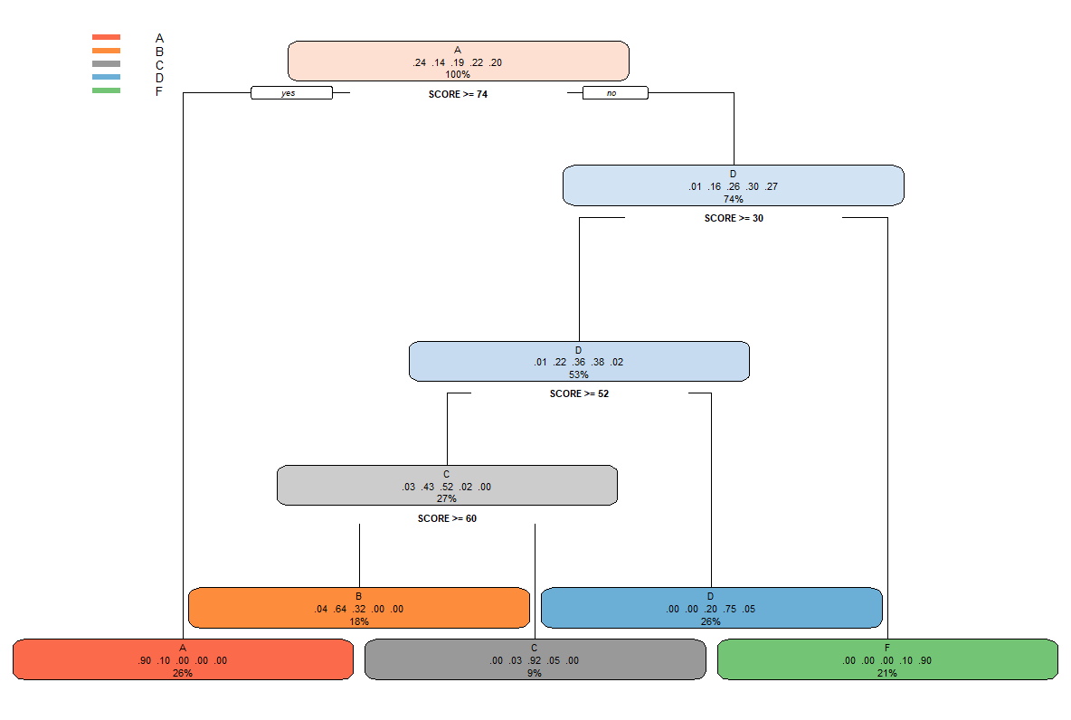
Using Rpart
Using Rpart we can get a more accurate prediction when it comes to Mr. Moody’s Grading policies.
From what we got we can see where the grade scales from:
A>=74
B>=60
C>=52
D>=30
F<30
As we can see that class has a curved grade. The curve mostly relying on the score but also by other factors. We will further test with minsplit.
> library(rpart)
> library(rpart.plot)
> m2018_train <- read.csv("~/Moody2018.csv",stringsAsFactors=FALSE)
> m2018_train <- read.csv("~/M2018_train.csv",stringsAsFactors=FALSE)
tree <- rpart(GRADE ~ SCORE+ASKS_QUESTIONS+LEAVES_EARLY+PARTICIPATION, control=rpart.control(minsplit=200), data = m2018_train)
> rpart.plot(tree)

Slide 4
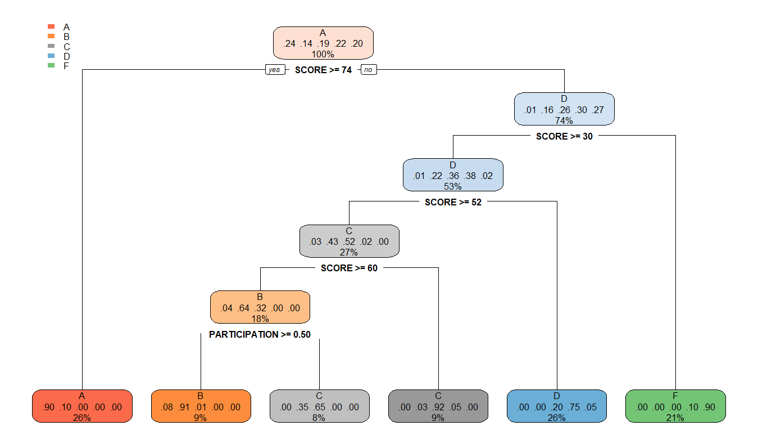
Rpart pt.2
Using the minsplit function in rpart we can achieve different trees. On my base tree I used 200.
Using 300 minsplit removed B which is what we’re searching for.
Using 100 minsplit we got new information we didn’t get before.
With this minsplit we see that the scoring remains the same but PARTICIPATION has an affect in whether deciding a student receives a B or a C.
As we can see having above 50% participation gives a student a boost to a B
> tree <- rpart(GRADE ~ SCORE+ASKS_QUESTIONS+LEAVES_EARLY+PARTICIPATION, control=rpart.control(minsplit=100), data = m2018_train)
> rpart.plot(tree)

Slide 5
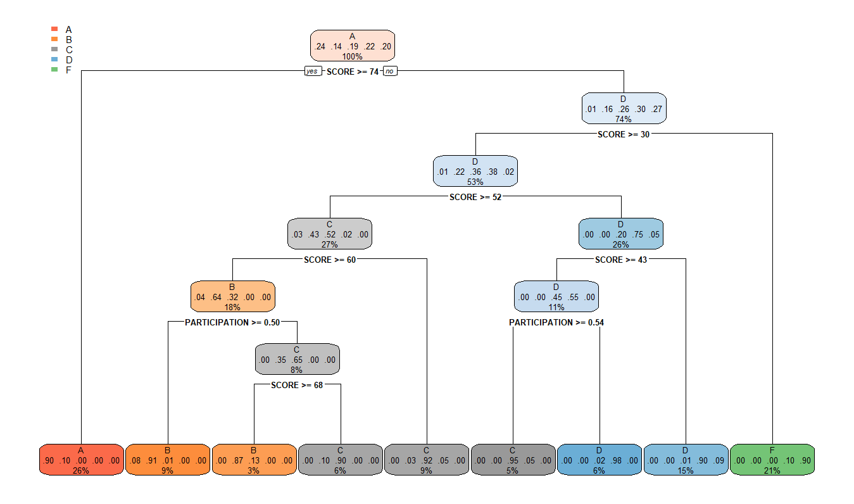
Rpart pt.3
After seeing that decreasing our Minsplit function opened up new data that helps us better predict the grades. I again halved the amount of minsplit to 50 and we some nice results.
As we can see from the tree plot, the people who have over 50 percent in participation and have a grade of 68+ actually get a grade boost from a C to a B.
While the participation score barely affects those in the lower in the D section as the person’s score is still to low even with the boost.
> tree <- rpart(GRADE ~ SCORE+ASKS_QUESTIONS+LEAVES_EARLY+PARTICIPATION, control=rpart.control(minsplit=50), data = m2018_train)
> rpart.plot(tree)

Slide 6
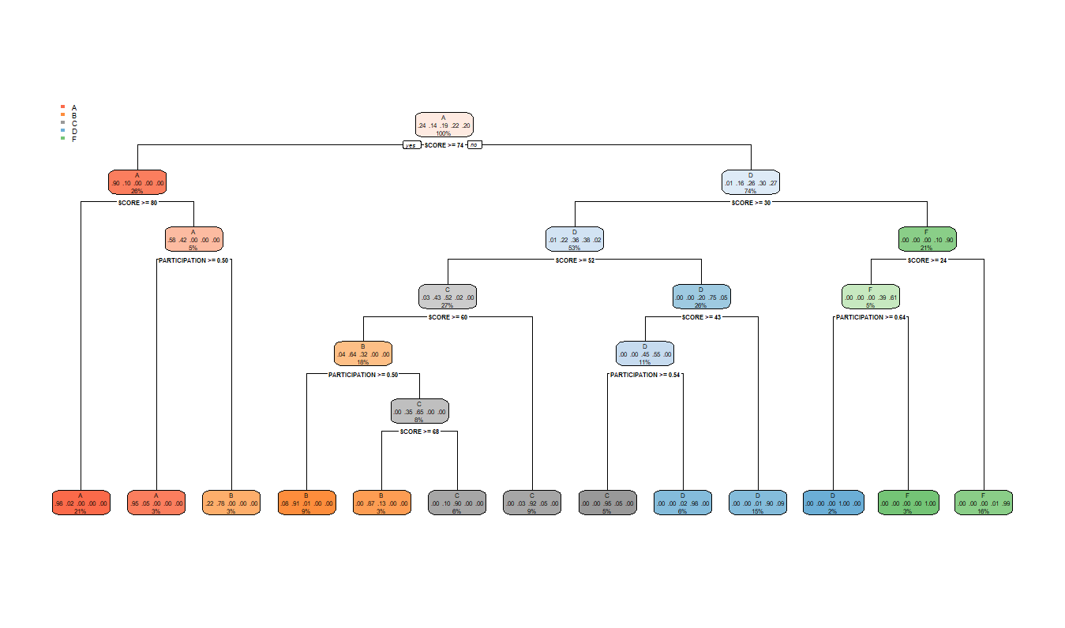
Rpart. Pt.4 Finale
I again reduce the minsplit by halve to achieve the participation boost for all scores and we can how much of an effect participation has on an individual’s grade.
Participation is a huge decider when it comes to landing in a higher grade.
13% of the class gained a higher grade than they would have received if they didn’t participate more than 50% of the time.
With minsplit 25, we get the most detailed tree as possible but now we have to predict.
> tree <- rpart(GRADE ~ SCORE+ASKS_QUESTIONS+LEAVES_EARLY+PARTICIPATION, control=rpart.control(minsplit=25), data = m2018_train)
> rpart.plot(tree)

Slide 7
Prediction
I start to apply the scores I got from the Rpart data and apply to my prediction error.
As such I'm getting a much smaller error than I did in my prediction 1 which was .1984.
As we see have a really small prediction.
> decision <- rep('F',nrow(train))
> decision[train$SCORE>24 & train$PARTICIPATION>0.64] <- 'D'
> decision[train$SCORE>30] <- 'D'
> decision[train$SCORE>43 & train$PARTICIPATION>0.54] <- 'C'
> decision[train$SCORE>52] <- 'C'
> decision[train$SCORE>60 & train$PARTICIPATION>0.5] <- 'B'
> decision[train$SCORE>70] <- 'B'
> decision[train$SCORE>74 & train$PARTICIPATION>0.5] <- 'A'
> decision[train$SCORE>80] <- 'A'
> myprediction<-train
> myprediction$GRADE <-decision
> error <- mean(train$GRADE!= myprediction$GRADE)
> error
[1] 0.07151371
> decision <- rep('F',nrow(train))
> decision[train$SCORE>30] <- 'D'
> decision[train$SCORE>43 & train$PARTICIPATION>0.54] <- 'C'
> decision[train$SCORE>52] <- 'C'
> decision[train$SCORE>60 & train$PARTICIPATION>0.5] <- 'B'
> decision[train$SCORE>70] <- 'B'
> decision[train$SCORE>74 & train$PARTICIPATION>0.5] <- 'A'
> decision[train$SCORE>80] <- 'A'
> myprediction<-train
> myprediction$GRADE <-decision
> error <- mean(train$GRADE!= myprediction$GRADE)
> error
[1] 0.09058403

Slide 8
Cross Validate
After using Rpart we must make sure the data is as accurate as possible using cross validate.
We use cross validate with different minspilt to get the best prediction as possible.
> CrossValidation::cross_validate(m2018_train, tree, 2, 0.7)
accuracy_subset accuracy_all
1 0.9126984 0.9126984
2 0.9047619 0.9285714
> CrossValidation::cross_validate(M2018_train, tree, 5, 0.8)
accuracy_subset accuracy_all
1 0.9166667 0.9166667
2 0.9107143 0.9107143
3 0.8809524 0.8809524
4 0.9107143 0.9107143
5 0.8988095 0.8988095

Slide 9
Conclusion
After using the Rpart function and the Cross validate we figure out that our data is predicted to be accurate around 90% to
Unlike my Prediction 1 Challenge in which I barely accounted for Participation and other factors we can see it played a significant role in affecting final grades.
Using the prediction error we get around .07 meaning that our achieved scored through rpart is really good.

Slide 10
Submission Code
> decision <- rep('F',nrow(test))
> decision[test$SCORE>24 & test$PARTICIPATION>0.64] <- 'D'
> decision[test$SCORE>30] <- 'D'
> decision[test$SCORE>43 & test$PARTICIPATION>0.54] <- 'C'
> decision[test$SCORE>52] <- 'C'
> decision[test$SCORE>60 & test$PARTICIPATION>0.5] <- 'B'
> decision[test$SCORE>70] <- 'B'
> decision[test$SCORE>74 & test$PARTICIPATION>0.5] <- 'A'
> decision[test$SCORE>80] <- 'A'
> myprediction<-test
> myprediction$GRADE <-decision
> outcome<-data.frame(ID=submission$STUDENTID,GRADE=myprediction$GRADE)
> write.csv(outcome,"M2018_sample_submission.csv",row.names = F)

