Slide 1
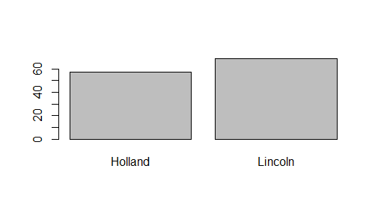
Traffic in Holland and Lincoln Tunnels (Volume per minute)

Slide 2
Is data telling us the truth?
Or is it just random chance?
p-value – chance that what you got is a random chance
That is, you have nothing!

Slide 3
Is Lincoln Tunnel more busy than Holland Tunnel?

Slide 4
How to look smart at data science talk?
Have you calculated p-values?

Slide 5
First there must be hypothesis
Boring one: NULL hypothesis – nothing really happens. SKEPTIC
You hope you can reject it!
Show that it is unlikely to get what you have by random chance UNDER NULL HYPOTHESIS

Slide 6
Examples of NULL hypotheses
Traffic in Holland Tunnel is same as in Lincoln Tunnel
French Wines are equally priced as Californian Wines
Crime has not changed as result of Gun laws
Unemployment has not changed as result of tax reductions
My candidate is not leading your candidate
Even though your plot may show otherwise

Slide 7
Z-tests and some statistics

Slide 8
Micro-intro to statistics….
Descriptive statistics
Inference statistics

Slide 9
Basic Measure of Descriptive Statistics
Means (mu)
Range, IQR, Variance, Standard Deviation (sigma)
Position – simple ranking, percentile ranking, z-score
Shape: Histograms, Z-scores, percentile rankings, box and whisker displays

Slide 10

Standard deviation

Slide 11
Chebyschev Theorem
For any data distribution 1-1/k^2 of data lies within k standard deviations from the mean (k>1)
So for 3 sigmas…..no matter what distribution, we get 1-1/9of data ~ 89% of values and within 2 sigmas 75% of the values
Isn’t it amazing, that this holds regardless of the distribution?

Slide 12
“Data analyst script” – what do you do after you get the data?
Calculate basic measures! Get a feeling for a data distribution
Run basic plots
See of anything is “interesting”
If so, follow up….validate with common sense and p-values

Slide 13
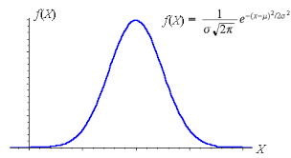
Normal distribution

Slide 14
Central Limit Theorem
Normal distribution (Bell curve) is special
No matter what the data distribution is. Means of data samples turn to follow normal curve….

Slide 15
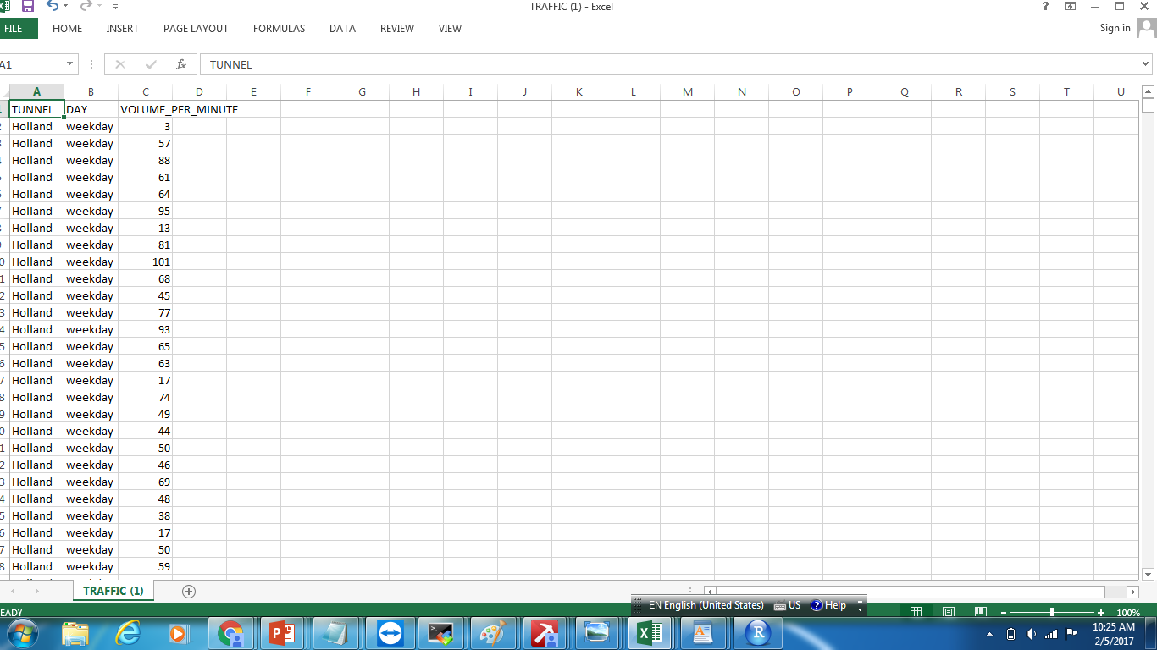
Traffic.csv

Slide 16
We will take 1000 samples of traffic data – two weeks long each
n <- 1000
lincoln_14 <- vector("numeric",n)
sample(N,14,replace=T)

Slide 17
Let’s come back to traffic differences
Generate n samples of size of 14 from the year long traffic data measurments (14 out of total of N)
lincoln_14<-mean(lincoln[sample(N,14,replace=T)])

Slide 18
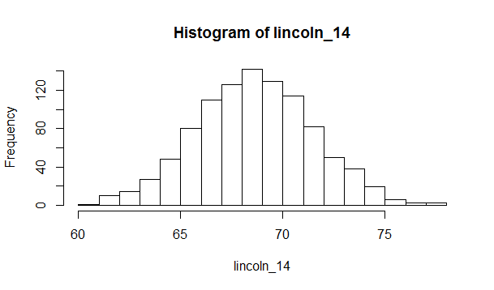

Slide 19
Now larger samples (60 days…)
lincoln_60[jj] <- mean(lincoln[sample(N,60,replace=T)])

Slide 20
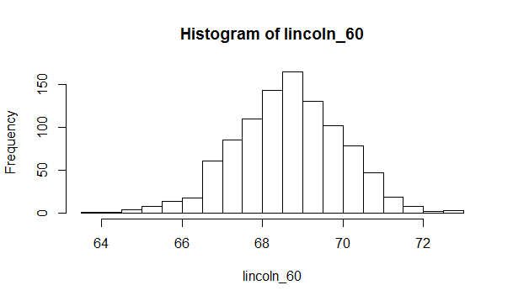

Slide 21
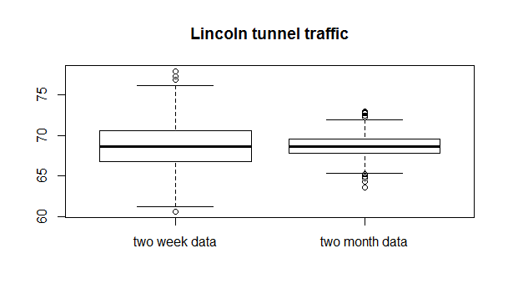

Slide 22
sd(lincoln_14) [1] 2.821081 > sd(lincoln_60) [1] 1.321644

Slide 23
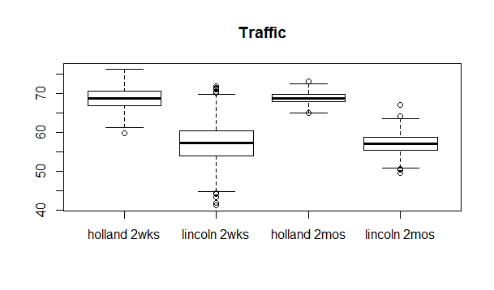

Slide 24
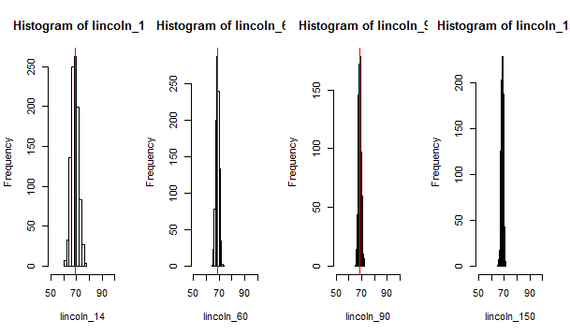

Slide 25
Note that the sampling distribution becomes more and more concentrated around the mean

Slide 26
Regardless of data distribution….
The histograms match the shape of normal distribution
The central limit theorem guarantees that the histogram will come closer and closer to normal distribution as the sample size gets larger and larger.
This is an extremely powerful (and surprising!) result

Slide 27
Distribution of sample means
Distribution of sample means is NORMAL
The mean of the set of sample means will equal mu, the mean of the population
The standard deviation sigma of the set of sample means will be approximately equal to sigma/sqrt(n) (smaller as the standard deviation of the entire population)
Distribution of means is more NARROW (sigma is smaller)

Slide 28
Now see the recommended Khan Academy videos on
“Single sample”hypothesis testing
“Two samples” hypothesis
https://www.khanacademy.org/math/probability/statistics-inferential/hypothesis-testing-two-samples/v/hypothesis-test-for-difference-of-means

Slide 29
Z-value: Normalizes the data
Traffic in Lincoln Tunnel: 60/minute
Traffic in Holland tunnel: 66/minute
Is traffic in Holland Tunnel > Lincoln Tunnel?
NULL Hypothesis: NO (zero difference)
Than how likely it is that we get 6?
It all depends on standard deviation sigma
6/sigma = z-value

Slide 30
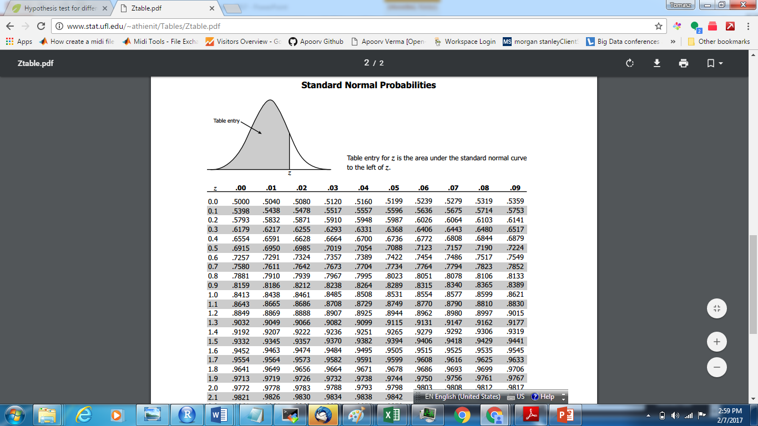

Slide 31
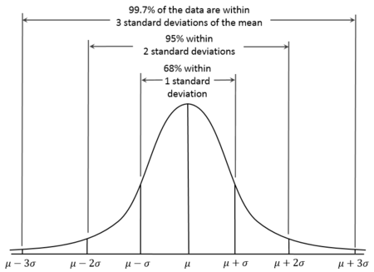

Slide 32
Z Test
According to central limit theorem, the distribution of D_null is a normal distribution when n goes infinity.
We want to use inference and math to calculate the normal distribution formula and p value.
Null Hypothesis:
There is no traffic difference between Lincoln and Holland tunnels.
Alternative Hypothesis:
Lincoln is busier than Holland

Slide 33
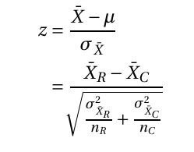
normal distribution curve
The Bell curve can be determined when the population mean and standard deviation are both known. z score is how many standard deviation to the center of curve.

Slide 34
Now check data101 how to calculate p-value using Z-test
http://data101.cs.rutgers.edu/laboratory/pages/ztest

Slide 35
Summarizing
Calculate mean and standard deviation sigma
Then calculate z-value
Once we have z- value we have p-value

Slide 36
P-value
The p-value is defined as the probability of obtaining a result equal to or "more extreme" than what was actually observed, when the null hypothesis is true.
CONDITIONAL upon null hypothesis being true
In other words: RANDOM CHANCE

Slide 37
P-values misconceptions
P Value is NOT the Probability of Making a Mistake
Incorrect interpretations of P values are very common. The most common mistake is to interpret a P value as the probability of making a mistake by rejecting a true null hypothesis (a Type I error).
There are several reasons why P values can’t be the error rate.
1-p is not a probability of null hypothesis being false

Slide 38
Advice to Speakers
ON ANY DATA DRIVEN PRESENTATION

Slide 39
Speakers: Tell a story with the data
NICE (provocative) Title….
Present your data investigation like a detective drama, personalize it, “After seeing this, I said “wait a minute!”…
Anticipate questions “Many may ask “so what?”…well, here is why it is important….we can make more $$, save more lives…trees….fish….we can cut more trees, catch more fish..whatever….

Slide 40
Summarize with powerful and clear conclusion(s)
“relatable to your audience
If you want to get better grade from Professor Moody sit in the first row and ask questions!
Don’t leave early slamming the door – your grade will suffer!

Slide 41
Questions to ask Data Science speaker (and draw attention☺
Generic always works: SO WHAT? How do your findings change what you are doing?
Given a plot, and speaker saying “Looks like born under Virgo sign are more likely to make high capital gains”. Great opportunity for tough question!
Seems like there must be confounding variable! It cannot be true. It is just biased data – have you looked at education level, progfessions? May be in your data all wall streeters *happen* to be born under VIRGO sign?
Question statistical analysis - your results are close…did you calculate p-value?
WORST: Why didn’t you …..(you get then thanks for great suggestion…or nice debate, naaah…I don’t think it matters..why would it….etc)

Slide 42
More on questions
Anticipate questions: Is data good, may be data is missing something? May be it is sample size? May be sample is too small?
Anticipate questions: “Some may ask – what is the p-value?” – well, here it is….or, we did not compute it because…..

