Slide 1
Patterns, Trends and Basic Plots
Data101.cs.Rutgers.edu/laboratory
http://www.statmethods.net/graphs/bar.html

Slide 2
What’s interesting?
Contradictory to our expectations? So called “Bayesian Prior”
Outliers
High Correlation
What are TOP K, Bottom K values

Slide 3
Do you know what I found? – can’t wait to show you…..
Salaries do not depend on education?
Salaries clearly are positively correlated with education
IF groom and bride are born under the same sign THEN marriage has much higher chance to survive

Slide 4
Interesting vs actionable
Wines from Montenegro are much more expensive than French wines
Californian wines are rated the highest
Sweden has the highest cost of living
Greatest basketball players are more than 6’ 7’’ tall

Slide 5
Interesting and/or actionable?
Honda has the best repair record
Vegetarians live 3 years longer
Lincoln tunnel traffic is higher than Holland tunnel traffic on weekends
Out of top 10 richest people in US, 7 of them are under 45

Slide 6
Why look for patterns, trends?
ACTIONABLE (we can do something based on the analysis which will benefit someone)
DATA CLEANING – biased data collection, errors, missing data
CURIOSITY (did you know that?)

Slide 7
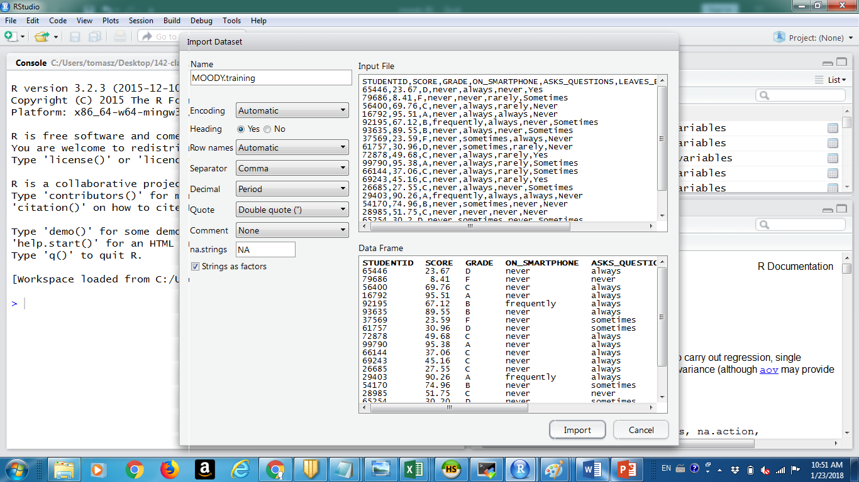
R studio

Slide 8
How much R do I need to know?
LaboRatory - data101@cs.rutgers.edu/laboratory
ONE LINERS
student_performance <- read.csv("MOODY.csv")
boxplot(student_performance$SCORE, main='My first Boxplot’)
mosaicplot(moody$GRADE~moody$ON_SMARTPHONE) gradeTable <- table(student_performance$GRADE)

Slide 9
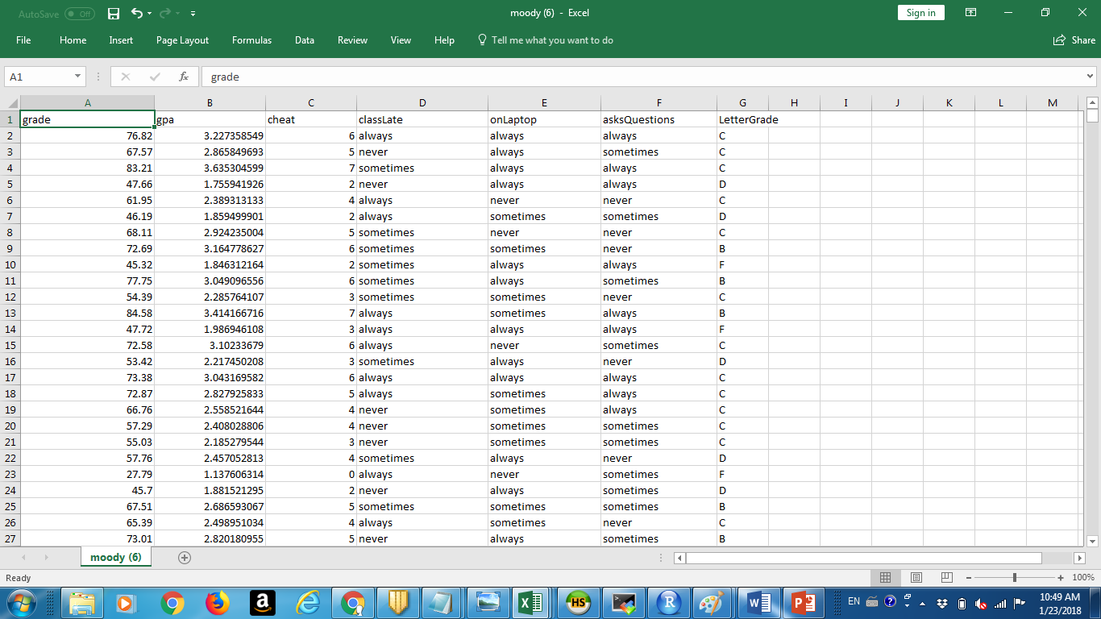
Professor Moody data set

Slide 10
ZodiacChallenge.csv
"AGE" "STATUS" "EDUCATION" "YEARS"
"PROFESSION" [6] "CAPITALGAINS"
"CAPITALLOSS" "NATIVE" "ZODIAK"

Slide 11
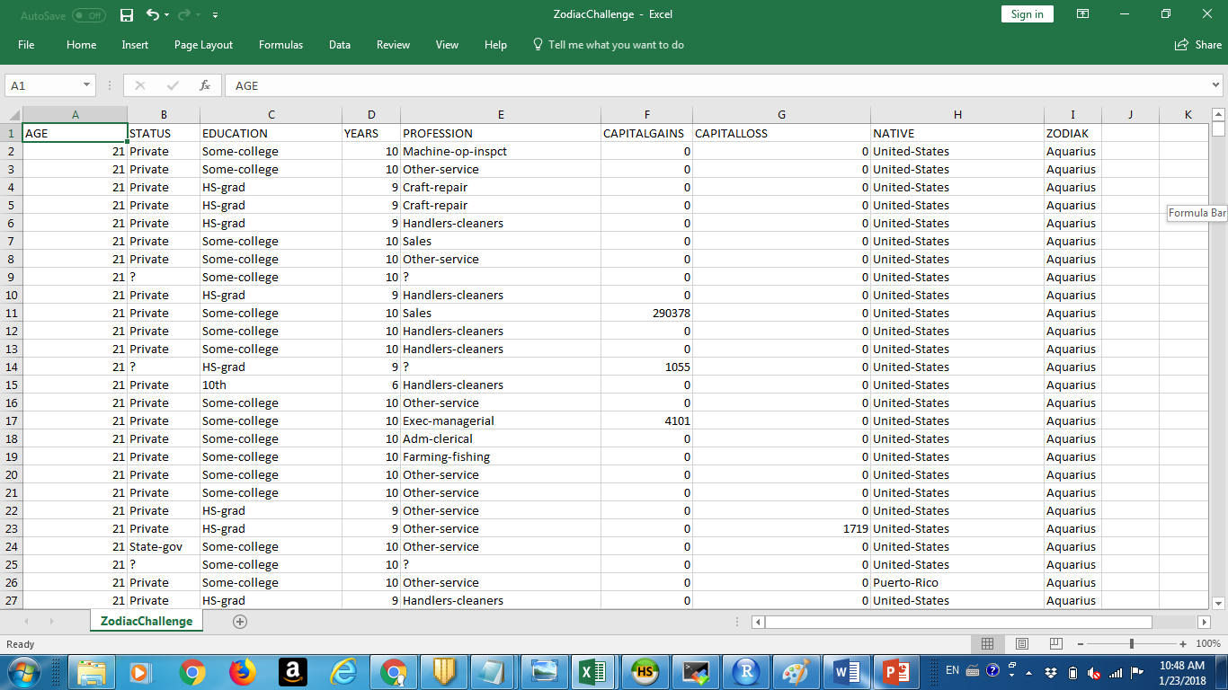

Slide 12
Patterns in Data
Born under Aries sign make more money?
Married are older than Single?

Slide 13
Patterns
Same age but more years of education -> more salary?
Postgraduate education recipients older than the rest?

Slide 14
Whats actionable?
Not Actionable: being born under different zodiac sign. Can’t choose this. But may be can hire Aries only?
But education as well as Profession are actionable

Slide 15
More education -> more salary?
More education -> Higher Capital Gains
Status vs Education?

Slide 16
Which Plot to use?
Depends on variable types: NUM, CAT?
Depends on the number of variables: 1,2,3? More than 3 will be tough – then multiple graphs
Depends on the number of distinct categorical values (LEVELS). Too many? We have a problem!
PPP - how to prepare the data? PREPROCESS

Slide 17
Zodiac puzzle –class of 2016
We have obtained Zodiac signs of individuals in a census data (we skipped some columns which were present earlier), also it is a bit different data - but definitely familiar from adult census data from uc irvine data set.
There are some golden patterns embedded in data. Something mysterious and celestial (supernatural) in nature? For example "born under good sign?" Or may be not? If you find them you win gold. You may always find some other patterns, but they will only be good enough for silver. What is interesting - signs which bring good or bad luck? Or may be zodiac signs are just noise and there are some other interesting relationship in the data?

Slide 18
Best solutions from Zodiac puzzle
Misc/Best Solutions from Students (Zodiac puzzle)

Slide 19
Preprocessing commands
Data Structures/table
Transformations/Subset
Transformations/character category
Transformations/numerical category
Transformations/tappy

Slide 20
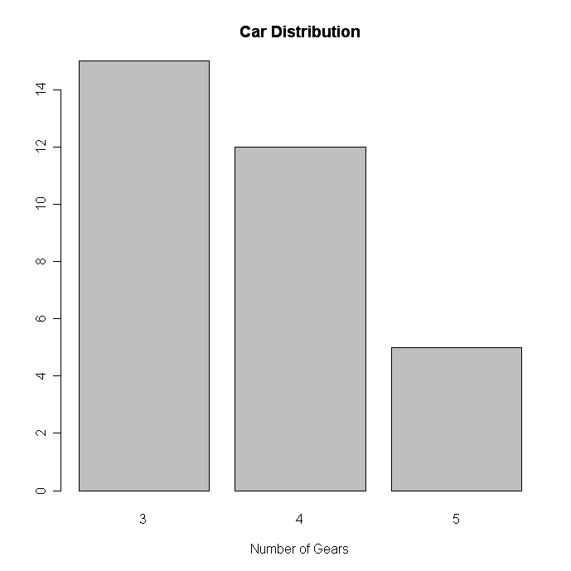
Bar Plot - TYPE: CAT

Slide 21
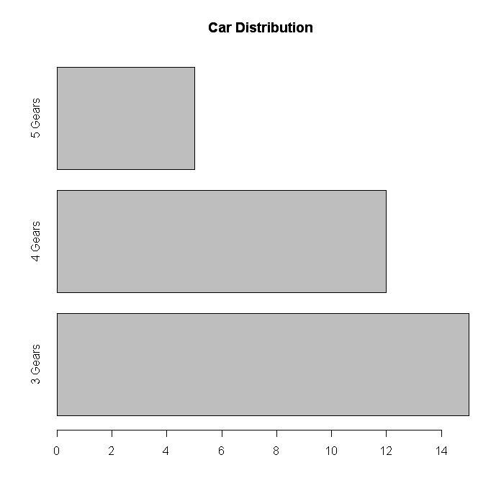
Horizontal Bar Plot TYPE: CAT

Slide 22
LaboRatory
Plots/ Barplots

Slide 23
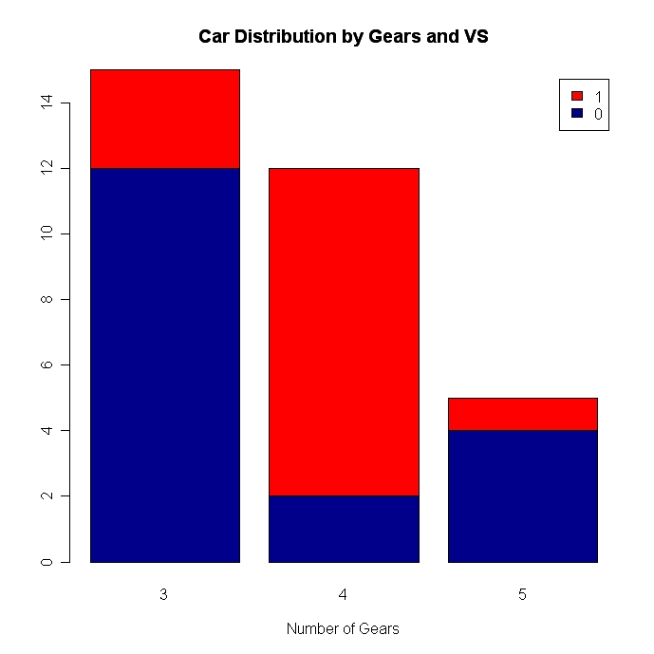
Stacked Bar Plot TYPE: CAT x CAT

Slide 24
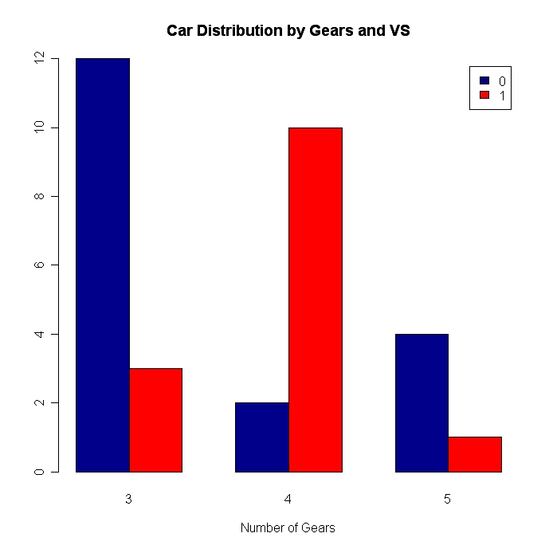
Grouped By Plot TYPE: CAT x CAT

Slide 25
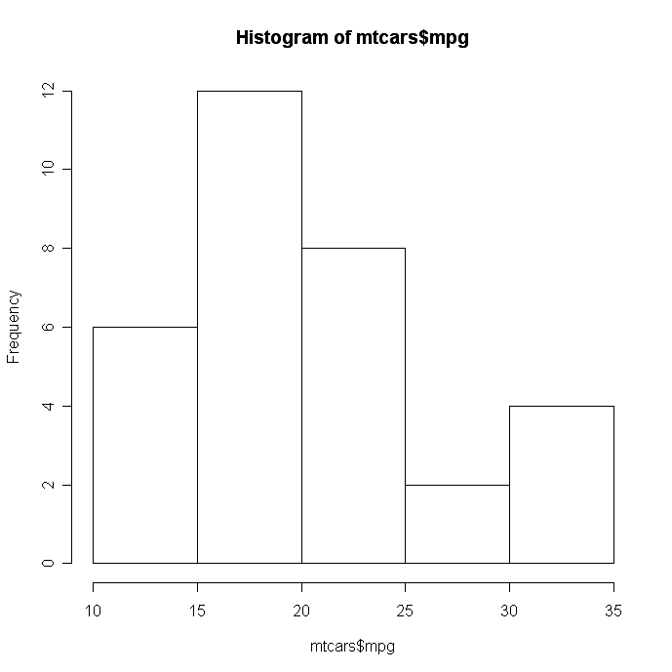
Density Graphs: Simple Histogram TYPE: NUM

Slide 26
LaboRatory
Transformations/Histogram

Slide 27
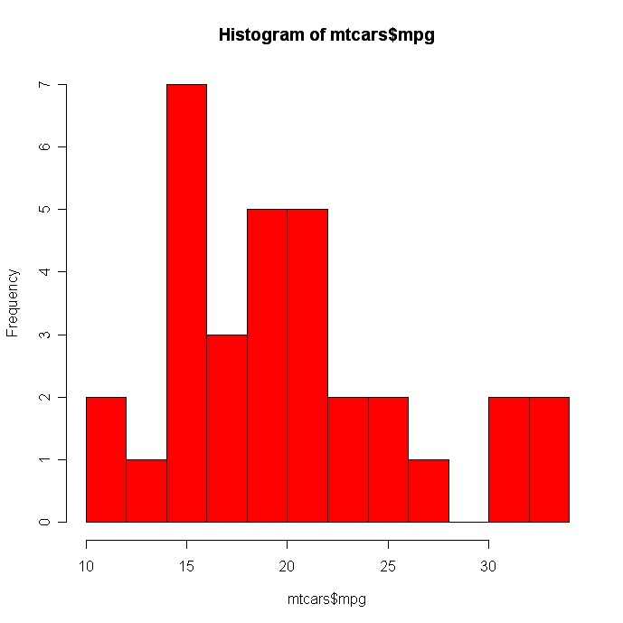
Colored Histogram with number of bins TYPE: NUM

Slide 28
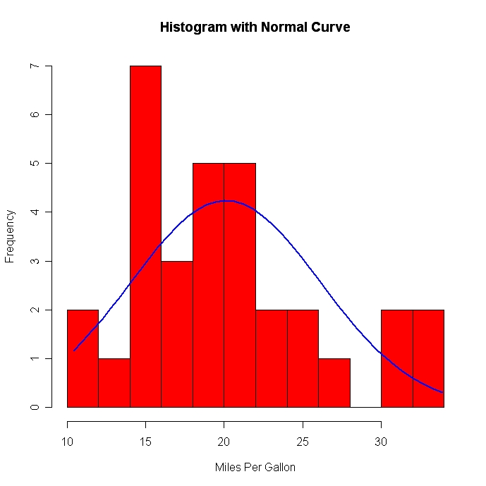
Histogram with normal curve

Slide 29
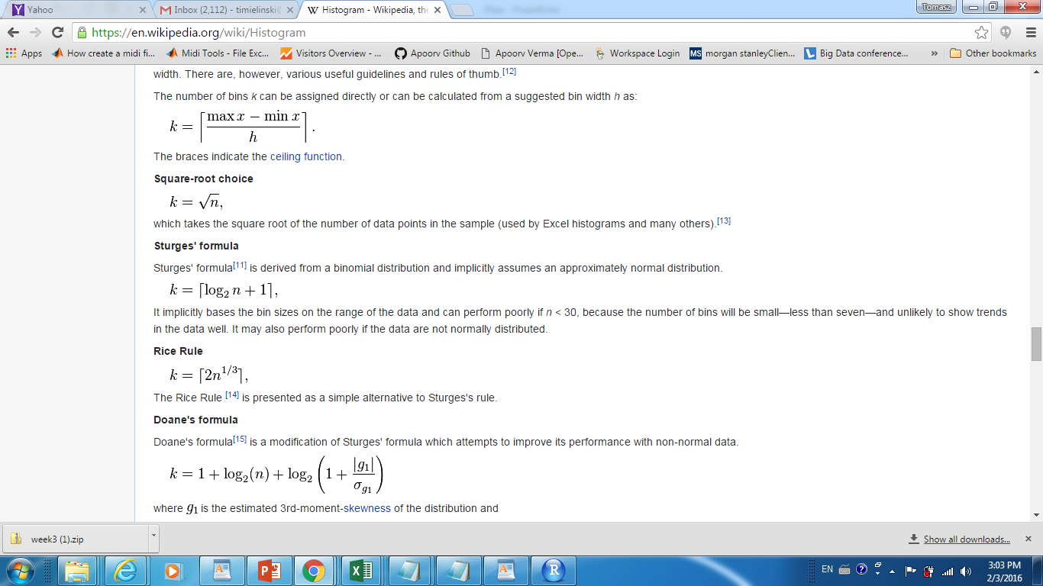
Number of Histogram Bins

Slide 30
Plots
Data101.cs.Rutgers.edu/laboratory

Slide 31
Why R?
R is like a crude smart phone with TONS of applications!
Any cutting edge machine learning code is first added to the R library…..
You only need to write few lines of code…and your are riding on shoulders of giants
No need for full PL power: loops, conditonals, recursion…..

Slide 32
Typical commands
plottype(variable1, variable, tag1= , tag2=,……file = ….)

Slide 33
From basic plots
Scatter plots
Boxplots
Barplots
Mosaic (HeatMap)
Pie Charts
Density Plots
…

Slide 34
data101.cs.rutgers.edu/laboratory
DATA TYPES PANEL: DATATYPES/read.csv
PLOTS/plot, PLOTS/boxplot etc

Slide 35
Categorical, Numerical and Ordinal Variables…
CAT: Categorical: GRADE like A, B, C, D
NUM: Numerical: SCORE: like 89.64
ORD: Ordinal: ordered categorical: D<C<B<A

Slide 36
Simple and more complex
DATA -> PLOT
DATA -> TRANSFORMATION ->PLOT

Slide 37
More complex
DATA -> TRANSFORMATION ->PLOT

Slide 38
Transformations
DATA SUBSETTING
DOMAIN TRANSFORMATIONS
CONTIGENCY MATRICES

Slide 39
DATA SUBSETTING
We only want to plot data which is a SUBSET (i.e only students who got an A)

Slide 40
DOMAIN TRANFORMATION
Make score a CATEGORICAL attribute
High (>80)
Middle (60,80]
Low < 60

Slide 41
Which plot to use?
It all depends on the variables, CAT (categorical), NUM (numerical),
NUM x NUM scatter plot
CAT x CAT mosaic plot
CAT x NUM box plot
NUM box plot, histogram
CAT bargraph…..

Slide 42
LaboRatory
Plots/Density plot

Slide 43
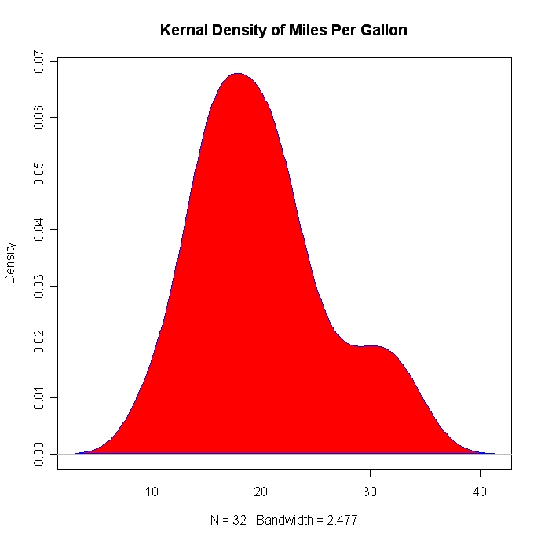
Kernel Density Plot TYPE: NUM

Slide 44
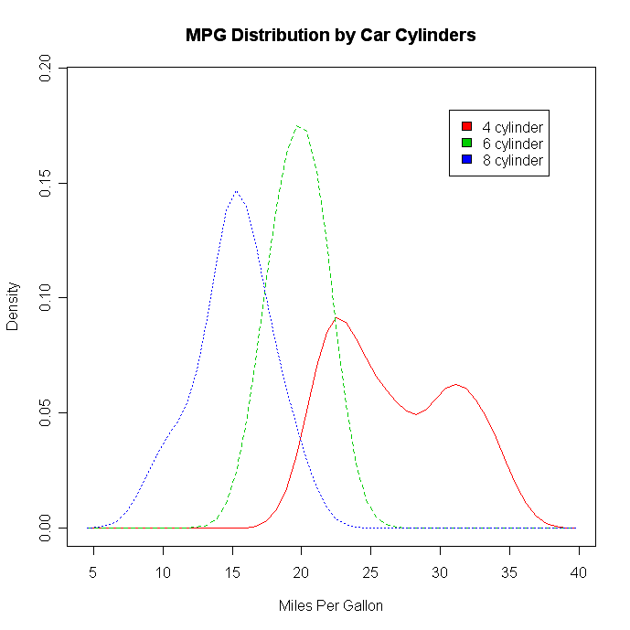
Overlayed Kernel Density Plots TYPE: CAT

Slide 45
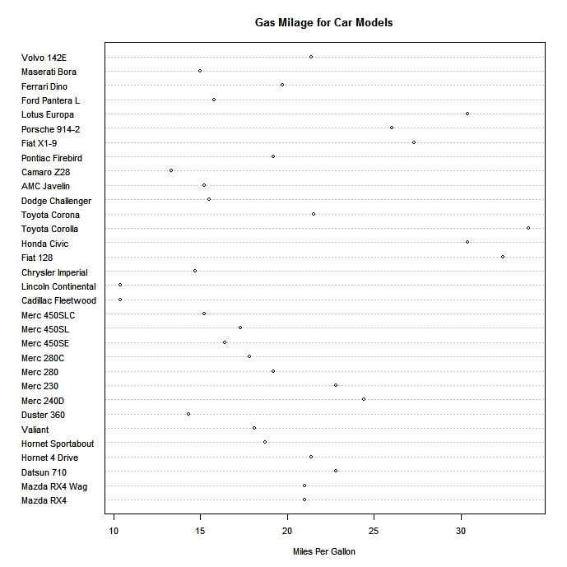
Dotplot: NUM x CAT, NUM X NUM

Slide 46
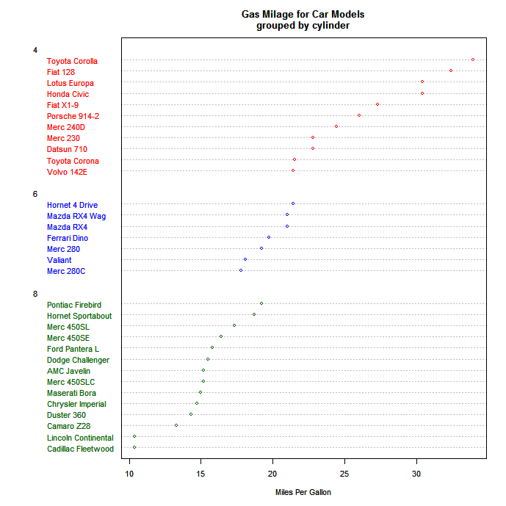
Grouped, Sorted and Colored Dotplot TYPE: NUM x CAT (taxonomy)

Slide 47
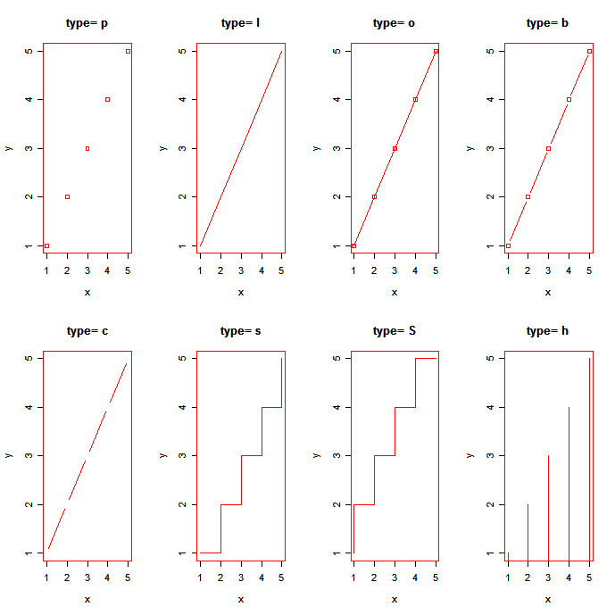
Line Charts NUM x NUM x CAT

Slide 48
LaboRatory
Plots/Line Charts

Slide 49
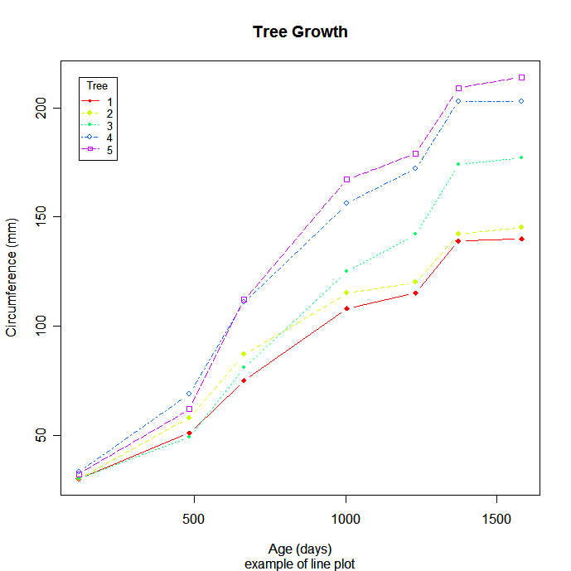
Line Charts

Slide 50
LaboRatory
Plots/Piechart

Slide 51
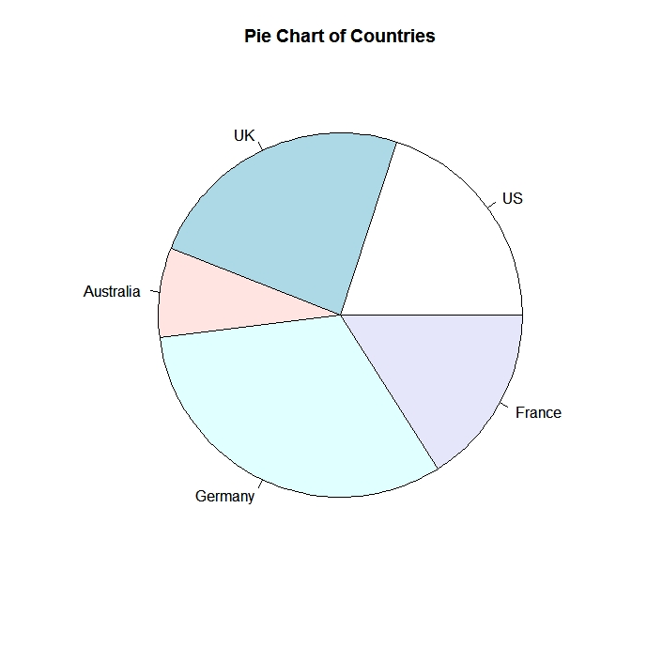
Piecharts TYPE: CAT

Slide 52
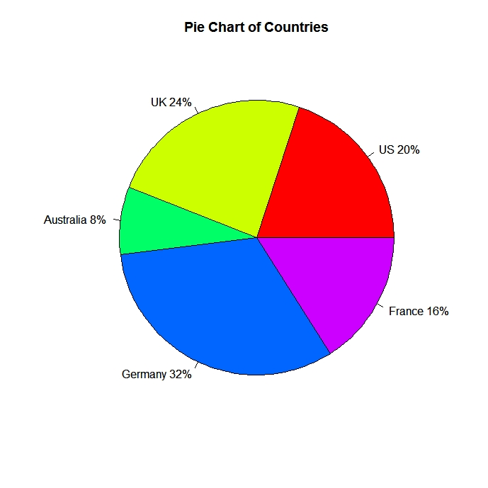
Piecharts

Slide 53
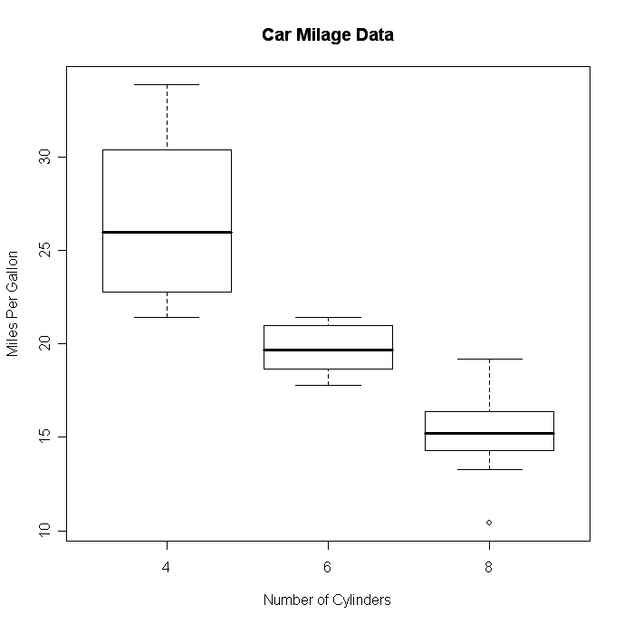
Boxplots TYPE: NUM x CAT

Slide 54
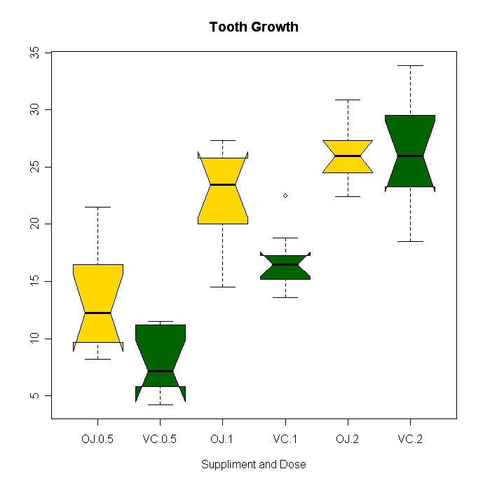
Tooth Growth Box Plot TYPE: CAT x CAT x NUM

Slide 55
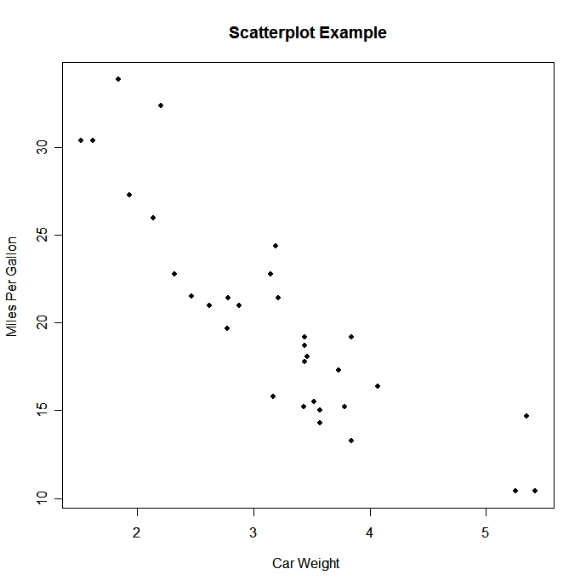
Scatter Plot TYPE: NUM x NUM

Slide 56
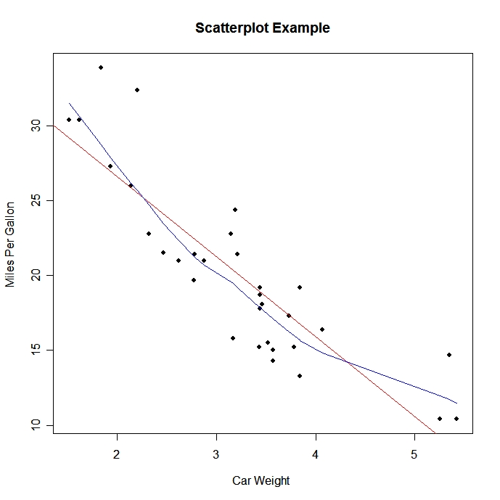
Scatterplot TYPE: NUM x NUM

Slide 57
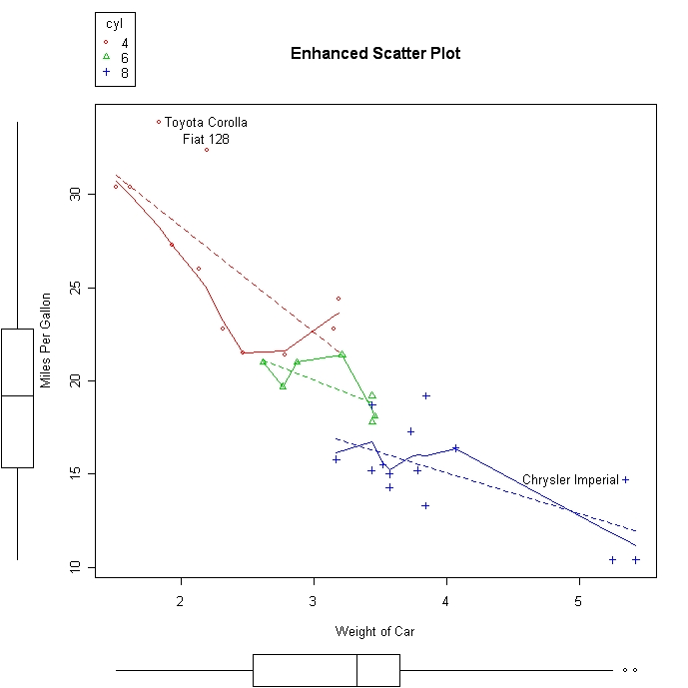
Enhanced Scatter Plot: NUM x NUM x CAT

Slide 58
LaboRatory
Plots/ plot

Slide 59
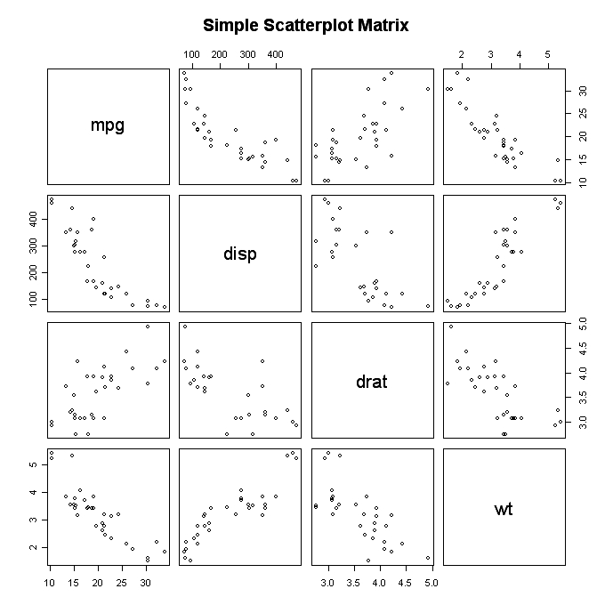
Scatterplot Matrix TYPE: NUM x NUM x CAT

Slide 60
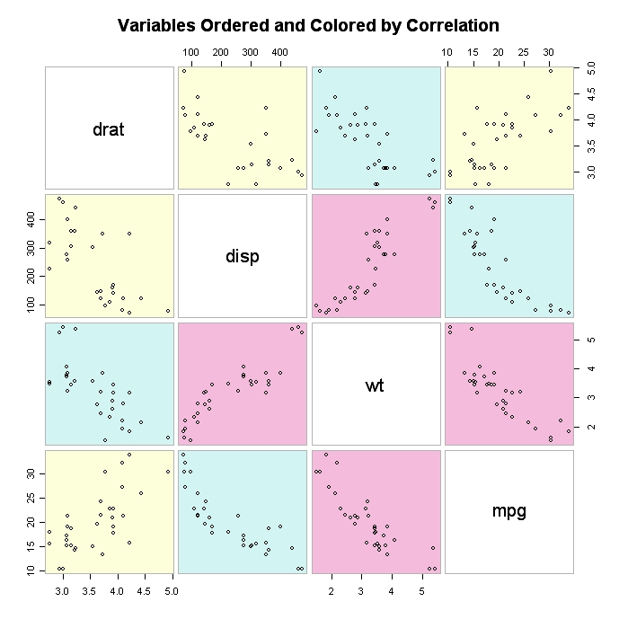
Scatter Plot Matrix TYPE: NUM x NUM x CAT

Slide 61
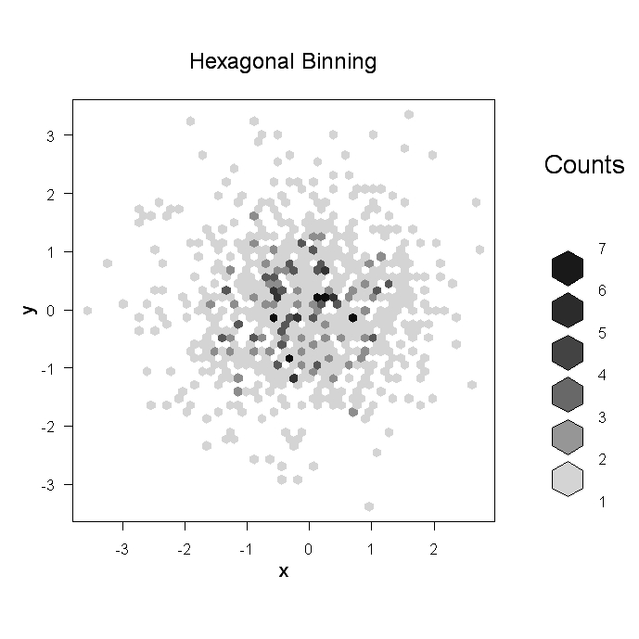
Scatter Plot Matrix

Slide 62
Mosaic plot
Plots/mosaic plot

Slide 63
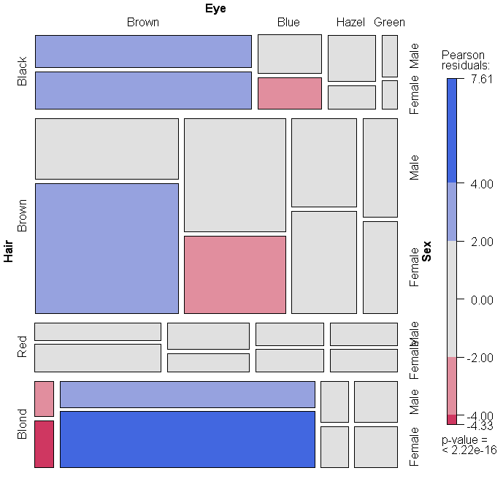
Mosaic Plot TYPE: CAT x CAT

Slide 64
Combining plots
Plots/par

Slide 65
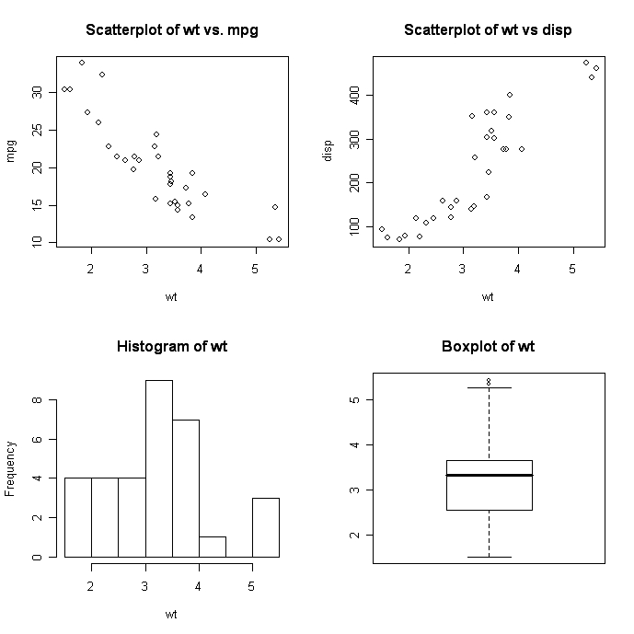
Combining Plots

Slide 66
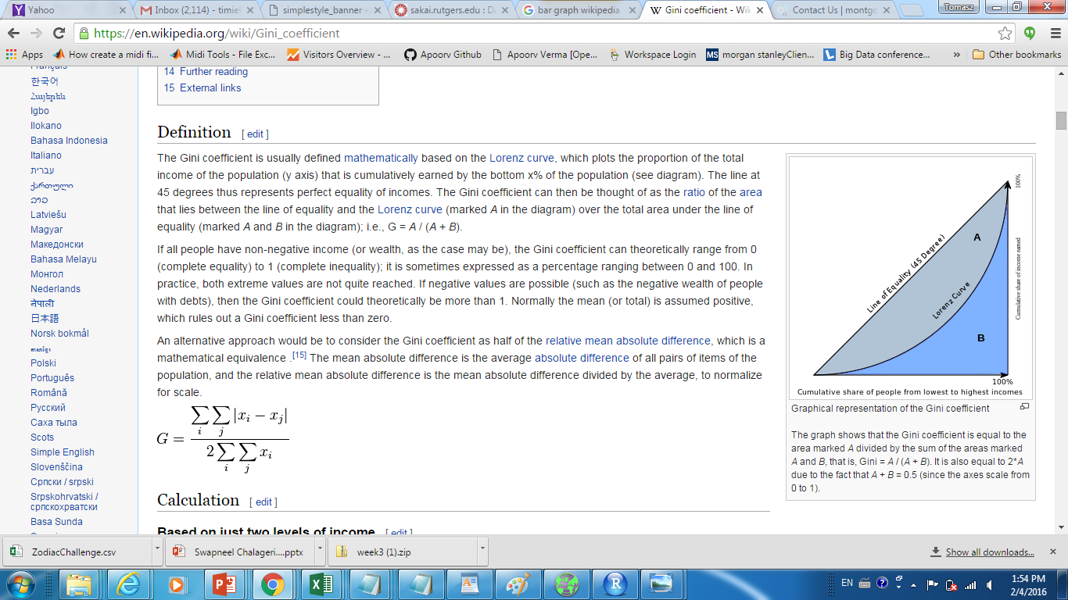
Gini coefficient

