Slide 1
Data Transformations

Slide 2
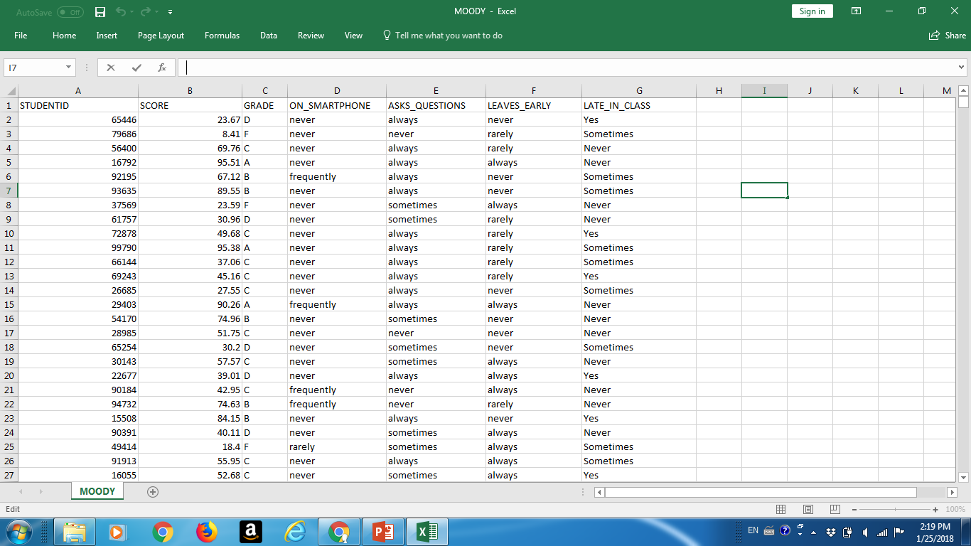
moody.csv data set

Slide 3
No pre-processing
moody <- read.csv(“moody.csv")
boxplot(moody$SCORE)

Slide 4
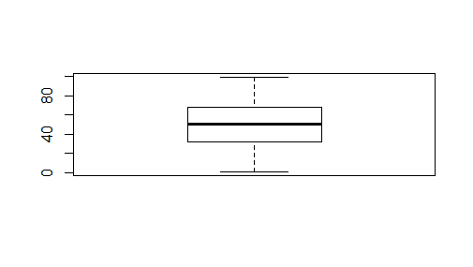
Boxplot

Slide 5
Some pre-processing
table(moody$GRADE)
A B C D F
145 310 604 272 249
barplot(table(moody$GRADE))

Slide 6
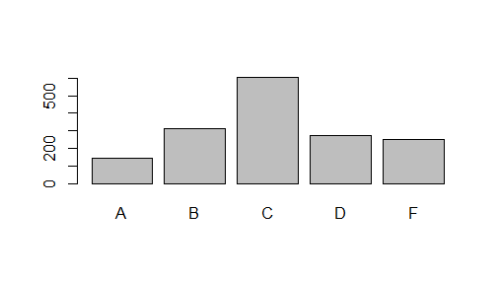
Simple barplot

Slide 7
Basic data types in R
Vectors http://data101.cs.rutgers.edu/laboratory/pages/c
Matrices http://data101.cs.rutgers.edu/laboratory/pages/matrix
Data frames http://data101.cs.rutgers.edu/laboratory/pages/dataframes

Slide 8
Quotes and brackets
“ Kyle” - is the string Kyle - factor
Kyle (no quotes) - must be defined as variable
“17’ – is the string
17 is the integer
VERY IMPORTANT - do not confuse ( ) with [ ] -
( ) for functions…..[ ] for data frames, matrices

Slide 9
Vectors
myVect<-c("Robert","Ethan","Bruce","Kyle")

Slide 10
Matrices
matrix(c(1,2,3, 11,12,13))
myMat <- matrix(c(1,2,3, 11,12,13),nrow = 2, ncol = 3)

Slide 11
Data Frames – different types
firstName <- c("Ethan", "Captian", "John", "Selina") lastName <- c("Hunt", "Jack", "Whick", "Kyle") sex <- c("MALE", "MALE", "MALE", "FEMALE") score <- c(97, 88, 85, 92) #creating a data frame named stu_df stu_df <- data.frame(firstName, lastName, sex, score) stu_df

Slide 12
Subsetting
Subset(moody, moody$GRADE==‘A’)
moody[moody$GRADE==‘A’,]

Slide 13
summary command
summary(moody)
summary(moody$GRADE)
summary(moody$SCORE)

Slide 14
Adding a new column to data frame
stu_df$age <- c(38, 50, 45, 24) stu_df

Slide 15
Domain Transformations
CATEGORICAL
NUMERICAL

Slide 16
Data transformations
Create a new attribute with different taxonomy
http://data101.cs.rutgers.edu/laboratory/pages/charactercategory
Replace grade with passing and failing grades
Countries ->Continents
Cars -> Where they were produced
Universities ->public, private

Slide 17
Pass/Fail example
moody[,8] <- "" moody[moody$GRADE=="F",8] <- "fail“
moody[,8] <- "" moody[moody$GRADE!="F",8] <- "pass“
colnames(moody)[8] <- "pass or not"

Slide 18
Add pass/fail to possible grades
levels(moody$GRADE) <- c(levels(moody$GRADE),"pass","fall")

Slide 19
Add a new grade – “excellent”
levels(moody$GRADE) <- c(levels(moody$GRADE),"excellent") moody[moody$SCORE>=90,3] <- "excellent"

Slide 20
NUMERICAL ATTRIBUTES WITH FEW VALUES
Convert to Categorical

Slide 21
Factors - quality levels example
Assume wine quality levels 1-5
plot(wine$QUALITY,wine$PRICE) #we want to see the distribution of price of each quality level, but it gives us a scatter plot, which makes it hard for us to see the distribution
is.factor(wine$QUALITY) #the result is false, which means quality is numeric value rather than factor

Slide 22
factor_quality <- factor(wine$QUALITY) #convert quality values into factors
plot(factor_quality, wine$PRICE) #now we can generate the box plot and see the distribution clearly

Slide 23
wine$QUALITY <- factor(wine$QUALITY,labels=c(" A",“B",“C",“D",“F"))

Slide 24
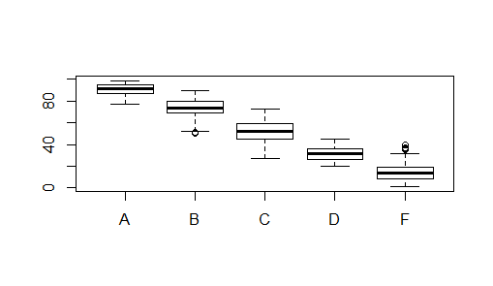
Boxplot

Slide 25
Subplots (thanks Kunal)
Consider the MOODY's dataset. You want to plot grade~asks_questions.
Asks_questions has 4 labels (rarely, never, frequently, always).
Suppose you want to select only 2 labels (never and always).

Slide 26
Factoring
moody1 <- subset(moody,moody$ASKS_QUESTIONS == "never" | moody$ASKS_QUESTIONS == "always")
Now you need to factor the asks_questions column of moody1 because even though the other 2 labels are removed, they will still have value 0 on the plot.
moody1$ASKS_QUESTIONS <- factor(moody1$ASKS_QUESTIONS)

Slide 27
Subplot of mosaicplot
Now you can plot
mosaicplot(moody1$GRADE~moody1$ASKS_QUESTIONS).
You will have 2 labels on the Y axis.

Slide 28
Grouping by data in R
ask_question_grade <- tapply(moody$SCORE,moody$ASKS_QUESTIONS,mean)

Slide 29
tapply
Allows to compute aggregates such as mean, sum, median, max, min for DATA SLICES or DATA PARTITIONS
tapply(NUM, CAT, Aggregate)
NUM – numerical, CAT - categorical
We can create a table for different values of CAT of Aggregate(NUM)

Slide 30
Data Puzzles
Is professor Moody unfair in his grading?
Is gun control effective?
Are wine prices fair?
Are CO2 emissions responsible for global warming?

