Slide 1
Data Transformations

Slide 2
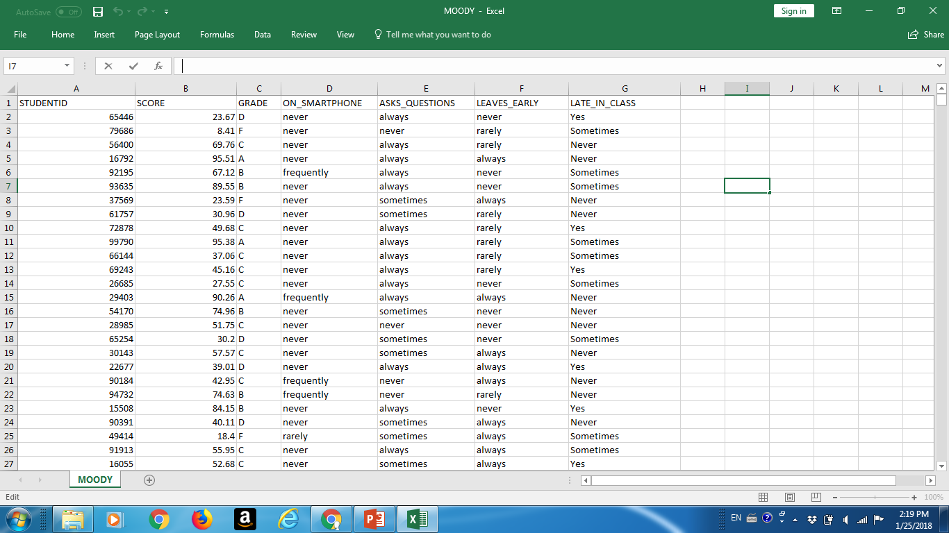
moody.csv data set

Slide 3
No pre-processing
moody <- read.csv(“moody.csv")
boxplot(moody$SCORE)

Slide 4
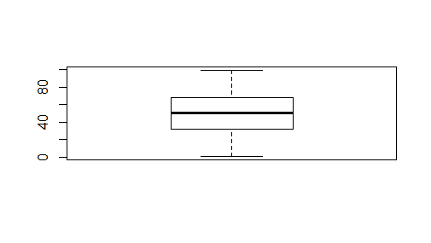
Boxplot

Slide 5
Some pre-processing
table(moody$GRADE)
A B C D F
145 310 604 272 249
barplot(table(moody$GRADE))

Slide 6
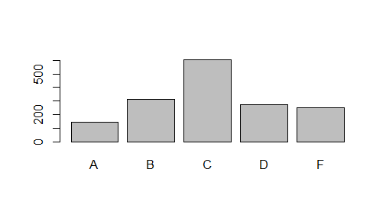
Simple barplot

Slide 7
Subsetting
Subset(moody, moody$GRADE==‘A’)
moody[moody$GRADE==‘A’,]

Slide 8
Basic data structures in R
Vectors http://data101.cs.rutgers.edu/laboratory/pages/c
Matrixes http://data101.cs.rutgers.edu/laboratory/pages/matrix
Data frames http://data101.cs.rutgers.edu/laboratory/pages/dataframes

Slide 9
Vectors
myVect<-c("Robert","Ethan","Bruce","Kyle")

Slide 10
Matrixes
matrix(c(1,2,3, 11,12,13))
myMat <- matrix(c(1,2,3, 11,12,13),nrow = 2, ncol = 3)

Slide 11
Data Frames – different types
firstName <- c("Ethan", "Captian", "John", "Selina") lastName <- c("Hunt", "Jack", "Whick", "Kyle") sex <- c("MALE", "MALE", "MALE", "FEMALE") score <- c(97, 88, 85, 92) #creating a data frame named stu_df stu_df <- data.frame(firstName, lastName, sex, score) stu_df

Slide 12
Naming rows in data frame
rowNames <- c("first Row","Second row","Third Row","fourth Row")
stu_df <- data.frame(firstName, lastName, sex, score, row.names = rowNames)
#to only access rows 1 thru 3 and column 3 thru 4
stu_df <- stu_df[1:3, 3:4]
stu_df[1,]

Slide 13
Adding a new column to data frame
firstName <- c("Ethan", "Captian", "John", "Selina") lastName <- c("Hunt", "Jack", "Whick", "Kyle") sex <- c("MALE", "MALE", "MALE", "FEMALE") score <- c(97, 88, 85, 92) rowNames <- c("first Row","Second row","Third Row","fourth Row") stu_df <- data.frame(firstName, lastName, sex, score, row.names = rowNames) stu_df # adding new column to the existing data frame stu_df$age <- c(38, 50, 45, 24) stu_df

Slide 14
Domain Transformations
CATEGORICAL
NUMERICAL

Slide 15
Data transformations
Create a new attribute with different taxonomy
http://data101.cs.rutgers.edu/laboratory/pages/charactercategory
Replace grade with passing and failing grades
Countries ->Continents
Cars -> Where they were produced
Universities ->public, private

Slide 16
Domain Transformations - Numerical
Intervals - price range into 5 ranges
What type of Intervals? Equal size, pretty, equally populated

Slide 17
Pass/Fail example
moody[,8] <- "" moody[moody$GRADE=="F",8] <- "fail“
moody[,8] <- "" moody[moody$GRADE!="F",8] <- "pass“
colnames(moody)[8] <- "pass or not"

Slide 18
Rename the grades into pass/fail
moody <- read.csv("http://arpitshah101.github.io/RHelpPages/data/MOODY.csv") levels(moody$GRADE) #so far we have four factors levels(moody$GRADE) <- c(levels(moody$GRADE),"pass","fall") #except for the existed factors, we manually add "pass" and "fail" factors.

Slide 19
Add a new grade – “excellent”
moody <- read.csv("http://arpitshah101.github.io/RHelpPages/data/MOODY.csv") levels(moody$GRADE) <- c(levels(moody$GRADE),"excellent") moody[moody$SCORE>=90,3] <- "excellent" #we judge whether the grade is excellent by checking whether the score is more than 90, and we fill "excellent" in the 3rd column. summary(moody$GRADE)

Slide 20
Uses of tapply
ask_question_grade <- tapply(moody$SCORE,moody$ASKS_QUESTIONS,mean)
Average price of wine PER country

Slide 21
tapply
Allows to compute aggregates such as mean, sum, median, max, min for DATA SLICES or DATA PARTITIONS
tapply(A,B, Aggregate)
We can create a table for different values of B of Aggregate(A)

Slide 22
Examples
tapply(SCORE, GRADE, mean)
tapply(PRICE, COUNTRY, max)
tapply(CAPITALGAINS, COUNTRY, sum)

Slide 23
What to do with Excels
Complex columns
Complex values
Taxonomies

Slide 24
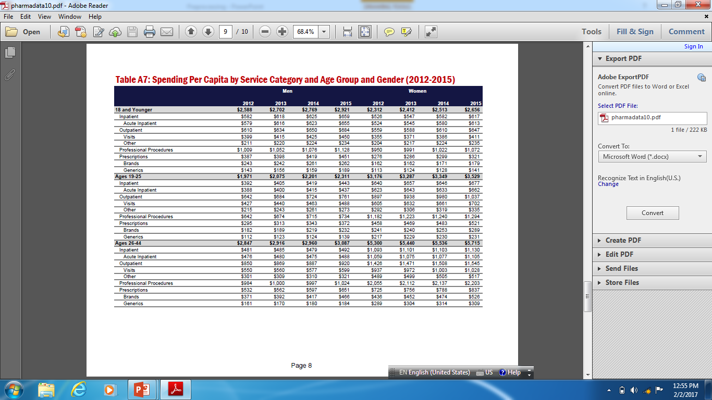
Molding Excels

Slide 25
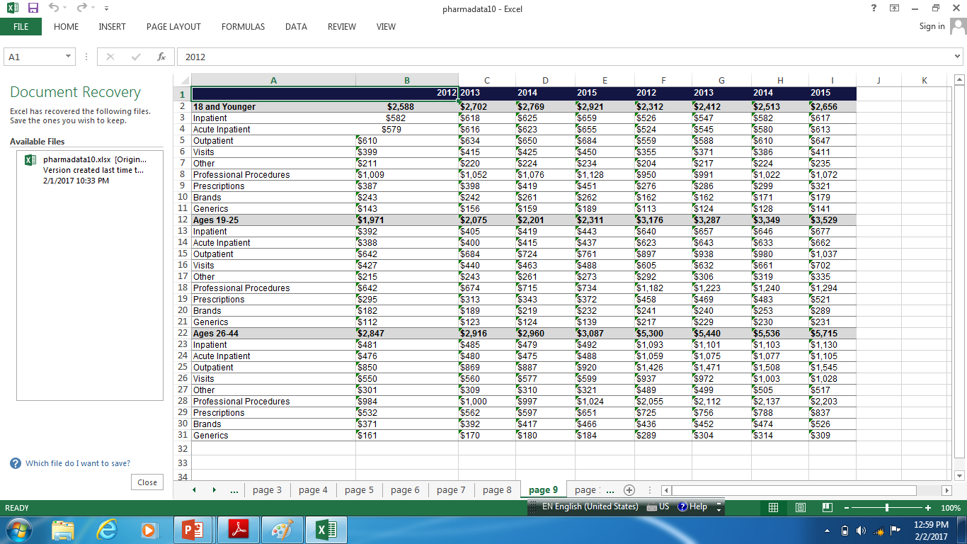
Tools to extract excel from pdf

Slide 26
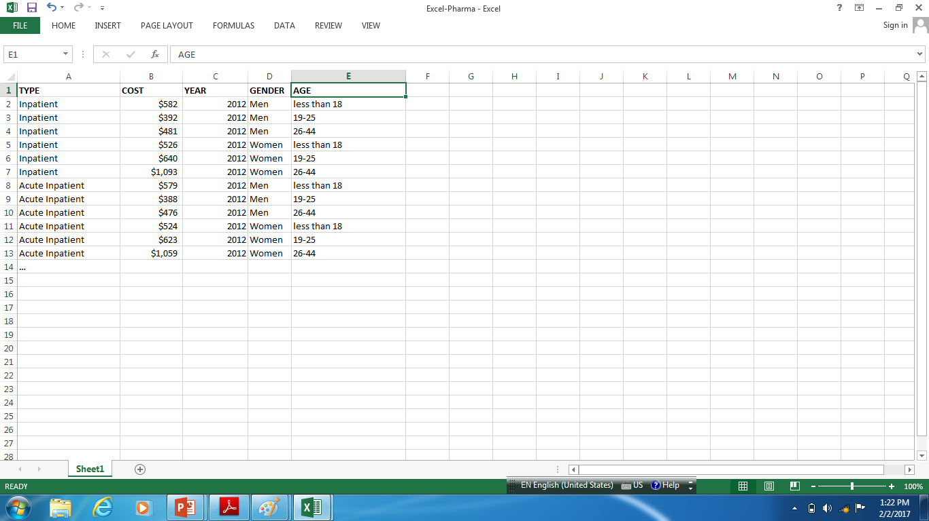
Converted into simple Excel

Slide 27
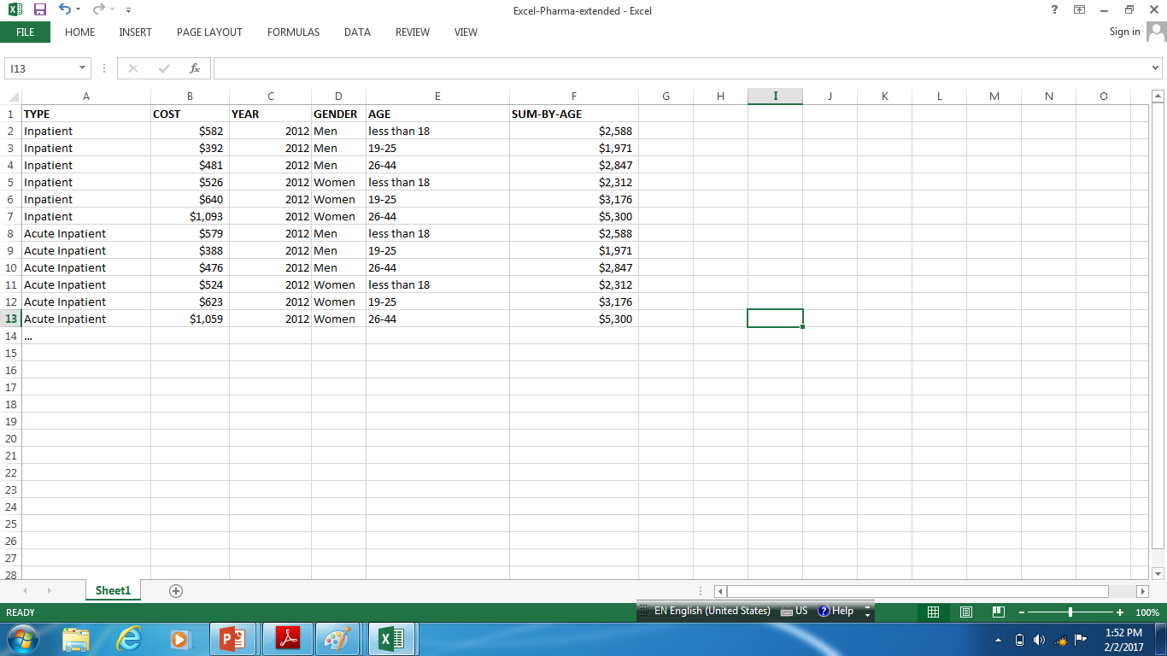
Extended (with redundant) function

