Slide 1
Multiple hypothesis:p-values
Healthy skepticism – How to Evaluate your patterns?

Slide 2
When is z-test accurate?
For the Z-test to be applicable, certain conditions must be met.
Sample size is not large the Z-test may not perform well.
The test statistic should follow a normal distribution. Generally, one appeals to the central limit theorem to justify assuming that a test statistic varies normally.
If the variation of the test statistic is strongly non-normal, a Z-test should not be used.

Slide 3
Patterns examples
Capital gains higher for FIRE and under 40
Natives more happy in function of their income
Old more happy than young?
Slovenian spouses make one more happy
32 year olds with high income are most happy
The happiest person in the world should be someone who is female, married to someone from El Salvador, is around 56 years old and with very high income"

Slide 4
Q “Traffic in Holland tunnel is higher than in Lincoln” p-value =0.003 Would you accept it? A) Yes, B)* No [biased sample!]
TUNNEL | DAY | VOLUME
Lincoln | Weekend | 41
Holland | Weekday | 94
Holland | Weekday | 87
Holland | Weekday | 96
Holland | weekday | 80
Lincoln | weekend | 48
Lincoln | weekend | 39
Holland | weekend | 51
Lincoln | weekend | 40

Slide 5
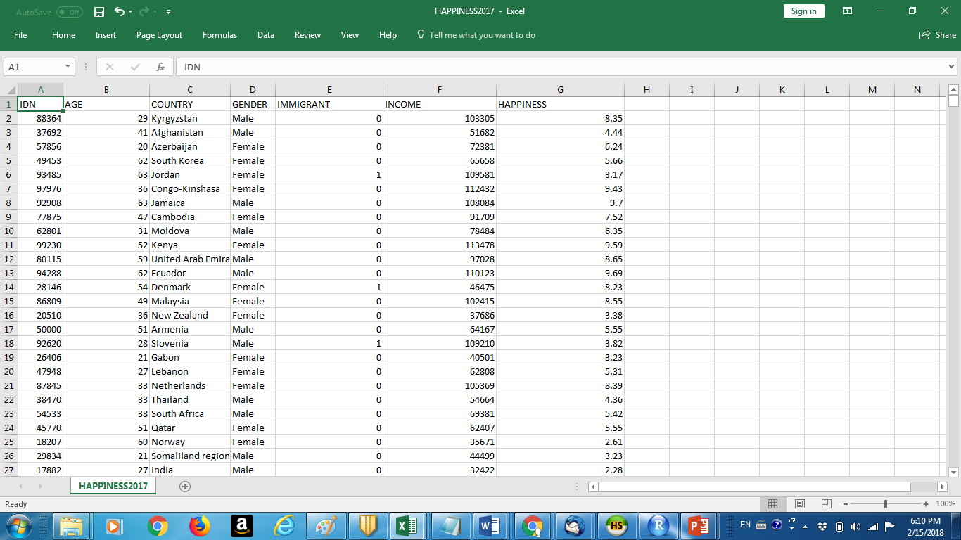
Happiness – married to immigrants from different countries

Slide 6
Q: Immigrants: 8.6 Natives: 7.5, are immigrants more happy?
We run 1000 permutation tests and 950 of these tests show
mean(Immigrants_ Hapinness) > mean(Natives_Happiness) + 1
What can we say about p-value?
p<0.05
p<0.95
* p>0.95
None of he above
COMMENT: why C? Notice that more than 950 random permutations would get immigrants happier by at least 1.1 (8.6-7.5). Thus more than 95% chance we could get the observed result assuming NULL hypothesis it true.
Something was probably wrong with the way test was run. Notice that if we got 950 tests mean(Immigrants_ Hapinness) < mean(Natives_Happiness) + 1 (flip the >)
than (a) would be correct answer.

Slide 7
Q: What is p-value of mean(H)>mean(L)
H = High Numbers: Hundred Numbers >100 are higher than
L= Low Numbers: Hundred Numbers <100
A) *p ~ 0
B) p ~ 1
C) p=0.5
COMMENTS: Since we do not know more about these two groups it may be possible to construct a high variance data sets H and L with very small difference of means - mean(H)-mean(L). In such case z-value may be very small and p-value large. Can you find such example?

Slide 8
Q: To use z-test for difference of means of two populations
A) We need standard deviation of union of two populations
B) *We need standard deviation of each of the two populations

Slide 9
What will r say?
firstName <- c("Ethan", "Captian", "John", "Selina")
lastName <- c("Hunt", "Jack", "Whick", "Kyle")
sex <- c("MALE", "MALE", "MALE", "FEMALE")
score <- c(97, 88, 85, 92)
rowNames <- c("first Row","Second row","Third Row","fourth Row")
stu_df <- data.frame(firstName, lastName, sex, score, row.names = rowNames)
stu_df.score
A) 88 will be there
B) * Error
C) NULL

Slide 10
What will r say?
moody <- read.csv("http://arpitshah101.github.io/RHelpPages/data/ProfessorMoody.csv")
ask_question_grade <- tapply(moody$SCORE,moody$ASKS_QUESTIONS,max)
A) maximum score a student got in the class
B) * maximum score a student got for each of the values of ASK QUESTIONS attributes
C) Error

Slide 11
Create new data
Cat1<-rep("GroupA",10)
Cat2<-rep("GroupB",10)
Cat<-c(Cat1,Cat2)
Val1<-rnorm(10,mean=25, sd=10)
Val2<-rnorm(10,mean=30, sd=10)
Val<-c(Val1,Val2)
d<-data.frame(Cat,Val)
(*) mean(d[d$Cat=='GroupA',2])-mean(d[d$Cat=='GroupB',2])

Slide 12
Part of the d frame just generated - mean(GroupB) > mean(GroupA)+10
CAT | VAL
GroupA | 21.45
GroupB | 20.03
GroupB | 31.88
GroupA | 28.66
GroupB | 29.88
GroupB | 28.74
GroupA | 23.88
GroupA | 27.01
GroupB | 33.11

Slide 13
If (*) returns -10.07then p value will be? P<0.05? Yes */No?
-
Cat1<-rep("GroupA",10)
Cat2<-rep("GroupB",10)
Cat<-c(Cat1,Cat2)
Val1<-rnorm(10,mean=25, sd=10)
Val2<-rnorm(10,mean=30, sd=10)
Val<-c(Val1,Val2)
d<-data.frame(Cat,Val)
(*) mean(d[d$Cat=='GroupA',2])-mean(d[d$Cat=='GroupB',2])
PermutationTestSecond::Permutation(d, "Cat", "Val",10000, "GroupA", "GroupB")
Comment: estimate z-value: seems like it is >2. Since std is around 4.

Slide 14
Patterns….
CLAIM: Immigrants are happier than Natives

Slide 15
More Analysis
Number of Permutations | P- Value
10 | 0.1
100 | 0.04
500 | 0.076
1000 | 0.061
2000 | 0.0635
5000 | 0.0582
10000 | 0.0652

Slide 16
What do we observe?
P- Value from Z-test: 0.07
P- Value from Permutation Test: 0.076 (after 500 iterations)
A low difference in means results in higher P- Value

Slide 17
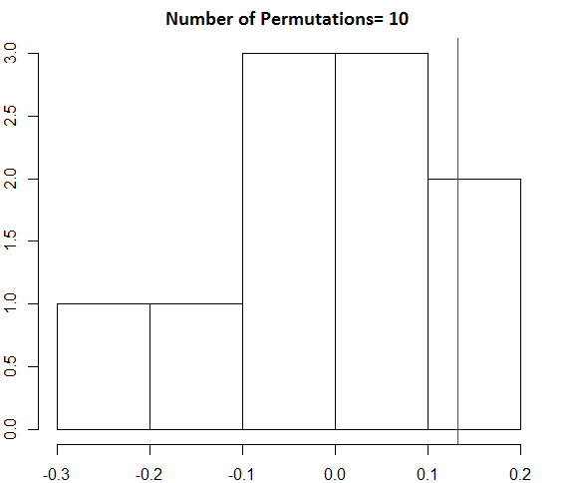
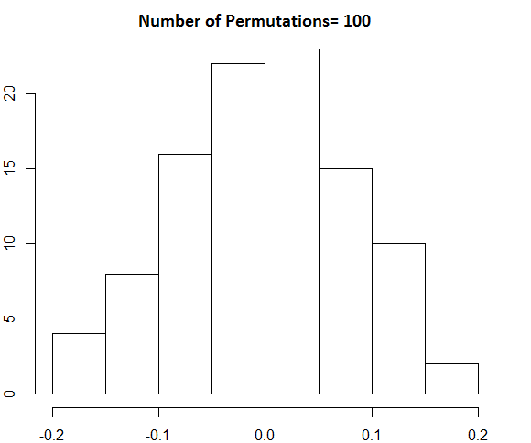
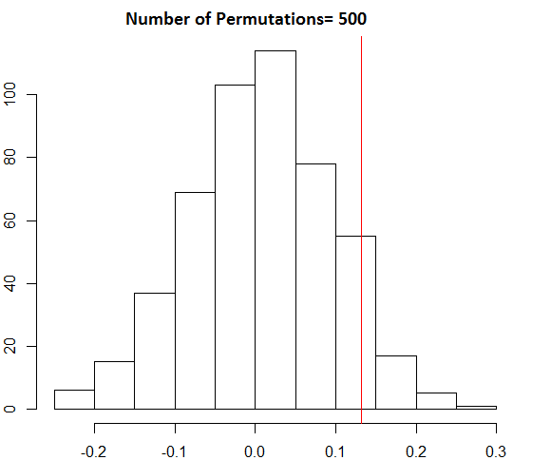
Distribution of Diff. of Means
Histograms of difference of means for different number of permutations.
Red line shows observed difference of mean (=0.13).

Slide 18
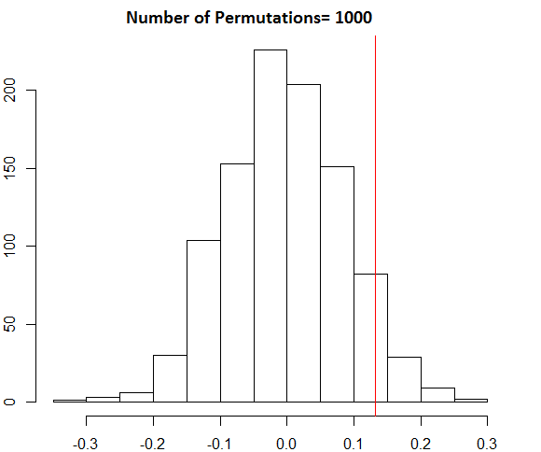
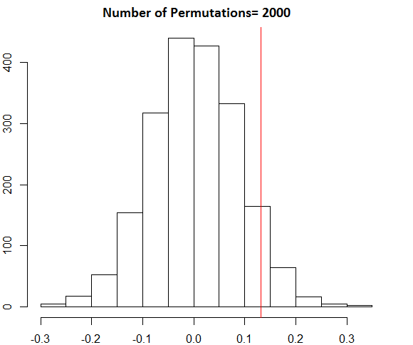
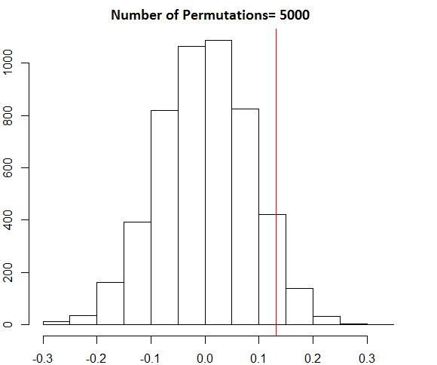
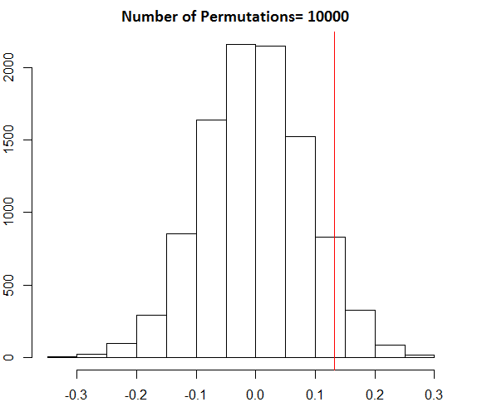

Slide 19
Null hypothesis – no association
Permutation tests cannot solve all problems: they are valid only when the null hypothesis is ‘no association’

Slide 20
p-value “hunting”
PermutationTestSecond::Permutation(read.csv("HAPPINESS2017.csv"), "COUNTRY", "HAPPINESS", 1000, "Russia", "Poland")
p=0.497

Slide 21
PermutationTestSecond::Permutation(read.csv("HAPPINESS2017.csv"), "COUNTRY", "HAPPINESS", 1000, "China", "France")
p=0.285

Slide 22
PermutationTestSecond::Permutation(read.csv("HAPPINESS2017.csv"), "COUNTRY", "HAPPINESS", 1000, "Italy", "France")
p=0.072

Slide 23
[1] 0
install.packages("devtools")
devtools::install_github("devanshagr/PermutationTestSecond")
PermutationTestSecond::Permutation(read.csv("HAPPINESS2017.csv"), "COUNTRY", "HAPPINESS", 1000, "El Salvador", "Lesotho")
p=0
> PermutationTestSecond::Permutation(read.csv("HAPPINESS2017.csv"), "COUNTRY", "HAPPINESS", 1000, "El Salvador", "Lesotho") [1] 0
>

Slide 24
Multiple Comparison – curse of high dimensionality of data
Big data – wide dimensions
Possibly hundreds of thousands of attributes/columns!
Possibly a lot of “amazing” conclusions/patterns
But…..lots of “junk” also…

Slide 25
P-value “hunting”
Test many hypotheses to find the smallest p-value you could
Is this "allowed," from a statistical perspective ?
The answer is "NO"!

Slide 26
Overfitting the data
Searching through the available data to find statistically relevant results, and then claiming that these results *generalize* to other datasets, without accounting for the search process.
By searching through the data for desirable results, your conclusions may be seriously biased, if you don't properly account for the search process.

Slide 27
Bonferroni Correction
An analogy: If an exam has enough questions, then you're bound to get at least one question right by guessing, even if you don't know anything about the subject.
We'll also propose a simple solution that works for many multiple testing problems -- the "Bonferroni correction."

Slide 28
In short
For one hypothesis the acceptable p-value is widely viewed as p=0.05
For N hypothesis it would be 0.05/N
N = 10^6?
p value better be 5x 10^-8!

