Slide 1
Prediction I
Machine learning 101

Slide 2
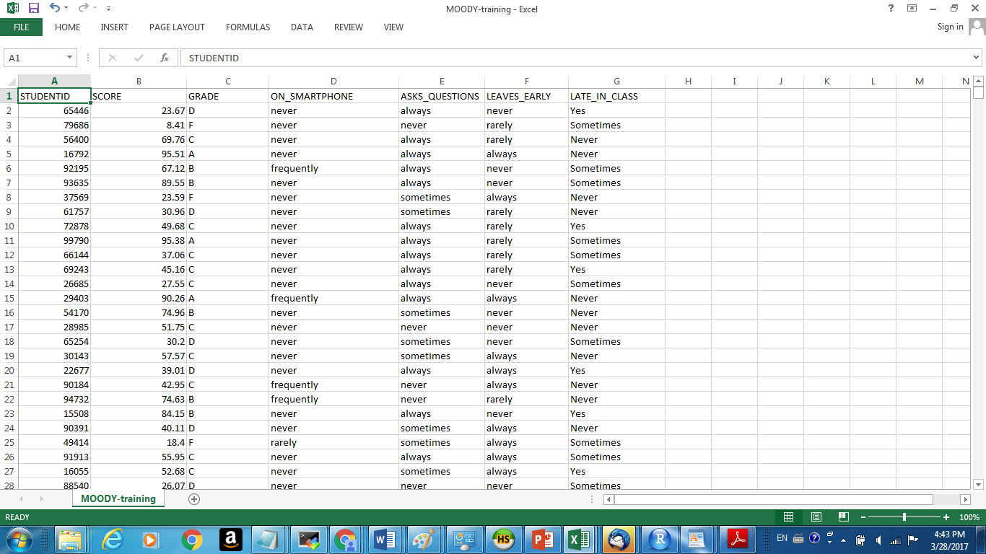
Training

Slide 3
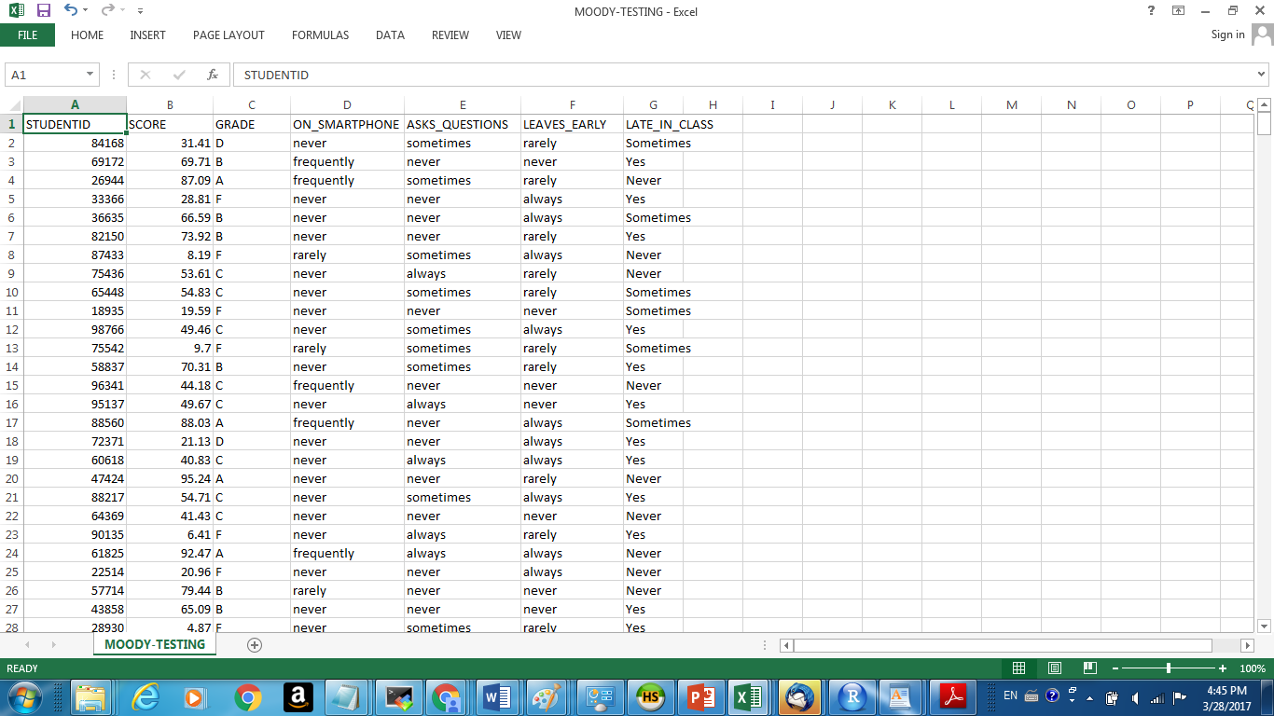
Testing

Slide 4
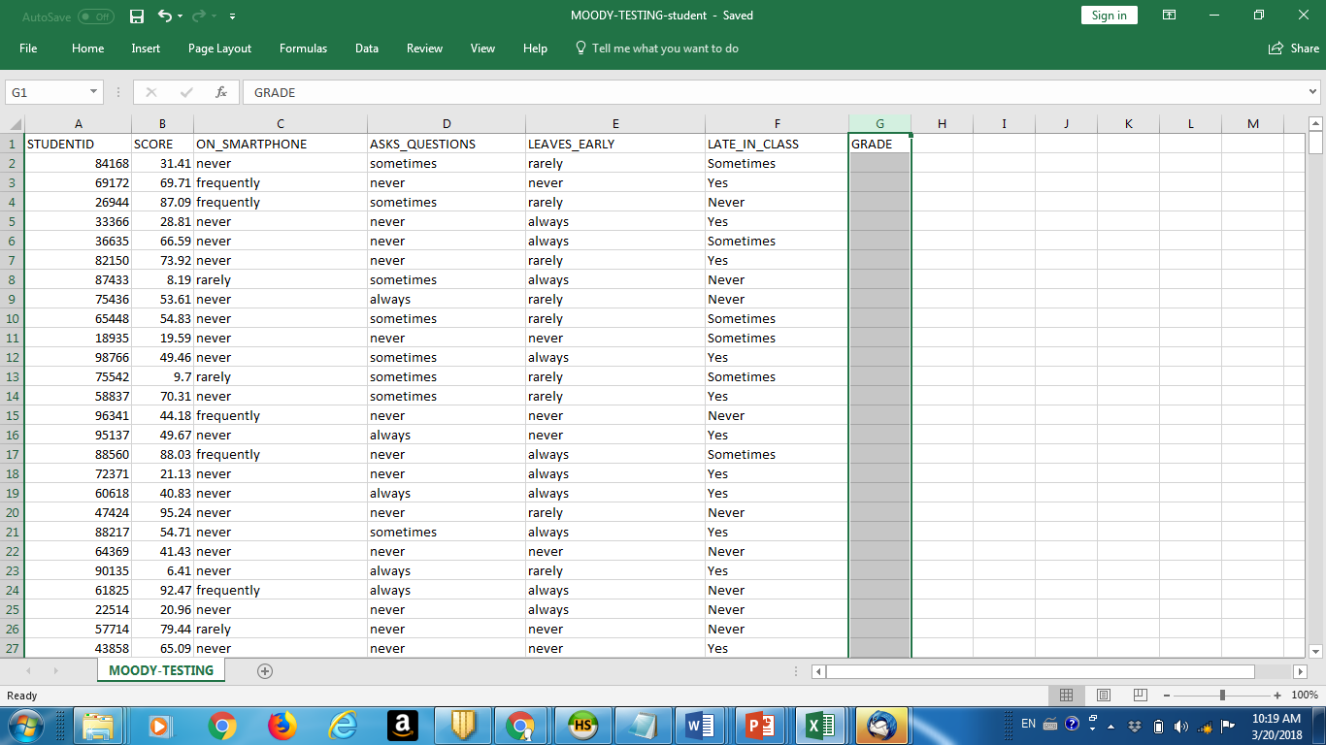
MOODY_TESTING_student

Slide 5
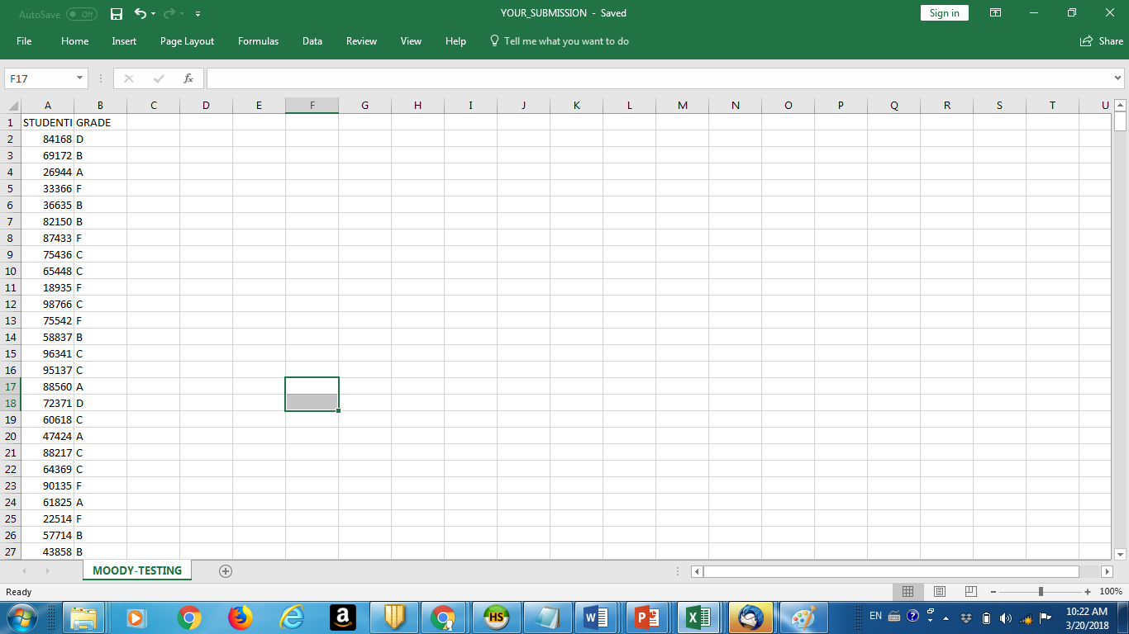
Your submission

Slide 6
Your result
PREDICTION ERROR – how often were you wrong in your prediction?
We compare MOODY_TESTING file (complete with grades we only know) with your *predicted* grades
KAGGLE will compute the errors and RANK YOUR SOLUTIONS.

Slide 7
Clean Prediction – no libraries
test<-read.csv("moody_testing_data.csv")
summary(test)
myprediction<-test
decision <- rep('F',nrow(myprediction))
decision[myprediction$SCORE>40] <- 'D'
decision[myprediction$SCORE>60] <- 'C'
decision[myprediction$SCORE>70] <- 'B'
decision[myprediction$SCORE>80] <- 'A'
myprediction$GRADE <-decision
error <- mean(test$GRADE!= myprediction$GRADE)
error

Slide 8
How to predict “freestyle”
Plot
Try some rules
What are prediction rules?
How to implement them in R?

Slide 9
Examples of Prediction Rules
If SCORE >80 then “A” else if SCORE >70 then “B” else…
If SCORE > 80 AND AskQuestions = “Frequently” then “A”
SCORE1 = SCORE +5 if Never on Smart Phone, If SCORE1 >80 then A
If 0.1 * SCORE + AskQuestions – LeaveEarly – SmartPhone > 3 then “A”
Etc etc

Slide 10
Intuition + trial and error
Plus the million dollar question
WILL THESE RULES BE PREDICTIVE? FOR FUTURE DATA SETS
Train -> TEST -> TEST ->TEST
Overfiting is the danger

Slide 11
How to make sure that rules are predictive?
CROSSVALIDATION
Split the training set into training and testing. K-fold. Then see which rules (we call them models) hold best.

Slide 12
PREDICTION CUP 2018 ON KAGGLE.COM
We will run it for next few weeks – 4-6 challenges.
We will use Kaggle (attend recitations!)
Weekly leaderboard will be published
We will crown the Prediction Champions

