Slide 1
Importing Data and Plotting

Slide 2
How to do basic data analysis?
Download data
Load data from file to R
Plot!

Slide 3
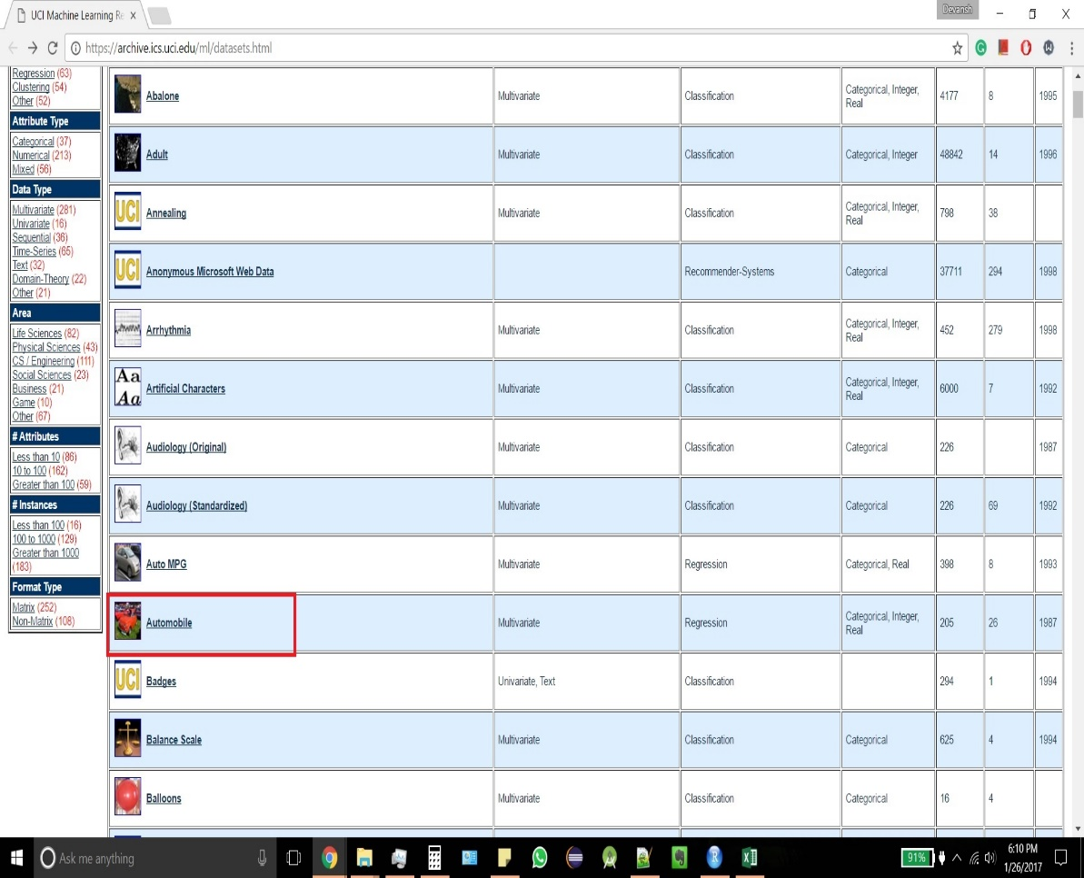
Download data
Use UCI ML repository archive as an example.
https://archive.ics.uci.edu/ml/datasets.html
For today, we will download Automobile data.

Slide 4
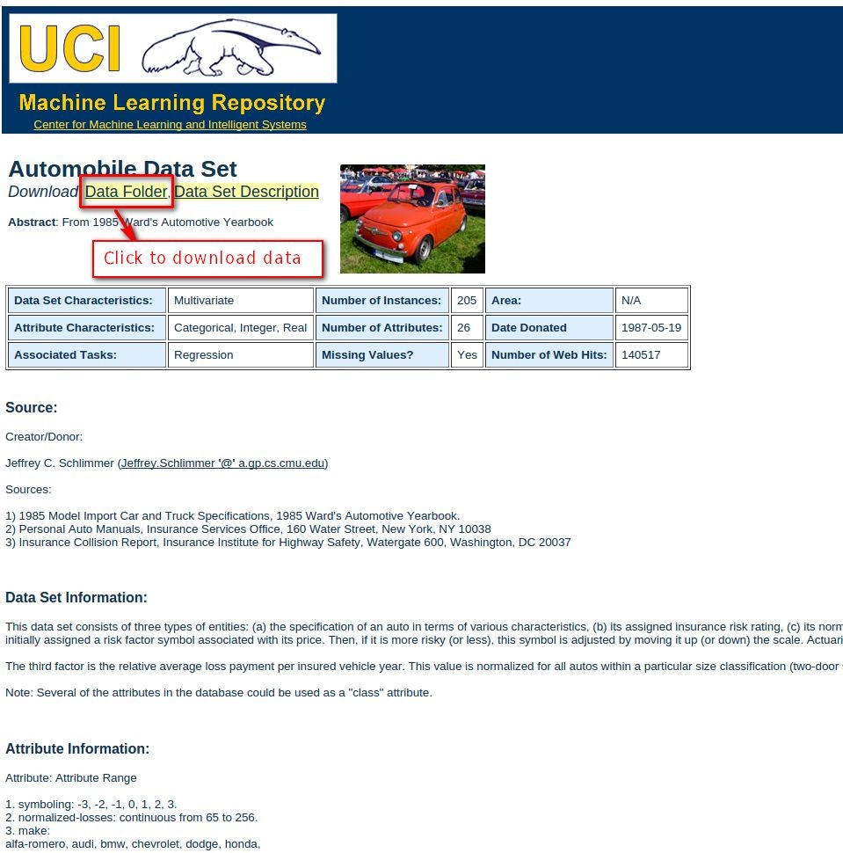
Download data
Click data folder to download the data set.
You can find header information, data set information in Data Set Description button.

Slide 5
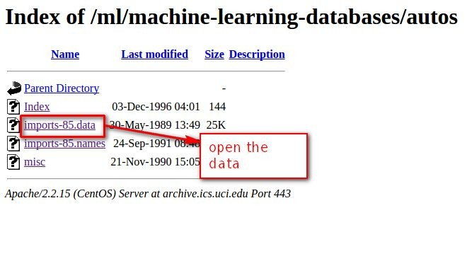
Download data
Data file always the has .data extension name and with biggest file size.
Open the data file. Some browser will start to download the data file directly, others will open it in the browser.

Slide 6
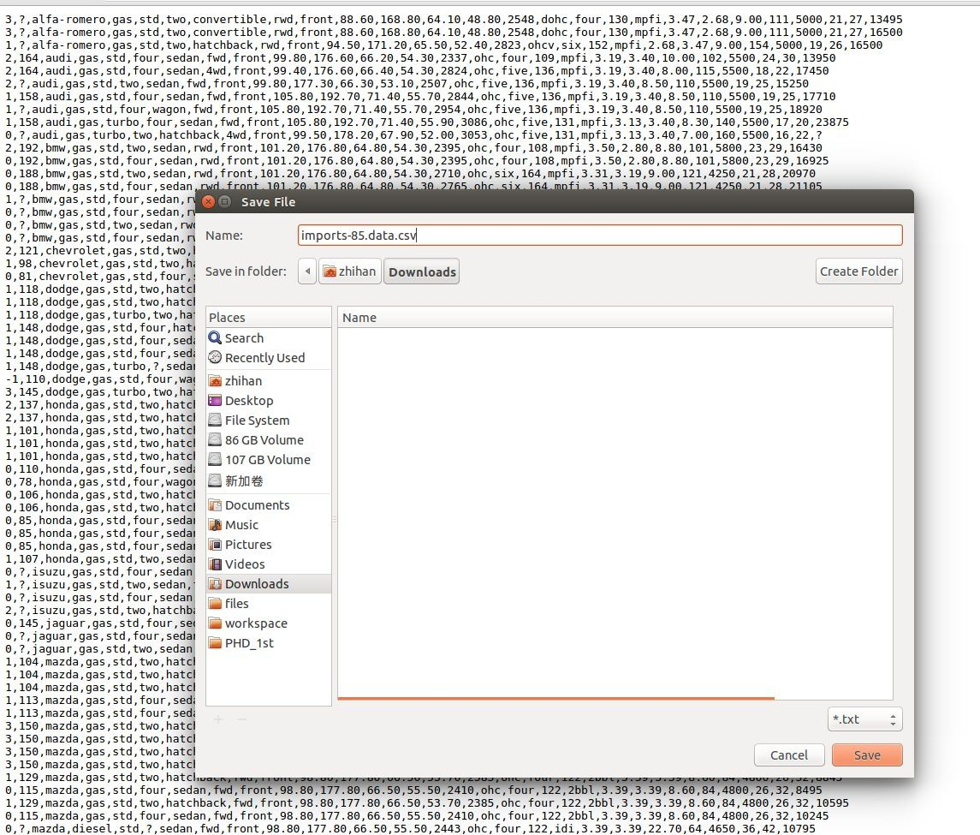
Download data
If the data file is opened in the browser, right click on the browser and click ‘save as’.
Change the file extension name from default to ‘csv’ in order to be processed easily.
If attribute header information is not contained, we can get it from data set description.

Slide 7
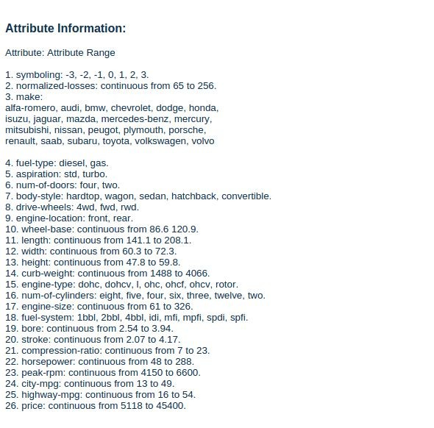
Add attribute header
Find the attribute information on the data set description page.
Open the data file in spreadsheet, insert a new row in the first row and add header information.

Slide 8
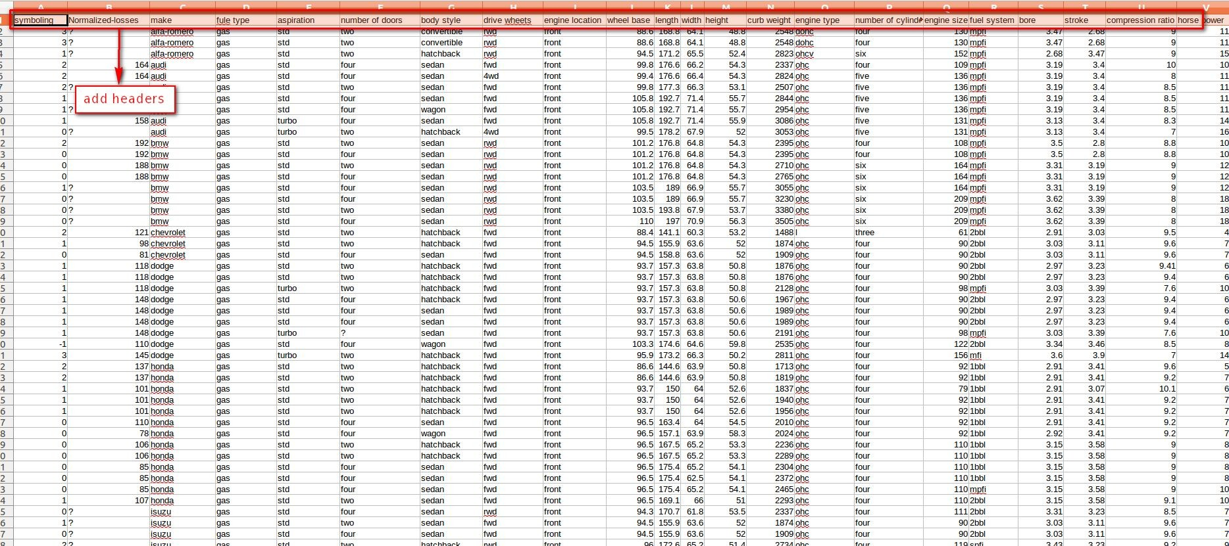
Add attribute header

Slide 9
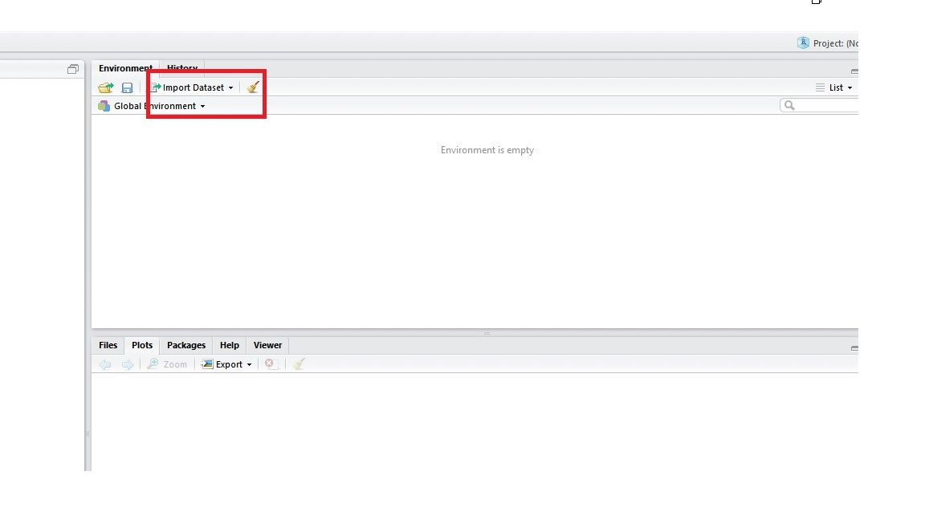
Read data from csv to R
Open the Rstudio
Click “Import Dataset” tab as indicated in left figure. It will be present in upper left window of Rstudio.
Browse for the dataset that you have just downloaded. Click Import button after data loads.

Slide 10
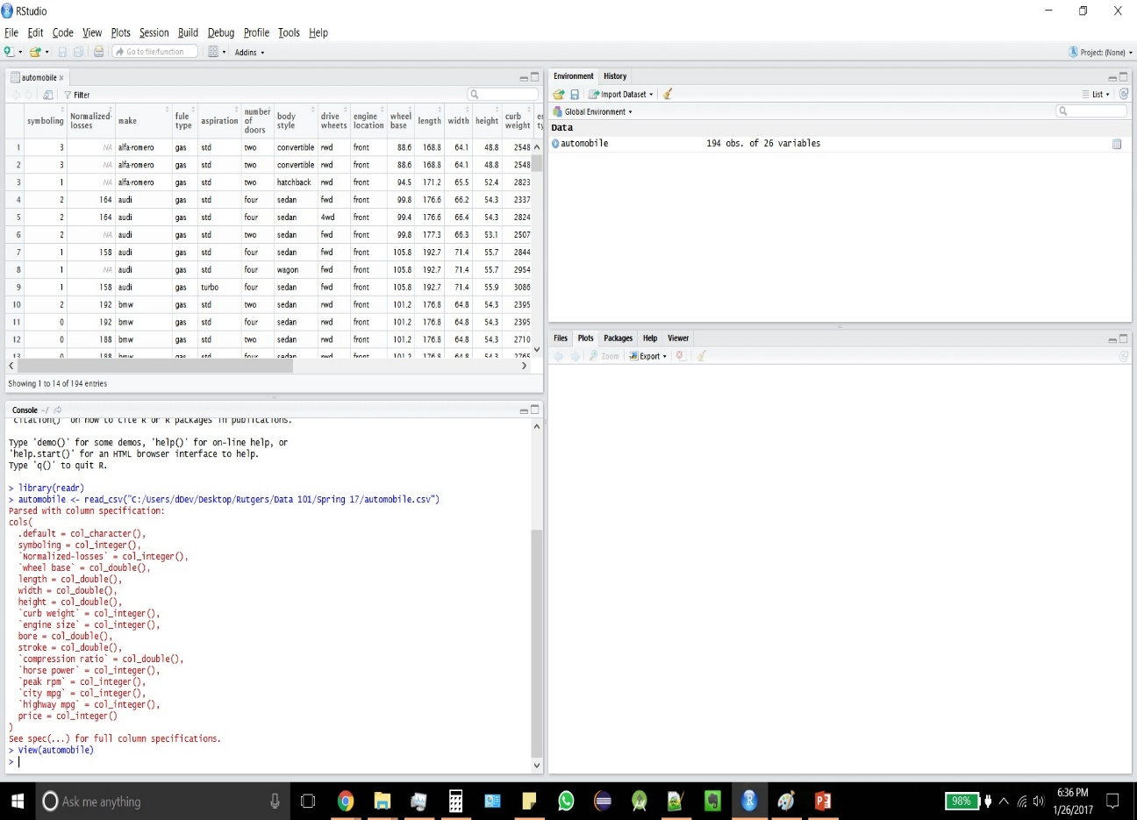
Read data from csv to R
After data loads successfully, you will see Rstudio as shown in left. In upper left corner of Rstudio, you can see the dataset you selected.

Slide 11
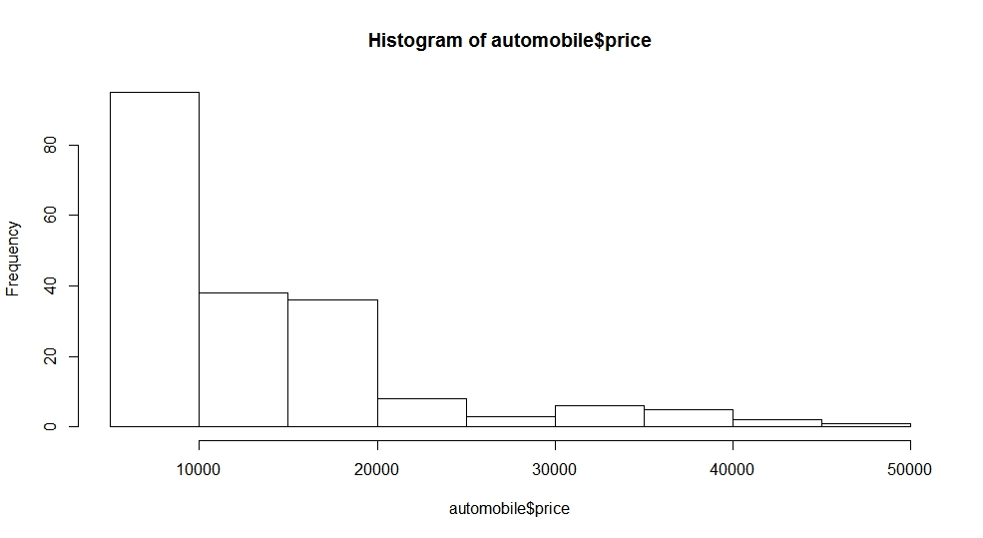
Plots - Histogram
hist(automobile$price)

Slide 12
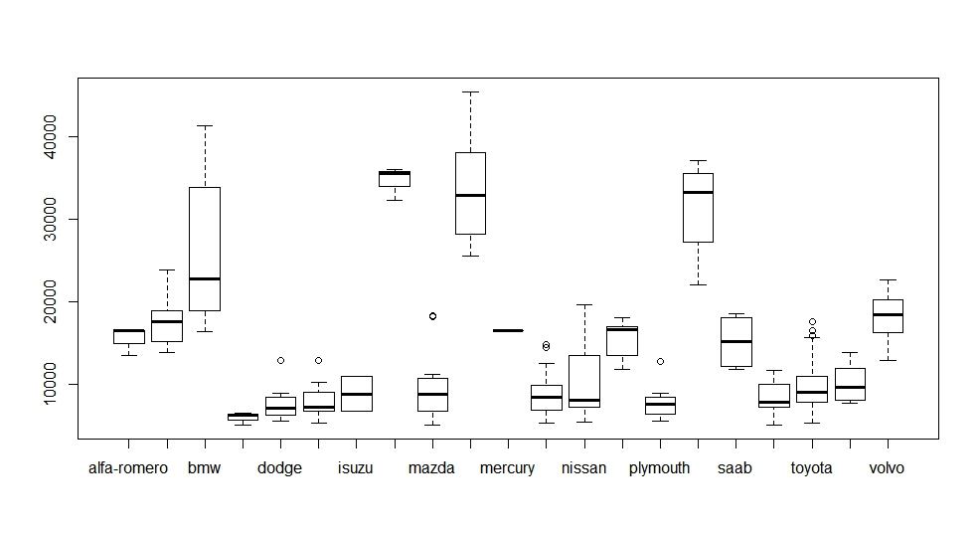
Plots - Boxplot
boxplot(automobile$price~automobile$make)

Slide 13
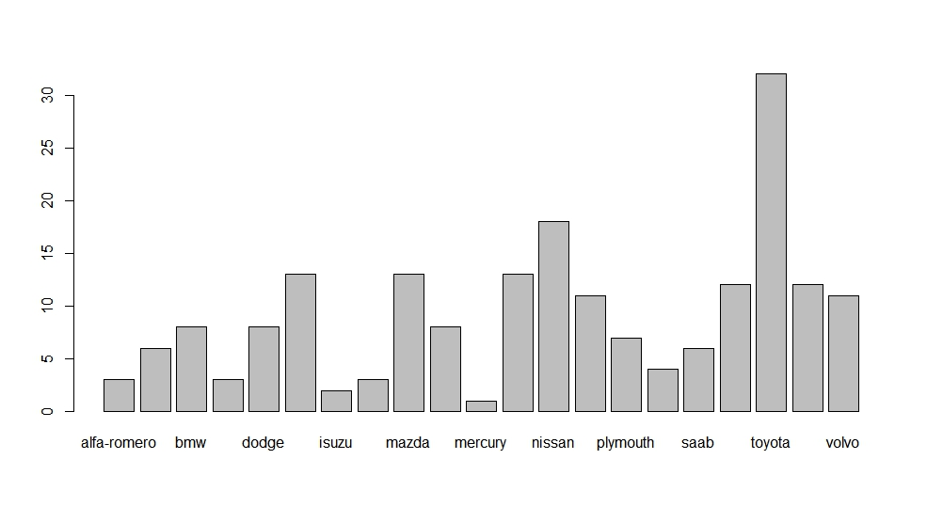
Plots - Barplot
For a Barplot, you first need to make a table of the column and then use the table to make a barplot.
table(automobile$make)
barplot(table(student_performance$GRADE))

Slide 14
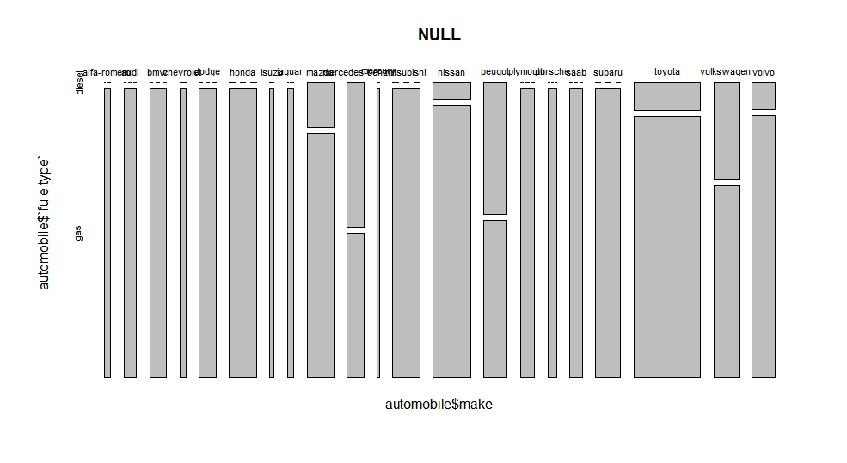
Plots – Mosaic Plot
mosaicplot(automobile$make~automobile$`fule type`)

