Slide 1
Professor Moody’s Class Grades: Deciphering
By Jarlin Almanzar

Slide 2
Moody’s Grades
Objective: Help the TA, to help future students understand their grade.
What factors influence the grades
Backed with plots and evidence
Data provided by Rutgers
URL: https://sakai.rutgers.edu/access/content/attachment/0c55f23a-8b8f-4f96-9135-a2c2b230ea01/Assignments/28afaf6e-a6e6-4a76-be2f-fba82b06fbad/moody2018-a.csv

Slide 3
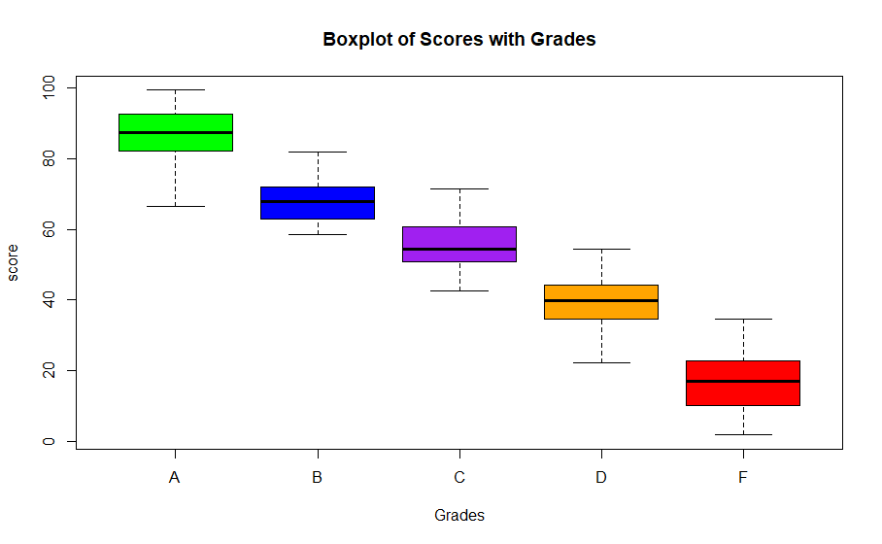
Grades mostly depend on Scores
As usual when it comes to grades most
Of the it is made up by the individual’s
Score.
This boxplot shows that those with
High-scores generally got better grades.
However it also shows that there is some type of
Curve when it comes to the grading.
Making the passing grade around the 50’s.
boxplot(moody2018.a$SCORE~moody2018.a$GRADE, ylab='score', xlab='Grades', main='Boxplot of Scores', col = c("green","blue","purple","orange","red"))

Slide 4
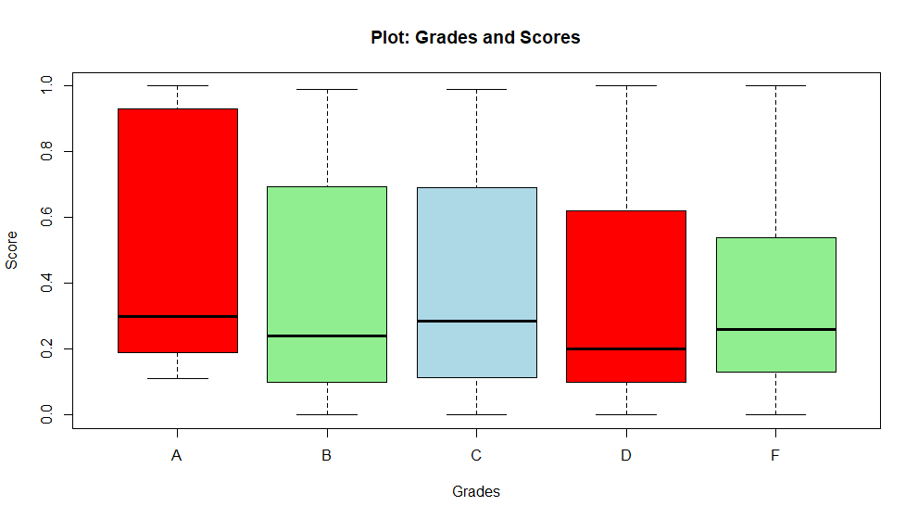
Participation
It seems those who individually participated more generally scored higher than those who barely participated .
While the usual median wasn’t that far from each other, the max shows a huge difference between those who got A’s and those who got F’s
plot(moody2018.a$GRADE,moody2018.a$PARTICIPATION, xlab="Grades", ylab="Score", main="Plot: Grades and Scores", col = c("red", "light green", "light blue")

Slide 5
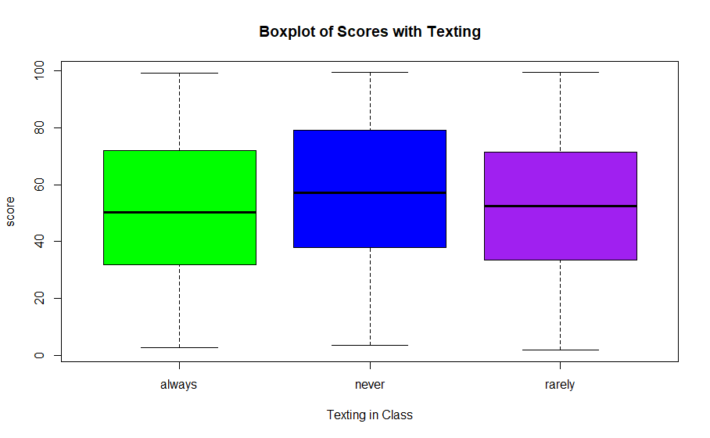
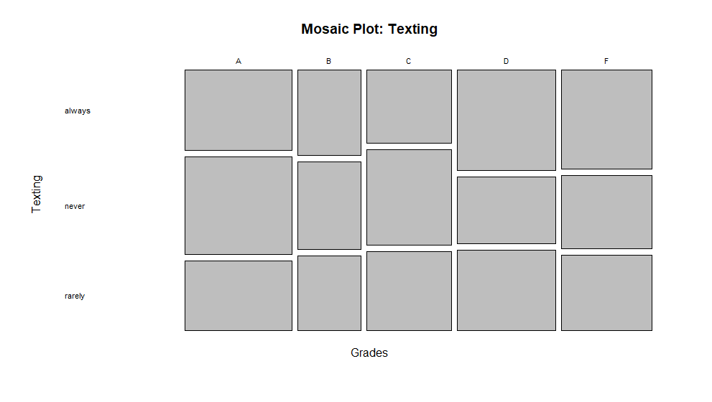
Boxplot & Mosaic plot: Texting
Based off the Boxplot and the Mosaic Plot we can that texting had an effect on grades,
The more an individual texted the lower grade.
and the less they texted the higher the grade.
totals=table(moody2018.a$GRADE,moody2018.a$TEXTING_IN_CLASS)
mosaicplot(totals, main="Texting")
boxplot(moody2018.a$SCORE~moody2018.a$TEXTING_IN_CLASS, ylab='score', xlab='Texting in Class', main='Boxplot of Scores with Texting', col = c("green","blue","purple","orange","red"))

Slide 6
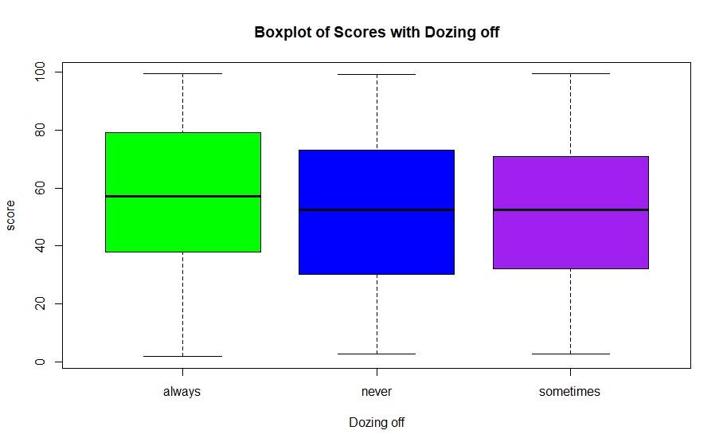
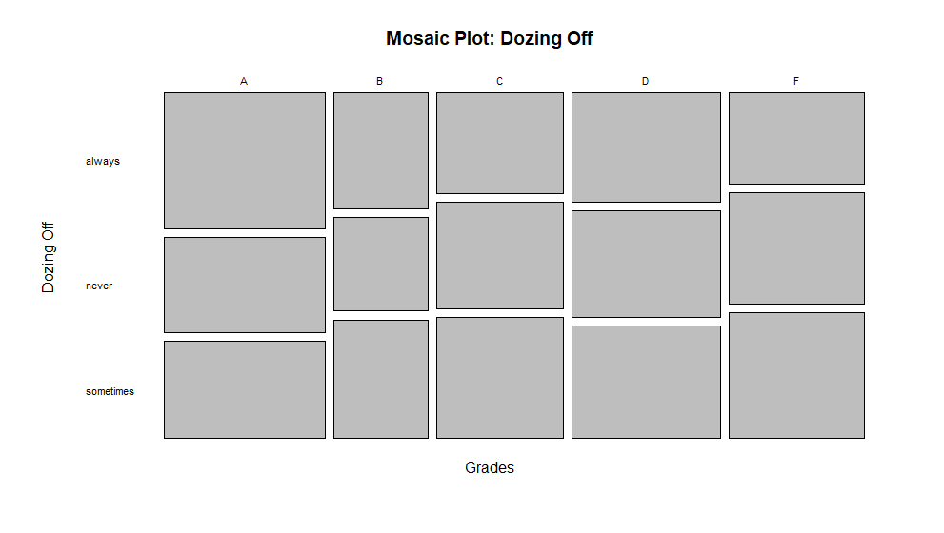
Boxplot & Mosaic plot: Dozing Off
Based of Dozing off, Prof. Moody was very understanding of students who slept in his class as those who dozed a lot score much better those
Who never or sometimes dozed off.
totals=table(moody2018.a$GRADE,moody2018.a$DOZES_OFF)
mosaicplot(totals, main="Mosaic Plot: Dozing Off", xlab="Grades", ylab="Dozing_Off", off=5, las=1)
boxplot(moody2018.a$SCORE~moody2018.a$DOZES_OFF, ylab='score', xlab='DOZES_OFF', main='Boxplot of Scores with Grades', col = c("green","blue","purple","orange","red"))

Slide 7
Conclusion
Based off the stats, it seems that the grades were mostly based off scores that either had a negative/positive impact based on participating, dozing off, and texting.
Students who participated a lot more than the rest of the class scored higher, though not by much.
While students who texted, were negatively affected lowering their score by a good amount.
Mr. Moody was lenient on students who dozed off, and in fact scoring them higher than those who sometimes or never dozed off.
Tell the students that: “Participating in class, doing well in assignments, and dozing off in class helped your grades, while those who usually texted had their grades affected”.

