Slide 1
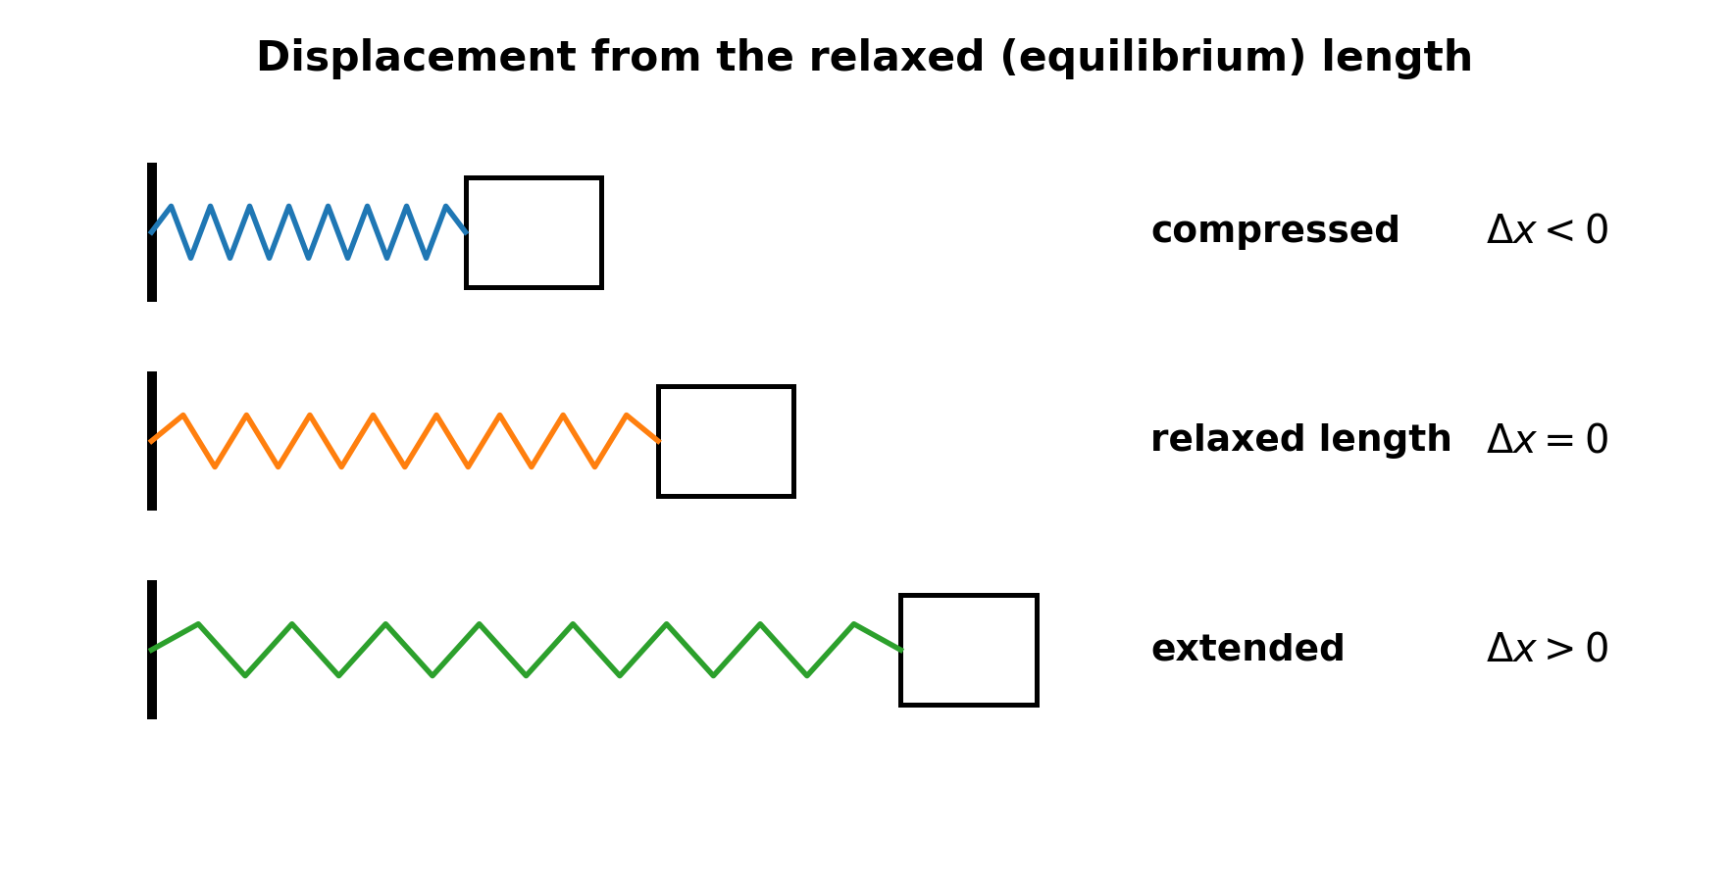
Elastic Potential Energy
AP Physics 1 · Unit 3 · Lesson 4

Slide 2

1 · Ideal spring: restore equilibrium
AP Physics 1 · Unit 3 · Lesson 4
The minus sign gives direction:
force points toward equilibrium

Slide 3
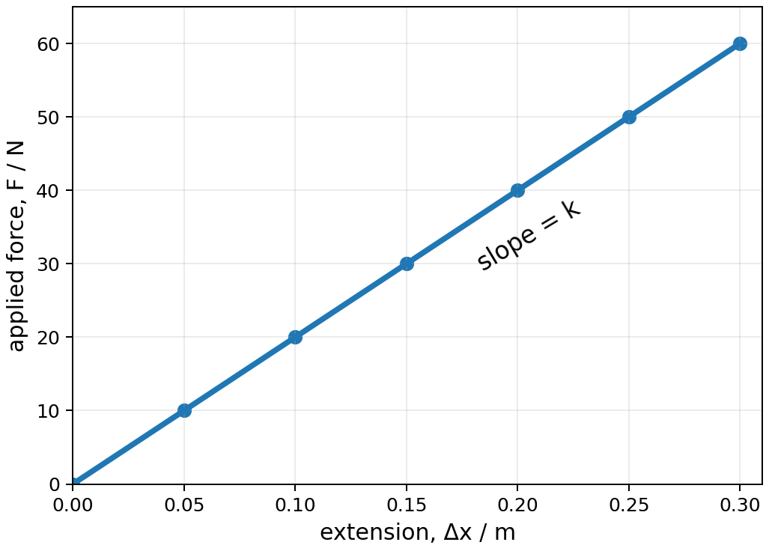
Applied force builds the graph
AP Physics 1 · Unit 3 · Lesson 4
slow stretch → applied force balances spring force
gradient = k
F = kΔx (magnitude, extension)

Slide 4
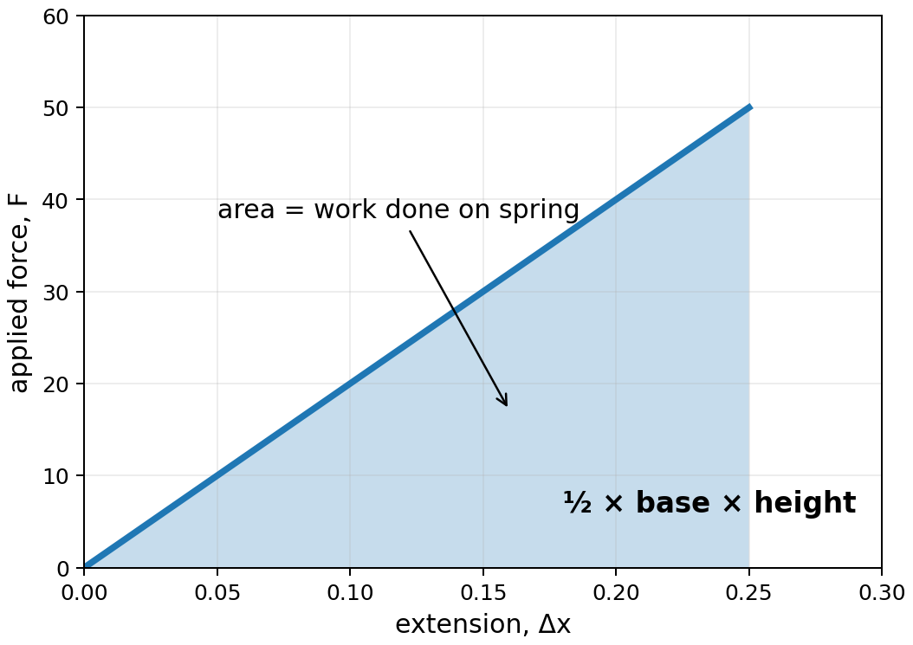

2 · Variable force → area
AP Physics 1 · Unit 3 · Lesson 4
Work done ON spring = triangular area

Slide 5


3 · Derive the stored energy
AP Physics 1 · Unit 3 · Lesson 4
work done on ideal spring → stored elastic potential energy

Slide 6
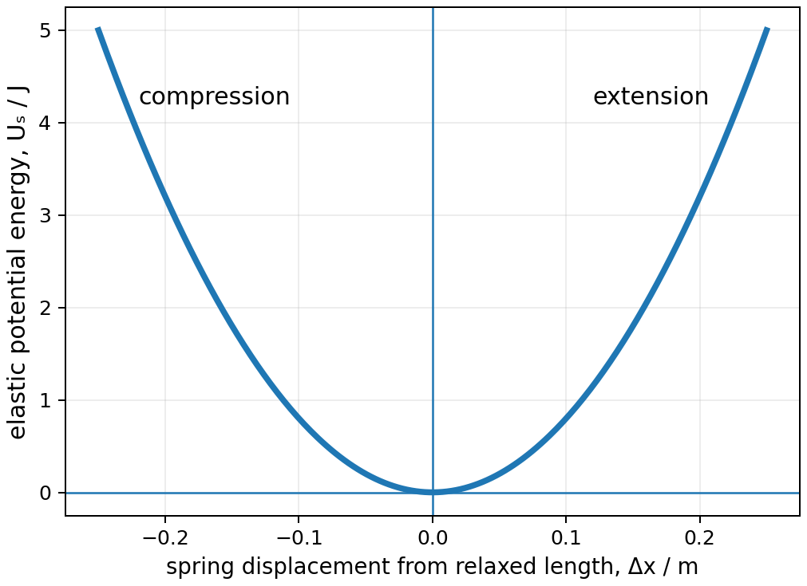
What does Uₛ depend on?
AP Physics 1 · Unit 3 · Lesson 4
k twice as large → Uₛ twice as large
|Δx| twice as large → Uₛ four times as large
same |Δx|: compression and extension store the same Uₛ

Slide 7
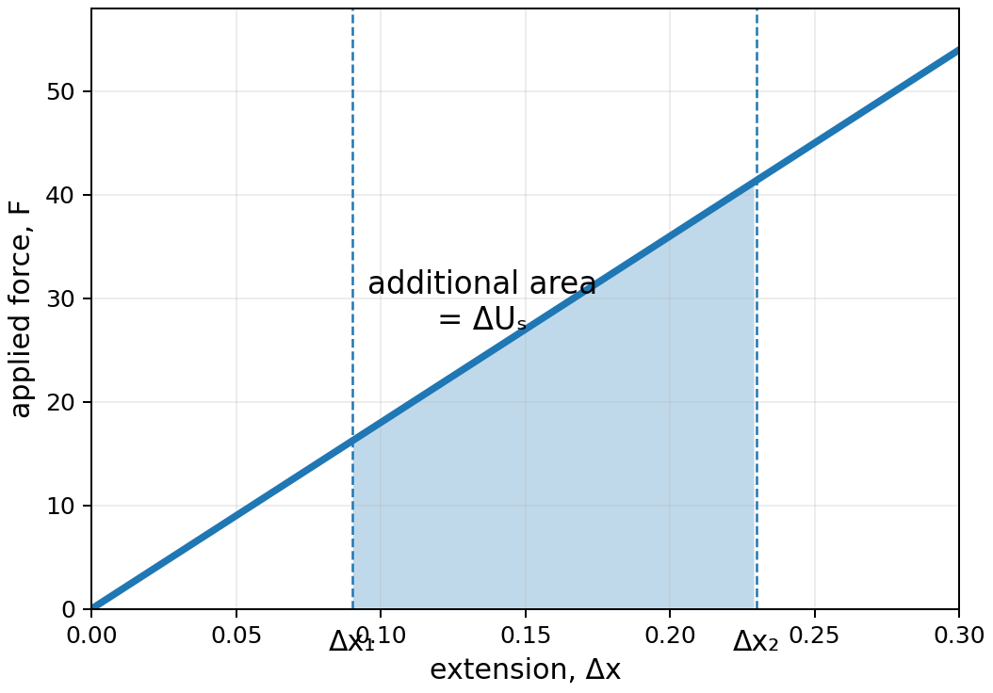

4 · Already stretched? Compare energies
AP Physics 1 · Unit 3 · Lesson 4
NOT: square of the change in extension

Slide 8
Compression works the same way
AP Physics 1 · Unit 3 · Lesson 4
Δx may be negative — Uₛ remains positive because displacement is squared

Slide 9
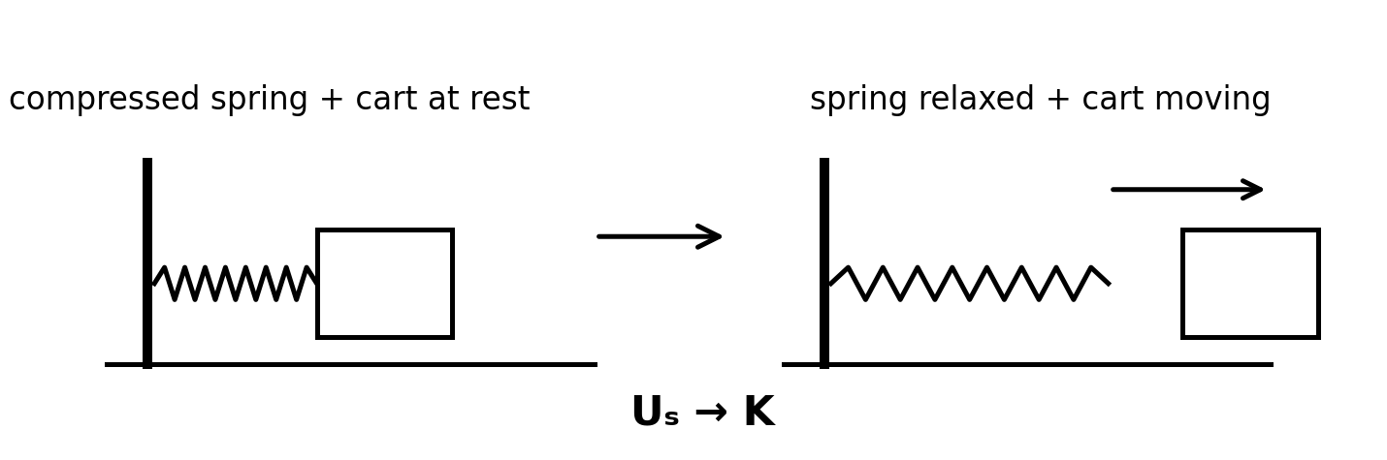

5 · Spring energy ↔ kinetic energy
AP Physics 1 · Unit 3 · Lesson 4
horizontal + frictionless:
No change in gravitational potential energy
spring relaxes → cart speeds up

Slide 10
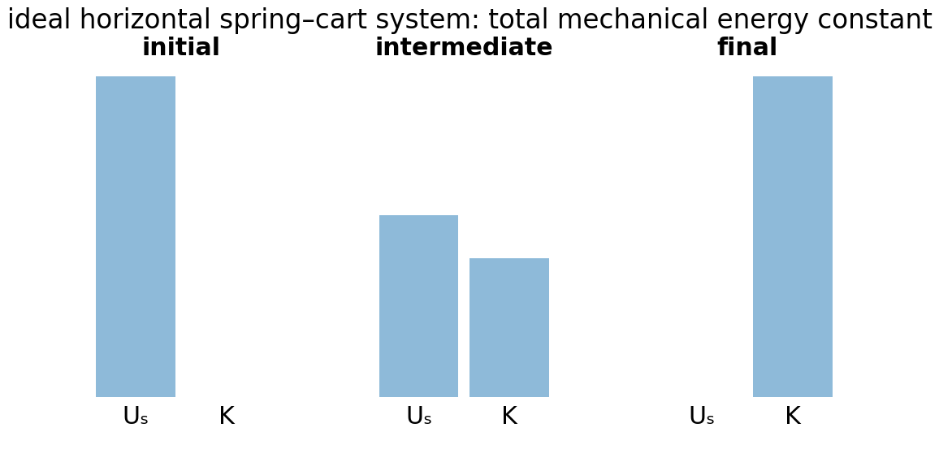
Energy bars tell the story
AP Physics 1 · Unit 3 · Lesson 4
same total height of energy bars
for an ideal isolated system

Slide 11
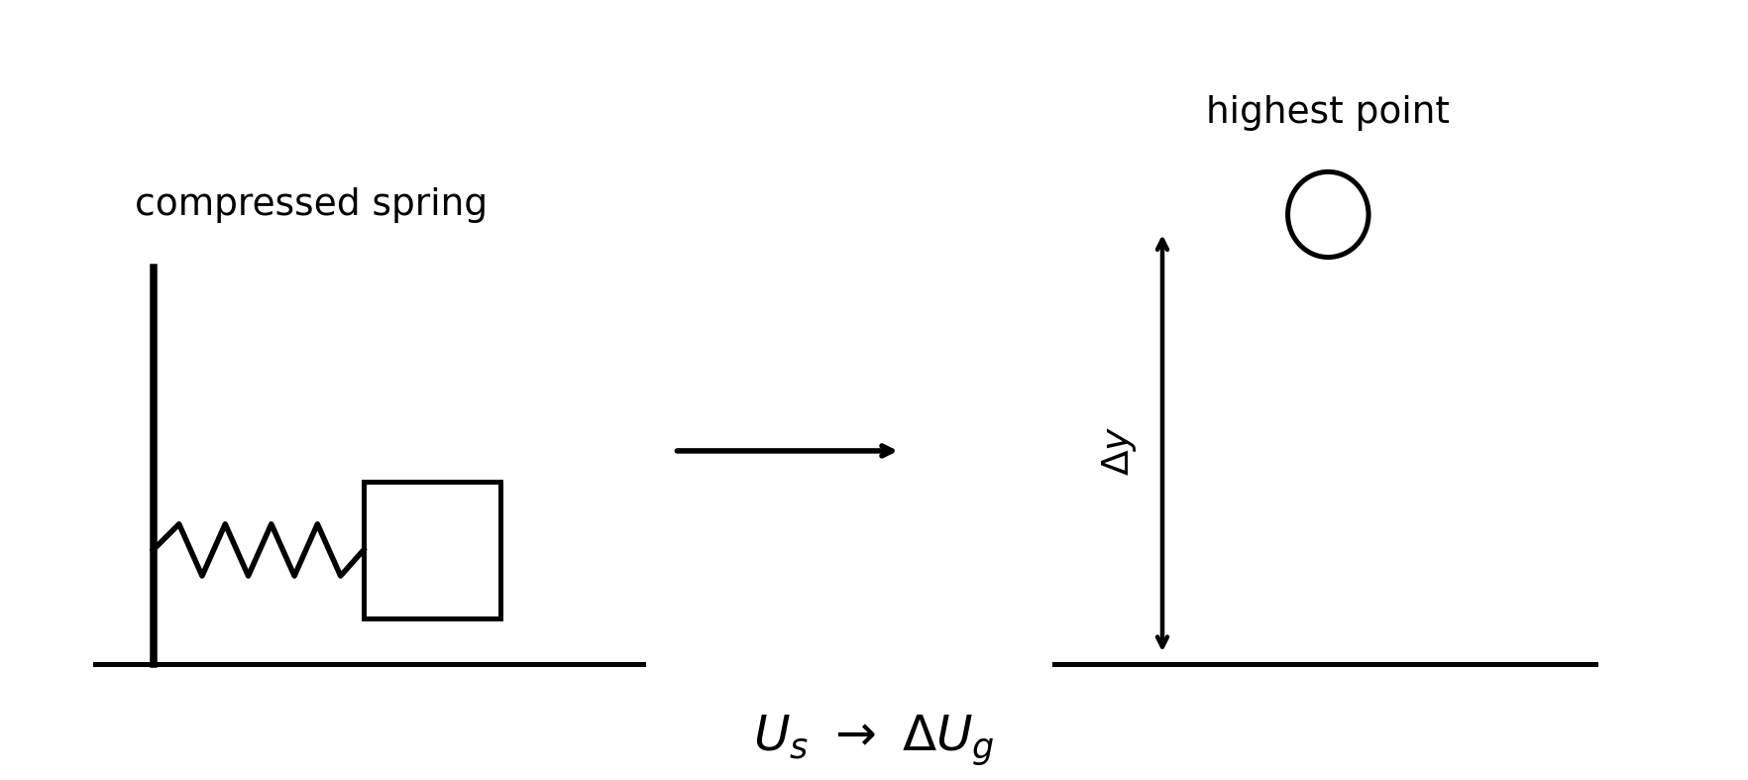

6 · Spring energy ↔ gravitational potential energy
AP Physics 1 · Unit 3 · Lesson 4
Choose initial and final states before substituting.

Slide 12
Common errors
AP Physics 1 · Unit 3 · Lesson 4
Using the spring restoring force and the applied force as though they have the same direction.
Squaring only the change in extension when moving between two nonzero displacements.
Forgetting that compression also stores positive elastic potential energy.
Skipping the energy statement and jumping straight to substitution.
Mixing cm with m.

Slide 13
Exit check
AP Physics 1 · Unit 3 · Lesson 4
Can you derive Uₛ from the area under the graph?
Can you solve from the relaxed length, between two nonzero extensions, and for compression?

