Slide 1
Mechanical Work and Power
AP Physics 1 · Unit 3 · Lesson 3
force + displacement → energy transfer → rate

Slide 2
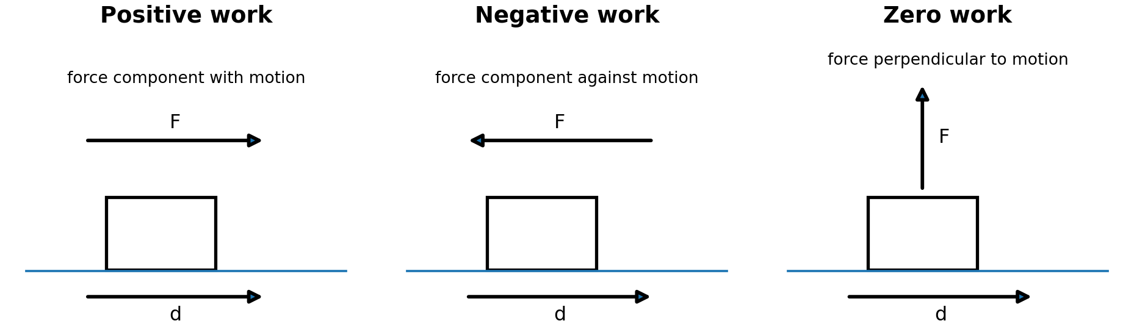
Today
AP Physics 1 · Unit 3 · Lesson 3
Work by one force
Positive / negative / zero work
Net work and kinetic energy
Area under force-displacement graphs
Average and instantaneous power

Slide 3
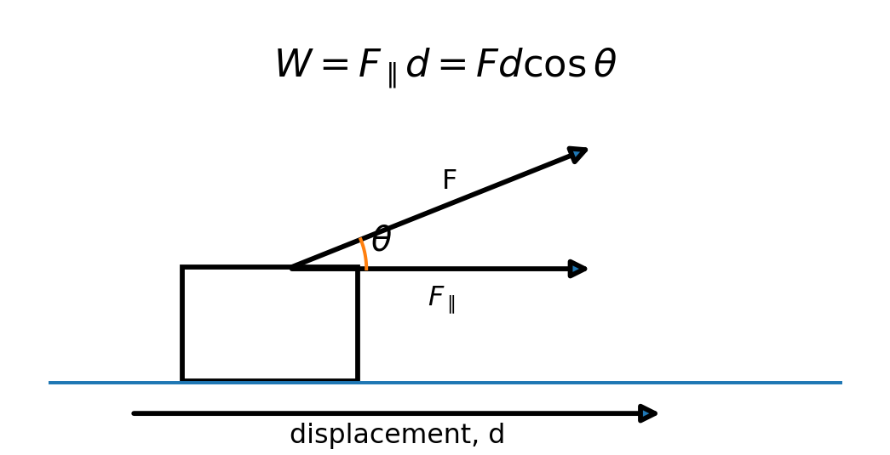

Work: only the parallel component matters
AP Physics 1 · Unit 3 · Lesson 3
θ = angle between force and displacement

Slide 4
Positive, negative, zero
AP Physics 1 · Unit 3 · Lesson 3
Ask: what is the angle between F and d?

Slide 5
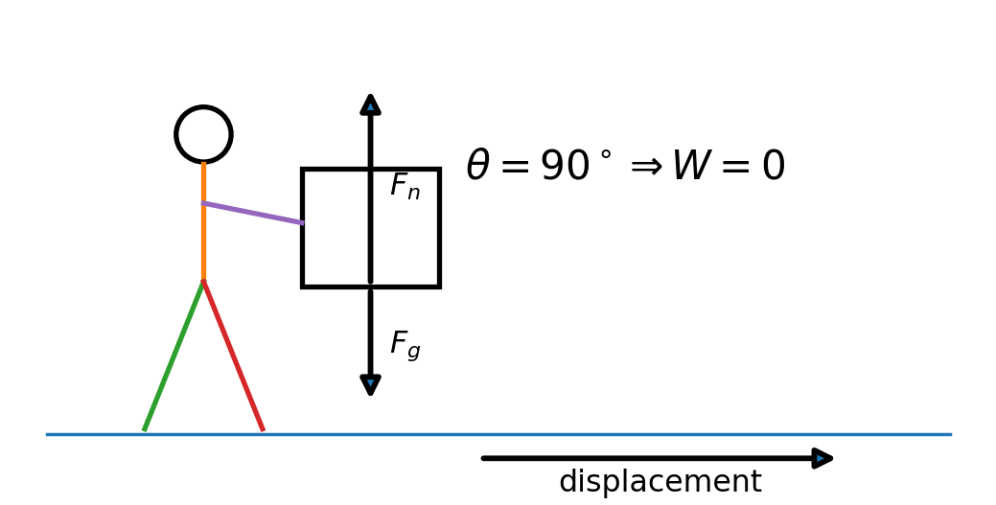
Zero work can still feel tiring
AP Physics 1 · Unit 3 · Lesson 3
Support force: vertical
Displacement: horizontal
Mechanical work by support force = 0
Biological energy expenditure ≠ mechanical work on box

Slide 6

Net work changes kinetic energy
AP Physics 1 · Unit 3 · Lesson 3
net W > 0 → K increases
net W = 0 → K unchanged
net W < 0 → K decreases

Slide 7
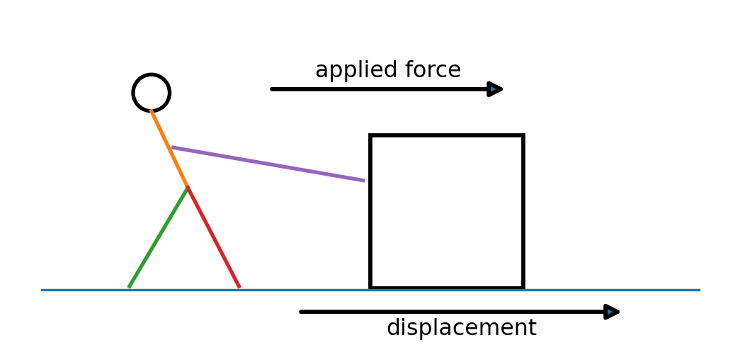
One force is not the whole story
AP Physics 1 · Unit 3 · Lesson 3
A push can do positive work.
Friction can do negative work.
Normal force and weight can do zero work on a horizontal displacement.
Add the work from all forces to get ΔK.

Slide 8
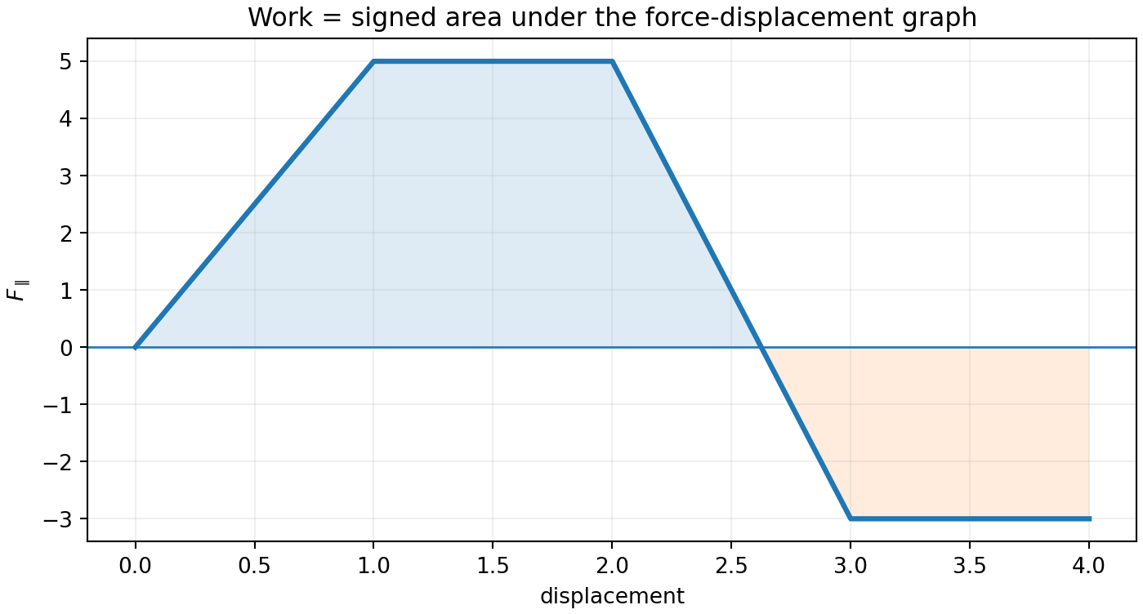
Variable force: area, not one Fd
AP Physics 1 · Unit 3 · Lesson 3
Area above axis → +W
Area below axis → −W
Split simple shapes
Use signed total area

Slide 9
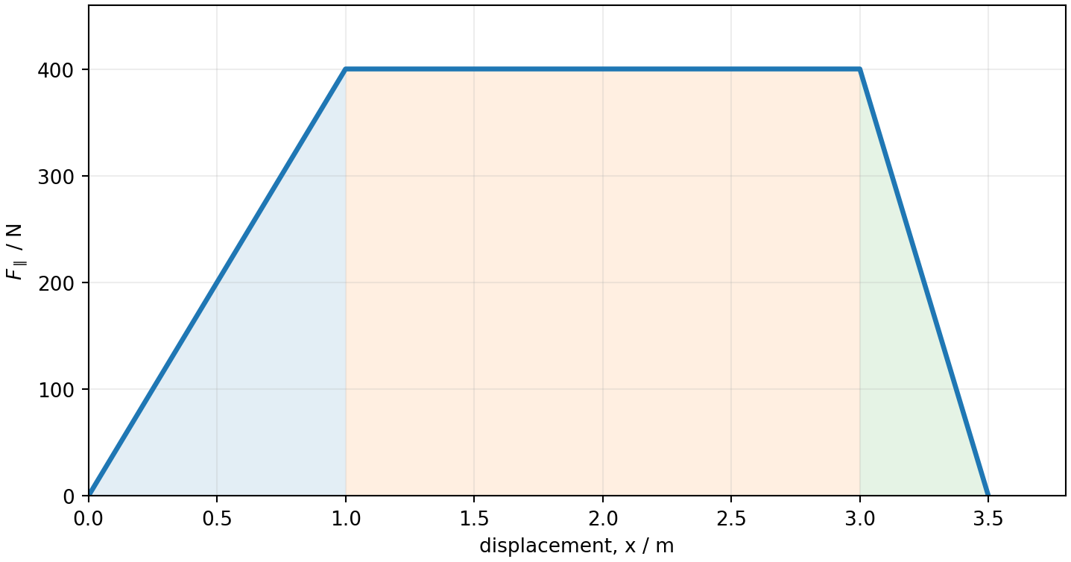
Your worksheet graph
AP Physics 1 · Unit 3 · Lesson 3
½(1)(400) + (2)(400) + ½(0.5)(400) = 1100 J

Slide 10
Path matters... sometimes
AP Physics 1 · Unit 3 · Lesson 3
Conservative
Nonconservative
Path-independent work
Potential energy exists
Closed path → net work 0
Path-dependent work
Friction, air resistance
Mechanical energy may dissipate

Slide 11

Power = how fast energy changes
AP Physics 1 · Unit 3 · Lesson 3
1 watt = 1 joule per second

Slide 12

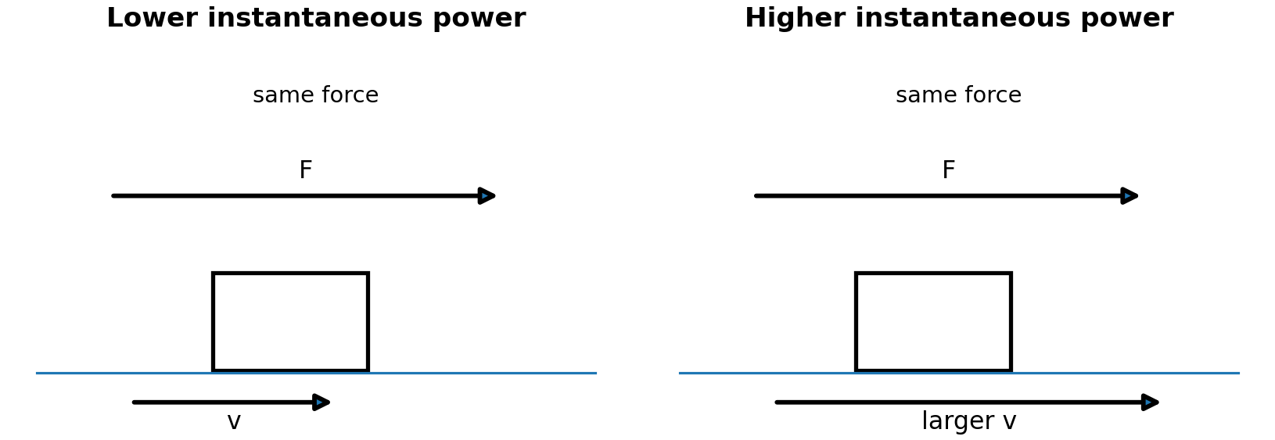
Instantaneous power
AP Physics 1 · Unit 3 · Lesson 3

Slide 13
Constant force ≠ constant power
AP Physics 1 · Unit 3 · Lesson 3
If speed increases...
instantaneous power increases
At constant speed, force constant → power constant

Slide 14
Problem: 480 N push, no friction
AP Physics 1 · Unit 3 · Lesson 3
m = 360 kg
F = 480 N
d = 3.5 m
v₀ = 1.0 m s⁻¹
Find W, a, v, Kᵢ, Kf, ΔK, Pavg

Slide 15
Problem: constant speed with friction
AP Physics 1 · Unit 3 · Lesson 3
constant speed → net force is zero
work by person: +
work by friction: −
kinetic energy unchanged

Slide 16
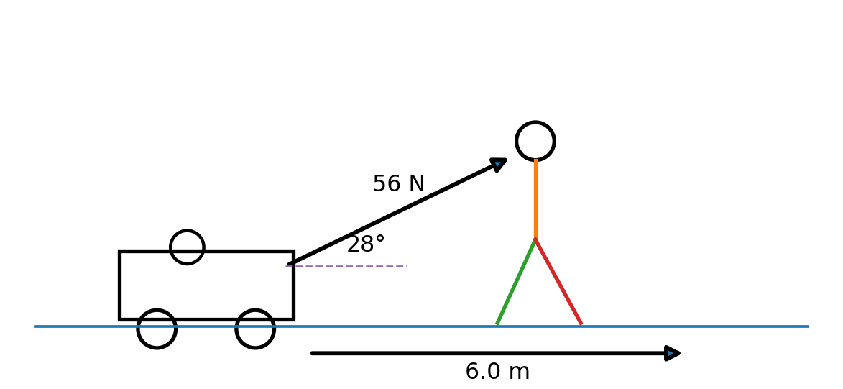
Two angle checks
AP Physics 1 · Unit 3 · Lesson 3
90° → zero work
28° → use cos28°

Slide 17
Quick check
AP Physics 1 · Unit 3 · Lesson 3
1. Friction opposes motion. Sign of its work?
2. Net work = 0. What stays unchanged?
3. Force constant, speed doubles. What happens to instantaneous power?
4. What does area below an F∥-x graph mean?

Slide 18
Exit checklist
AP Physics 1 · Unit 3 · Lesson 3
Can I identify θ correctly?
Can I distinguish work by one force from net work?
Can I use signed graph area?
Can I use ΔK = ΣW?
Can I distinguish average from instantaneous power?

