Slide 1
Using the Law of Conservation of Energy
AP Physics 1 · Unit 3 · Lesson 2

Slide 2
Objectives
AP Physics 1 · Unit 3 · Lesson 2
Identify the main energy transfer in a physical event.
State and explain conservation of energy.
Solve problems by comparing total energy before and after an event.
Use AP notation consistently, with genuine subscripts and superscripts.
Compare force-and-motion and energy methods.

Slide 3
Working standard
AP Physics 1 · Unit 3 · Lesson 2
EQUATION FIRST
Write the governing equation symbolically.
Rearrange if necessary.
Substitute values with units.
State the answer with units and sensible precision.

Slide 4

Conservation of energy
AP Physics 1 · Unit 3 · Lesson 2
Energy cannot be created or destroyed.
Choose initial and final states clearly.
Account for all relevant energy stores.
No work-energy theorem in this lesson.

Slide 5


AP Physics 1 notation used today
AP Physics 1 · Unit 3 · Lesson 2
Near-Earth gravitational potential-energy change
General gravitational potential energy
Normal force
Friction force
Net force

Slide 6
Task 1 · Energy transfers
AP Physics 1 · Unit 3 · Lesson 2
A small, dense ball falls through the air.
A car with its engine switched off coasts uphill and slows down.
The school lift descends at steady speed.
A compressed spring launches a cart on a horizontal track.
A bicycle brakes to rest on level ground.
A bouncy ball strikes the floor and compresses before rebounding.
Lift descending at steady speed:
Gravitational → Internal

Slide 7
Tasks 2–3 · From idea to calculation
AP Physics 1 · Unit 3 · Lesson 2
Start by writing the energy equation.
Keep the sign of the gravitational potential-energy change consistent.
For kinematics, write the kinematics relationship before substituting.
For kinetic energy, state the kinetic-energy equation before numbers.

Slide 8
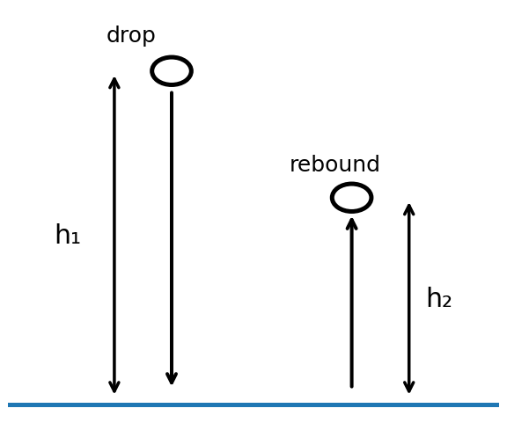
Task 5 · Bouncy ball practical
AP Physics 1 · Unit 3 · Lesson 2
Measure mass, drop height and repeated rebound heights.
Calculate the initial gravitational potential energy.
Calculate the rebound gravitational potential energy.
Calculate the mechanical energy not recovered.
Discuss internal energy, sound and uncertainty.

Slide 9
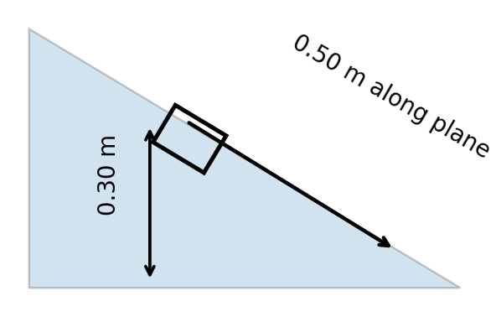

Task 6A · Incline: force method
AP Physics 1 · Unit 3 · Lesson 2
Then use v² = v₀² + 2aΔx

Slide 10
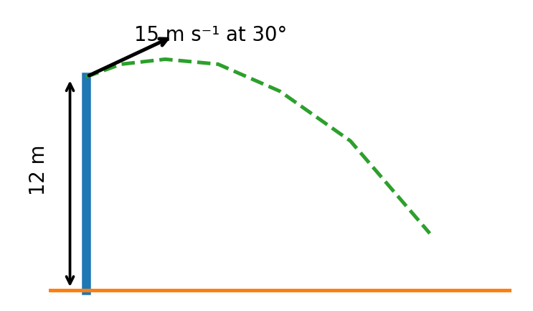
Task 6B · Projectile
AP Physics 1 · Unit 3 · Lesson 2
Resolve the initial velocity into horizontal and vertical components.
At the top, the vertical velocity is zero while the horizontal component remains.
State the kinetic-energy equation before substitution.
With negligible drag, the kinetic-energy change balances the gravitational-potential-energy change.

Slide 11
Task 7 · Beyond constant g
AP Physics 1 · Unit 3 · Lesson 2
Use the general gravitational-potential equation shown at left.
Its zero is defined at infinite separation.
Use the near-Earth change equation only when gravitational field strength is approximately constant.

Slide 12
Task 8 · Falling with drag
AP Physics 1 · Unit 3 · Lesson 2
Account for gravitational energy lost between kinetic and internal energy.
State the kinetic-energy equation first.
State the constant-acceleration equation first.
Begin force analysis with Newton’s second law.
Taking downward as positive, weight and drag act in opposite directions.

Slide 13
Tasks 9–10 · Derive before calculating
AP Physics 1 · Unit 3 · Lesson 2
v² = v₀² + 2gH
Derive the familiar result from energy conservation.
For projectiles, energy can avoid solving for time.

Slide 14
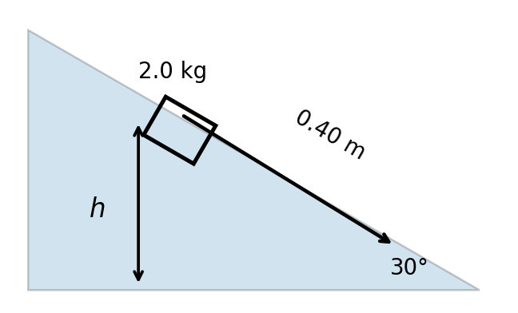
Task 11 · Frictionless incline
AP Physics 1 · Unit 3 · Lesson 2
Energy route: conservation of energy

Slide 15


Task 12 · Rough incline: AP force notation
AP Physics 1 · Unit 3 · Lesson 2
Perpendicular to the plane: the net force is zero.
Parallel to the plane: apply Newton’s second law.
Use the AP force symbols shown above consistently.
Use the kinetic-friction coefficient with its proper subscript.

Slide 16
Exit check
AP Physics 1 · Unit 3 · Lesson 2
Identify the energy transfer.
Choose initial and final states.
Write the equation first.
Use AP notation and correct subscripts.
Then substitute and calculate.

