Slide 1
Visualization of neural network prediction using LIME package
Spiced Academy Trial Lecture
29.10.2021
Arjun Haridas

Slide 2
Agenda
1. Goal and Motivation
2. The need for Interpretability in models
3. Intro to CNN
4. Intro to LIME
5. Code Example

Slide 3
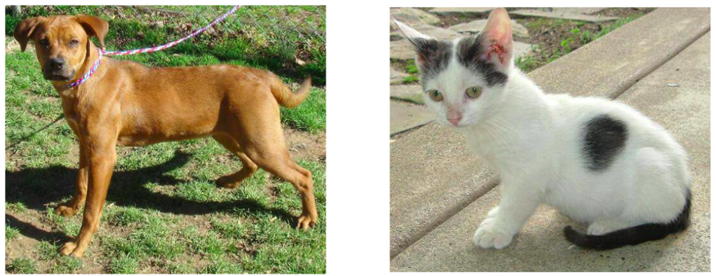
Goal - Classification
Which features identify each pets?

Slide 4
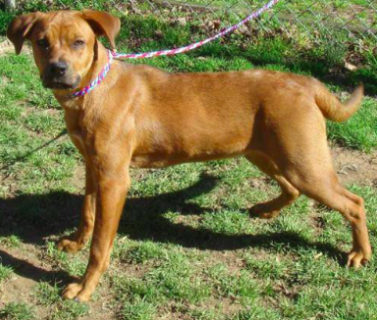
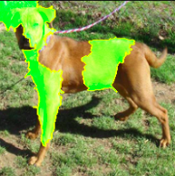
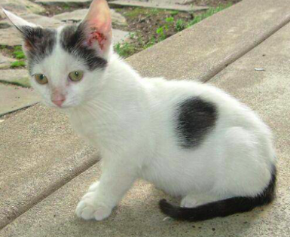
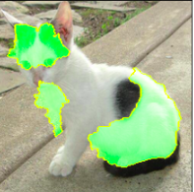
Motivation
Input
Output
Black Box

Slide 5
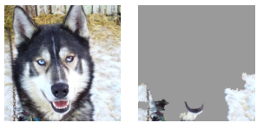
2. The need for Interpretability in models
Verification of the model
How do we trust the model?
Production ready models (Hospitals etc..)
Detect and improve untrustworthy models
Example - Classification of Husky vs Wolf
Learning from the model
Alpha Go
Compliance to legislation
EU's GDPR law for "Right to explanation" for AI systems

Slide 6
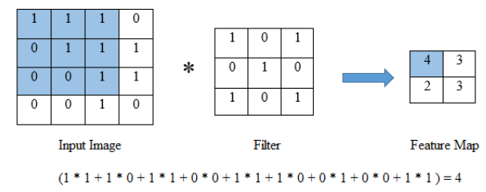
3. Into to CNN - Convolutional neural network
A CNN takes an input image and passes through several layers which include convolutional layers, pooling layers, and fully connected (FC) layers to produce an output.
Convolution Layer :
Extracts features from an image to produce feature maps

Slide 7
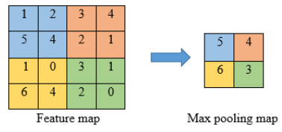
Pooling Layer:
Reduces the dimensionality of the feature map while retaining the information of the image by either taking the average or the largest value in the feature map

Slide 8
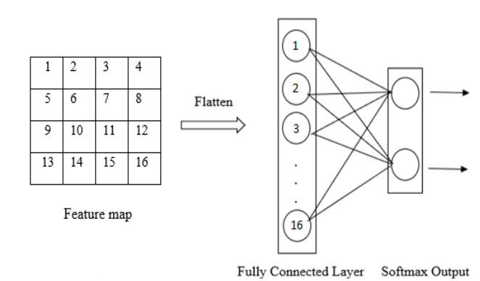
Fully connected layer :
Uses the features extracted from the final convolution or pooling layer and uses it to classify the image into the respective classes.

Slide 9
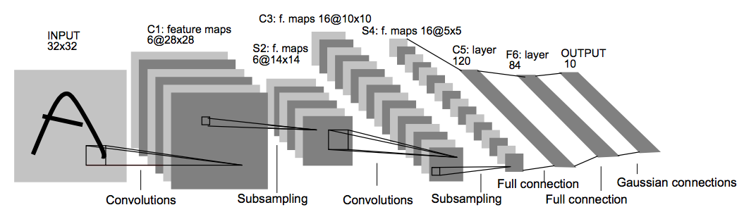
Quick look into CNN
Interactive visualisation of CNN - Adam Harley
PhD Robotics - CMU
Visualization of CNN - LeNet Architecture

Slide 10
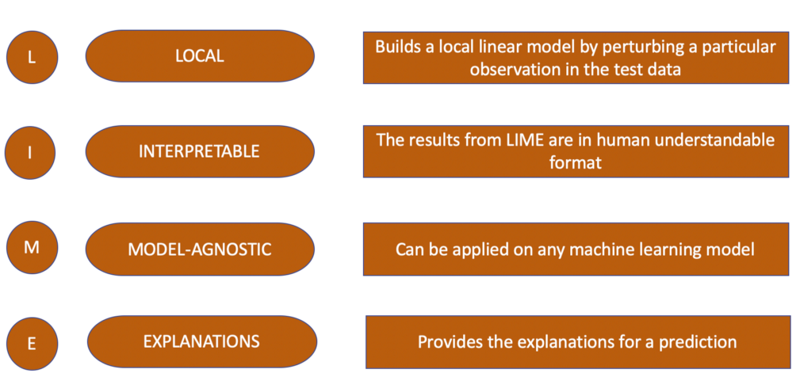
4. Into to LIME - Local Interpretable Model-agnostic Explanations

Slide 11
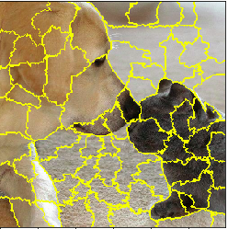
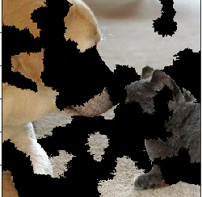
LIME - Algorithm
Extract super-pixels and create random perturbations
Use model to predict the new perturbed images
Calculate distance between perturbed images and
original image to get similarity scores
Fit a linear model with perturbed images, predictions
and similarity scores
This gives the importance of each super-pixel segment
for the prediction of a dog/cat.

Slide 12
Code Example - Classification

Slide 13
Resources
Husky vs Wolf
Lime Paper
CNN Visualisation
LeNet
Kaggle notebook
Talk on LIME framework by author

