Slide 1
End-to-End ETL Pipeline for E-Commerce Analytics
DATA ENGINEERING PROJECT
Data Ingestion • Validation • Transformation • Data Warehouse • Analytics Dashboard
Prepared by:
Ajay B
6
17
4
1
Data Sources
Transformation Rules
Warehouse Tables
Dashboard

Slide 2
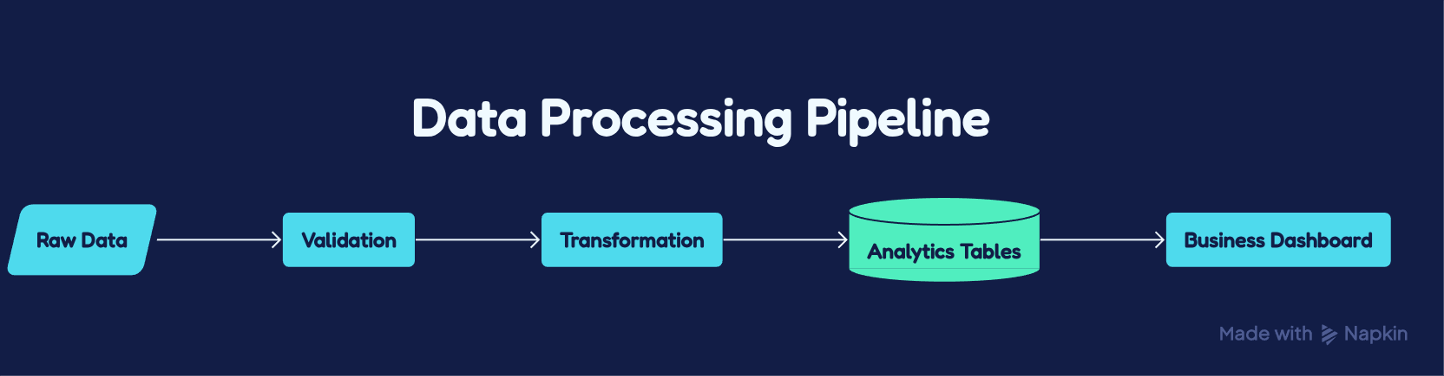
Business Problem and Project Objectives
Business Problem :
• Multiple heterogeneous data sources
• Poor data quality
• No centralized analytical dataset
Key Challenges :
Multiple input formats (CSV, JSON, TSV, LOG)
Missing, duplicate, and inconsistent records
Invalid customer and product references
Different currencies requiring standardization
Raw data unsuitable for direct analytics
Project Objectives :
✔ Design a modular and maintainable ETL pipeline
✔ Validate and cleanse incoming data
✔ Apply business transformation rules
✔ Generate analytics-ready fact and dimension tables
✔ Deliver business insights through an interactive dashboard
02

Slide 3
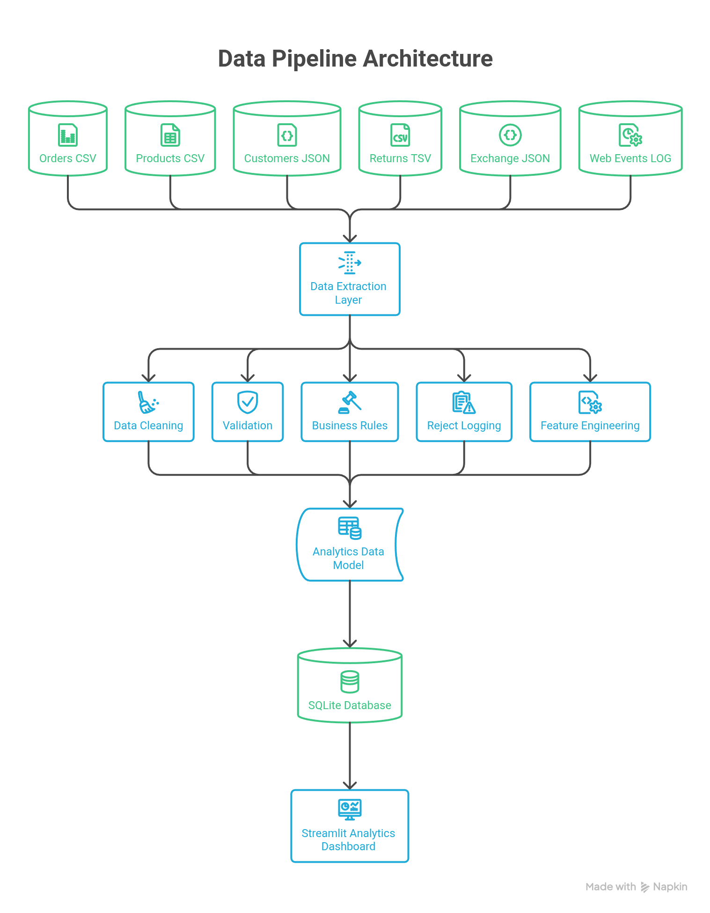
Solution Architecture
03

Slide 4
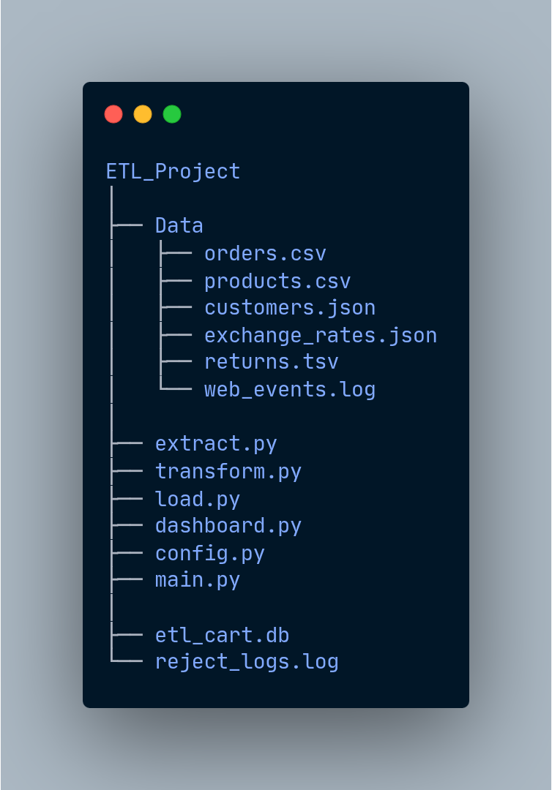
Project structure
📥 extract.py Reads and loads data from multiple source formats.
⚙ transform.py Validates, cleans, applies business rules, and performs feature engineering.
💾 load.py Loads analytics-ready tables into SQLite.
📊 dashboard.py Builds interactive KPI dashboards using Streamlit.
⚙️ config.py Centralizes validation rules, mappings, and configuration.
🚀 main.py Coordinates the complete ETL workflow.
04

Slide 5
Data Extraction Layer
Data Sources
Flow Diagram
Responsibilities
Orders.csv | Products.csv
Customer.json | Returns.tsv
Exchange_rate.json | Web Events.log
Multiple Data Sources
📥 Read CSV, JSON, TSV & LOG
🔄 Parse multiple file formats
📄 Convert into Pandas DataFrames
📦 Return dictionary of tables
extract.py
Dictionary of Pandas DataFrames
05

Slide 6
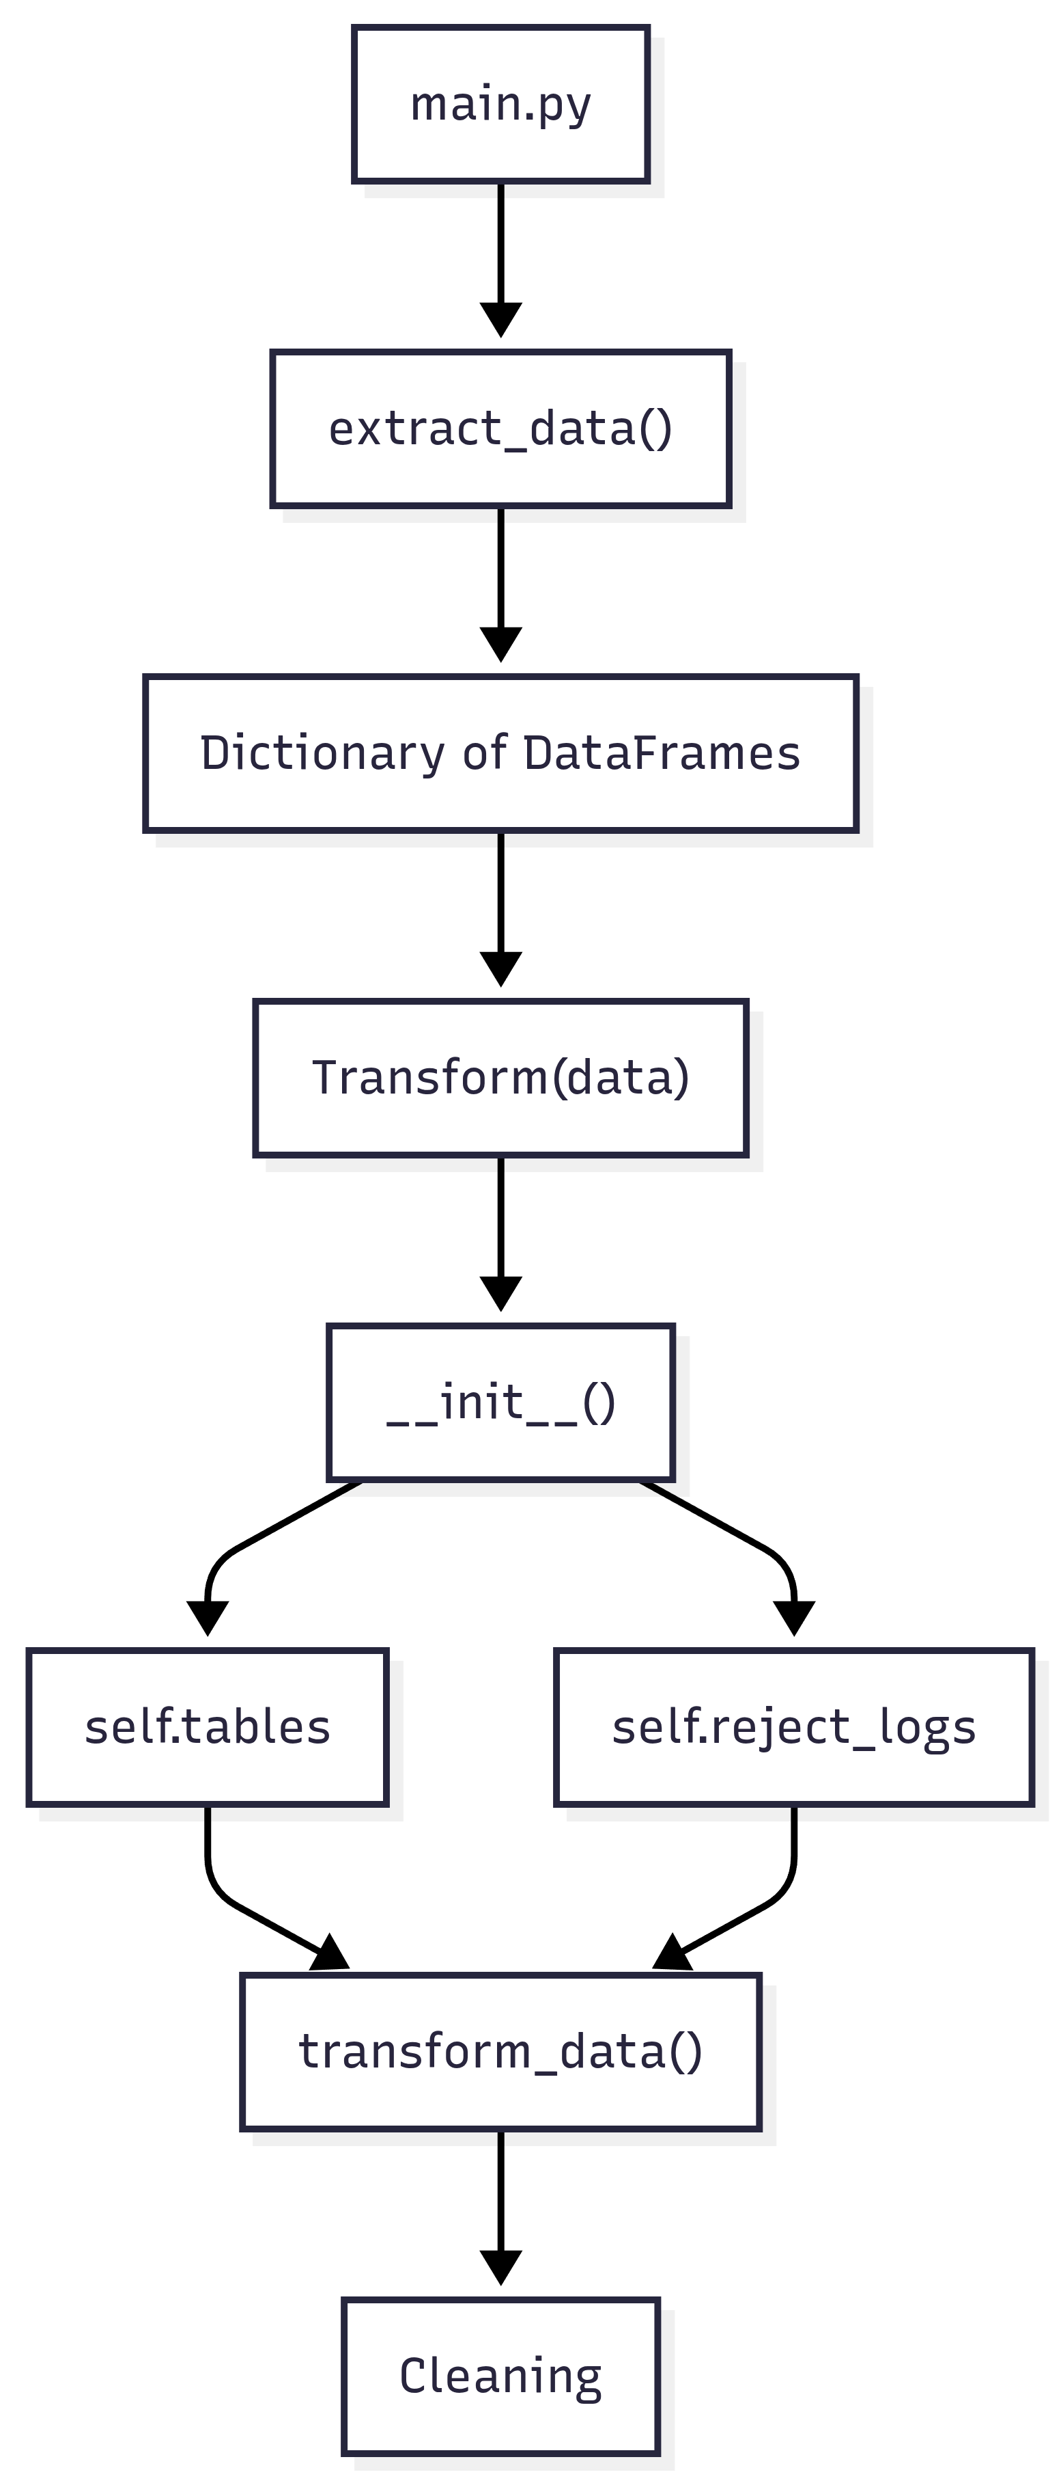
Transformation Module Architecture
🏗 Object-Oriented Design
Encapsulates all transformation logic
Maintains a reusable workflow
📦 Shared State
self.tables
Stores all DataFrames throughout the ETL process
📝 Reject Logging
self.reject_logs
Captures invalid records without interrupting processing
06

Slide 7
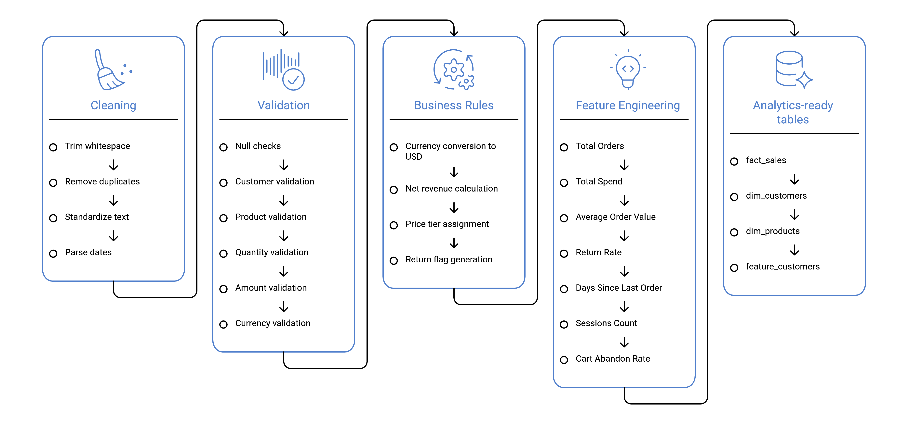
Transformation Pipeline
07

Slide 8
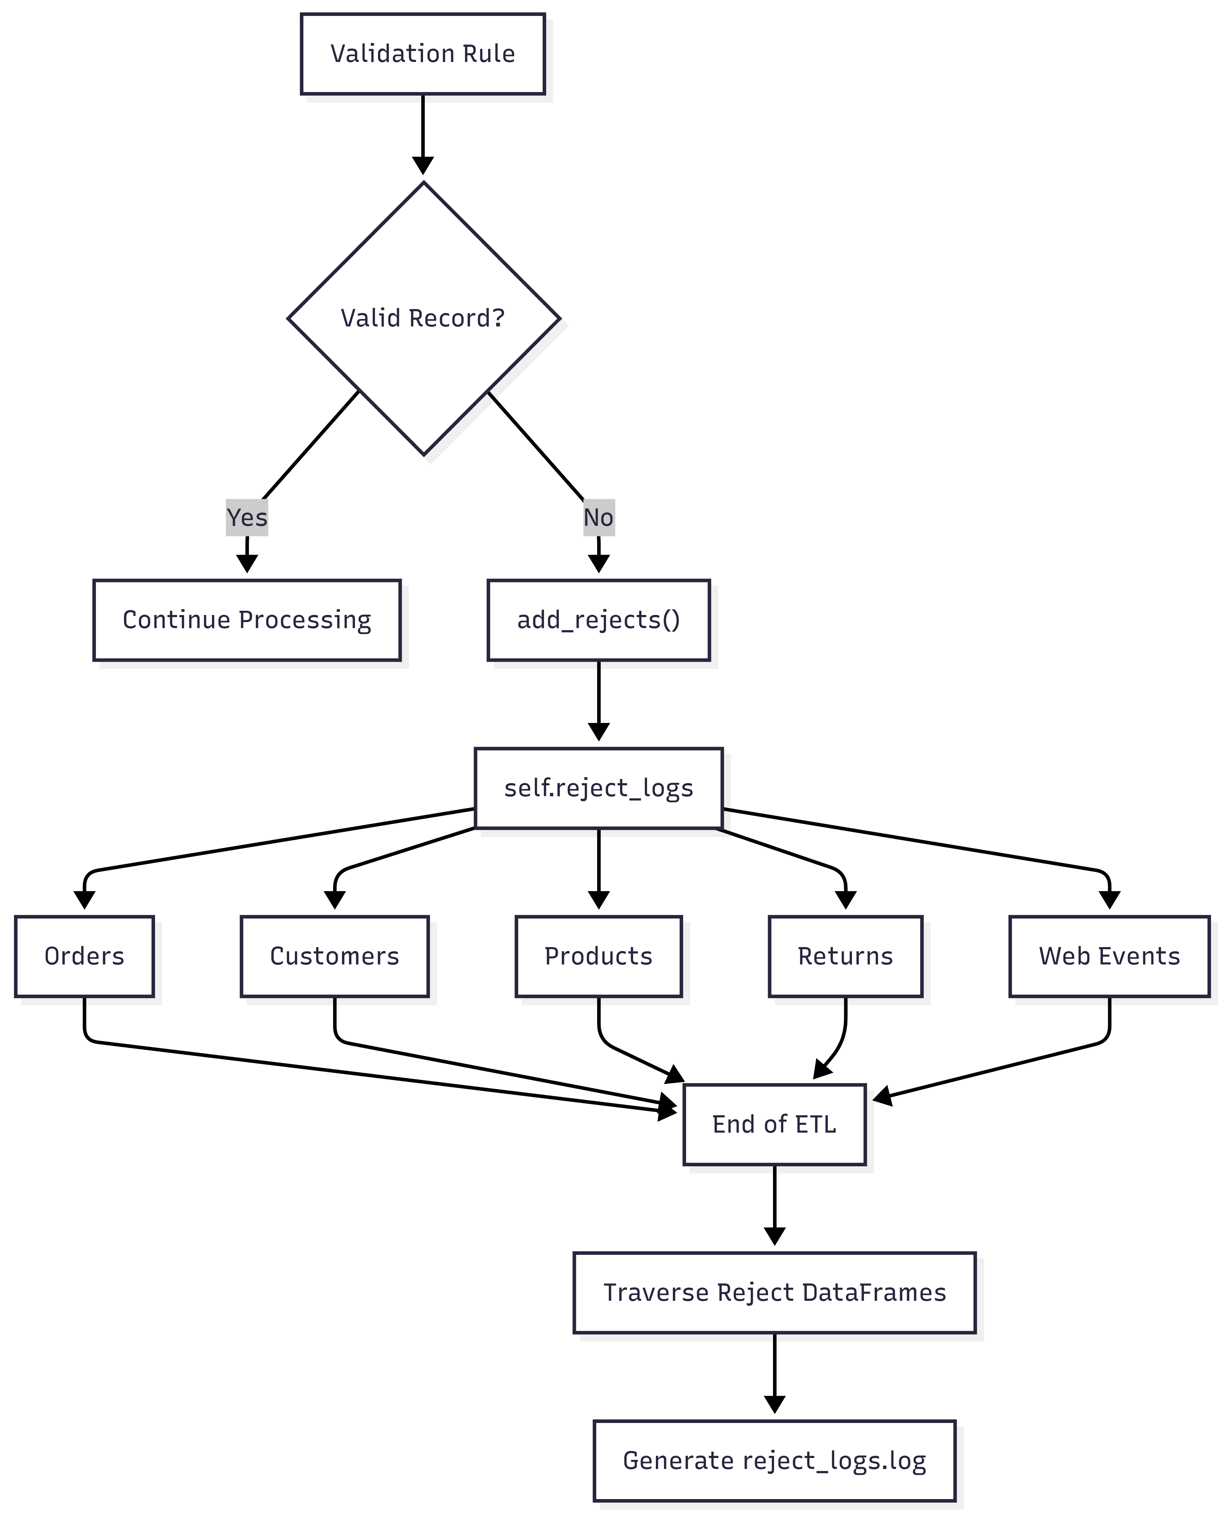
Reject Logging Mechanism
🛡 Non-Blocking Processing
• Invalid records are isolated without interrupting the ETL workflow.
• Valid records continue through subsequent transformation stages.
📂 Table-wise Reject Storage
• Rejected rows are stored in separate DataFrames for each source table.
• self.reject_logs maintains all rejected records throughout execution.
📝 Centralized Log Generation
• All reject DataFrames are traversed after ETL execution completes.
• A consolidated reject_logs.log file is generated for auditing.
📊 Audit & Traceability
• Each rejected record includes its table name, row number, and reject reason.
• Provides complete traceability for debugging and data quality analysis.
08

Slide 9
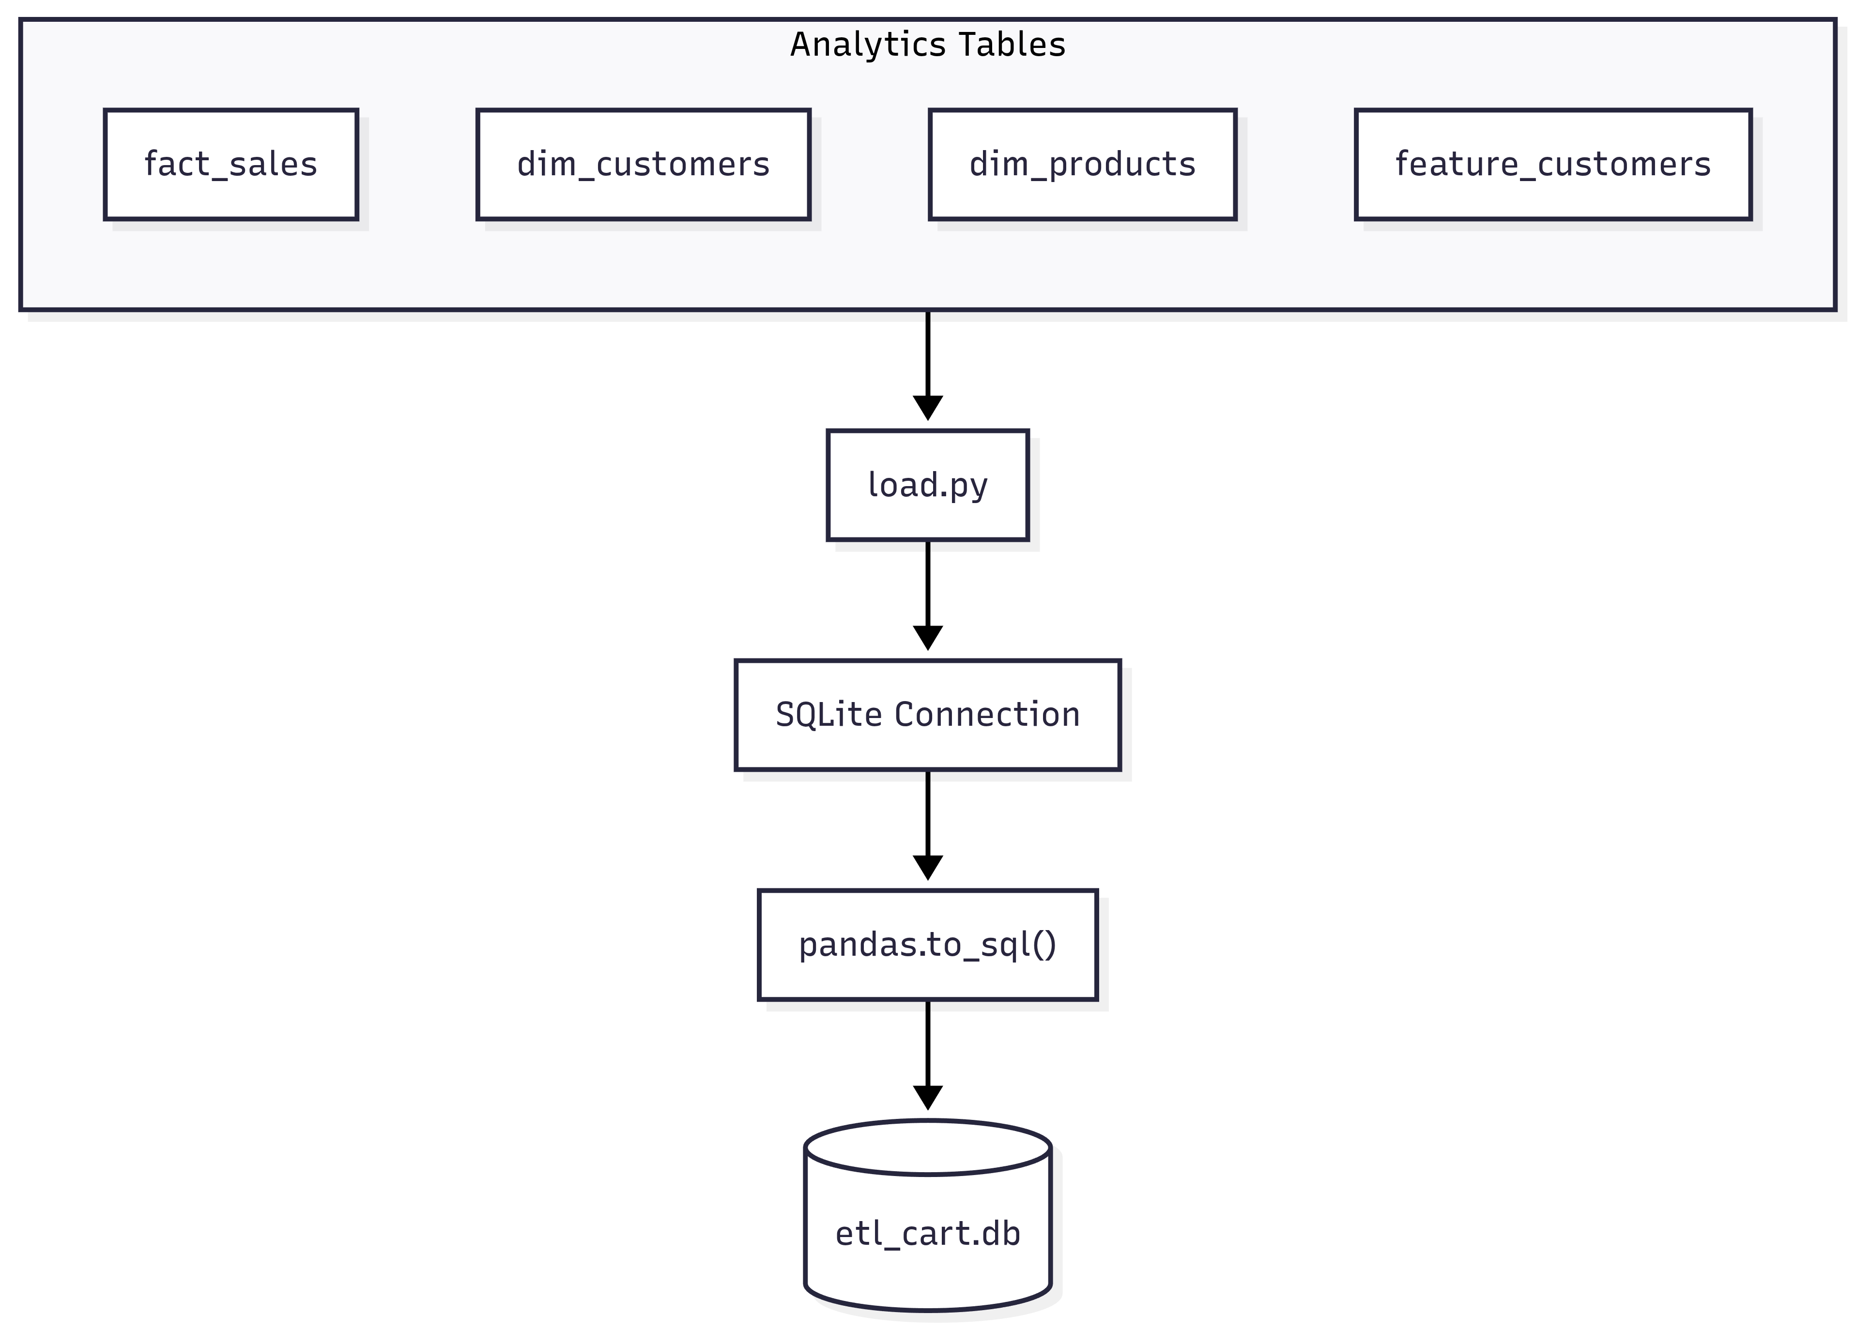
Loading Layer & Data Warehouse
💾 Data Loading
Loads analytics-ready DataFrames into SQLite.
Each table is written using pandas.to_sql().
🗄 Data Warehouse
Stores cleaned and transformed data in etl_cart.db.
Provides a centralized repository for analytics.
09

Slide 10
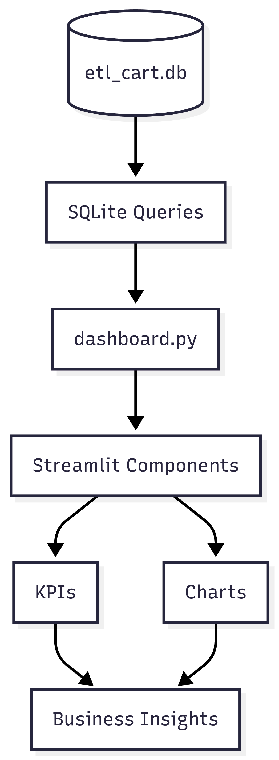
Dashboard Architecture
📊 Interactive Dashboard
Built using Streamlit for real-time analytics.
Provides an intuitive interface for business users.
🗄 Data Retrieval
Reads analytics tables directly from SQLite.
Executes SQL queries to compute KPIs.
📈 Visual Analytics
Displays interactive charts and KPI cards.
Enables quick exploration of sales performance.
🎯 Business Decision Support
Converts processed data into actionable insights.
Supports revenue, customer, and product analysis.
10

Slide 11
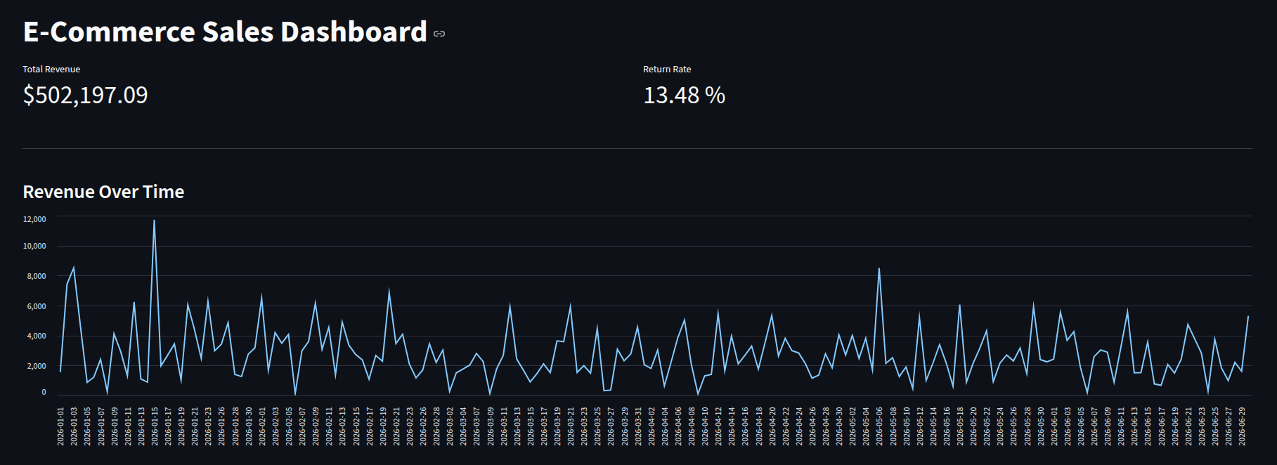
Dashboard Analytics
11

Slide 12
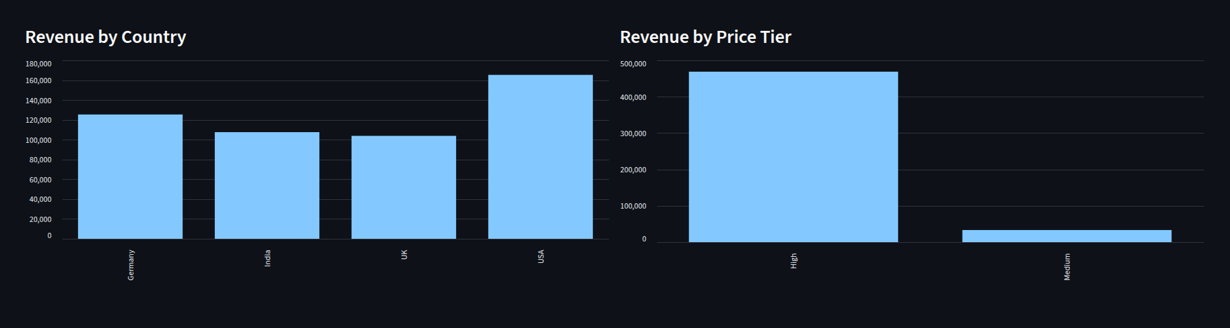
Dashboard Analytics
11

Slide 13
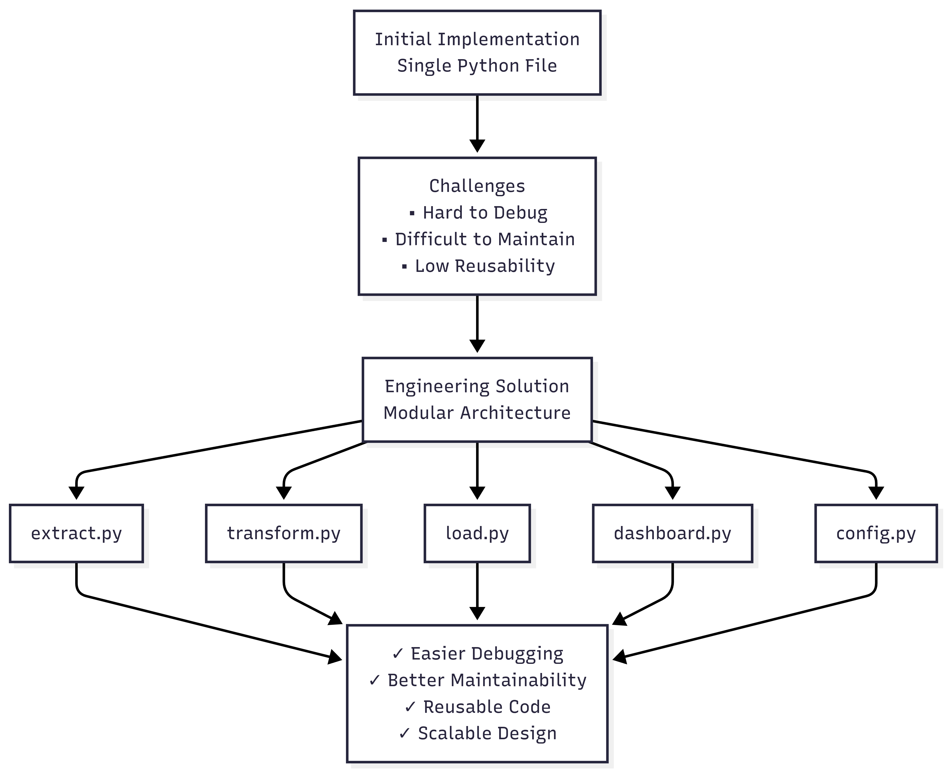
Challenges & Project Evolution
14

Slide 14

Thank You

