Slide 1
Fault Resilient & Optimized Localization using Naked Mole Rat Algorithm
Project Mentor: Dr. Veena Anand (Assistant Professor)
Project Members: Ajay Baghel (19115006)
Shubham Gupta (19115085)

Slide 2
OVERVIEW
OBJECTIVE
Apply a fairly new optimization algorithm to address a WSN localization problem and assigning appropriate coordinates to the unknown sensor nodes.
Localization in a 2D dynamic environment using a single anchor node (static) along with virtual anchors to locate target nodes (dynamic) using hexagonal projection technique,
Estimated location is optimized using NMRA
SIGNIFICANCE
Report data that is geographically meaningful
Routing relies on location info
Unrealistic to rely on placement/arrangement of sensors.
Notes:
Coverage and connectivy, topology management

Slide 3
INTRODUCTION

Slide 4
Introduction
Localization: A process to assign the location in terms of 2D and 3D coordinates to every node or a group of nodes in the sensor field
Localization methods consist of three main steps
Finding in-range anchor nodes
Distance calculation position computation
Location estimation
Sensors (nodes) are categorized into;
Anchor nodes (coordinates are known)
Target nodes

Slide 5
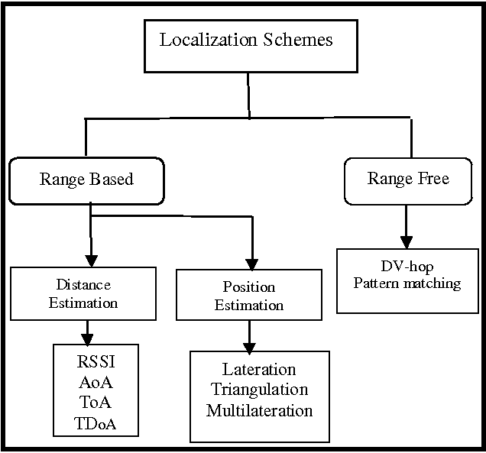
Localization Methods
Distance Estimation is the process of estimating the distance between two known objects.
Position Estimation is the process of estimating the coordinates of the object using previously estimated distance as well as mathematical approximation.
The estimated position is now optimized using various meta-heuristic algorithms such as NMRA.
Notes:
Look into range based and range free schemes

Slide 6
Literature Review
In previous studies:
Particle Swarm Optimization (PSO)-based Computational Intelligence (CI) algo for location determination of mobile nodes was presented to achieve minimum localization error.
Anchor nodes were deployed at the corners of sensing fields
Virtual anchor nodes are used to locate unknown nodes using centroid.
Distance was calculated using RSSI.
Optimization algo: PSO
Modification of previous Technique :
Single anchor node instead of multiple anchor nodes
Optimization algo: Naked Mole Rat Algorithm (NMRA)

Slide 7
Literature Review
Paper Title | Technique used | Conclusions | Drawbacks
Range-free 3D node localization in anisotropic wireless sensor networks | RFHPSO and RFBBO | Modelled edge weights by using fuzzy logic system to reduce computational complexity. And then these weights are optimized by using HPSO and BBO to reduce location error. | Range-free techniques are cost effective but are less accurate.
Range based wireless sensor node localization using PSO, HPSO, BBO, and FA | Proposed virtual anchor concept | HPSO was modelled for fast convergence. The proposed algorithm has been found to have better accuracy. | Longer Convergence time
3D localization of moving target nodes using single anchor mode in anisotropic WSN | Single anchor using PSO, HPSO, BBO, and FA in 3D environment | HPSO has faster convergence rate and having less localization error. | Energy parameters are not taken into consideration.
Optimized localization of target nodes using single mobile anchor node in WSN | PSO, HPSO, BBO, and FA in 2D environment | HPSO provide better results as compared with other metaheuristics. | Limited range, network can become dead because only one anchor node
An efficient localization approach for WSNs using hybrid DA-FA Algorithm | Hybrid DA-FA | Less localization error and faster convergence rate as compared with PSO, HPSO, BBO, FA and rate. | -
Notes:
drawbacks

Slide 8
Implementation Setup

Slide 9
Implementation Setup
The network is simulated using the following configurations
The field area is 15 x 15.
Initially anchor node is deployed at the center (7.5,7.5)
20 target nodes are deployed at random locations.
Random mobility is added to each target node.
Each sensor is given 10 units of energy initially.

Slide 10
Assumptions & Features
Following assumptions are considered for the implementation
For each movement, target nodes consume some amount of energy.
Similarly, anchor nodes consume energy for localizing target nodes.
Complete field is in range of anchor node.
Features
Locate nodes for each movements
Fault tolerant

Slide 11
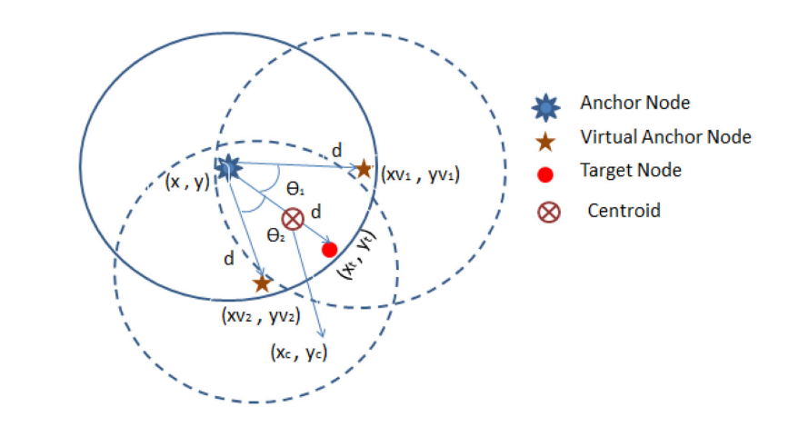
Localization Algorithm
Following steps are considered for the implementation
Distance between target nodes and anchor node in calculated.
Deploy 6 virtual anchor nodes at the same distance out of which 2 are selected at the minimum distance to the target node.
Calculate the centroid with the single anchor node as well as the two virtual anchor nodes, which is assumed to be the initial guess.

Slide 12
NMRA Optimization Algorithm
The algorithm consists of 3 phases:
Initialization: 30 mole rats are deployed randomly within a unit range from the centroid.
Worker’s Phase: Each worker will update it’s fitness to become a breeder.
Breeder’s Phase: Breeder’s will update it’s fitness to stay in the breeder’s category.
Best breeder after 60 epochs is the best solution.
Notes:
NMRA

Slide 13
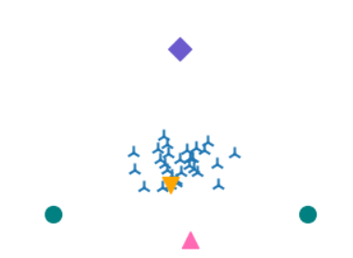
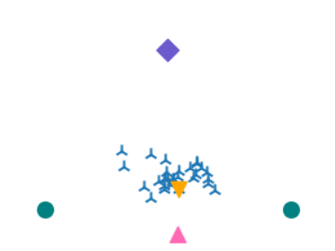
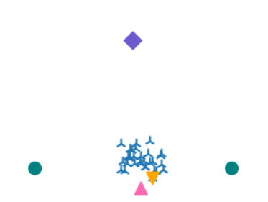

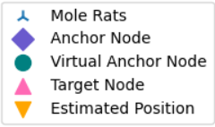
Optimization Algorithm
Epoch 1
Epoch 10
Epoch 20
Epoch 40

Slide 14
Novelty
The main drawback with the base paper is that, they did not take energy into consideration.
Consider the case when anchor node runs out of energy or gets damaged due to environmental factors, the network will not be able to localize itself.
To rectify this we associated each sensors with energy, and set a threshold.
A Node is considered dead if it’s energy is less than the threshold
After the anchor is dead, Bully Algorithm is used to elect new anchor node
Notes:
NMRA

Slide 15
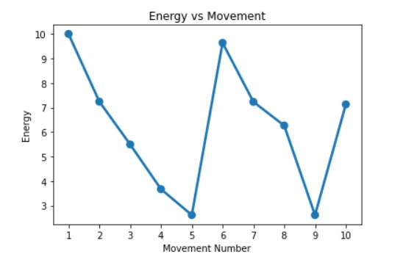
Novelty
New Anchor node selected
Anchor node dies
Notes:
NMRA

Slide 16
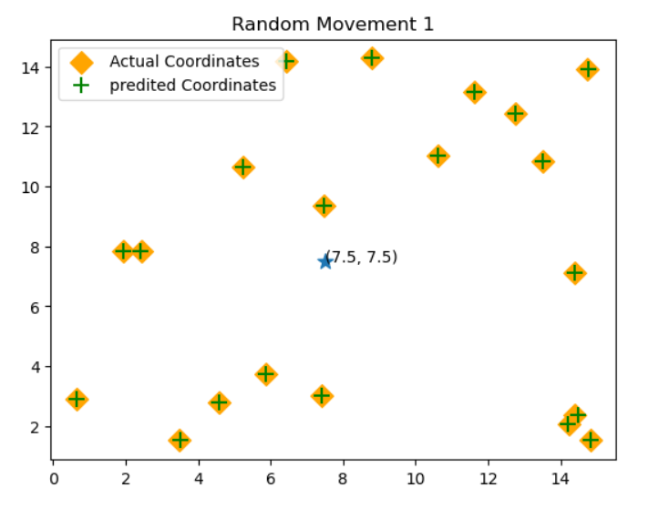
First Movement
Energy consumption is increased for demonstration purposes.
Energy of anchor node >= 2

Slide 17
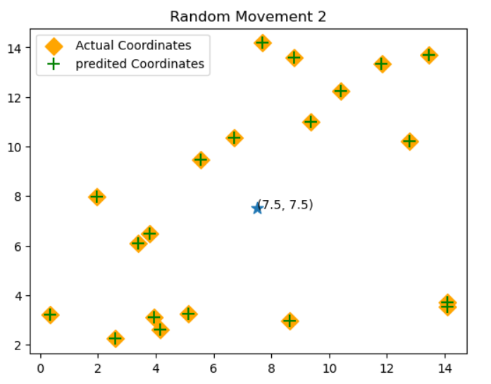
Second Movement
Energy of anchor node >= 2

Slide 18
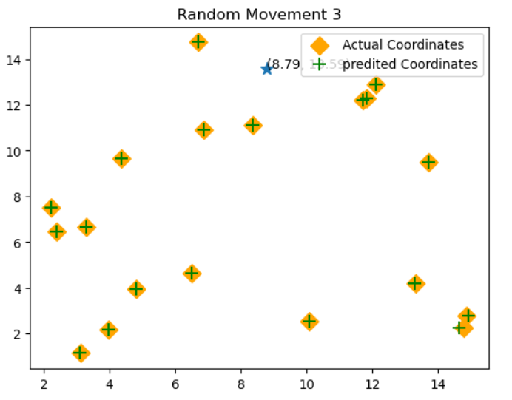
Third Movement
Energy of previous anchor node < 2
One target node with maximum energy is elected as new anchor

Slide 19
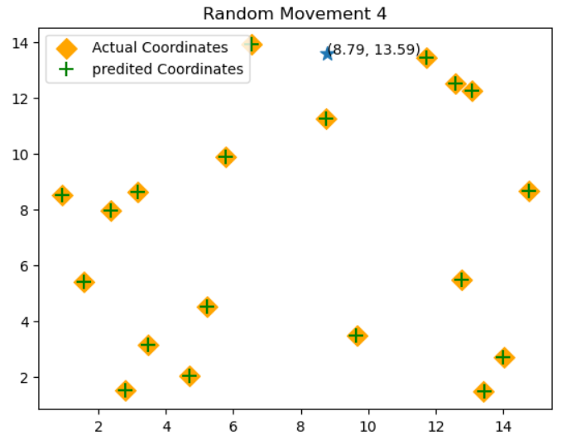
Fourth Movement
One target node with maximum energy is elected as new anchor

Slide 20
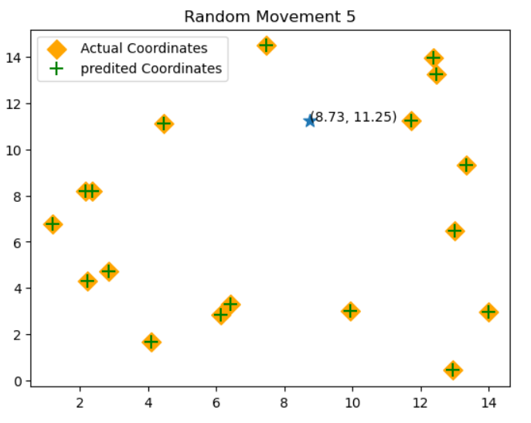
Fifth Movement

Slide 21
Results & Analysis

Slide 22
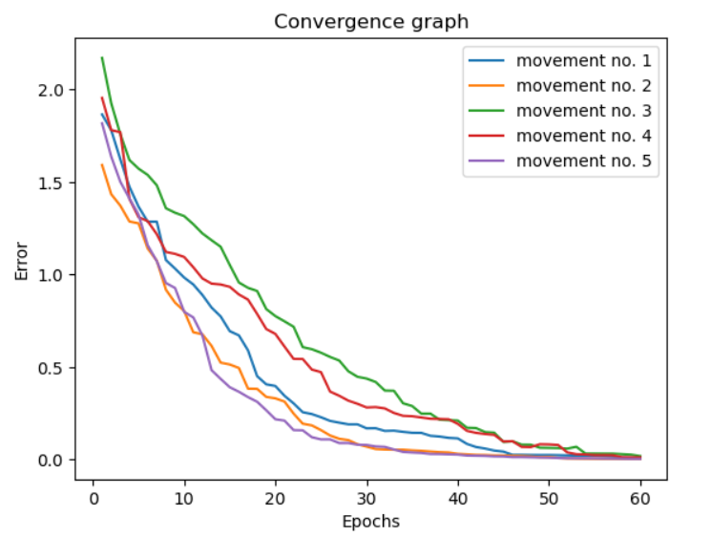
Error Convergence
Average error for all nodes with increasing epochs.

Slide 23
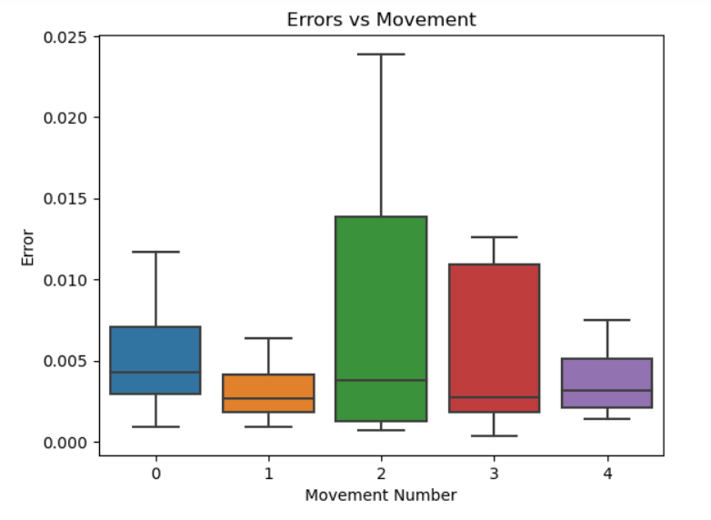
Error vs Movement
Minimum, maximum and median error for each movement.

Slide 24
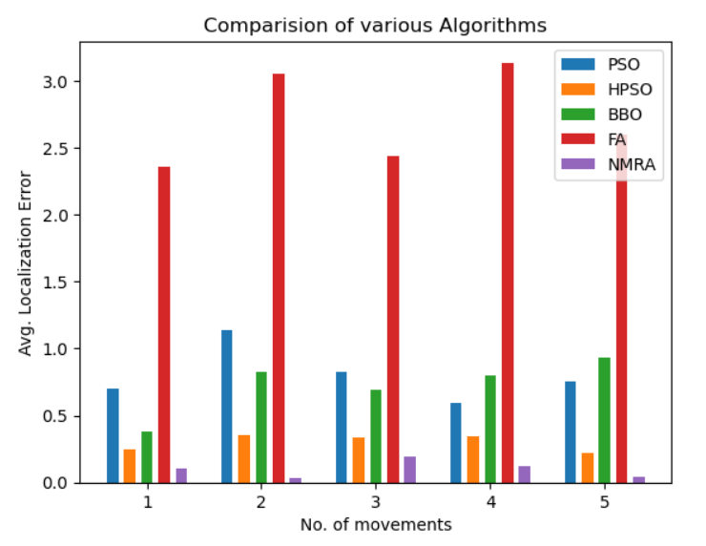
Comparison with other algorithms
Average error comparison with other meta-heuristic algorithms.
Particle Swarm Optimisation
Hybrid PSO
Biogeography-based Optimization
Firefly Algorithm

Slide 25
Convergence Rate
Algorithm | Convergence Rate
Particle Swarm Optimization(PSO) | 0.2832s
HPSO | 0.2176s
BBO | 0.7884s
FA | 0.9219s
NMRA (Base Paper) | 0.1834s
NMRA (Our Implementation) | 0.1334s

Slide 26
Conclusion
The NMRA algorithm has a better convergence rate and gives lower error compared to other existing algorithm.
In addition, we added fault tolerance to the network which increased it’s life expectancy.

Slide 27
Thank you

