Slide 1

Calorie Tracker
Guided by,
Ms.Jeevitha senior assistant professor
NHCE
Student name : B.Ajay
Semester / Sec : 4-A
USN : 1NH20CS039

Slide 2
Contents
Introduction
Problem Statement
Objectives
Algorithm
Technology Used

Slide 3

Introduction
Calorie Tracker is a mini project that allows the user to make the process of calculating calories as easy as possible.
It comes with many features such as workout companion,weight gain/loss companion,calories burnt calculator and BMI calculator.
This project is an all round health application which is designed to provide the user with timed workout sessions and provide diet and workout plans.
This mini project has been designed via JAVA.

Slide 4
Problem Statement
Keeping track of calories manually when a person is trying to gain or lose weight is a tedious and time consuming process. This project is designed to make tracking calories as easy as possible. It also includes a workout companion with built in timer which helps in organising a workout session. It also provides suggestions to the user which they need to follow during a weight loss/gain journey such as customised workout and diet plans along which it also helps in keeping tabs with amount of calories burnt after physical activity and a BMI calculator.

Slide 5
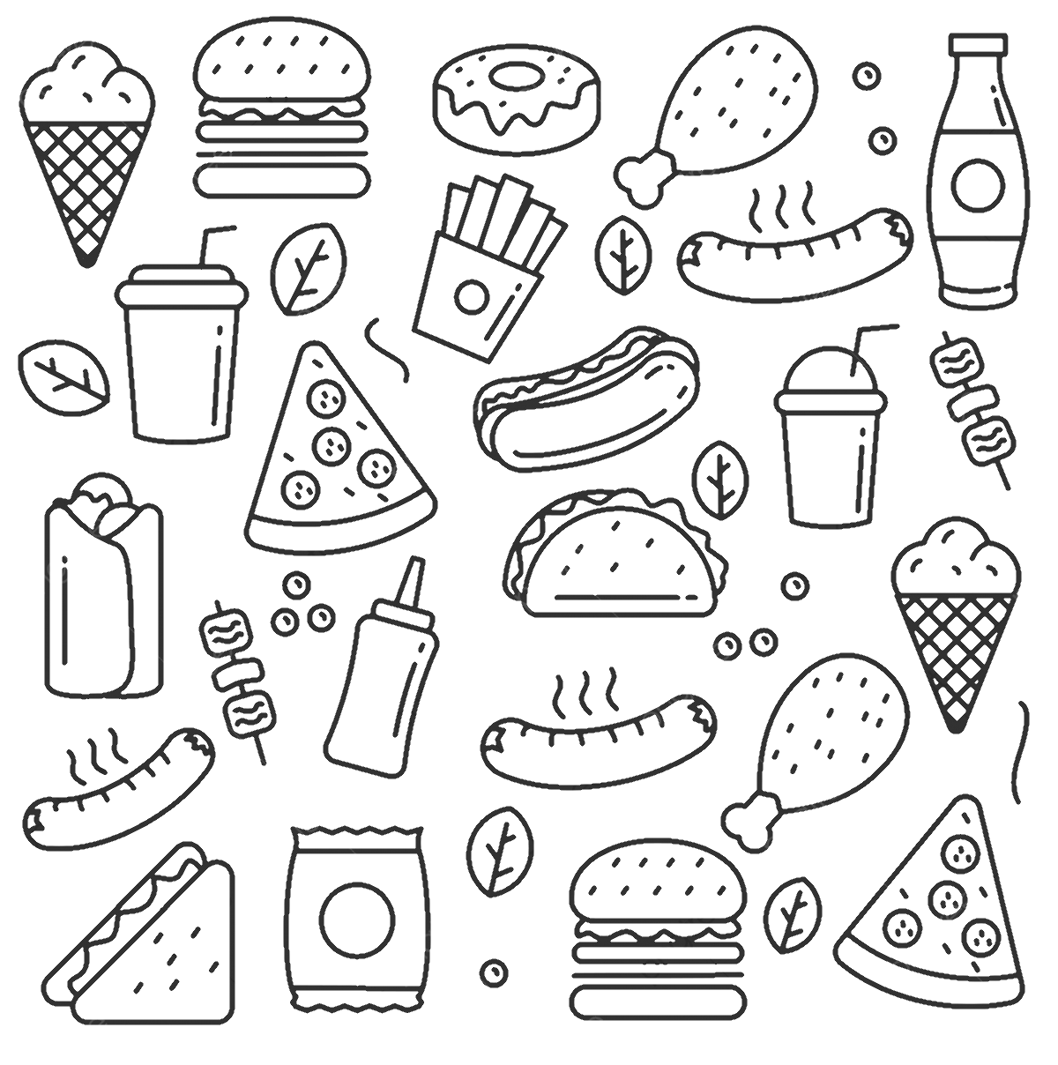
Objectives
The objectives of this project are :
To make calorie tacking an easy task.
To give the user tips to follow during weight loss/gain.
To organise customised workout sessions.
To Provide customised workout and diet plans.
To help in calculating BMI(Body Mass Index).

Slide 6
Algorithm
Step 1 : Start
Step 2 : Ask user which feature of the program they want to use .
Step 3 : run the timer for each exercise throughout the workout session and then display the amount of calories burnt during the session.
Step 4 : ask the necessary details from the user and calculate and display if their calorie goal has been reached or not.

Slide 7
Step 5 : Ask the necessary details from the user and then calculate and display the number of calories that the user requires to put or cut weight.
Step 6 : Ask the necessary details from the user and then calculate and display the BMI of the user along with diet and workout plan suggestions
Step 7 : Ask the necessary details from the user and then display the total amount of calories he/she have burnt after the physical activities.
Step 8 : End

Slide 8
Technology Used
Hardware requirements –
i)Processor – Intel core i3
ii) RAM – 3GB or more
Software requirements –
i)IDE Eclipse
ii) Operating system- Windows

Slide 9
Thank You

