Slide 1


Project Screening Presentation on “Stock Market Analysis”
Students:
Ajay Deshpande (1RN16CS005)
Dhanush C (1RN16CS021)
Guide:
Prof. Devaraju B
Asst. Prof. Dept. of CSE, RNSIT
Department of Computer Science and Engineering
RNS Institute of Technology
2019-20

Slide 2
CONTENTS
INTRODUCTION
REQUIREMENTS
SYSTEM ARCHITECTURE/BLOCK DIAGRAM
INNOVATIVENESS & USEFULNESS
IMPLEMENTATION
CONCLUSION

Slide 3

PECTEN LABS
Pecten is a Fintech Start-up that has created a suite of products and services that leverages vast amounts data and effectively recalibrates and using proprietary modes based on Artificial Intelligence and Machine Learning.
Pecten provides an AI driven dynamic investment approach to achieve wealth growth and long-term value creation.

Slide 4
INTRODUCTION
Web is the major source of information.
To collect information from web we use Web Scraping.
Collecting this information is labour-intensive if done manually. Hence we need automation tools for this purpose.

Slide 5
INTRODUCTION
Selenium is a fully fledged automation which can be used for testing, web scraping, browser automation. It can be integrated with python and used to interact with a website in a browser.
We collect stock-data and use pandas to pre-process the data and store it on sqlite database.
The collected data can be visualized using Chart.js and predictions can be made for buying and selling stocks.

Slide 6
PROBLEM STATEMENT
To automate the process of stock data collection from web, pre-process it, show visualization of variance of data and make predictions using machine learning.

Slide 7
PROPOSED SYSTEM
Collect data from website using selenium with python.
Pre-process data as per requirement using pandas and regex.
Store pre-processed data in sqlite database.
Visualize data using Chart.js
Predict the trend using machine learning.

Slide 8
OBJECTIVE
To predict trend of stocks using machine learning.
To automate the collection of data required for prediction.

Slide 9
REQUIREMENTS
Functional Requirements
Selenium software
Chromedriver software
Chart.js
sqlite3

Slide 10
REQUIREMENTS
Non - Functional Requirements -
Reliability
Accuracy
Adaptability
Usability

Slide 11
REQUIREMENTS
Hardware Requirements -
RAM: 8GB or More
Processor: Intel Core i5 or higher
Processor Speed: 1.8 GHz or higher
Standard Monitor or display unit
Chrome Browser v77 or more

Slide 12
REQUIREMENTS
Software Requirements -
Operating System: Ubuntu 18.04 LTS
Web Browser: Google Chrome Version 77.0
Jupyter Notebook Version 6.0
Python 3.6.8
Libraries:
Pandas 0.25.1
Scikit-learn 0.21.3
Selenium 3.141.0

Slide 13
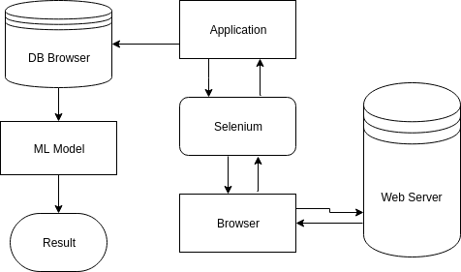
SYSTEM ARCHITECTURE / BLOCK DIAGRAM
System Architecture
DataBase
Flask Server
Visualization

Slide 14
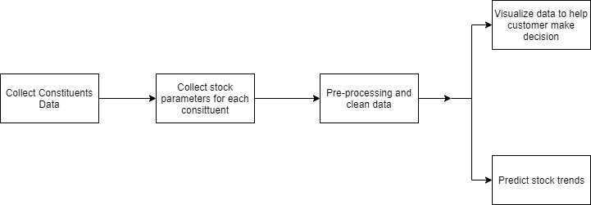
SYSTEM ARCHITECTURE / BLOCK DIAGRAM
Flow Diagram

Slide 15
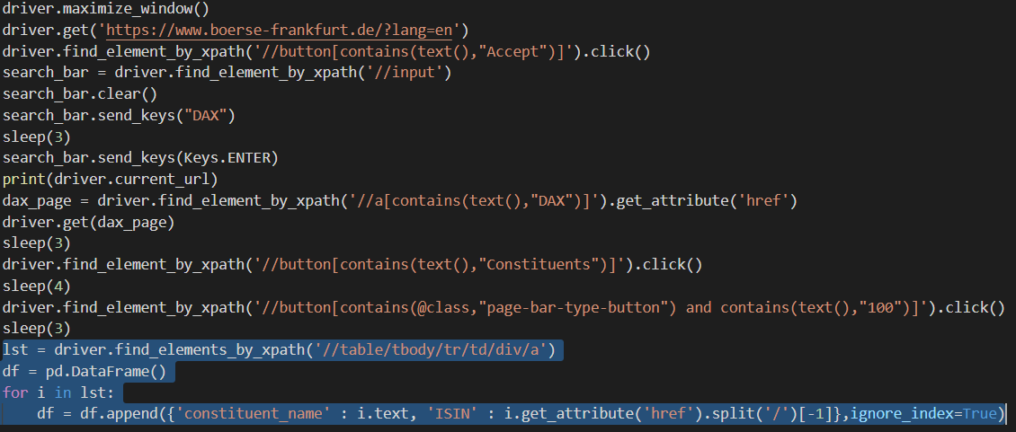
IMPLEMENTATION
Collect constituent data using get_constituents() function

Slide 16
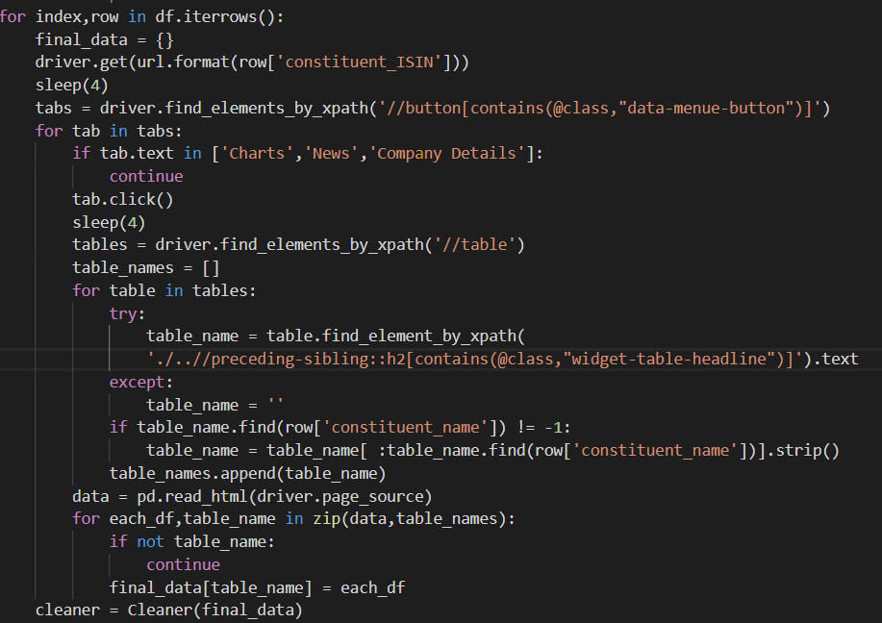
IMPLEMENTATION
Collect stock parameters of each constituent using collect() function

Slide 17
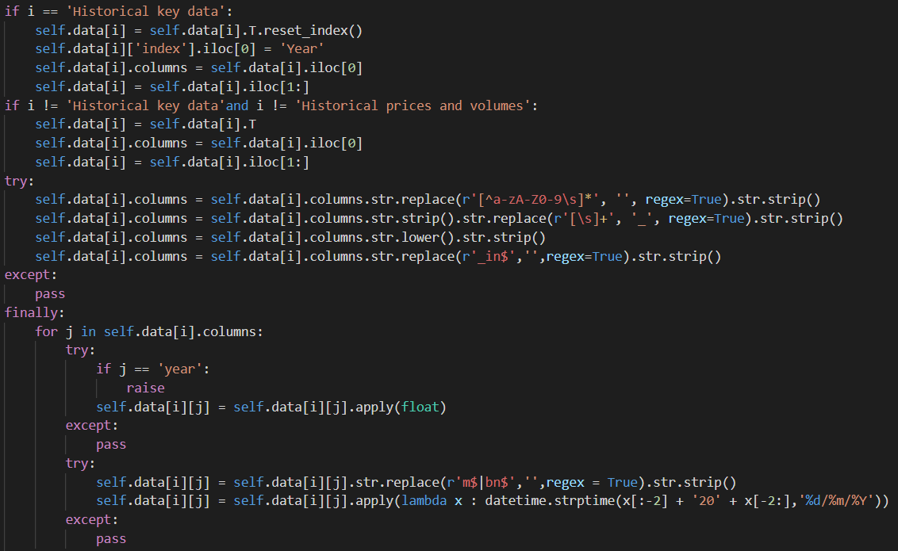
IMPLEMENTATION
Cleans the tabular data using cleaner class’ clean() function

Slide 18
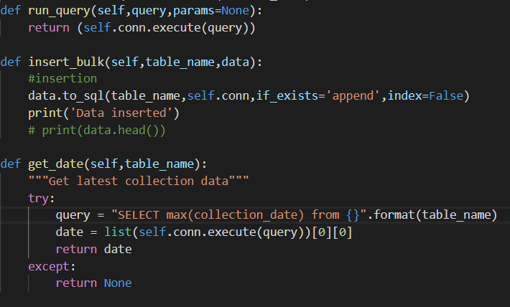
IMPLEMENTATION
Storage utility class with above function

Slide 19
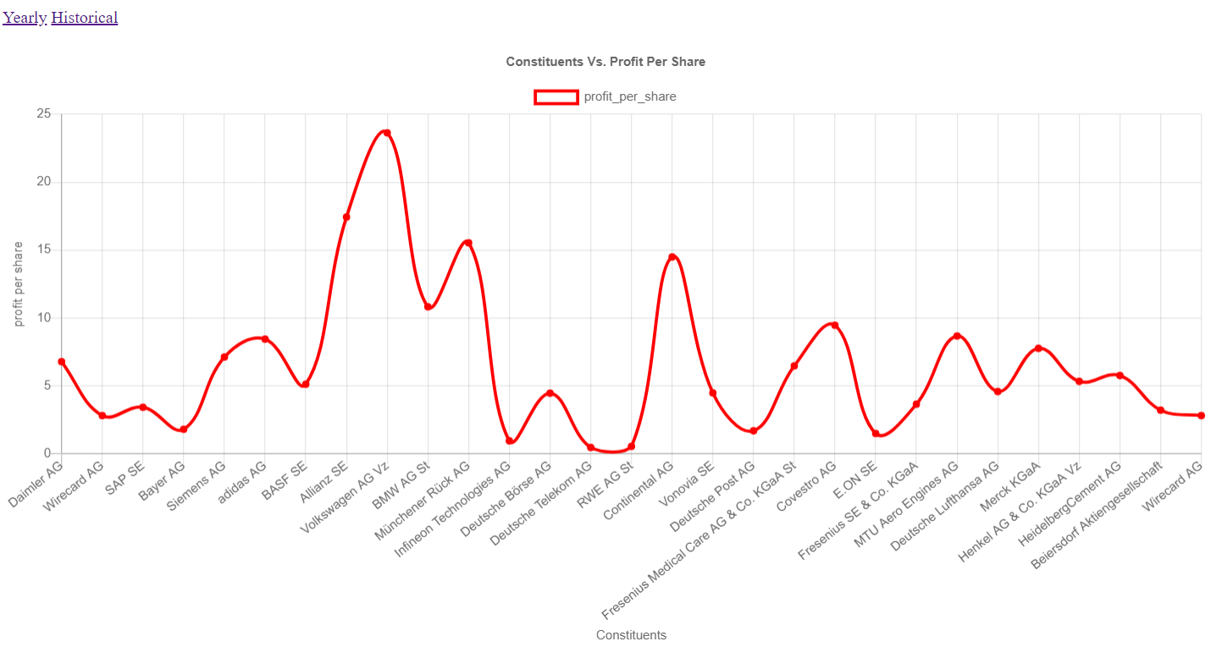
VISUALIZATION

Slide 20
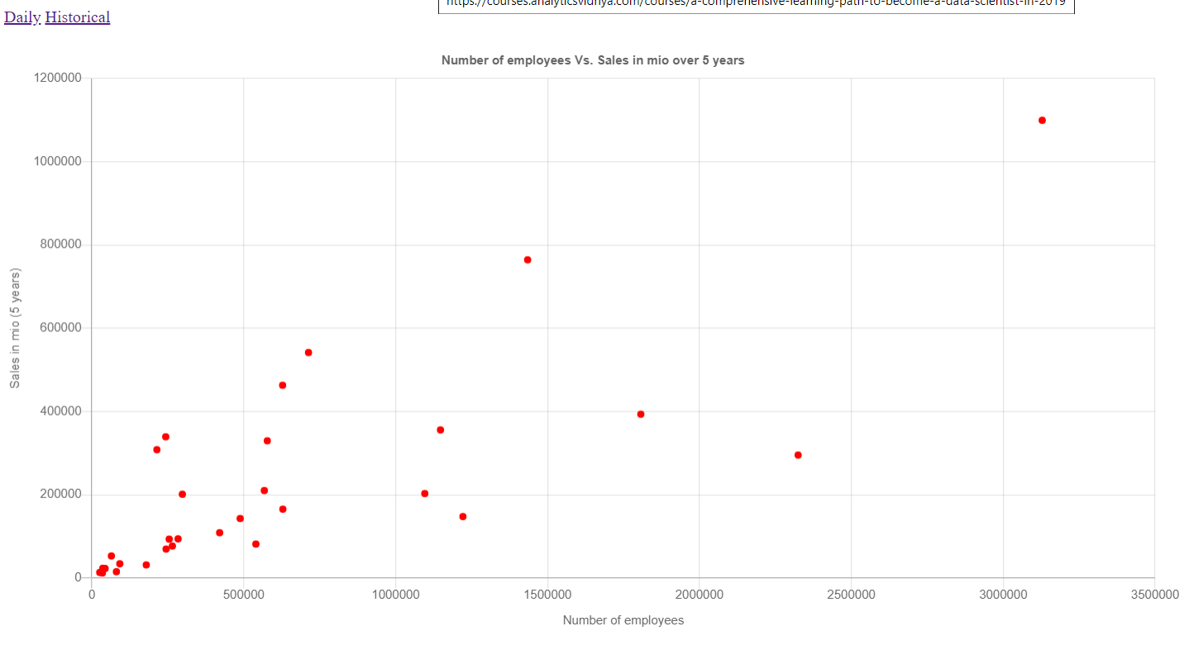
VISUALIZATION

Slide 21
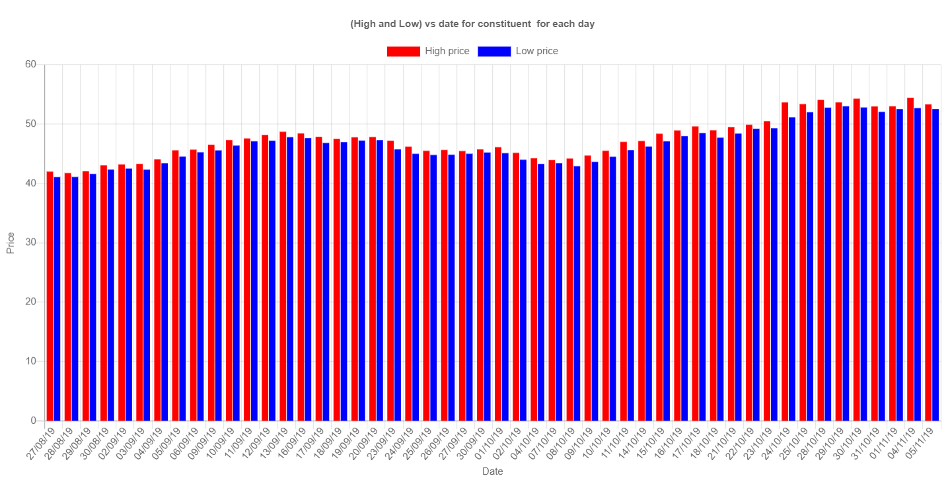
VISUALIZATION

Slide 22
CONCLUSION
The application is useful for a user to make a decision whether to sell, buy or hold on to a stock.
The application now has to be run manually every week. An automated software like jenkins or airflow can be used to run this weekly automatically.
We can use online storage like GCP or AWS to handle large incoming traffic.
The model used to predict can be improved to provide better accuracy.

Slide 23
SUGGESTIONS….!

Slide 24
THANK YOU!!!

