Slide 1
Online Shopping

Slide 2
Objective
To develop a small and resource efficient E-Commerce Web Application, that will act as a platform for several individuals and companies to sell their product.

Slide 3
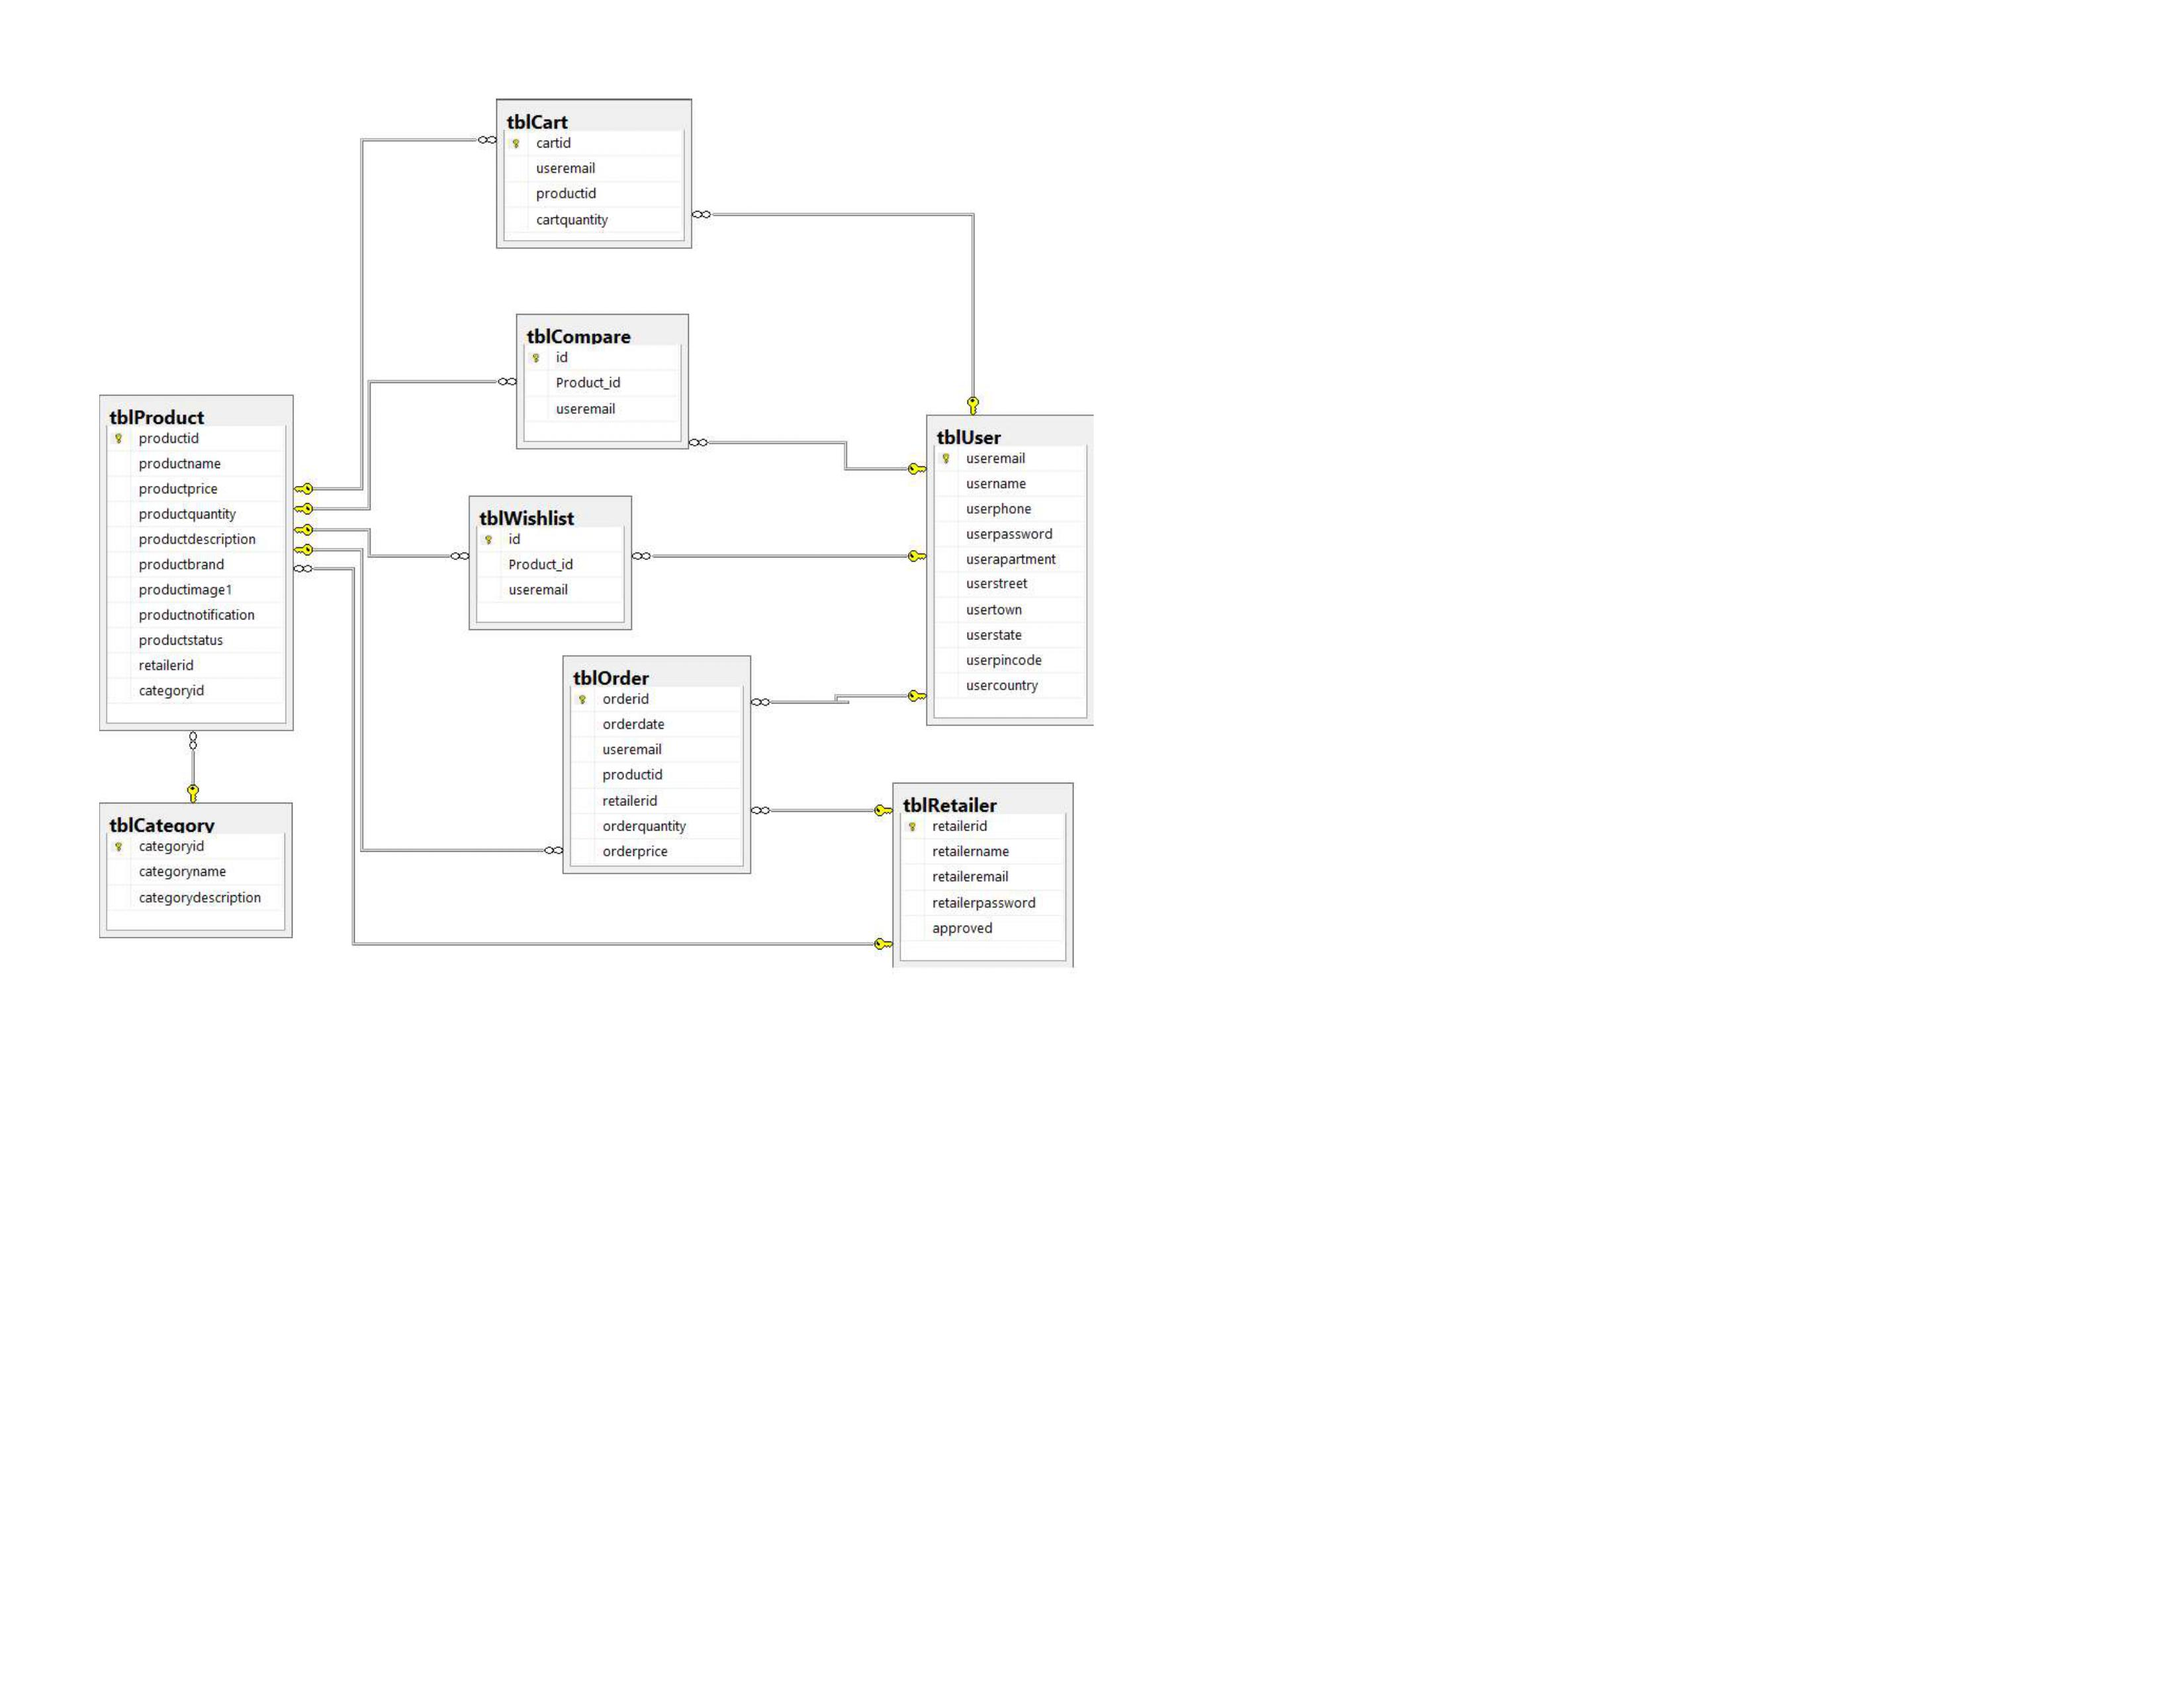
Database Diagram

Slide 4
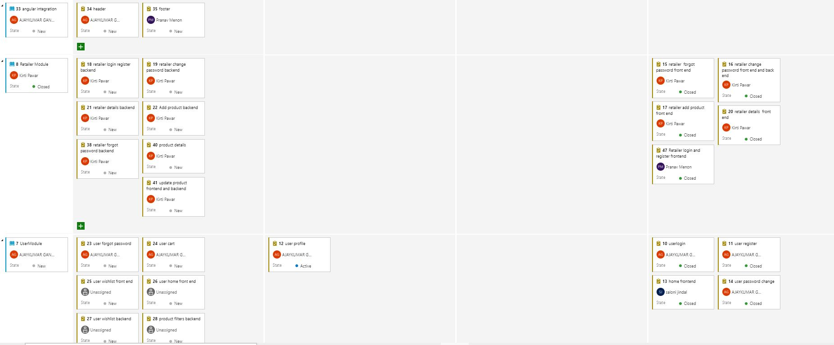
SCRUM BOARD DAY 1

Slide 5
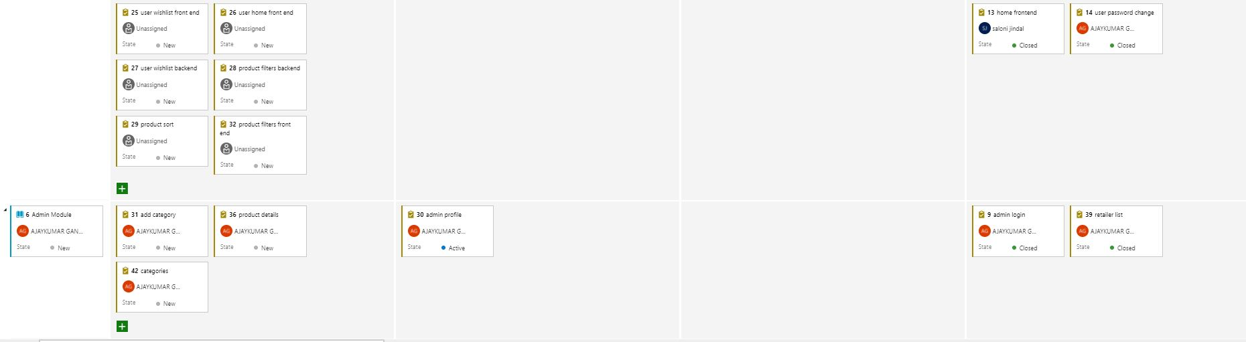
SCRUM BOARD DAY 1

Slide 6
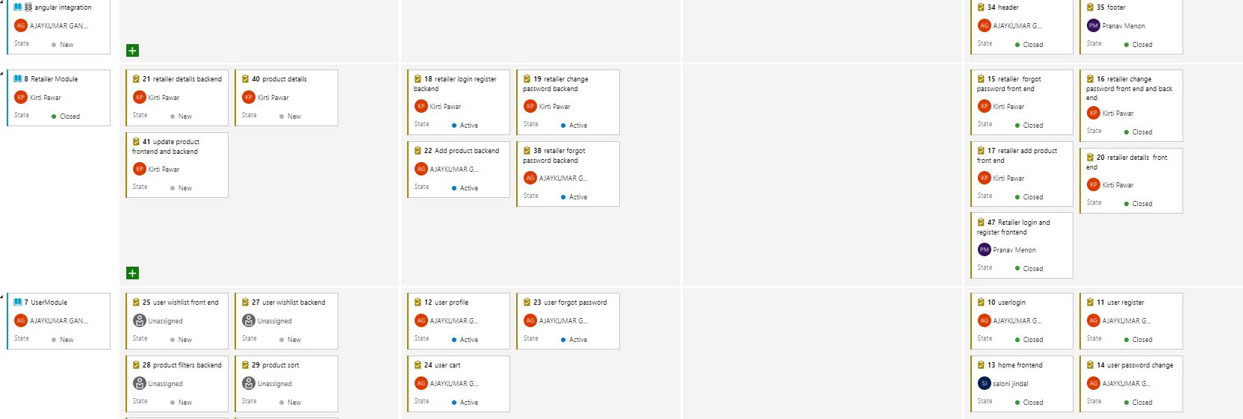
SCRUM BOARD DAY 2

Slide 7
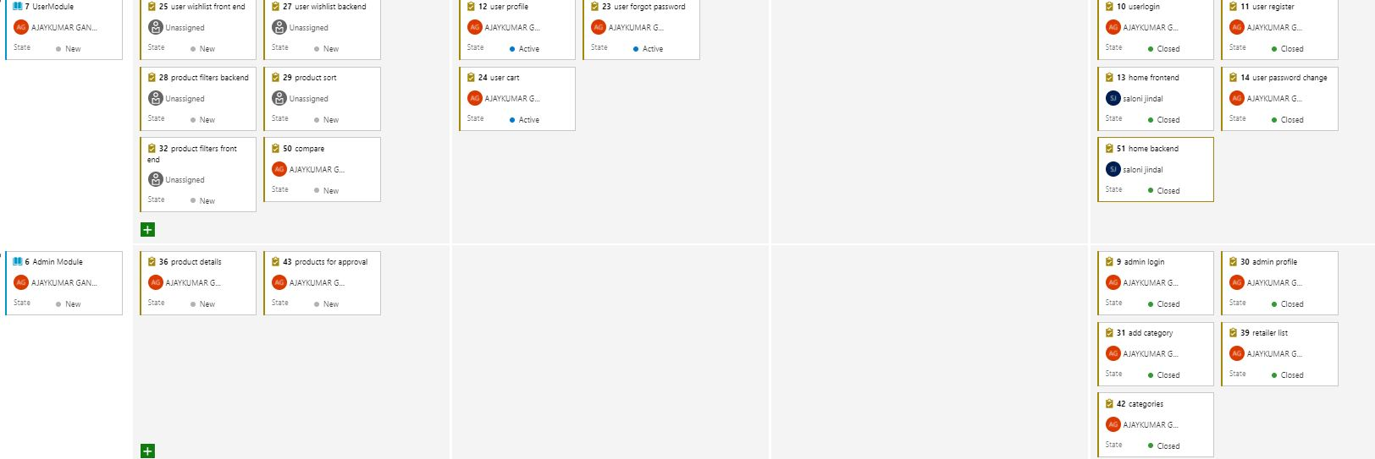
SCRUM BOARD DAY 2

Slide 8
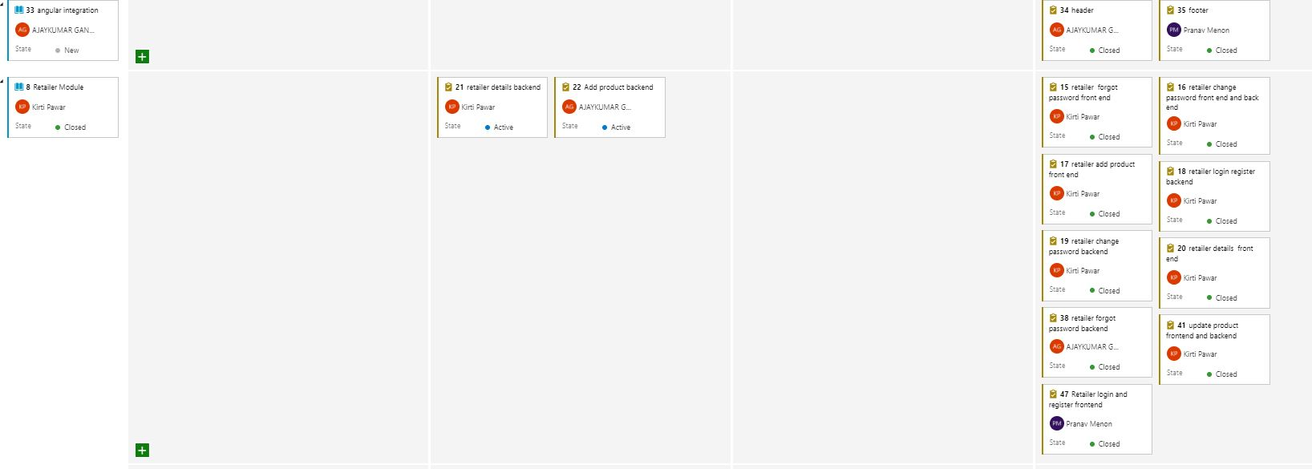
SCRUM BOARD DAY 3

Slide 9
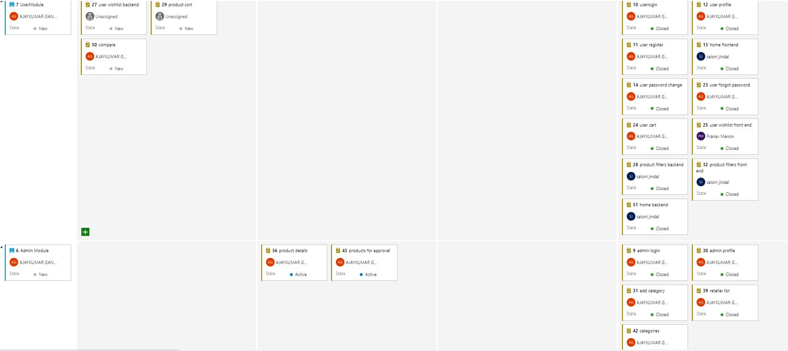
SCRUM BOARD DAY 3

Slide 10
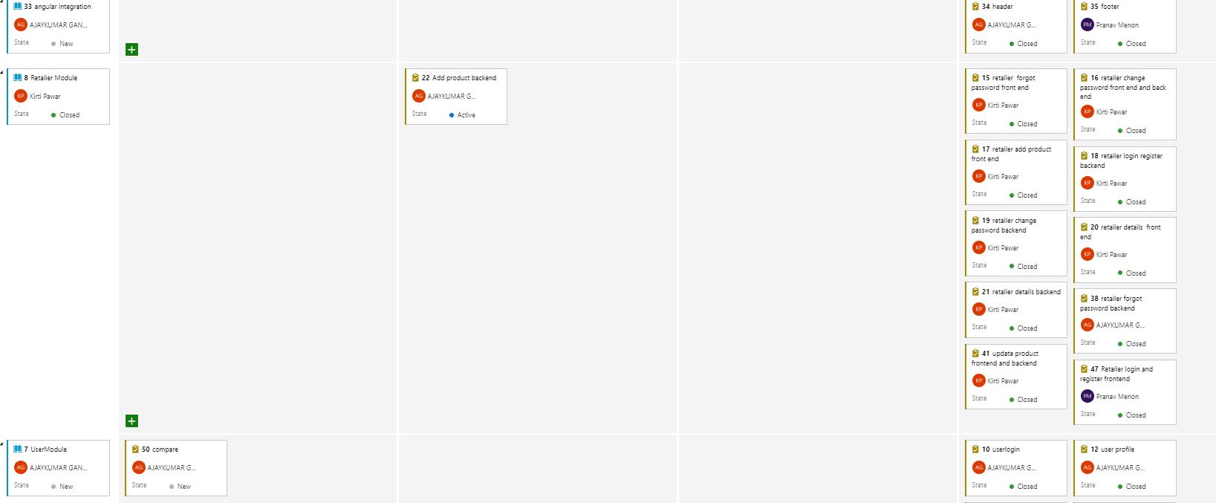
SCRUM BOARD DAY 4

Slide 11
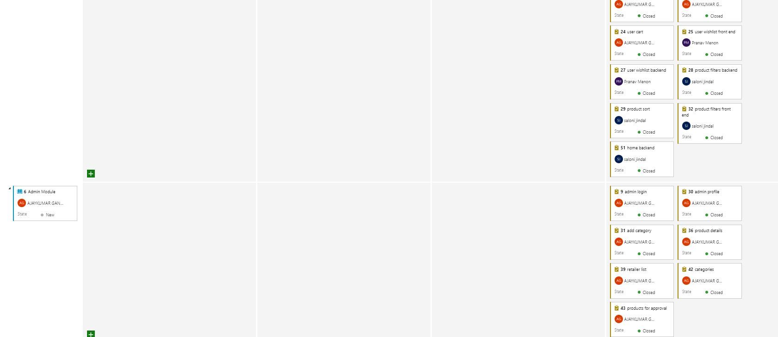
SCRUM BOARD DAY 4

Slide 12
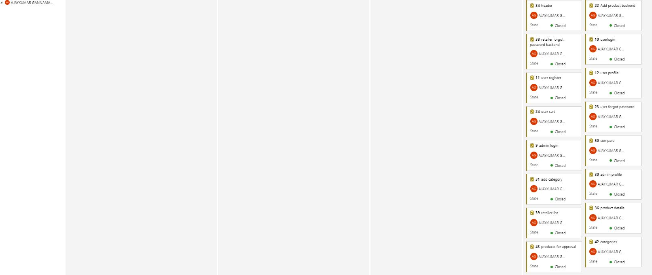
FINAL SCRUM

Slide 13
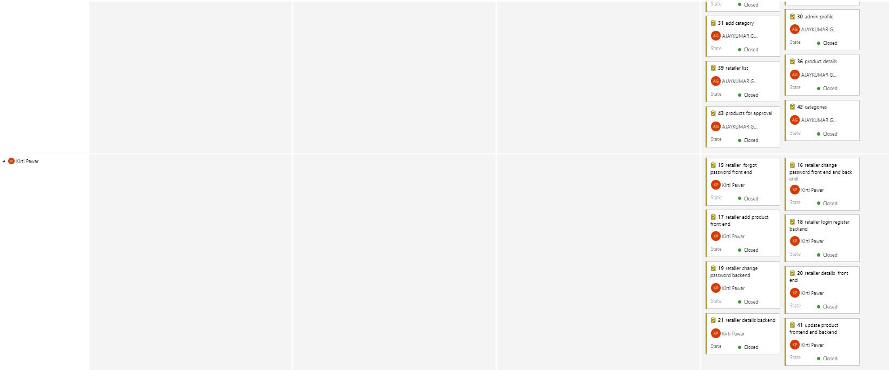
FINAL SCRUM

Slide 14
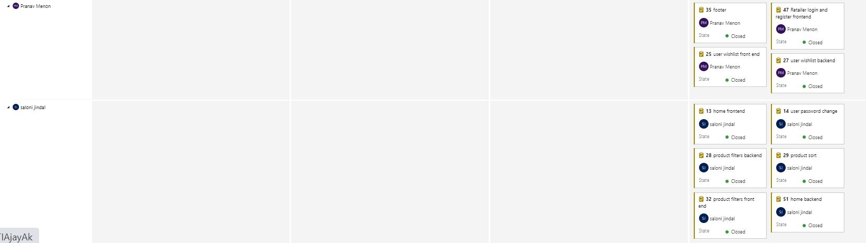
FINAL SCRUM

Slide 15
Issues
SMTP Exception while sending an email
Transferring image as file
Loading image from Visual Studio
CORS policy errors
Importing various modules in Visual Studio Code
Mapping Error

Slide 16
Learnings
We learnt to implement the project with database first approach.
We learnt to integrate the frontend and backend with the API.
With the implementation of this project, we understood the working and implementation of a basic E-Commerce application.

Slide 17
THANK YOU

