Slide 1

Google Trends Market Intelligence & Forecasting using Python -Internship Project Submission
Prepared by: Ajay Gautham C
Organization: AENEXZ TECH PVT LTD

Slide 2
Table of contents
01
02
03
04
05
06
Introduction
Project Objectives
Methodology & Data Collection
Data Analysis & Visualization
Regional Analysis & Forecasting
Conclusion & Future Work

Slide 3

Introduction
Google processes billions of searches daily, generating valuable data about user interests and market demand.
Analysing search trends helps understand:
Technology adoption trends
Market demand changes
Emerging topics
Consumer interest patterns
Google Trends provides a platform to analyse this search behaviour.

Slide 4

Project Motivation
Problem Statement
Businesses and analysts often struggle to identify:
Which technologies are gaining popularity
Regional interest in different technologies
Future demand trends
Without proper analysis, organizations cannot make informed strategic decisions.

Slide 5

Objectives
Project Scope
The objectives of this project are:
Analyze Google search trends using Python
Compare search interest for multiple technologies
Identify regional demand patterns
Discover related trending queries
Forecast future search trends using time-series forecasting

Slide 6
Technologies Used
Programming Language:
Python
Libraries Used:
Pandas
Pytrends
Matplotlib
Seaborn
Prophet
Tools Used:
Jupyter Notebook
GitHub
PowerPoint

Slide 7
Workflow
Data Collection using Pytrends API
Data Cleaning and Preprocessing
Exploratory Data Analysis (EDA)
Data Visualization
Regional Interest Analysis
Related Queries Extraction
Forecasting using Prophet Model
Insight Generation

Slide 8

Data Collection
Data was collected using the Pytrends API, which provides access to Google Trends data.
Keywords analyzed:
Artificial Intelligence
Data Science
Machine Learning
Cloud Computing
Cybersecurity
Timeframe analyzed:
Last 5 years of search trends

Slide 9
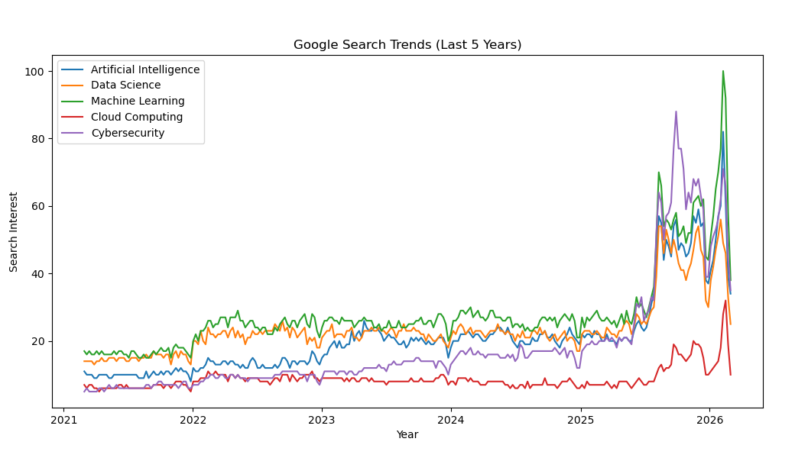
Trend Analysis Visualization
The visualization compares search interest trends for different technologies over time.
Key observation:
Artificial Intelligence and Machine Learning show strong growth trends.

Slide 10
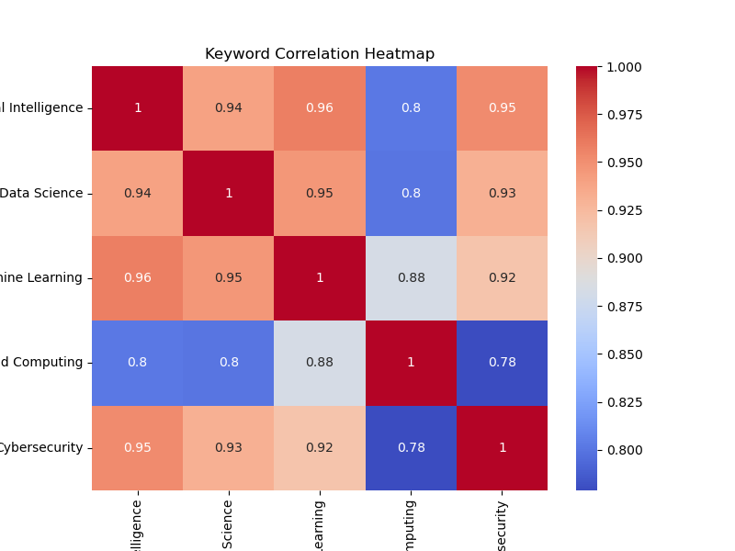
Correlation Analysis
The correlation heatmap shows relationships between search trends.
Example insight:
Machine Learning and Artificial Intelligence show strong correlation, indicating related growth patterns.

Slide 11
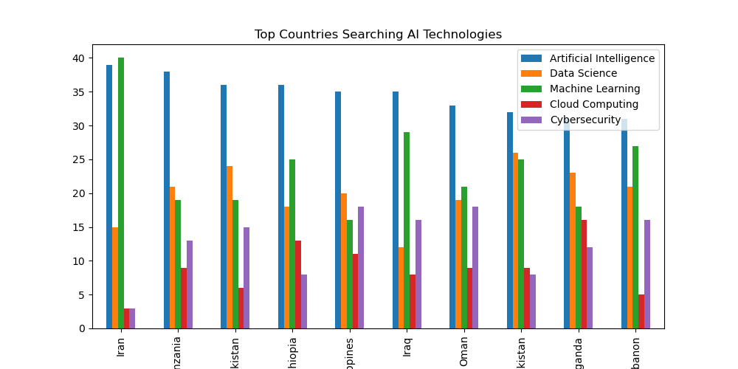
Regional Analysis
Regional analysis identifies which countries show the highest interest in emerging technologies.
This information can help companies target markets effectively

Slide 12
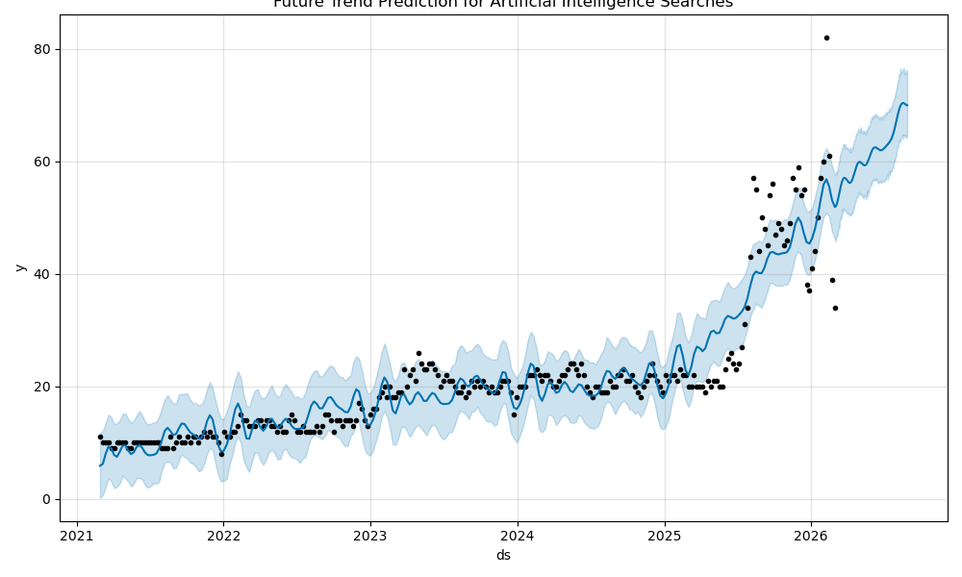
Future Trend Prediction
The Prophet forecasting model predicts future search interest.
Prediction period:
Next 180 days (6 months)
This helps understand future demand trends.

Slide 13

Key Insights
Important insights from the project:
Artificial Intelligence search demand has grown significantly in recent years
Machine Learning trends closely follow AI growth
Cloud Computing remains consistently popular
Cybersecurity interest increases during major cyber incidents
Technology searches show strong seasonal patterns

Slide 14
Conclusion
This project demonstrates how search trend data can be used to:
Analyze market demand
Identify emerging technologies
Predict future trends
Such insights can help businesses, researchers, and marketers make better strategic decisions.
Future Improvements :
Creating an interactive dashboard
Real-time trend monitoring
Integration with additional data sources
Advanced machine learning forecasting models

