Slide 1
Hyperledger Fabric
Ajay Herod
500764104
CPS 831

Slide 2
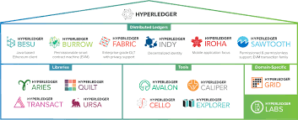
What is HyperLedger
Open Source Blockchain Technologies
Created by Linux Foundation in December 2015
Supports collaborative development of blockchain

Slide 3

What is Fabric
Hyperledger framework
Foundation for developing applications or solutions with a modular architecture
Develop open source business blockchain technology

Slide 4

Components of Fabric
Ledger
Assets
Chaincode
Permissions
Nodes
Private Channel

Slide 5

Ledger
Blockchain Log
Contains a history of transactions in chronological order
State database
Maintains the blockchain’s current state

Slide 6

Assets
Can be anything defined by a business
Transferred from business to business
Recorded in ledger

Slide 7

Chaincode
Business Logic for assets
Defines the asset and the transaction instructions for modifying them
Public to businesses

Slide 8

Permissions
Membership Identity Service
Manages IDs
Authenticate participants

Slide 9
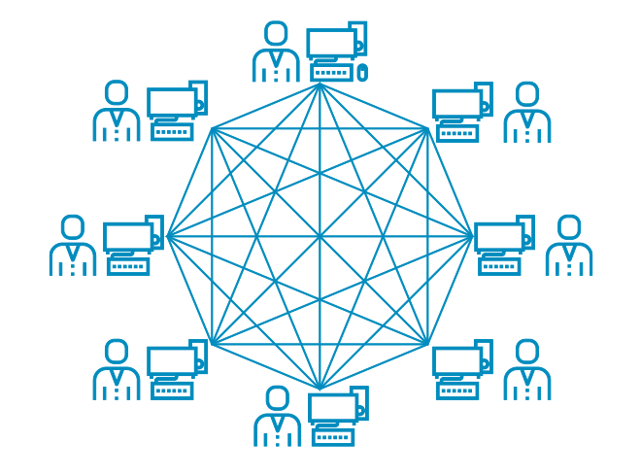
Nodes
Peer Node
Execute and verify transactions
Ordering Node
Order and propagate transactions

Slide 10
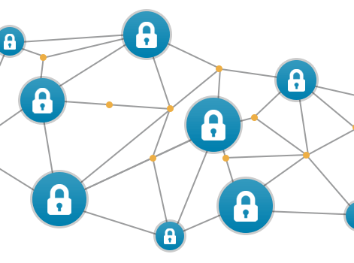
Private Channels
Restricted messaging paths that provide privacy for specific subsets
All data invisible to members not granted access

Slide 11

Fabric Goal/Purpose
Develop open source business blockchain technology
Private transactions and confidential contracts
Secure, Modular and Scalable

Slide 12

Installing Fabric Step 1
Download and install Docker Desktop
https://www.docker.com/products/docker-desktop

Slide 13

Installing Fabric Step 2
Download and install Go
https://golang.org/dl/

Slide 14

Installing Fabric Step 3
Download and install Node.js Runtime and NPM
https://nodejs.org/en/download/

Slide 15

Installing Fabric Step 4
Download and install windows git
https://nodejs.org/en/download/

Slide 16
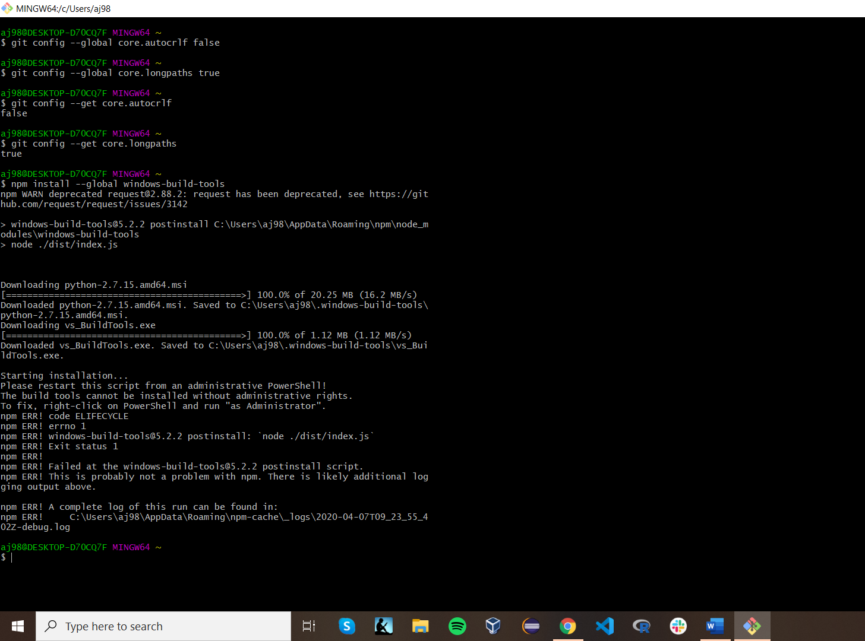
Installing Fabric Step 5
Open Git Bash
Run the following code in sequence
git config –-global core.autocrlf false
git config –-global core.longpaths true
git config –-get core.autocrlf
git config –-get core.longpaths
Restart your PC for environment variables

Slide 17
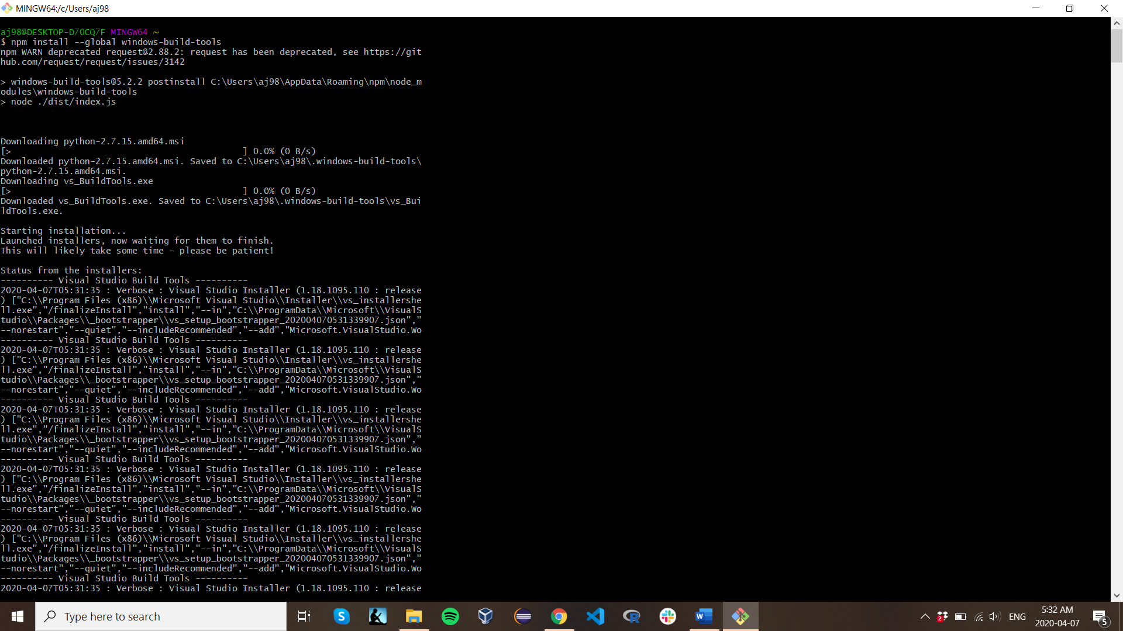
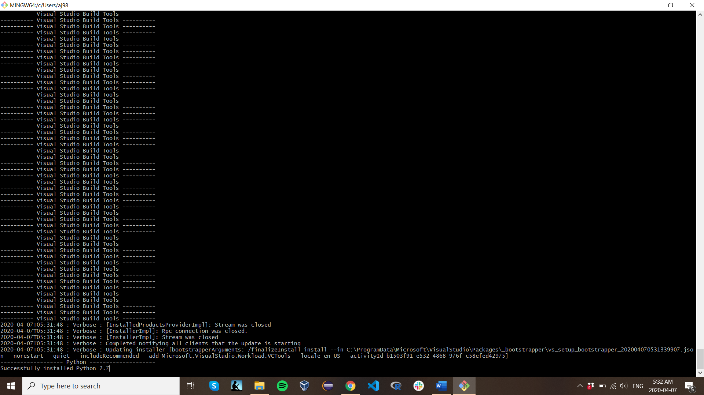
Installing Fabric Step 6
Install windows build tools
npm install –-global windows-build-tools

Slide 18
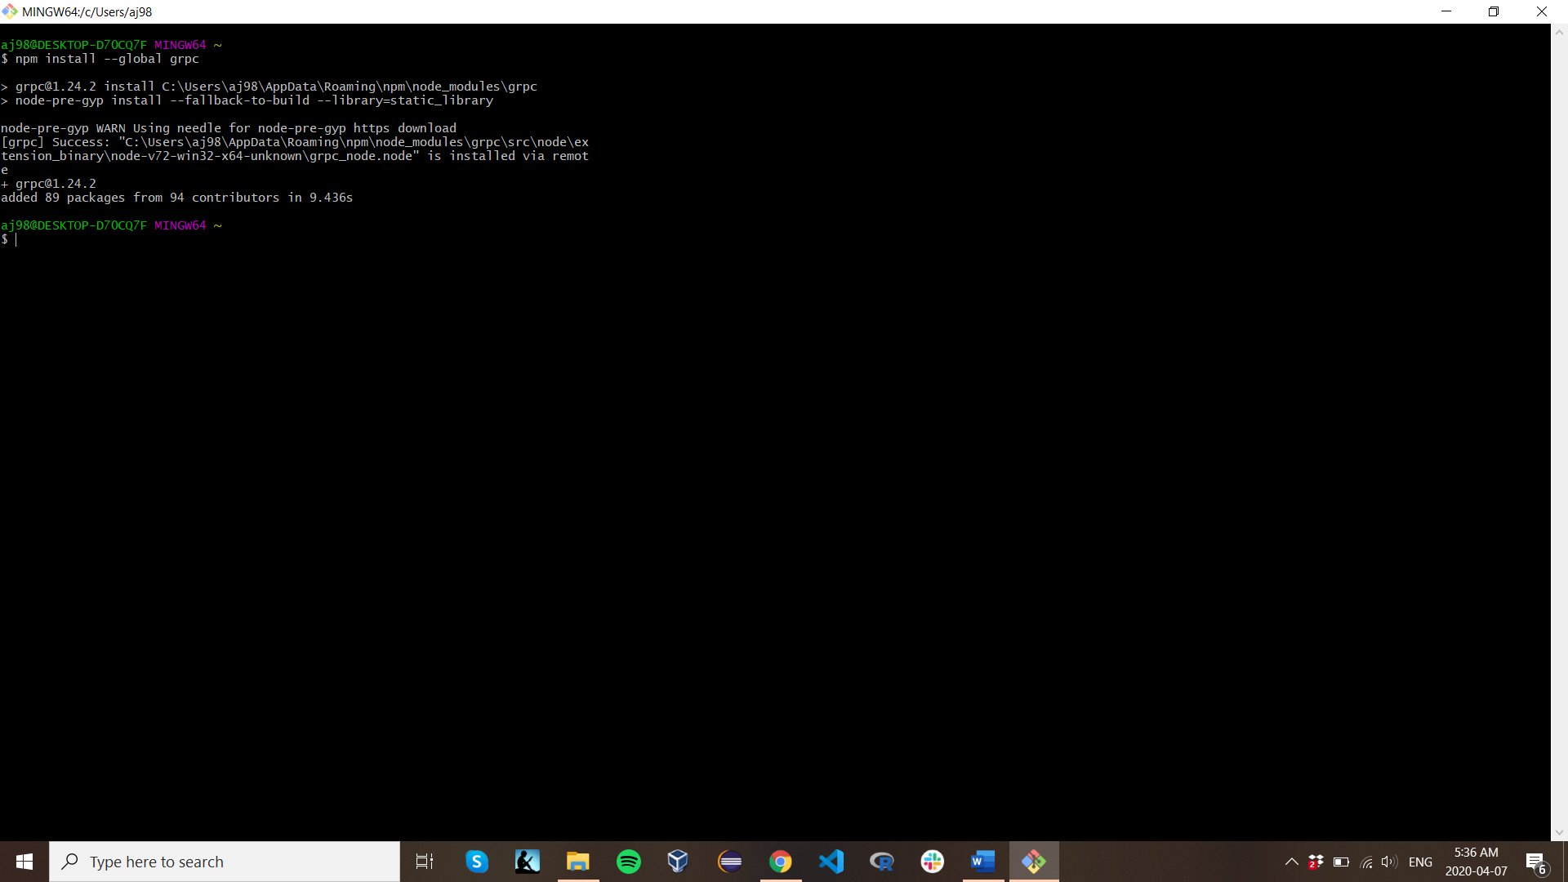
Installing Fabric Step 7
Install GRPC
npm install –global grpc

Slide 19
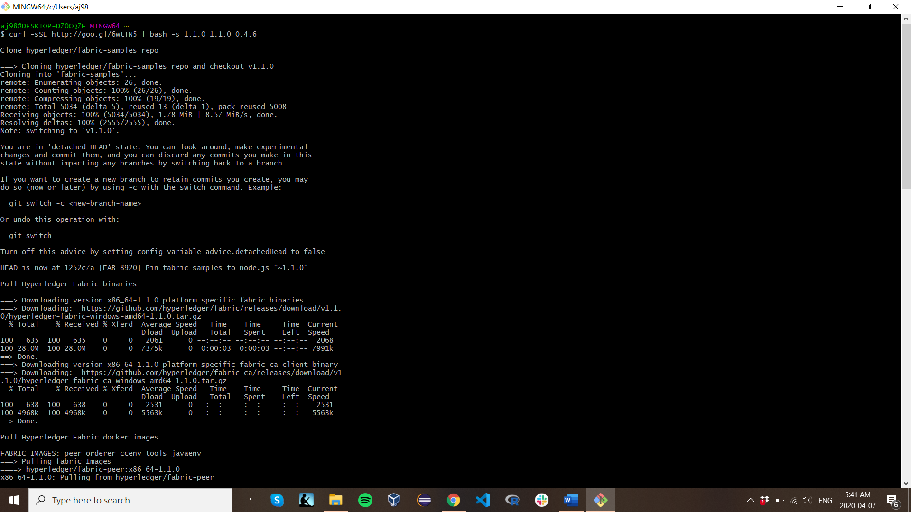
Installing Fabric Step 8
Install Platform-Specific Binaries
curl -sSL http://goo.gl/6wtTN5 | bash -s 1.1.0 1.1.0 0.4.6

Slide 20
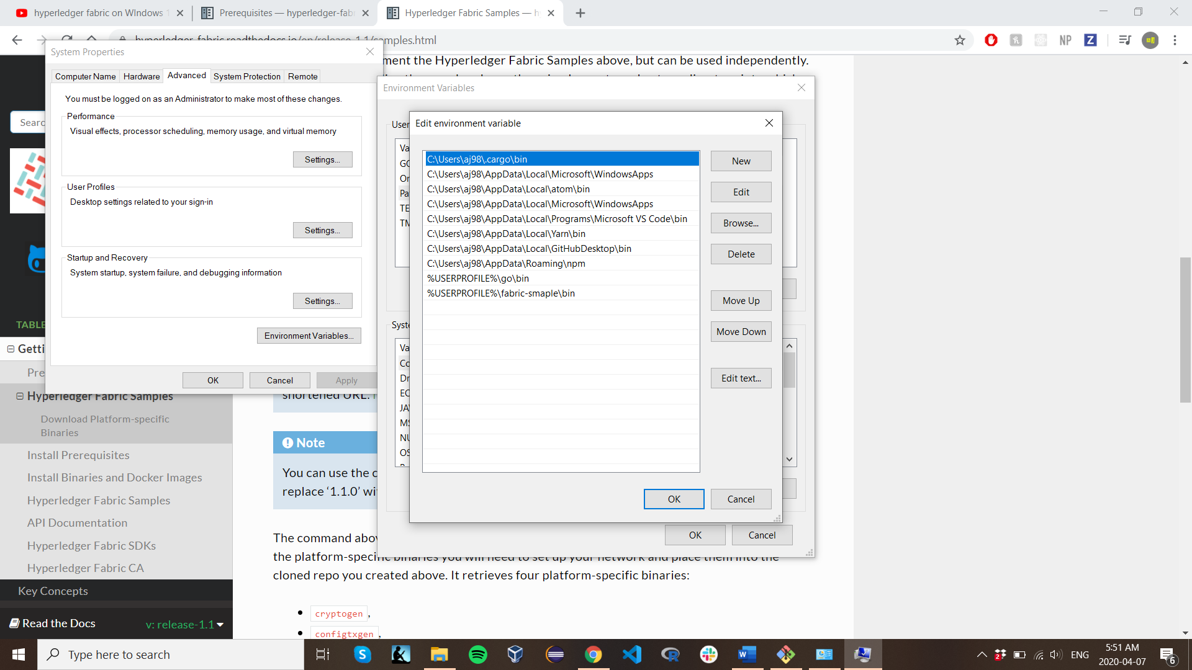
Installing Fabric Step 9
Go to your PCs
Control Panel
System and Security
System
Advanced System Settings
Environment Variables
Add environment variable %USERPROFILE% \fabric-samples\bin

Slide 21
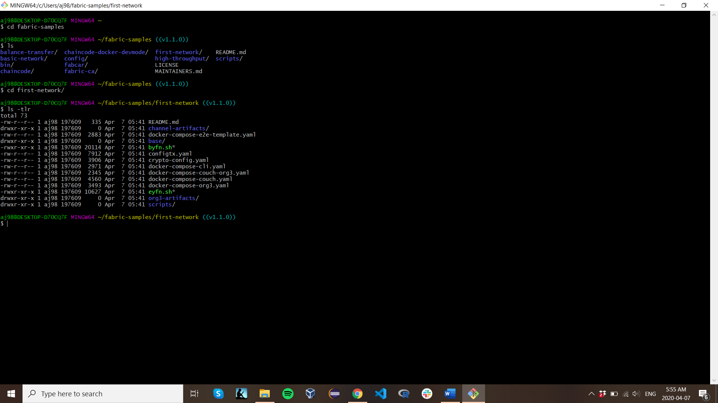
Building Your First Network
cd into the file fabric-samples
then into first-network
Verify that all the following files are there by running ls -tlr

Slide 22
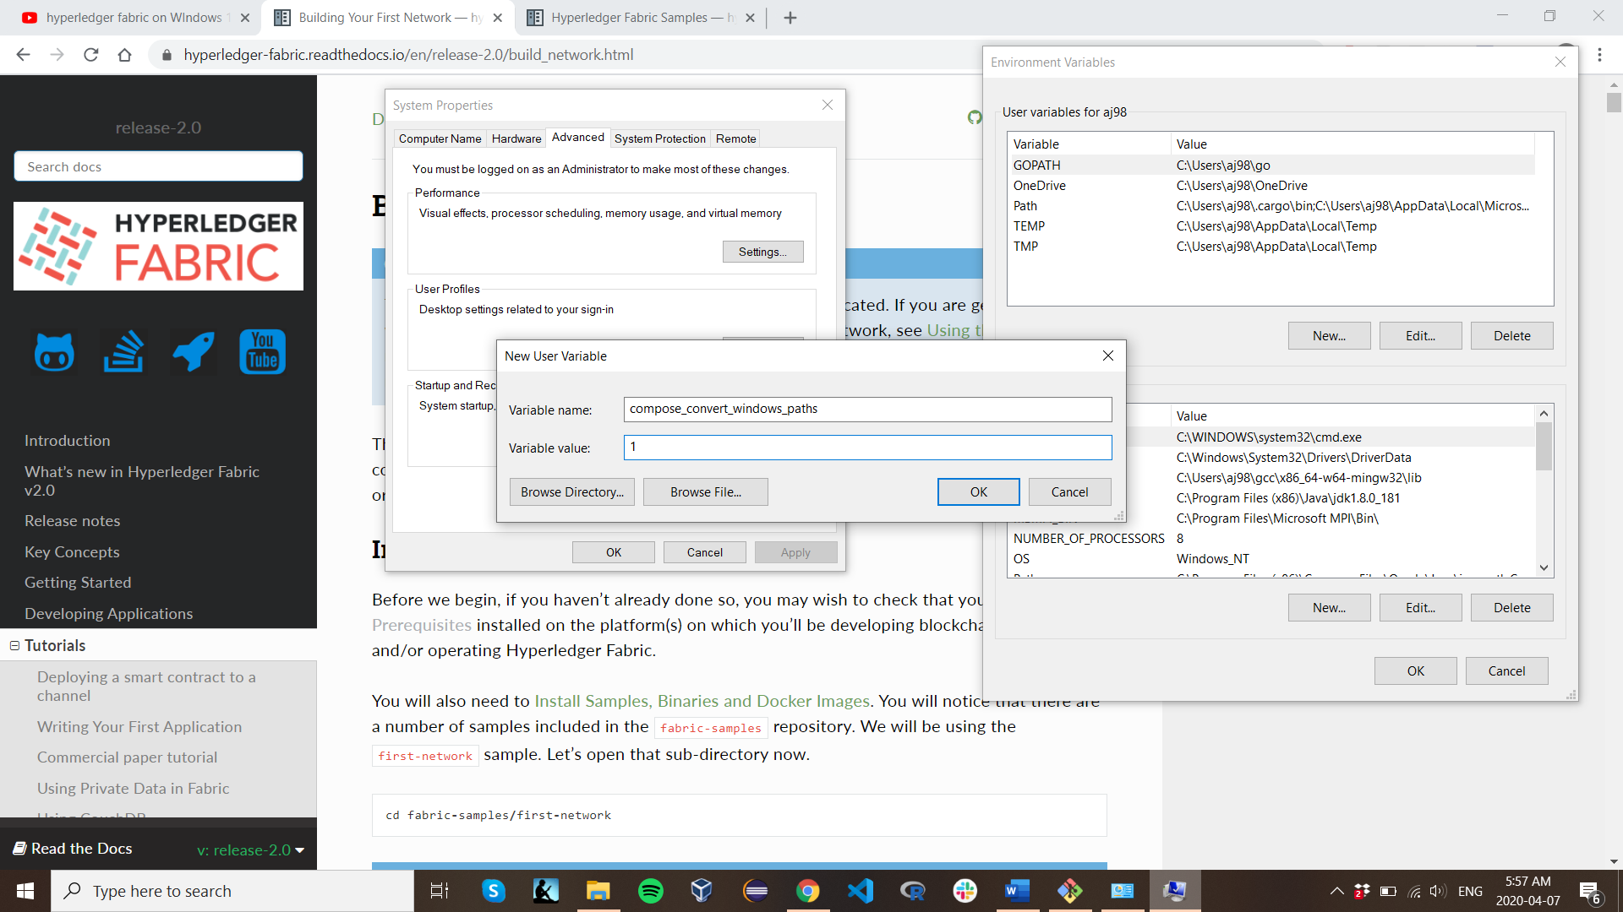
Building Your First Network
Go to your PCs
Control Panel
System and Security
System
Advanced System Settings
Environment Variables
Add a new user variable compose_convert_windowspaths = 1

Slide 23
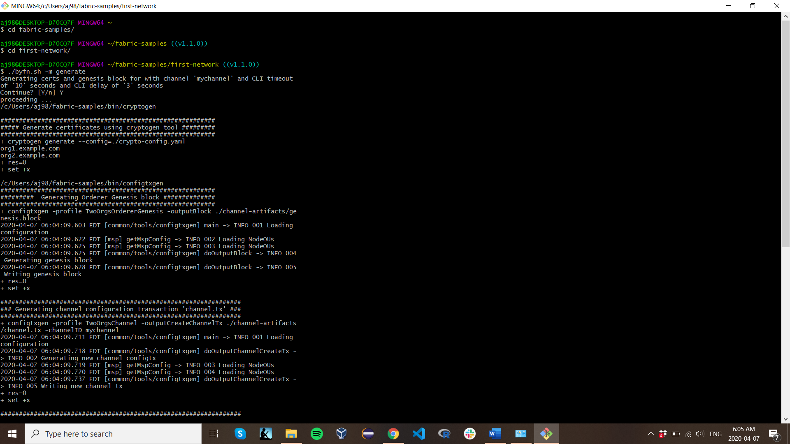
Building Your First Network
Generate Network Artifacts by
cd back to your first-network file
Run ./byfn.sh –m generate

Slide 24
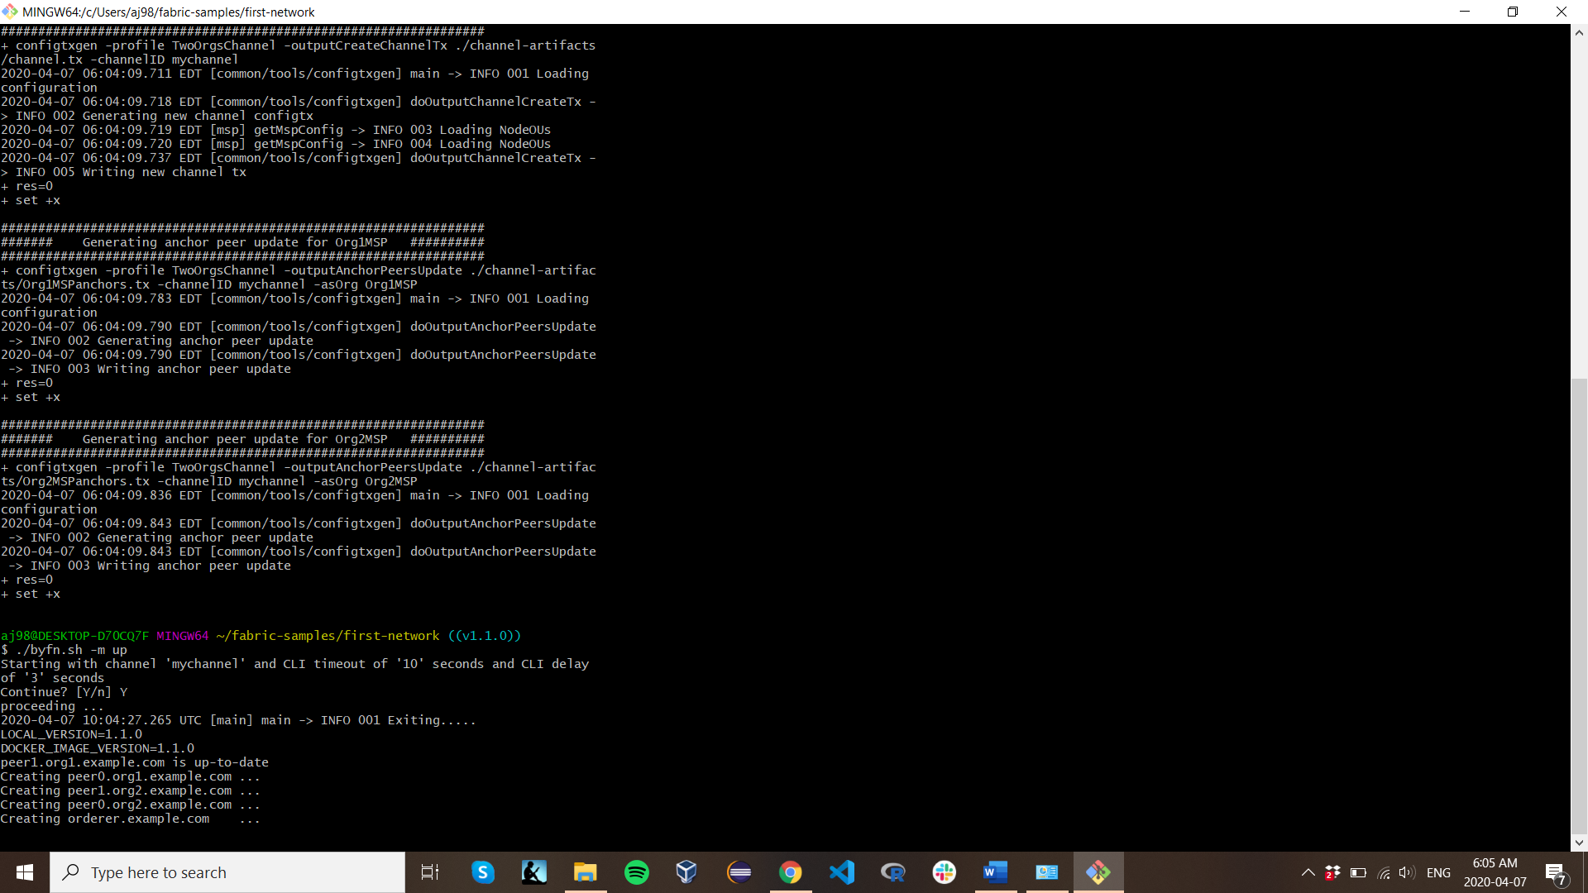
Fabric First Network
Bring Up the Network
By entering the following code ./byfn.sh -m up

Slide 25
Fabric First Network
Bring Down the Network
By entering the following code ./byfn.sh – m down

Slide 26
Resources
All information on Hyper Ledger Fabric and how to use it was and can be found on their website
https://hyperledger-fabric.readthedocs.io/en/release-2.0/whatis.html

