Slide 1


JavaScript Data Types
Siva Ninala
July 20, 2017

Slide 2
AGENDA
Data TYPES
COMPARSIONS
1
Type coercions
1
undefined
2
Equality VS Identity
2
null
3
Unusual Operators
3
number
4
In Operator
4
string
5
5
Logical OR
boolean
6
6
Constants & Comments
symbol (ES2015)
7
7
Eval
object

Slide 3
primitive typeS
string
number
boolean
null
undefined
symbol

Slide 4
Objects
“Normal” objects
Functions
Dates
Arrays
Maps, Sets …
Structured JSON

Slide 5
VARIABLE DECLARATION
keyword var, let, const
Variable name
Value
If no value assigned, value is undefined

Slide 6
VARIABLE DECLARATION – Examples
var myVar;
var myVar = 5;
keyword var
variable name
value is undefined by default
undefined is both type and value
keyword var
variable name
value is 5

Slide 7
typeof operator
The typeof operator returns a string indicating the type of the operand.
syntax : typeof operand

Slide 8
let taskId = 99;
console.log(typeof taskId);
What shows in the console?
number

Slide 9
let taskId = 99.9;
console.log(typeof taskId);
What shows in the console?
number

Slide 10
let taskId = “tsk-001”;
console.log(typeof taskId);
What shows in the console?
string

Slide 11
let isDone = true;
console.log(typeof isDone);
What shows in the console?
boolean

Slide 12
let isDone;
console.log(typeof isDone);
What shows in the console?
undefined

Slide 13
// let isDone;
console.log(typeof isDone);
What shows in the console?
undefined

Slide 14
let task = null;
console.log(typeof task);
What shows in the console?
object
/* well-known mistake */

Slide 15
NO TYPE MODIFIERS
var myNumber = 5;
var myString = “ Hello World”;
var myBool = false;
var myNull = null;
var myUndefined = undefined;
var myObject = {};

Slide 16
VALUE CAN BE REASSIGNED
var myVar = 5;
myVar = "Hello World”;
myVar = false;
myVar = null;
myVar = undefined;
myVar = {};

Slide 17
SINGLE VAR PATTERN
var myNumber = 5,
myString = "Hello World",
myBool = false,
myNull = null;

Slide 18
undefined

Slide 19
DETECTING undeclared
if (foo) {} //Reference Error
if (foo != undefined) {} //Reference Error
if (typeof foo == "undefined") {
console.log("foo is undefined");
}

Slide 20
NULL

Slide 21
NULL IN NUMBER CONTEXT
1 + null = 1

Slide 22
NULL IS OBJECT
typeof null = "object"

Slide 23
ATTENTION
null == 0 // false (bug in JS specifications)
null > 0 //false
null >= 0 //true

Slide 24
JAVA SYNTAX
var myNumber = new Number(5);
var myString = new String("Hello World");
var myBool = new Boolean(false);
var myObject = new Object();
var myString = new String("Hello World");
var myBool = new Boolean(false);
var myObject = new Object()

Slide 25
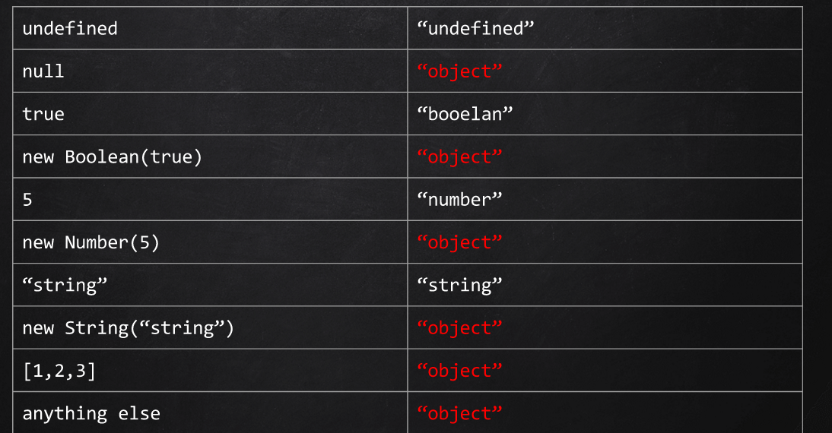
Typeof IS USELESS

Slide 26
USE instanceof INSTEAD
{} instanceof Object
[] instanceof Array

Slide 27
NUMBERS

Slide 28
NUMBERS
64-bit floating pointer
Precision problem
Example:
0.1 + 0.2 = 0.30000000000000004

Slide 29
MATH IN JAVASCRIPT
(0.1 * 9000000000 + 0.2 * 9000000000)/9000000000 //-- Fixed

Slide 30
SPECIAL NUMBERIC VALUES
Infinity
NaN (NOT A NUMBER)
- Any arithmetic operation with NaN results to NaN
Example:
42 / 0 == Infinity //true
“string” / 42 //NaN
NaN + 10 //NaN

Slide 31
DETECTING NaN
"string" / 42 == NaN //false
NaN == NaN //false
isNaN("string" / 42) //true
isNan(NaN + 42) // true

Slide 32
HOW TO CONVERT A STRING TO NUMBER
Number("42"); //42
Number("42$"); //NaN
parseInt("42"); //42
parseInt("42$") //42

Slide 33
parseInt
parseInt(string, radix);
If the input string begins with "0x" or "0X" Radix is 16(Hexadecimal)
If the input string begins with "0" Radix is 8(Octal)
If the input string begins with any other value, the radix is 10(Decimal)
- Always specify a radix

Slide 34
ATTENTION
045 + "str“ // “37str”
parseInt(045 + "str", 10) //37
parseInt("045str", 10) //45

Slide 35
ES5 Methods
.toString(radix)
// (8).toString(2) => “1000”
(10).toFixed(2); //”10.00”
(8).toExponential(4); // “8.0000e+0”
(255).toPrecision(4); // “255.0”

Slide 36
Safe Integers
-2⁵³< x < 2⁵³
Number.MIN_SAFE_INTEGER
Number.MAX_SAFE_INTEGER
Number.isSafeInteger(number)

Slide 37
When are computations with integers correct?
9007199254740990 + 3; // 9007199254740992
Number.isSafeInteger(9007199254740990); // true
Number.isSafeInteger(3); // true
Number.isSafeInteger(9007199254740992); // false
9007199254740995 – 10; // 9007199254740986
Number.isSafeInteger(9007199254740986); // true
Number.isSafeInteger(10); // true
Number.isSafeInteger(9007199254740995); // false

Slide 38
Math. Various numerical functionality
Constants
Exponents and Logarithms
Trigonometric Functions
Pow and Square Functions
Hyperbolic functions
Analysis Functions

Slide 39
Math. Constants (ES5)
Math.E The constant e, the base of the natural logarithm.
Math.LN10 The natural logarithm of 10.
Math.LN2 The natural logarithm of 2.
Math.LOG10E The base-10 logarithm of e.
Math.LOG2E The base-2 logarithm of e.
Math.PI The constant π.
Math.SQRT1_2 The number 1 divided by the square root of 2.
Math.SQRT2 The square root of 2.

Slide 40
Math. Trigonometric Functions (ES5)
Math.acos(x) Computes an arccosine.
Math.asin(x) Computes an arcsine.
Math.atan(x) Computes an arctangent.
Math.atan2(x) Computes the angle from the X axis to a point.
Math.cos(x) Computes a cosine.
Math.sin(x) Computes a sine.
Math.tan(x) Computes a tangent.

Slide 41
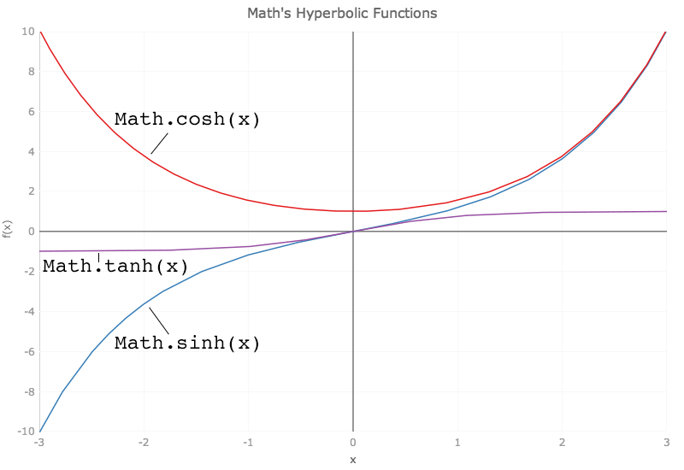
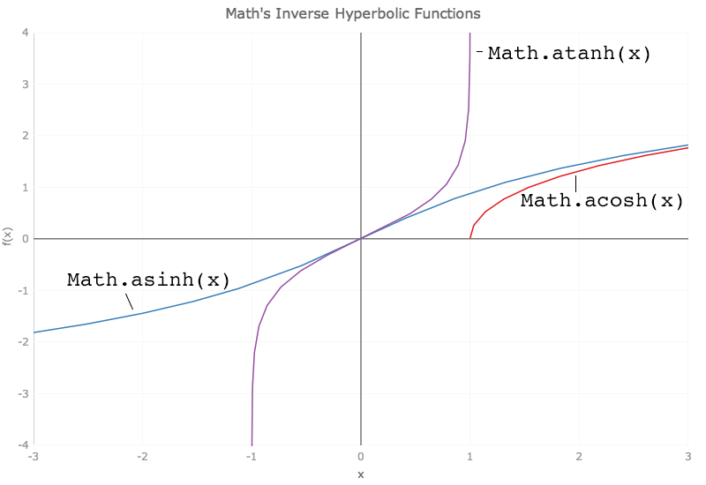
Math. Hyperbolic functions (ES6)
Math.sinh (х) Computes the hyperbolic sine of x
Math.cosh (х) Computes the hyperbolic cosine of x
Math.tanh (х) Computes the hyperbolic tangent of x
Math.asinh (х) Computes the inverse hyperbolic sine of x
Math.acosh (х) Computes the inverse hyperbolic cosine of x
Math.atanh (х) Computes the inverse hyperbolic tangent of x

Slide 42
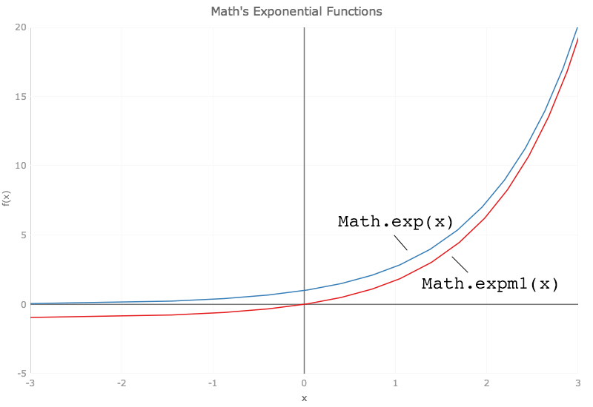
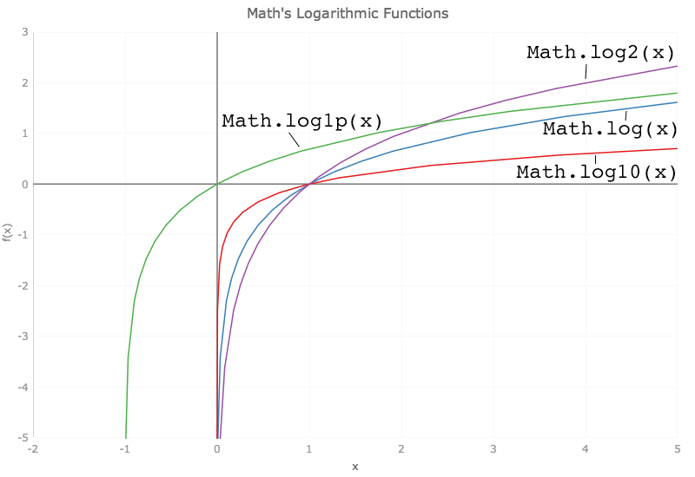
Math. Exponents and Logarithms (ES5 & ES6)
Math.exp(x) Computes a power of e.
Math.log(x) Computes a natural logarithm.
Math.expm1(x) Computes Math.exp(x)-1. The inverse of Math.log1p()
Math.log1p(x) Computes Math.log(1 + x). The inverse of Math.expm1()
Math.log2(x) Computes the logarithm to base 2.
Math.log10(x) Computes the logarithm to base 10.

Slide 43
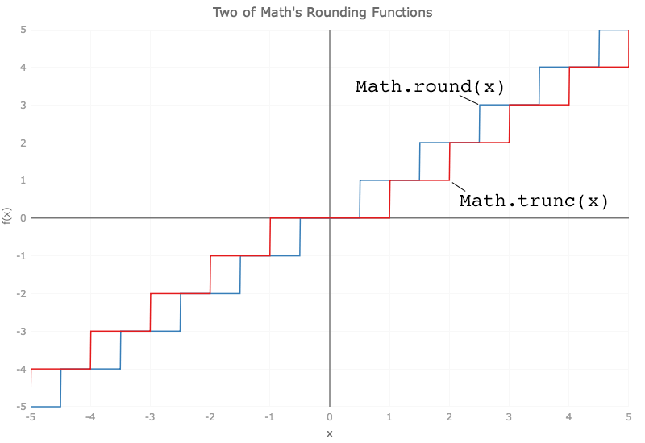
Math. Rounding Functions (ES5 & ES6)
Math.ceil(x) Rounds a number up.
Math.floor(x) Rounds a number down.
Math.round(x) Rounds to the nearest integer.
Math.trunc(x) Removes the decimal fraction of x.
Math.fround(x) Rounds x to a 32 bit floating point value (float)

Slide 44
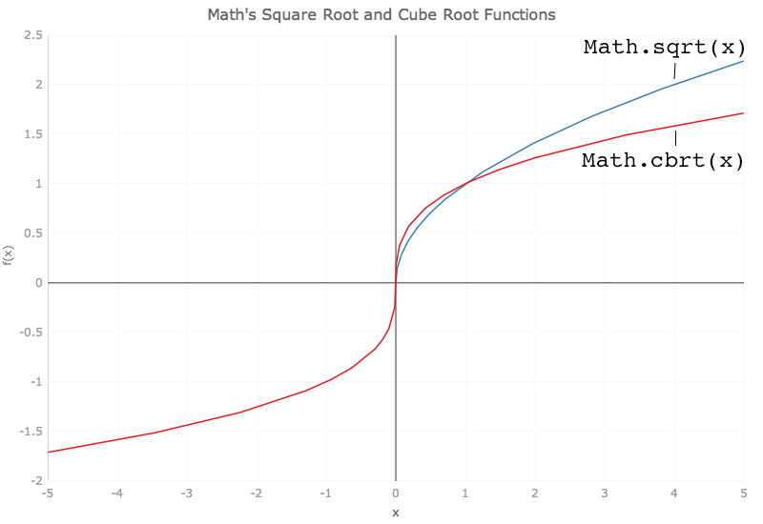
Math. Pow and Square Functions
Math.pow() Computes x to the power y.
Math.sqrt() Computes the square root.
Math.cbrt(x) Computes the cube root of x (∛x).

Slide 45
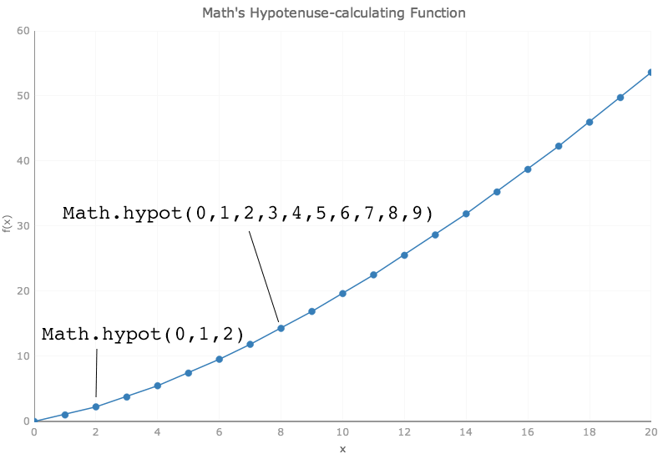
Math. Pow and Square Functions
Math.hypot (...values) Computes the square root of the sum of the squares of its arguments
Math.imul(x) multiplies the two 32 bit integers x and y and returns the lower 32 bits of the result

Slide 46
Math. Analysis Functions
Math.abs() Computes an absolute value.
Math.max() Returns the larger of two numbers.
Math.min() Returns the smaller of two numbers.
Math.random() Computes a random number.
Math.sign(x) Computes the sign of x as -1 or +1. Unless x is either NaN or zero; then x is returned
Math.clz32(x) Counts the leading zero bits in the 32 bit integer x.

Slide 47
STRINGS

Slide 48
STRINGS
Sequence of 0 or more 16-bit characters
Strings are immutable
Similar strings are equal
String literals can be use single or double quotes

Slide 49
STRINGS
var singleQuotes = 'my string'
var doubleQuotes = "my string"
singleQuotes == doubleQuotes //true
var myChar = 'a'
var charFromInt = String.fromCharCode(42); //*

Slide 50
CONVERT VALUE TO STRING
var num = 42;
String(num); //”42”
num.toString();
"" + num

Slide 51
Methods ES5
charAt(index)
charCodeAt(index)
concat(string2, string3[, ..., stringN])
indexOf(searchValue[, fromIndex])
lastIndexOf(searchValue[, fromIndex])
localeCompare()
match(regexp)
replace(regexp, newSubStr|function)
search(regexp)
slice(beginSlice[, endSlice])
split([separator] [, limit] )
substr(start[, length])
substring(indexA, [indexB])
toLowerCase()
toLocaleLowerCase()
toLocaleUpperCase()
toString()
toUpperCase()
trim()
valueOf()
String.fromCharCode(num1, …, numN)

Slide 52
Finding Strings
indexOf(str, index)
3 new methods
startsWith(str, index)
endsWith(str, index)
includes(str, index)
Notes:
indexOf => number
startsWith, endsWith, includes => boolean

Slide 53
BOOlean

Slide 54
BOOLEAN
true / false
False
false, null, undefined, “”, 0 , NaN
True
“false”, “0”, {}, everything else

Slide 55
BOOLEAN FUNCTION
Boolean(value);
Returns true if value is truthy
Returns false if value is falsy
Similar to !! prefix operator
var booleanVariable = Boolean("false"); //true
var booleanVariable = !!"false"; //true

Slide 56
OBJECT

Slide 57
OBJECTS
key, value unordered dynamic collections
Everything in JavaScript is an Object
Comparing by Reference
Properties and Methods could be added/deleted in runtime

Slide 58
EVERYTHING IS AN OBJECT
var myObject = {};
var myArray = [];
var myFunction = function(){};
var myDate = new Date();
var myError = new Error();

Slide 59
DYNAMIC NATURE
var a = {};
var b = {};
a == b;
a.x = 1;
b.y = "foo";
delete a.x;
a.x == undefined;

Slide 60
OBJECTS LIKE A MAP
var ages = {};
ages['Tony Stark'] = 35;
ages['Steve Rogers'] = 90;
ages['Bruce Benner'] = 40;
console.log(ages['Tony Stark']); //35
var name = 'Steve Rogers';
console.log(ages[name]);//90

Slide 61
DOT/ARRAY NOTATION
var point = {
x: 1,
y: 2,
method: function(){
return 42;
}
}
point.x == point['x']; //true
point.y == point['y']; //true
point.method == point['method'] //true

Slide 62
ATTENTION
point.42 = "forty-two"; //syntax error
point[42] = "forty-two";

Slide 63
OBJECT
var obj = {
x: 1,
y: 2,
z: 3
};
for(var key in obj) {
console.log(key, obj[key]); //x 1, y 2, z 3
}

Slide 64
Symbol

Slide 65
Symbols
Symbol Definition
“A symbol is a unique and immutable data type and may be used as an identifier for object properties.”
Mozilla Developer Network

Slide 66
Symbol properties
No literal
Unique token

Slide 67
SYMBOL Example
Symbols can be used as Object keys
Each new Symbol has a completely unique value
var foo1 = Symbol('foo');
var foo2 = Symbol('foo');
var object = {
[foo1]: 1,
[foo2]: 2,
};
object[foo1] === 1
object[foo2] === 2

Slide 68
Arrays

Slide 69
ARRAYS
Inherits from Object
Indices converted to strings and used as names for retrieving values
Have a special length property

Slide 70
ARRAYS
var array = new Array(1, 2, 3);
array = [1, 2, 3];
array = [1, "2", {}, []];
array.length == 4 //true

Slide 71
Java Syntax Sucks
var array = new Array(3);
// [undefined, undefined, undefined]
var array = new Array("3");
//["3"]

Slide 72
Array Methods
var arrayAsString = array.join("");
array.reverse();
array.sort(/* options: comparision function*/);
var newArry = array.concat("array");
var subArray = array.slice("startIndex", "endIndex");
array.splice("startIndex", "itemsToRemove");
var newArrayLength = array.push("value");
var removedValue = array.pop();
var newArrayLength = array.unshift("array");
var removedValue = array.shift();

Slide 73
DELETING ELEMENT
myArray = [‘a’, ‘b’, ‘c’, ‘d’];
delete myArray[1];
['a', undefined, 'c', 'd']
myArray.splice(1,1);
['a','c', 'd']

Slide 74
Functions

Slide 75
Functions
function sum(a, b){
return a + b;
}
var division = function(a, b){
return a / b;
}

Slide 76
COMPARSIONS

Slide 77
EVILS OF TYPE COERCIONS
'' == '0' //false
0 == '' // true
0 == '0' // true
false == 'false' //false
false == '0' //true
false == undefined; //false
false == null //false
null == undefined //true
'\t\r\n' == 0 //true

Slide 78
EQUALITY VS IDENTITY
(==, ===, !=, !===)
0 == ‘’ //true
0 === ‘’ //false

Slide 79
UNUSUAL OPERATORS
"hello, " + "world" === "hello, world"
+"1" === 1

Slide 80
IN
var a = {x : 1}
'x' in a //true

Slide 81
|| LOGICAL OR
var DEFAULT_WIDTH = 200,
DEFAULT_HEIGHT = 200;
var options = {width: 300};
var box = {
width: options.width || DEFAULT_WIDTH,
height: options.height || DEFAULT_HEIGHT
}
box.width === 300;
box.height === 200;

Slide 82
SEMICOLON
You can skip semicolons
But you should not
var a = b
(function(){alert(1)})()
var func = function(){
return
{a: 42}
}

Slide 83
CONSTANTS
var COLOR_BLUE = "#00F";
var COLOR_RED = "#0F0";
var COLOR_GREEN = "#F00";
var COLOR_ORANGE = "#FF7F00";

Slide 84
COMMENTS
/*
Multi line comments
*/
// Single line comment

Slide 85
EVAL
var code = 'alert("Hello, World!")';
eval(code);
EVAL is Evil

Slide 86
EMBEDDING SCRIPT IN HTML
<script>
alert("Hello, World");
</script>
<script src="path/to/your/js/file"></script>

Slide 87
ATTENTION
2.toString() //raises syntax error(identifier starts immediately after numeric literal)
//Fix
2..toString()
2 .toString()
(2).toString()

Slide 88
ATTENTION
var x = "50" - 0; // x == 50
var x = "50" + 0; // x == 500
var bool = new Boolean(false);
if (bool) {
alert("wat"); //shows wat
}
var bool = false;
if (bool) {
alert("wat") //this will never be alerted
}

Slide 89
ATTENTION
var a = new String("foo");
var b = "foo";
var c = new String("foo");
a == b //true
b == c //true
a == c //false
2 == [[[[2]]]] //true

Slide 90
Q & A

Slide 91
THANK YOU
For your attention

