Slide 1


JavaScript Scope
Siva Rallabhandi
April 28, 2017

Slide 2

Agenda
1
The this keyword
2
The new keyword
Notes:
Tool: http://google.github.io/traceur-compiler/demo/repl.html#

Slide 3
THIS

Slide 4
DETERMINED ON RUNTIME
Rules to determine the context of THIS
Explicit binding
Implicit binding
Hard binding
Used with new

Slide 5
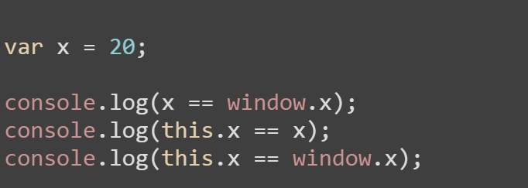
“This” in the global context
Explicit binding

Slide 6
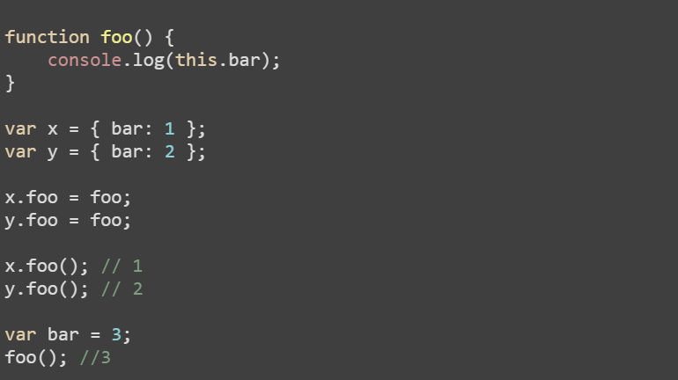
“This” in the function context
Implicit Binding: Value of this in function is determined by the form on invocation but not context of definition.

Slide 7
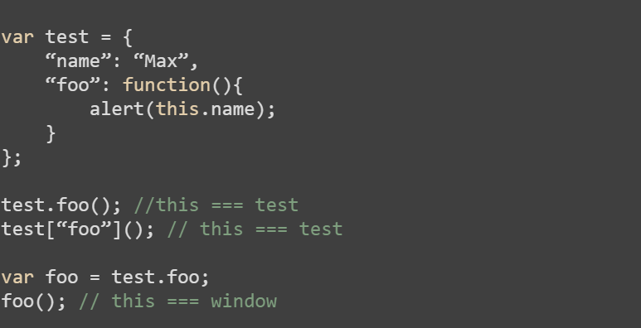
“This” in the function context
Implicit Binding

Slide 8
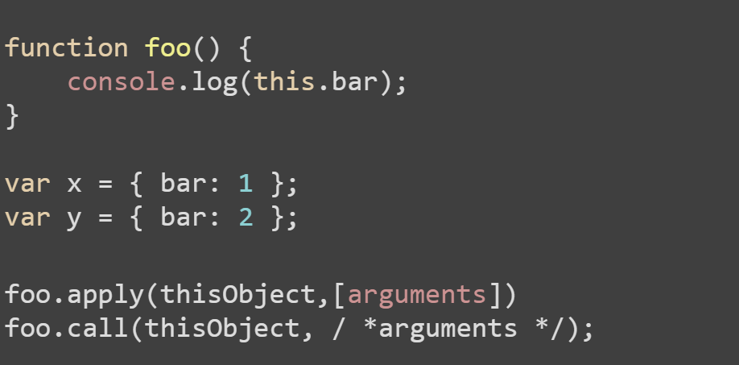
explicit setting of this
Hard binding: A function’s apply or call method allows for calling the function, explicitly specifying this.

Slide 9
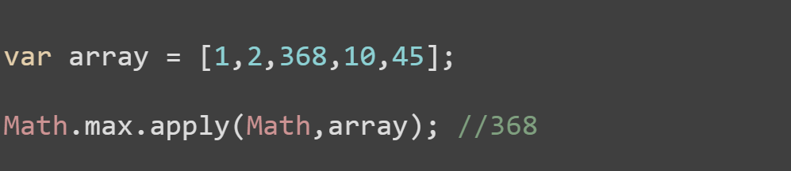
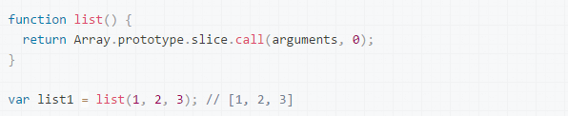
EXPLICIT SETTING OF THIS
Function borrowing

Slide 10
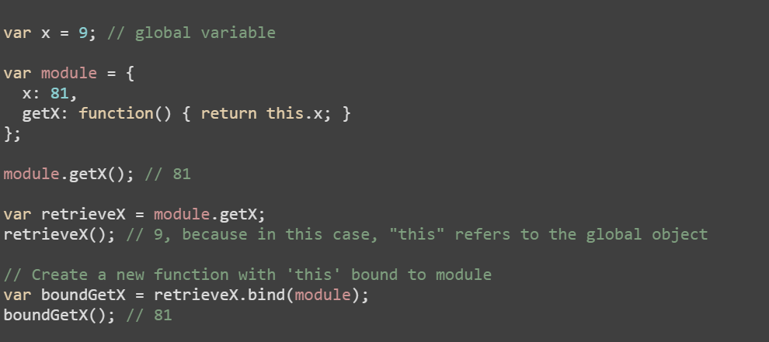
explicit setting of this
Hard binding: Can also be done using bind.

Slide 11
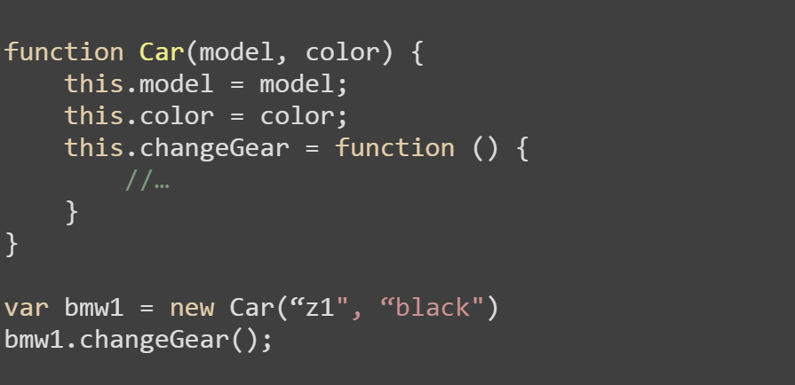
constructor form
Used with new keyword

Slide 12
The new keyword
4 important things that new keyword does:
Creates a brand new object.
Adds a [[Prototype]] link in the newly created object.
The newly created object is set as the this binding for that function call.
Will return this newly created object (unless the function returns and object of its own)

Slide 13
console.log(typeof Object);
What shows in the console?
function

Slide 14
let Task = function(action) {
this.action = action;
};
let task = new Task(“create”);
console.log(typeof task);
What shows in the console?
object

Slide 15
let Task = function(action) {
this.action = action;
return this;
};
let task = new Task(“create”);
console.log(typeof task);
What shows in the console?
object

Slide 16
let Task = function(action) {
this.action = action;
return {
done: false
};
};
let task = new Task(“create”);
console.log(task.action);
What shows in the console?
undefined

Slide 17
let Task = function(action) {
this.action = action;
return 10;
};
let task = new Task(“create”);
console.log(task.action);
What shows in the console?
create

Slide 18
let Task = function(action) {
this.action = action;
return [10];
};
let task = new Task(“create”);
console.log(task.action);
console.log(task);
What shows in the console?
undefined
[10]

Slide 19
let Task = function(action) {
this.action = action;
};
let task = new Task(“create”);
console.log(task.action);
console.log(task[“action”]);
What shows in the console?
create
create

Slide 20
let Task = function(action) {
this.action = action;
};
let task1 = new Task(“create”);
let task2 = new Task(“delete”);
console.log(task1 === task2);
What shows in the console?
false

Slide 21
Q & A

Slide 22
THANK YOU
For your attention

