Slide 1
Paper title
"Handling Divergent Reference Texts when Evaluating Table-to-Text Generation"

Slide 2

What is this about?
The paper addresses how to accurately evaluate the text generated from tables or structured data, even when the ference texts is divergent.
The paper proposes a method to handle this divergence, improving the reliability of the evaluation.

Slide 3

What Is divergent text?
In many datasets, the reference texts used for evaluation include information not present in the associated tables, leading to discrepancies.
In that case traditional metrics misrepresent the true quality of generated text which only considers the reference text for evaluation.

Slide 4
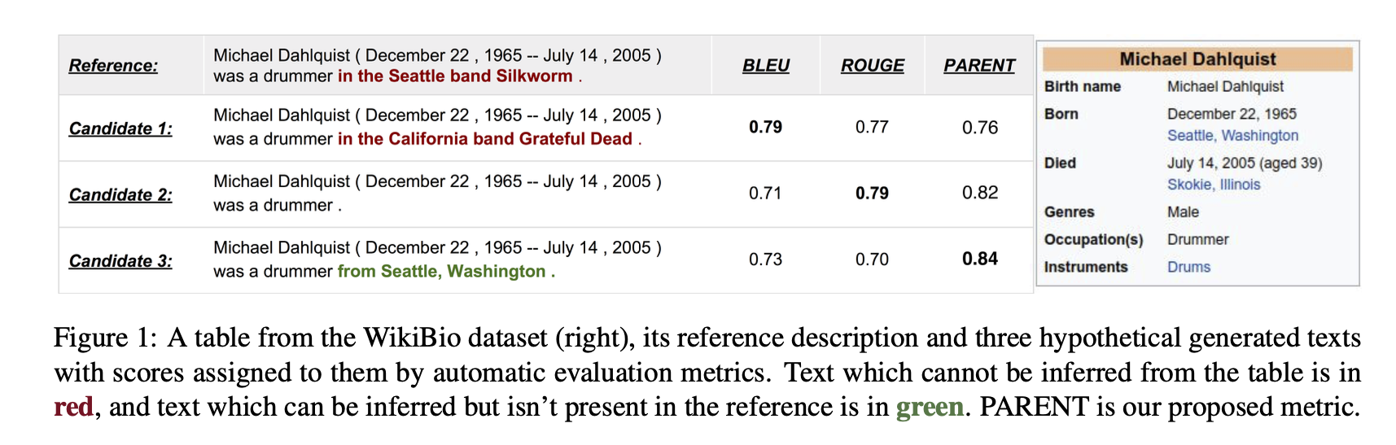
Example of divergent text:

Slide 5

parent
An evaluation metric for table to text generation model

Slide 6
What is parent ?
PARENT stands for "Precision And Recall of Entailed N-grams from the Table".
Automatic metrics that better correlate with human judgment, especially in cases of divergence by using both table and reference text.
It evaluates by calculating Precision, Recall and F-score.
Notes:
particularly when the generated text needs to be compared to both reference text and a structured table of facts (like a dataset).

Slide 7
How parent is computed?
Entailed Precision and Recall:
Entailed Precision: Measures how accurately the generated text reflects the table content, based on the overlap with the reference.
Entailed Recall: Measures how much of the reference text is covered by the generated text, considering the table's facts.
Notes:
particularly when the generated text needs to be compared to both reference text and a structured table of facts (like a dataset).

Slide 8
Entailed meaning
Entailment in This Context:
Entailed Information: If a piece of information in the generated text is "entailed" by the table or reference text, it means that the information is supported by or consistent with the facts in the table or can be logically derived from the reference text.
Entailed Precision and Recall: By focusing on entailed precision and recall, the PARENT metric evaluates not just word overlap, but whether the generated text accurately reflects the true content of the table.

Slide 9
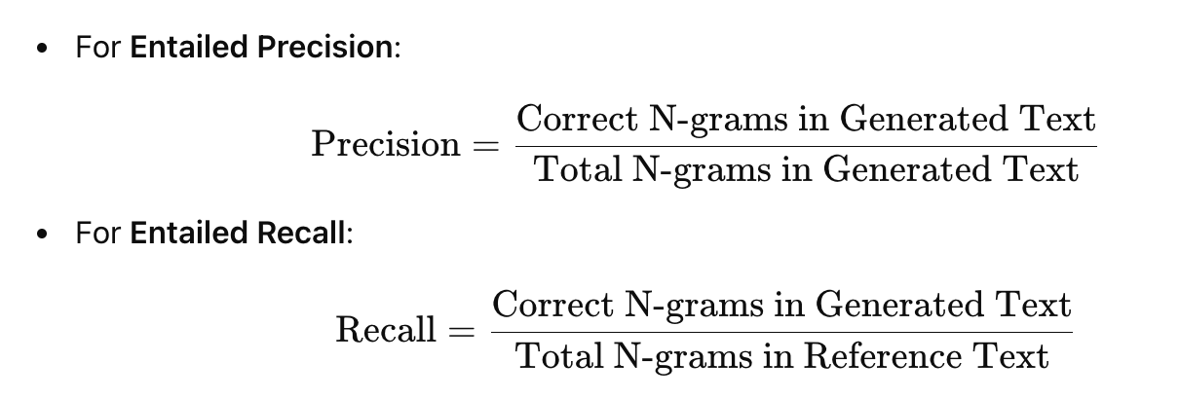
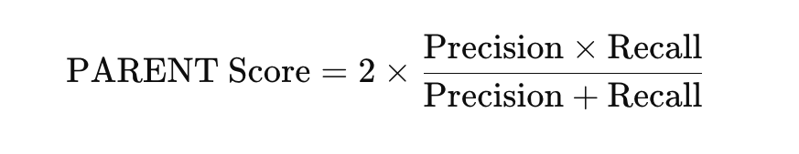
How parent is computed?
Calculates Entailed Precision and Recall:
Notes:
particularly when the generated text needs to be compared to both reference text and a structured table of facts (like a dataset).

Slide 10
Computation process
Step 1: Extracting N-grams
-N-grams are extracted from all of 3 (generated sentence, reference text and table)
Step 2: Entailment Model
-Word Overlap Model: Determines entailment based on direct word matches.
-Co-occurrence Model: Uses statistical data to check if certain words frequently co-occur and, therefore, may infer logical connections.
Step 3: Identify Correctly Entailed N-grams
-Check if the n-gram can be inferred from the table. This means checking if the information in the n-gram is either directly present or can be logically deduced from the facts in the table.

Slide 11
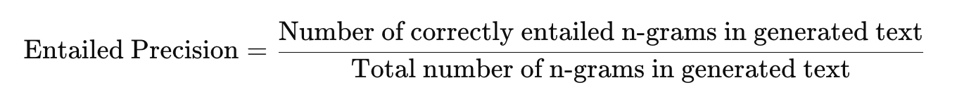
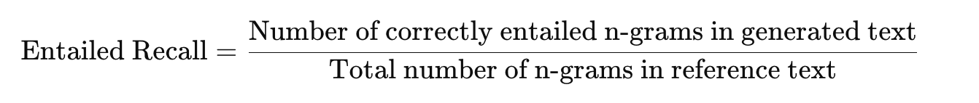
Computation process
Step 4: Calculating entailed precision and recall

Slide 12
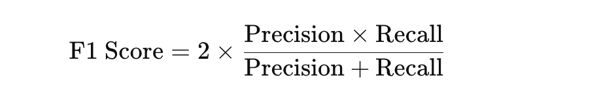
Computation process
Step 6: Combining Entailed Precision and Recall
-We calculate F1-score and this score is our PARENT score.

Slide 13
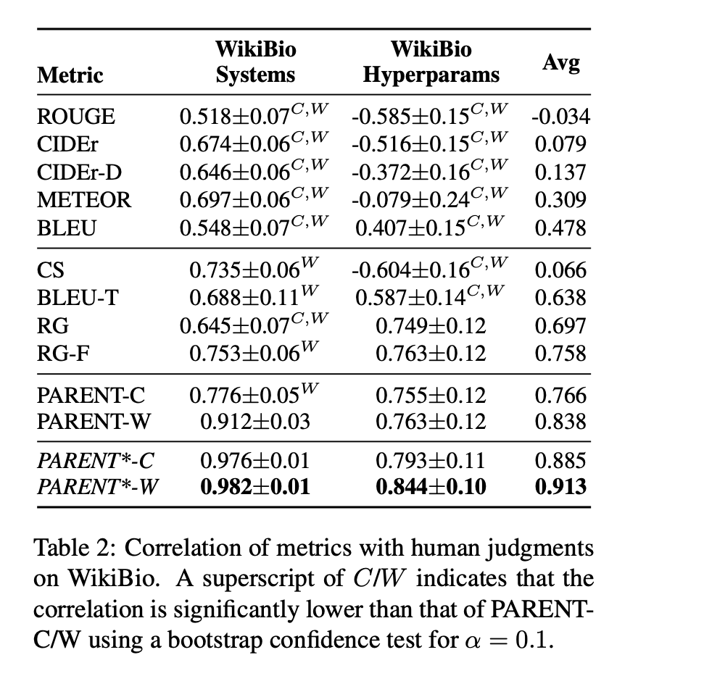
Experimental results

Slide 14
conclusion
Author studied automatic evaluation of table to text system when the references diverges from the table.Author proposed a new metric PARENT, which shows highest corelaltion with human across a range of settings with divergent refrences on WikiBio. And lastly showed that parent is comparable to best existing metrics when refrence are elicited by humans on WebNLG data.

