Slide 1

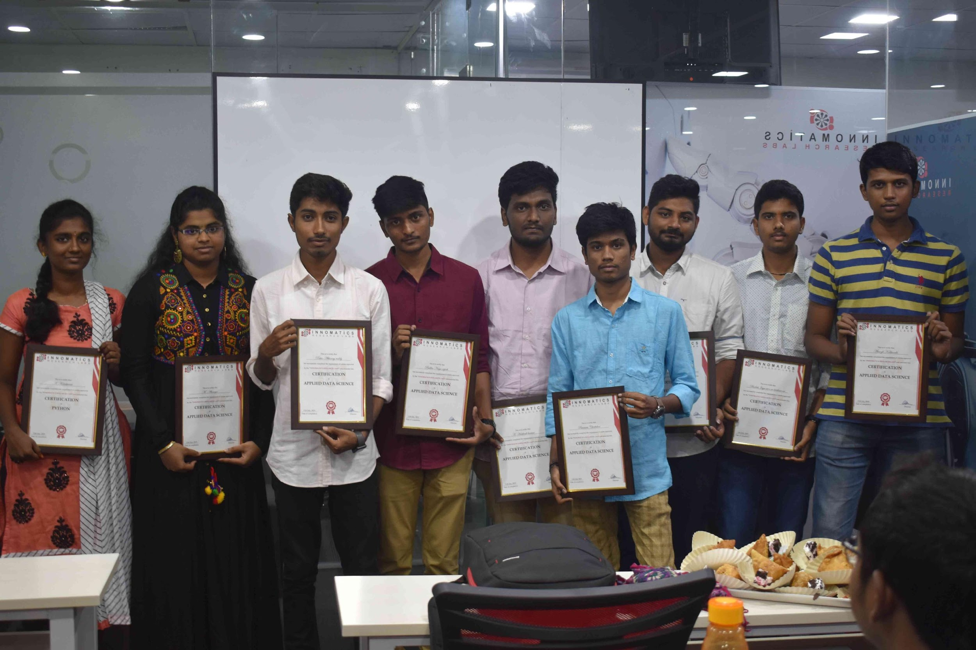
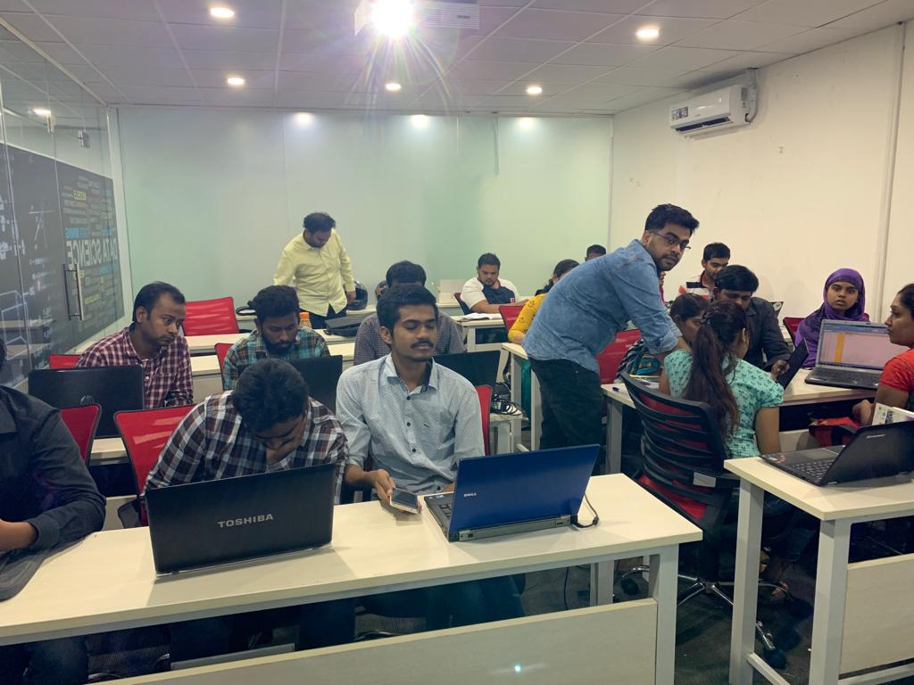

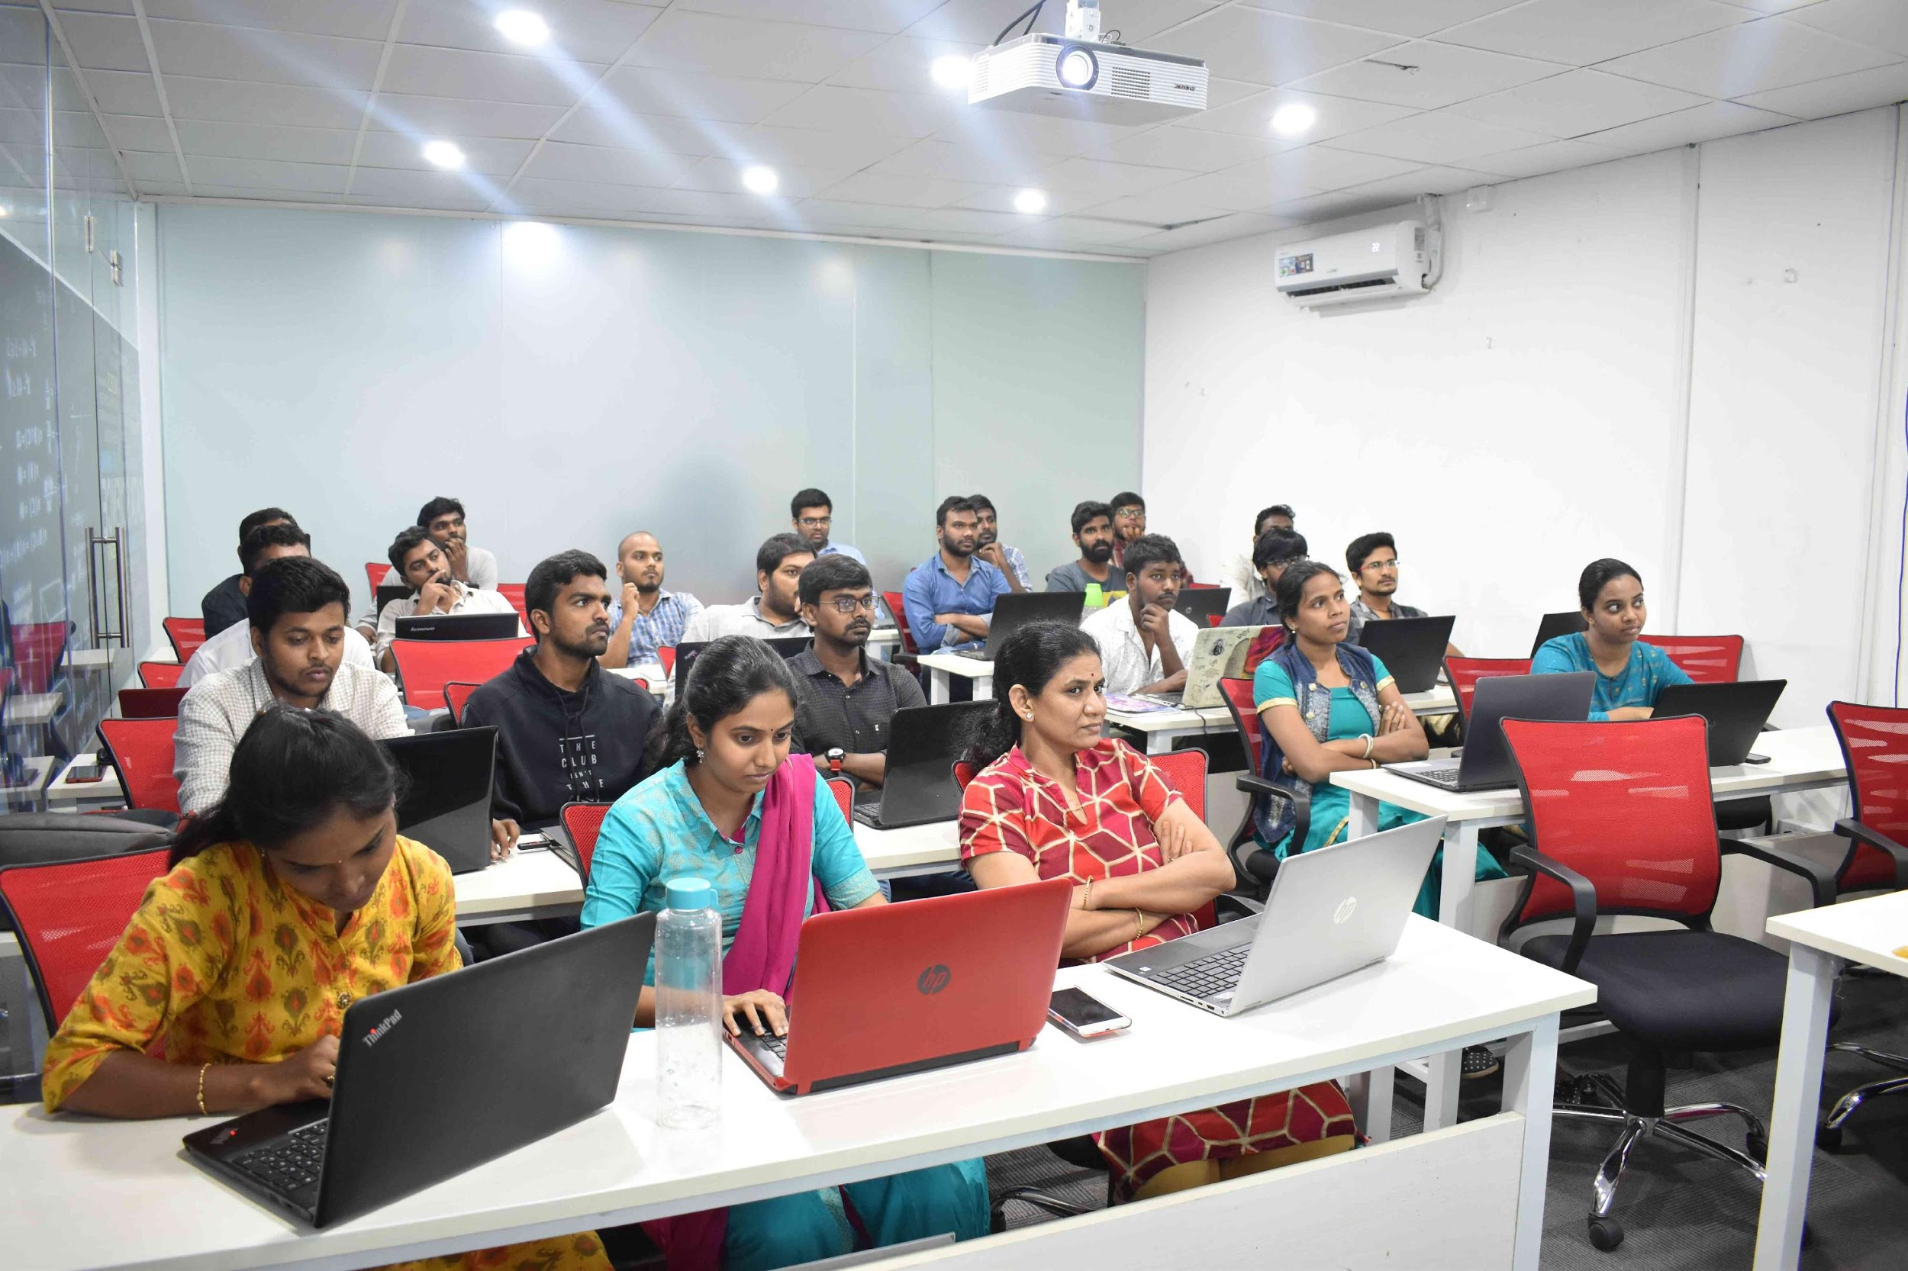



Slide 2
Web Scraping Wikipedia
For comparing various indices for migration and commercial ventures

Slide 3
About me
I completed my masters in Power Systems in the year 2015.
I want to take a big leap from current job , I found Data Science as Potential and Booming area.
I worked as Assistant Professor for 6 years and published 8 papers in various Journals and conferences. In my experience I was able to achieve various heights like completing project for DST under IEDC scheme.
The thing I love the most at innomatics is The way they respond towards their students at every level.

Slide 4
Problem Statement
Local and Global variables will be impacting people migration and Life style. We need to consider high impact factors which has direct connection with above mentioned conditions.
In this Project , I am going to web scrap data from various websites in order to compare components like Population, life expectancy ,Literacy Rate , Minimum wages of different countries.
By comparing all these parameters we can conclude which is the best countries to live and setup any commercial platforms

Slide 5
Acknowledgement
I have used Wikipedia website to gather required data. I wanted to acknowledge them for providing ample data.
This project is completely developed and used for educational uses. I request not to make any conclusion out of this analysis.
Thank you Innomatics Research labs for providing this opportunity to explore our knowledge and understanding.
My earnest respect towards Suresh sir and Nagamalleshwarararao sir. Your knowledge helped me to cross pitfalls

Slide 6
What does Web scraping mean?

Slide 7
Pitfalls in Web scraping
During this process I have come across many problems which I wanted to quote during this process. As a beginner web scraping is not a cake walk for me.
One should be cautious towards their problem statement as it decides total structure of the project.
Before taking this project, I have taken IPL and Stock Market.
When it comes to the case of IPL data is available as web page with internal links and it was a tedious process.
In Stock Market Project the data was easy to gather but I did not find much scope for analysis.

Slide 8
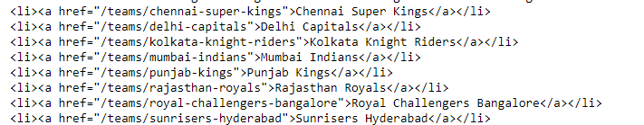
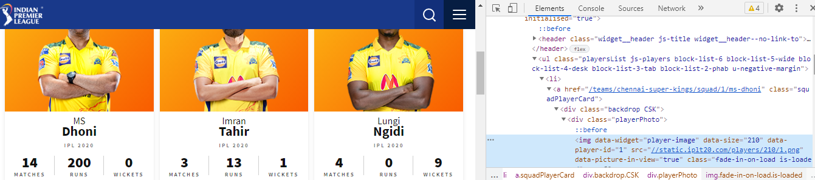
IPL Data
Data available in web pages
Data of the Player available in internal web pages

Slide 9
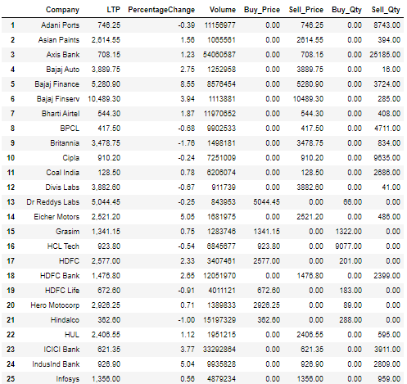
Stock Market

Slide 10
Data Gathering from Wikipedia
For the successful completion of the project we require , set of variables and their relation with other parameters to analyze the impact.
The Data collected contains parameters such as,
Name of the countries.
World Rankings in various indices.
Population Data.
Literacy Rate.
Life Expectancy.

Slide 11
Data Collection
Website1:
https://en.wikipedia.org/wiki/List_of_countries_and_dependencies_by_population
From this website. I have gathered data of world countries and their population,ranking and share of their population in world population.
Website2:
https://en.wikipedia.org/wiki/Good_Country_Index#2017_Top_163_Overall_Rank_(Version_1.2)
From this website various indices and ranking of various countries are collected.

Slide 12
Contd…
Website3:
https://en.wikipedia.org/wiki/List_of_countries_by_literacy_rate
The data gathered from this website contains literacy rates of various age groups.
Website4:
https://en.wikipedia.org/wiki/List_of_countries_by_life_expectancy
This website contains information about life expectancy of people in different countries

Slide 13
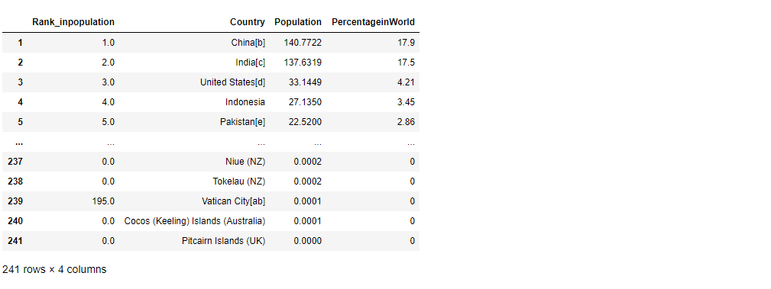
Data Features
Index
Or
Rows
Columns

Slide 14
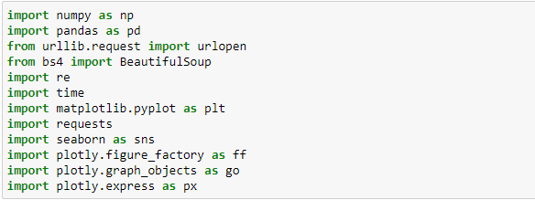
Import Required Libraries
Library Name
Alias Name

Slide 15
Data Cleaning
The Data which we acquire need not be in a structured way for the purpose of analysis. It need to cleaned as per the requirement.
In the above command the Rank_inpopulation contained [] which is needed to be clean .So , I used regular expressions and changed as per the requirement

Slide 16
Data Analysis
The process of
inspecting,
cleansing,
transforming and
modeling data
with the goal of discovering useful information, informing conclusions and supporting decision-making.

Slide 17
There are 6 types of Data Analysis
1. Descriptive Analysis.
2.Exploratory Analysis.
3.Inferential Analysis
4.Predictive Analysis
5.Causal Analysis
6.Mechanistic Analysis

Slide 18
Data Analysis
This stage helps us to find any errors or outliers are present in the data and conclusions can also be drawn. I have done various analysis like
Univariate analysis
Bivariate analysis
Multivariate analysis
All these analysis are done and represented both in Non graphical and graphical ways.

Slide 19
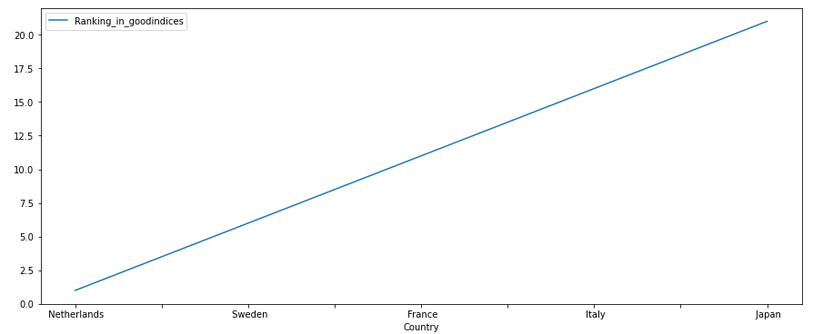
Univariate Analysis

Slide 20
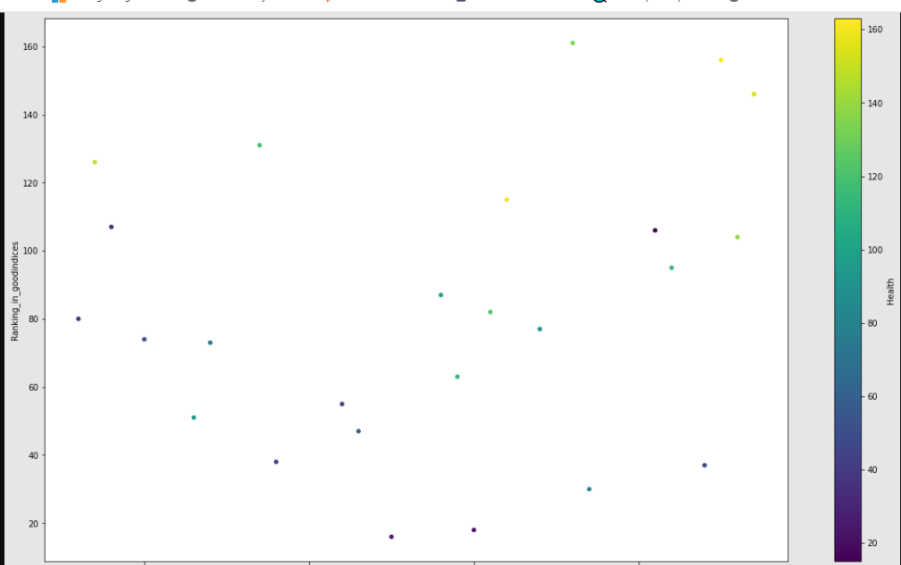
Bivariate Graphical

Slide 21
Conclusion
After completion of the Project we can now relate various parameters like.
Rank in Population Versus Population
Rank in Good Indices Versus Population
Literacy Rate Versus Rank in Good Indices
We can take any parameters for analysis as all the data is available.

Slide 22

THANK YOU

