Slide 1
Attrition Summary Report

Slide 2
Department Summary - Table
Educationfield | Gender | Attrition | N | Pct | Above Industry Avg | Cost Of Attrition
Human Resources | Female | Yes | 3 | 37.50% | Yes | $121,700
Technical Degree | Male | Yes | 19 | 27.14% | Yes | $770,767
Human Resources | Male | Yes | 4 | 26.67% | Yes | $162,267
Marketing | Male | Yes | 17 | 21.79% | Yes | $689,633
Technical Degree | Female | Yes | 9 | 20.45% | Yes | $365,100
Marketing | Female | Yes | 10 | 17.54% | Yes | $405,667
Medical | Male | Yes | 39 | 16.32% | Yes | $1,582,100
Life Sciences | Female | Yes | 32 | 15.38% | Yes | $1,298,133
Life Sciences | Male | Yes | 43 | 13.78% | Yes | $1,744,367
Medical | Female | Yes | 18 | 11.76% | Yes | $730,200
Other | Male | Yes | 5 | 11.11% | Yes | $202,833
Other | Female | Yes | 2 | 9.52% | Yes | $81,133

Slide 3
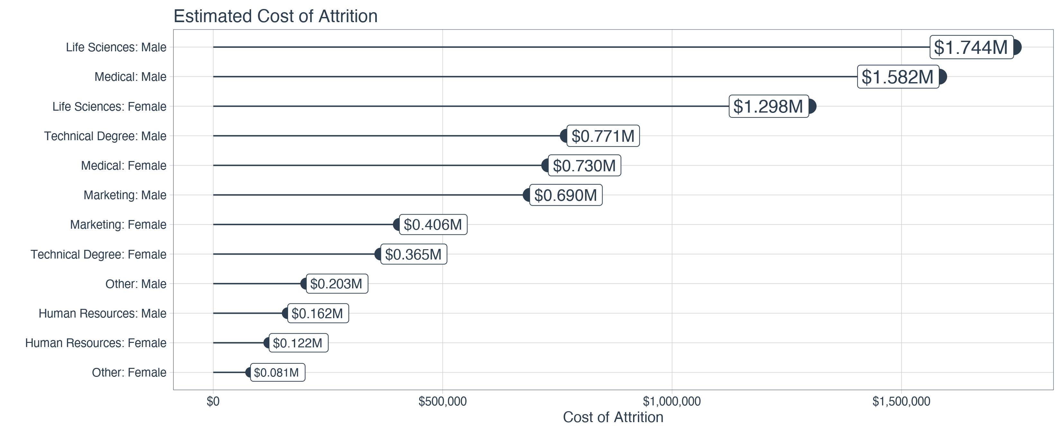
Department Summary - Plot

