Slide 1

CAP538 / ADA Notes
Basic Computational
Models
Algorithm Design and Analysis (ADA)
How algorithm costs are defined, counted, and compared.

Slide 2

What is a computational model?
A model gives ADA a controlled way to measure algorithms independent of specific hardware.
CORE IDEA
A simplified mathematical machine that states what operations are allowed and how much each operation costs.
Defines available instructions
Defines memory access rules
Assigns cost to operations
Lets algorithms be compared fairly
Input
Algorithm
Model
Cost
ADA • Basic Computational Models
02

Slide 3
Why ADA needs models
Measured seconds vary by machine; operation counts reveal algorithmic behavior.
H
Hardware noise
≍
Fair comparison
R
Resource focus
CPU speed, compiler, language, and OS can change real running time.
The same cost rules let linear search and binary search be compared meaningfully.
A model tells whether to count time, space, I/O, communication, or bits.
Linear search: up to n comparisons
Binary search: about log₂ n comparisons
External sort: count block transfers
Asymptotic view: ignore constants → keep growth rate
ADA • Basic Computational Models
03

Slide 4
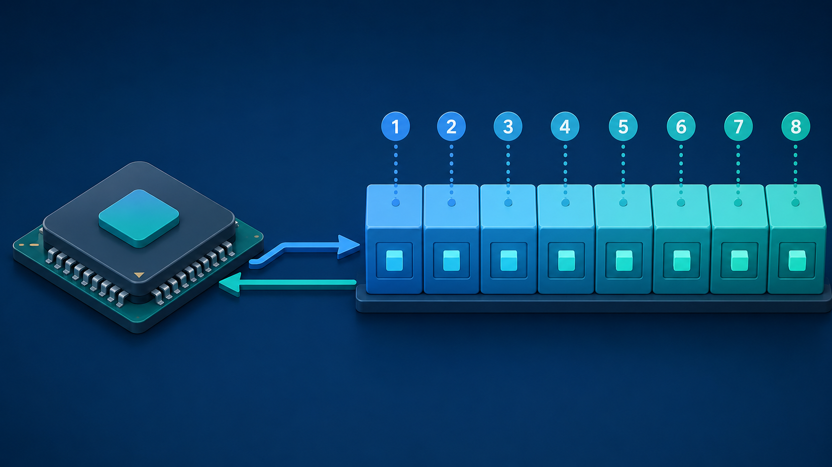
RAM model: the standard ADA baseline
Random Access Machine: one processor, direct memory access, constant-time basic operations.
ASSUMPTIONS
Instructions execute sequentially
Any memory location can be accessed directly
Array access A[i] is treated as O(1)
Ordinary arithmetic/comparison is O(1)
Enough memory is available for the algorithm
A[0], A[100], A[100000] → same access cost
Best for: loops, arrays, variables, arithmetic
ADA • Basic Computational Models
04

Slide 5
Counting operations under RAM
Example: summing an array takes time proportional to the number of elements.
sum = 0
for i = 0 to n − 1
sum = sum + A[i]
return sum
1
2
3
4
5
6
7
8
Visit each element once
n array accesses
n additions
n assignments / loop steps
T(n) = an + b ⇒ O(n)
ADA • Basic Computational Models
05

Slide 6
Word-RAM and cost of arithmetic
A stronger model for machine words, bit operations, and very large numbers.
WORD-RAM
Memory is organized into fixed-size words. One word stores an index, address, or normal machine integer.
Uniform-cost model
Every arithmetic operation counts as O(1), regardless of operand size.
word size: w = Θ(log n) bits
Logarithmic-cost model
Cost depends on the number of bits. Adding b-bit integers usually costs O(b).
Use bit-cost models for cryptography & big integers
ADA • Basic Computational Models
06

Slide 7
Comparison and decision-tree models
Used when an algorithm learns only through comparisons such as <, >, or =.
KEY ADA RESULT
a < b?
Any comparison-based sorting algorithm must distinguish n! possible input orders.
height ≥ log₂(n!) = Ω(n log n)
b < c?
a < c?
Merge sort and heap sort match this lower bound
order 1
order 2
order 3
order 4
Counting/radix sort can beat it by using key structure
ADA • Basic Computational Models
07

Slide 8
Pointer machine model
Memory is reached by following pointers instead of calculating arbitrary addresses.
Array under RAM
A[i] address can be computed directly.
node
1
→
node
2
→
node
3
→
node
4
access = O(1)
Following pointers one by one
Accessing the i-th node can require i pointer traversals.
Linked list under pointer model
Must traverse from head to target node.
worst case = O(n)
ADA • Basic Computational Models
08

Slide 9
Recursive model and recurrence relations
Divide-and-conquer algorithms are analyzed by expressing work in terms of smaller subproblems.
TYPICAL RECURRENCES
n
Binary search: T(n)=T(n/2)+O(1) → O(log n)
n/2
n/2
Merge sort: T(n)=2T(n/2)+O(n) → O(n log n)
n/4
n/4
n/4
n/4
The model highlights the cost of branching, combining results, and recursion depth.
Problem splits into smaller instances
ADA • Basic Computational Models
09

Slide 10
Turing machine: theoretical foundation
A precise model for what can be computed and how complexity classes are defined.
MACHINE PARTS
Infinite tape divided into cells
Read/write head
0
0
1
0
0
Finite control states
Transition function
read/write head
P
NP
Undecidable
Less convenient for daily algorithm counting, but essential for computability and complexity theory.
ADA • Basic Computational Models
10

Slide 11

Modern computational models
When the bottleneck is not just CPU instructions.
1
PRAM / parallel
Many processors; measure work, span, speedup.
2
External memory
Input too large for RAM; count block transfers.
3
Streaming
Process data in few passes with small memory.
4
Distributed
Multiple machines; communication becomes central.
Choose the model that captures the true bottleneck
ADA • Basic Computational Models
11

Slide 12
Choosing the right model
The same algorithm can have different costs under different assumptions.
EXAM TAKEAWAY
Problem setting
Model to use
A computational model is the bridge between an algorithm description and its complexity analysis.
General sequential algorithms
RAM
Bit tricks / hashing / integers
Word-RAM
Sorting by comparisons
Comparison / decision tree
State the model before analyzing
Linked structures
Pointer machine
Identify constant-time operations
Huge disk-based data
External memory
Count the dominant resource
Real-time massive streams
Streaming
Express growth with Big-O / Θ / Ω
Cloud / networked systems
Distributed
Model + operation count = complexity
ADA • Basic Computational Models
12

