Slide 1

CAP538 • ALGORITHM DESIGN AND ANALYSIS
Basic Computational
Models
A visual ADA guide to how algorithms are measured, compared, and reasoned about.
Model → Operations → Cost → Complexity

Slide 2

What is a computational model?
A controlled way to measure algorithms independent of a particular computer.
CORE IDEA
A simplified mathematical machine that states what an algorithm may do and how much each action costs.
Allowed operations
Memory access rules
Cost of each operation
Resources being measured
Input
Algorithm
Model
Cost
ADA • Basic Computational Models
02

Slide 3
Why ADA needs models
Measured seconds vary by machine; operation counts reveal algorithmic behavior.
H
Hardware noise
≍
Fair comparison
R
Resource focus
CPU speed, compiler, language, and OS can change real running time.
The same cost rules let two algorithms be compared meaningfully.
The model tells whether to count time, space, I/O, communication, or bits.
Linear search:
≤ n comparisons
Binary search:
≈ log₂ n comparisons
External sort:
count block transfers
Asymptotic view: ignore constants → keep growth rate
ADA • Basic Computational Models
03

Slide 4
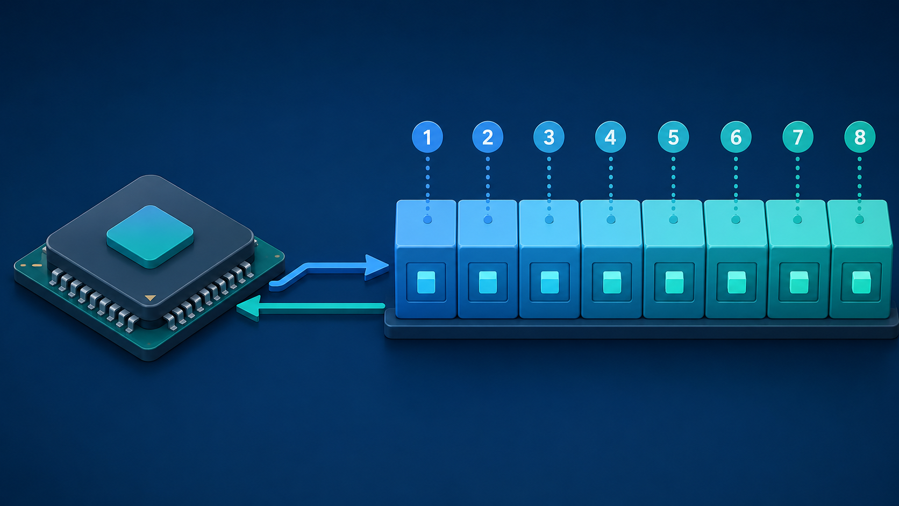
RAM model: the standard ADA baseline
Random Access Machine: one processor, direct memory access, constant-time basic operations.
ASSUMPTIONS
Instructions execute sequentially
Any memory location can be accessed directly
Array access A[i] is treated as O(1)
Ordinary arithmetic/comparison is O(1)
Enough memory is available for the algorithm
A[0], A[100], A[100000] → same access cost
Best for: loops, arrays, variables, arithmetic
ADA • Basic Computational Models
04

Slide 5
Counting operations under RAM
Example: summing an array takes time proportional to the number of elements.
sum = 0
for i = 0 to n − 1
sum = sum + A[i]
return sum
1
2
3
4
5
6
7
8
Visit each element once
n array accesses
n additions
n loop steps
T(n) = an + b ⇒ O(n)
ADA • Basic Computational Models
05

Slide 6
Word-RAM and arithmetic cost
A stronger model for machine words, bit operations, and very large numbers.
WORD-RAM
Uniform-cost
Memory is organized into fixed-size words. One word stores an index, address, or normal machine integer.
Every arithmetic operation counts as O(1), regardless of operand size.
word size: w = Θ(log n) bits
Logarithmic-cost
The cost depends on the number of bits in the operands; better for huge integers.
b-bit addition ≈ O(b)
ADA • Basic Computational Models
06

Slide 7

Comparison model
Only comparisons reveal information about element order.
ALLOWED TESTS
a < b a > b a = b
Used for comparison-based sorting
Works when actual key values are hidden
Worst-case lower bound for sorting is Ω(n log n)
Merge sort and heap sort match this bound
n! possible orders → decision tree height ≥ log₂(n!)
ADA • Basic Computational Models
07

Slide 8
Decision tree model
A visual model for the sequence of tests an algorithm performs.
HOW TO READ IT
Internal nodes are tests or comparisons
Branches are possible outcomes
Leaves are final answers
Tree height gives worst-case decisions
Average leaf depth can estimate average-case cost
For sorting: minimum height = Ω(n log n)
ADA • Basic Computational Models
08

Slide 9
Pointer machine model
Best for linked structures where access happens by following pointers.
KEY RULE
No direct address arithmetic. To reach data, the algorithm moves from record to record through pointers.
Linked lists
Trees
Graphs
Dynamic sets
node 1
node 2
node 3
node 4
node 5
Array A[i]: O(1) | Linked-list ith node: O(i)
ADA • Basic Computational Models
09

Slide 10
Recursive model: costs as recurrences
Divide-and-conquer algorithms are analyzed by expressing their time recursively.
Binary search
Problem n
T(n) = T(n/2) + O(1) ⇒ O(log n)
Merge sort
n/2
n/2
T(n) = 2T(n/2) + O(n) ⇒ O(n log n)
Solve subproblems, then combine
ADA • Basic Computational Models
10

Slide 11

Turing machine model
The theoretical foundation for computability and complexity classes.
MACHINE COMPONENTS
Infinite tape divided into cells
Read/write head
Finite states
Transition function
Move left or right after each step
Used for P, NP, decidability, and theoretical limits
ADA • Basic Computational Models
11

Slide 12

Parallel models: PRAM
Multiple processors work at the same time over shared memory.
VARIANTS
EREW: exclusive read, exclusive write
CREW: concurrent read, exclusive write
CRCW: concurrent read, concurrent write
Key measures
Work = total operations
Span = longest dependency chain
Speedup = T₁ / Tₚ
Goal: reduce time without wasting work
ADA • Basic Computational Models
12

Slide 13

External-memory and cache models
When memory hierarchy dominates performance, count data movement.
EXTERNAL MEMORY
Input is too large to fit in main memory, so the main cost is block transfers between slow storage and fast memory.
scan N items: O(N / B) block transfers
Cache-aware: uses known cache/block sizes
Cache-oblivious: efficient without explicit cache parameters
Important for large sorting, databases, and analytics
ADA • Basic Computational Models
13

Slide 14


Streaming and distributed models
Modern data often arrives continuously or lives across many machines.
Streaming model
Distributed model
One or few passes; limited memory; often approximate.
Separate machines communicate through messages; minimize communication rounds and volume.
ADA • Basic Computational Models
14

Slide 15
Choosing the right model
Use the model that matches the resource bottleneck of the problem.
Problem environment
Good model
General loops/arrays
RAM
Bit tricks, integer keys
Word-RAM
Comparison sorting
Comparison / decision tree
Linked lists, trees, graphs
Pointer machine
Divide and conquer
Recurrence model
Theory of computation
Turing machine
Multicore / shared memory
PRAM
Huge disk-based data
External-memory / cache
Data streams / cloud systems
Streaming / distributed
Always state your assumptions before deriving complexity.
ADA • Basic Computational Models
15

Slide 16
Quick recap
The model decides what “one step” means.
A computational model defines the rules of the machine, the operations allowed, and the cost assigned to those operations.
RAM is the default model for most ADA analysis
Use special models when memory, communication, bits, or parallelism dominate
Correct model choice makes time and space complexity meaningful
Algorithm + Model = Analysis
ADA • Basic Computational Models
16

