Slide 1

Jira: What is Jira?
Jira is a project management and issue-tracking tool used by software development and IT teams.
Purpose
Basic Concepts
Manage projects, track bugs, assign work, monitor progress, and organize workflows.
Project, Issue/Task, Assignee, Priority, Status.
Example Flow
Developer creates a task → assigned → works → reviewed → completed.

Slide 2
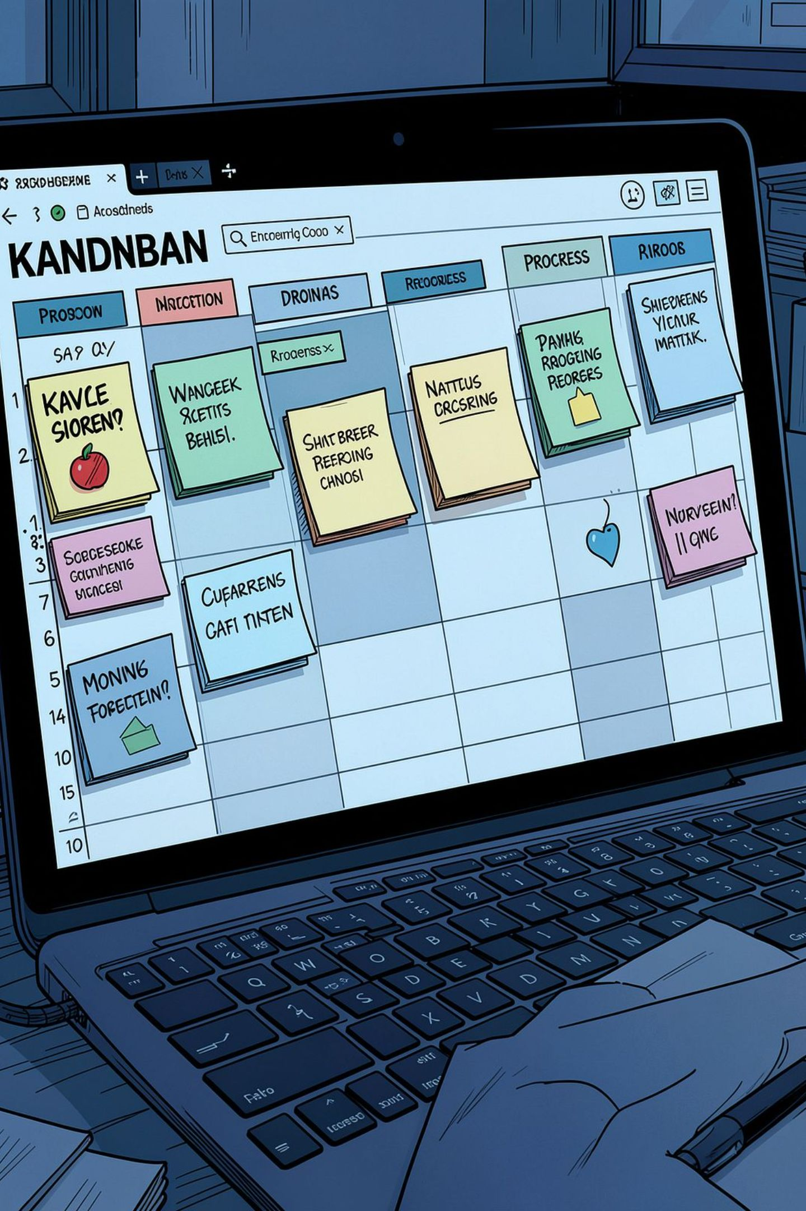

How Jira Works
Basic workflow: Create → Assign → Work → Review → Done
Simple Example
Library Management System tasks:
Create & Manage
Login Module — Ajay — In Progress
Database Design — Rahul — Done
Book Search — Amit — To Do
Fix Login Bug — Priya — Testing
Create tasks, report bugs, set deadlines.
Assign & Track
Key benefit: Central place to see what needs doing, who’s doing it, and what’s done.
Assign to team members, track status on boards.
Reports
Generate progress and performance reports.

Slide 3

Slack: What is Slack?
Slack is a team communication and collaboration platform — a digital workspace for conversations, files, and updates.
Purpose
Basic Concepts
Team communication, instant messaging, file sharing, group discussion, notifications.
Workspace, Channel, Direct Message, Thread.
Example Channels
#general, #development, #project-lms, #testing

Slide 4
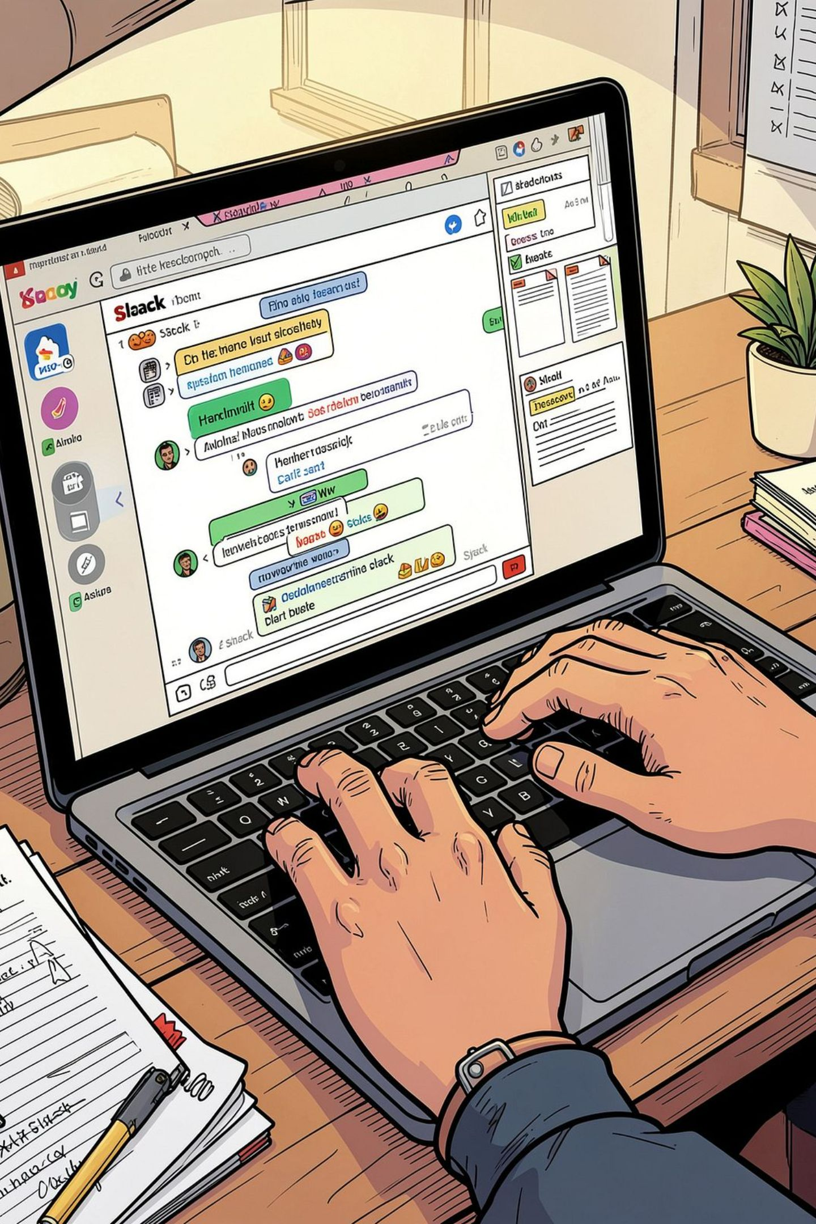

How Slack Works
Communication flow: Workspace → Channel → Message → Thread → Collaboration
Common Features
Example
Instant messaging, group & private channels
Threads, file sharing, notifications, search
Voice/video meetings, integrations with tools
Manager posts in #development → developer replies in thread → team discusses → file/code shared → work continues.
Key benefit: Faster, organized communication that reduces unnecessary email.

Slide 5
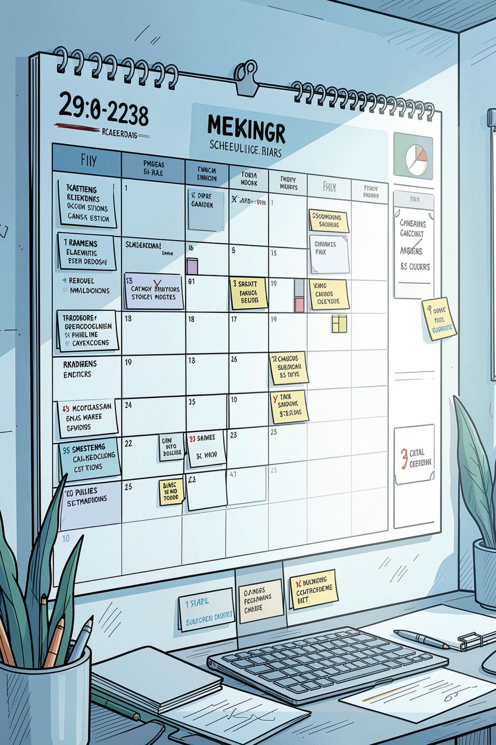
Calendar: What is Calendar?
Calendar apps (e.g., Google Calendar, Outlook) are scheduling and time-management tools for meetings, events, reminders, and deadlines.
Purpose
Basic Concepts
Schedule meetings, manage appointments, set reminders, avoid conflicts.
Event, Meeting, Reminder, Recurring Event, Invitation.
Example
Team Meeting — Mon 10:00–11:00 — Participants invited — Reminder 10 minutes before.

Slide 6
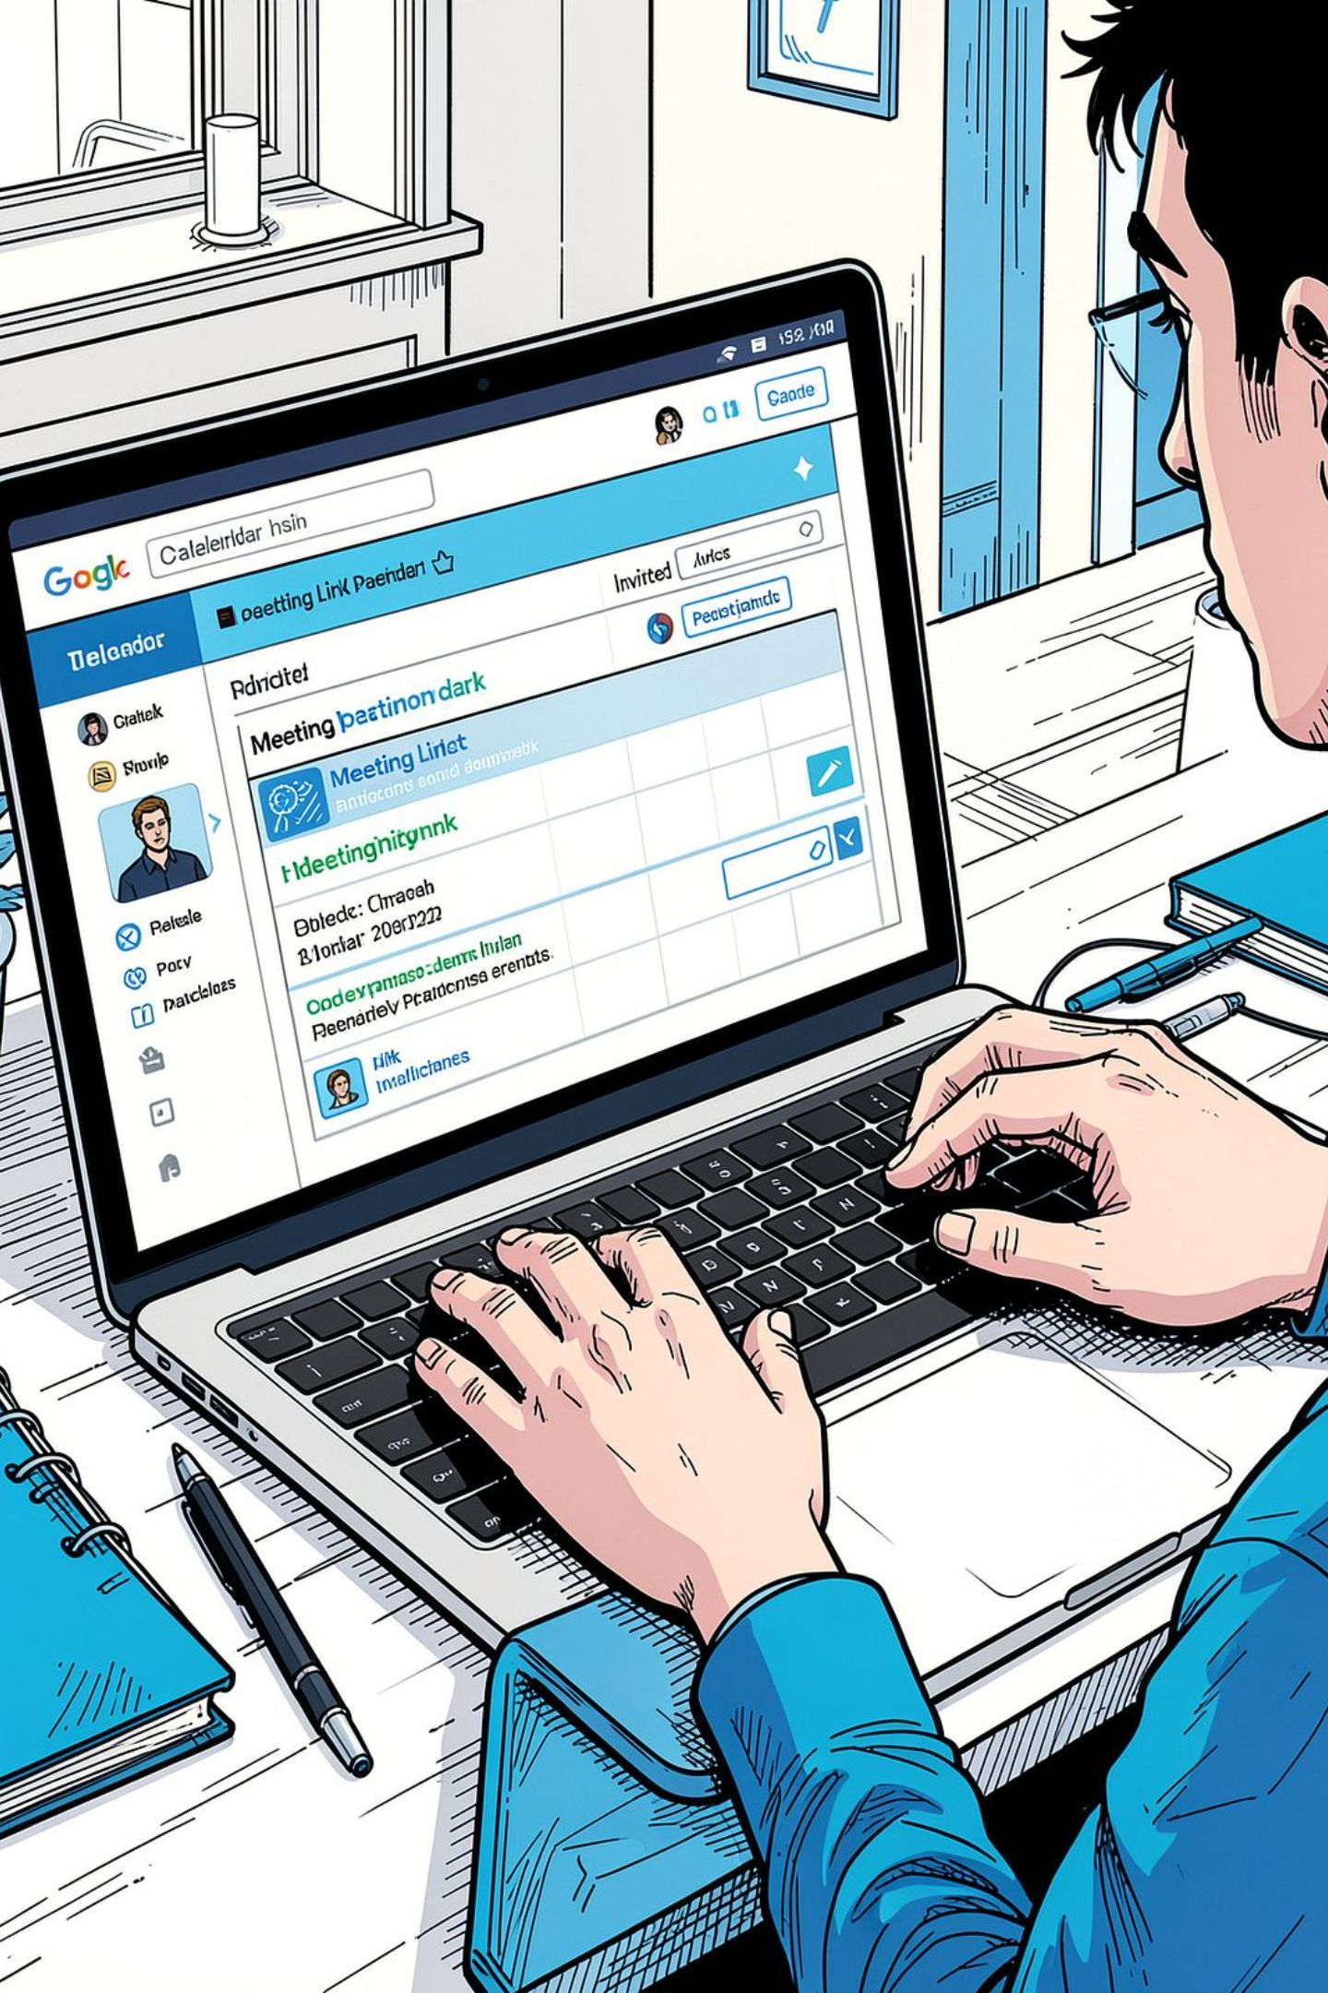

How Calendar Works
Process: Create Event → Add Details → Invite People → Reminder → Meeting → Complete
01
Example Event
Create Event
Project Review — Monday 11:00–12:00 — Development Team — Online — Reminder 15 minutes before.
Title, date, time, duration.
02
Key benefit: Coordinate schedules and manage time effectively.
Invite & Confirm
Add participants and location or online link.
03
Remind & Attend
Set reminders and check availability.

Slide 7
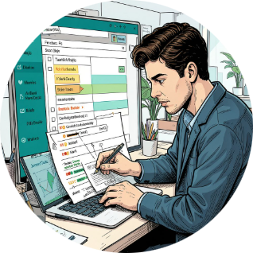
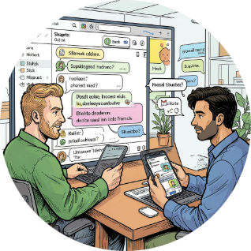
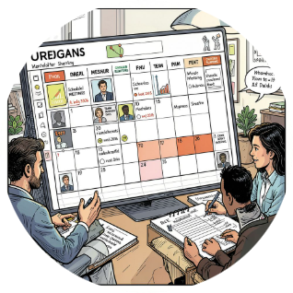
Conclusion
Jira
Slack
Calendar
Manages and tracks work — centralizes tasks, status, and progress.
Manages communication — organized, fast conversations and file sharing.
Manages time — schedules meetings, avoids conflicts, sends reminders.
Summary
Jira manages the work, Slack manages the communication, and Calendar manages the time.
Improves team collaboration
Boosts productivity and visibility
Streamlines task management, communication, and scheduling

