Slide 1
Knapsack Problem
Given a set of items, each with a weight and a value, determine a subset of items to include in a collection so that the total weight is less than or equal to a given limit and the total value is as large as possible.

Slide 2
Greedy Strategy
Greedy Criterion I
Items are arranged by their values , here the item with
maximum value is selected first
Greedy Criterion II
Items arranged by their weights, items with lightest weight is selected first
Greedy Criterion III
Items are arranged by certain ratio (ratio of value over weight), here the selection proceeds from maximum ratio to minimum one

Slide 3
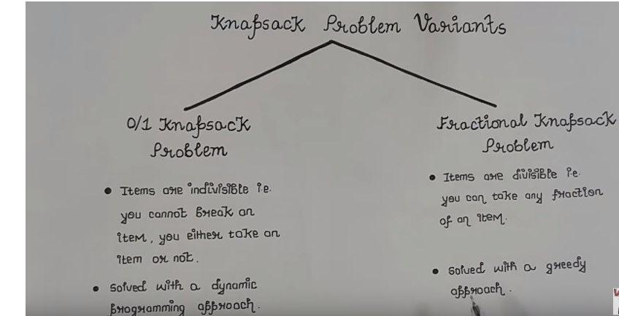

Slide 4
Applications
Finding the least wasteful way to cut raw materials
portfolio optimization
Cutting stock problems

Slide 5
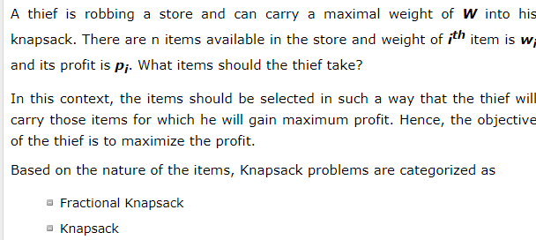
Problem Scenario

Slide 6
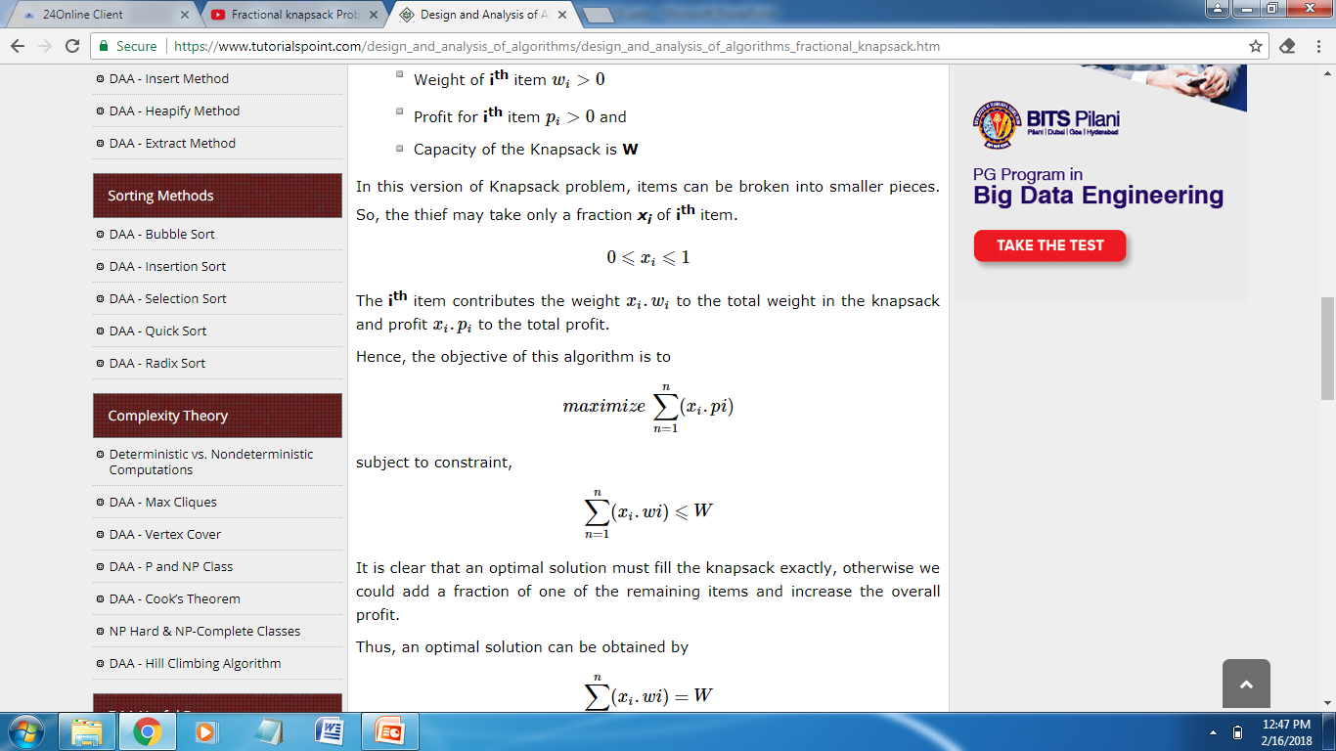
Problem
N number of items
Wi. . . . . . . . Wn Weight associated with items
Pi . . . . . . . . Pn Profit associated with items
Knapsack with certain capacity

Slide 7
Problem Domain

Slide 8
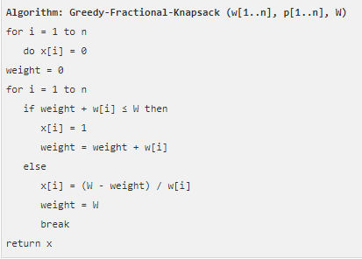
Algorithm

