Slide 1
Data Analyst Take Home Assignment Solution
Prepared by – Ajay Rai
Date- 8 November 2021

Slide 2

Executive Summary
Businesses can gain valuable insights about their customers' behavior by converting their customer data into cohort analysis charts. The presentation includes data manipulation, cohort charts, a cohort layer cake chart, and insights.

Slide 3
Contents
Initial setup
Methodology
EDA and handling missing data
Cohort analysis charts
Cohort layer cake
Results and conclusion

Slide 4
1. Initial Setup
Used Jupyter notebook (python: pandas) to analyze and manipulate the data
Dataframe had 5725 rows and 5 columns. There were no duplicate entries
Country_card column had 4047 null values.
Three most frequently represented countries were: United States, Australia, and Canada.

Slide 5
2. Methodology
Metrics: - Customer Retention Rate - Net Revenue Retention - Customer Lifetime Revenue - Customer Lifetime Value: need gross margin to calculate this
Assumptions: - assumed that the country of a customer is the country recorded in one of the transaction in “card_country” column. - consider that the first day of transaction for a customer in 2020 is the date of sign-up

Slide 6
3. EDA and handling missing data
The most frequent customer (cus_EBYELf8JdrJyb9) made 131 transactions but has never been registered with any country. One should discuss with team members to figure out the problem.
Grouped dataframe by customer to make a dictionary. Dictionary had country assigned to each customer. Used it to impute null values in ‘card_country’ column.

Slide 7
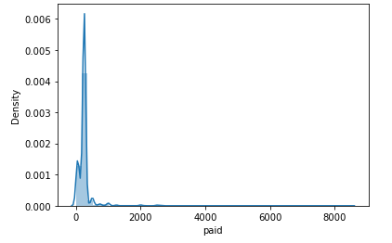
3. EDA and handling missing data
15.48% of customers placed an order more than once
8.67% of customers asked for a refund
There were some infrequent cases of customers, who paid more than 8000

Slide 8
Cohort Analysis Charts
Country | Number of customers
United States | 408
Australia | 71
Canada | 96
The top three most frequent countries are: - United State(US), Australia(AU), and Canada(CA)
Total number of customer from each country:

Slide 9
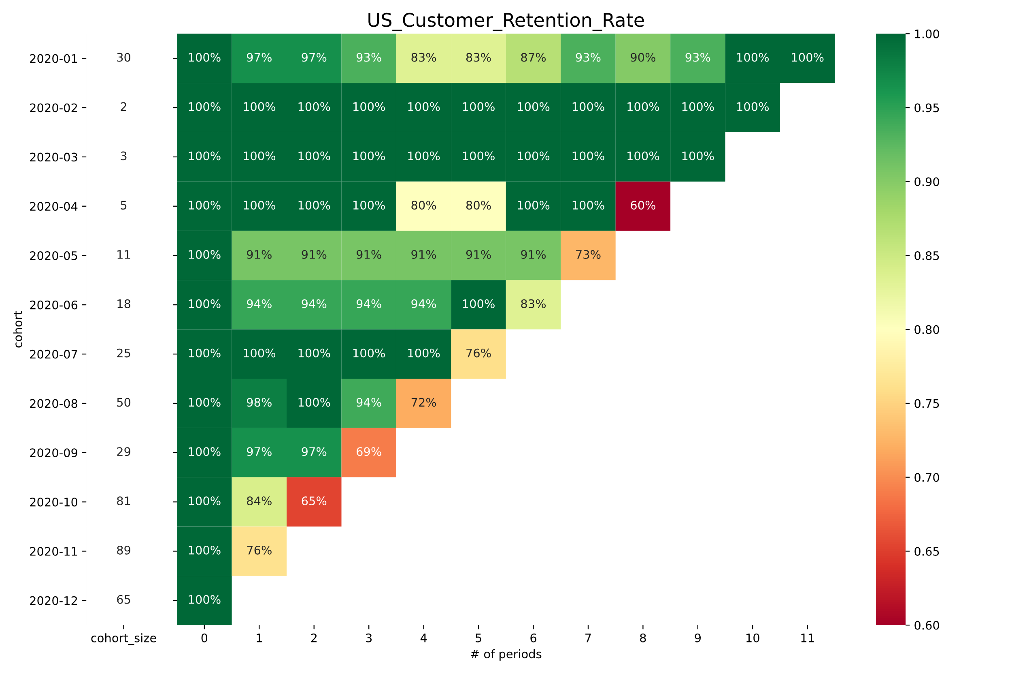
4.1.1 US Customer Retention Rate
Customer retention was low for 8 of the 12 cohorts in last month (2020-12).
Check out what happened in the United States during the month of December.
We can offer them some discounts, so they keep doing business.

Slide 10
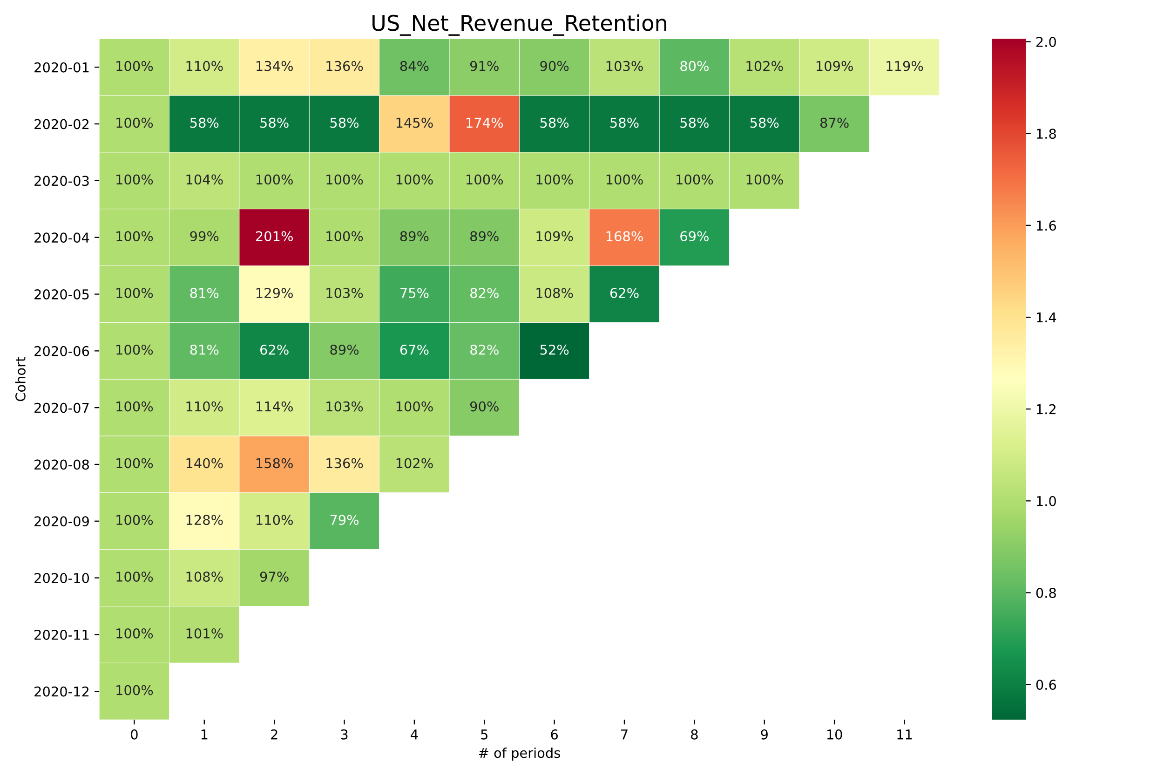
4.1.2 US Net Revenue Retention
Fourth-month cohort show a sudden increase in revenue in second period.
One possible explanation is a subscription upgrade.
We also see higher revenue retention in other cohorts, which could be because the company offered them a deal.

Slide 11
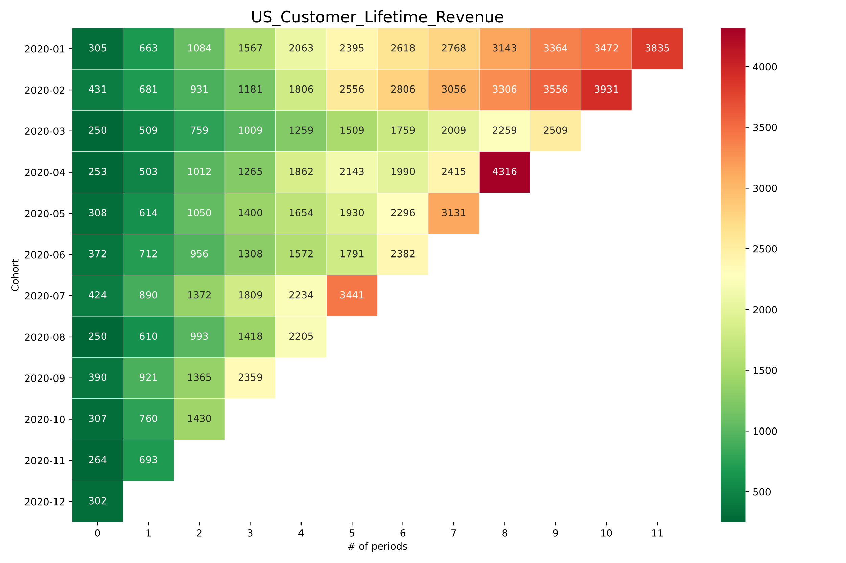
4.1.3 US Customer Lifetime Revenue
According to this graph, the company makes around 4000 from a customer by the end of the year.
The company made a lot of money in the first eight months for the cohort that joined in the fourth month.
It would be fascinating to learn more about the behavior of that specific cohort.

Slide 12
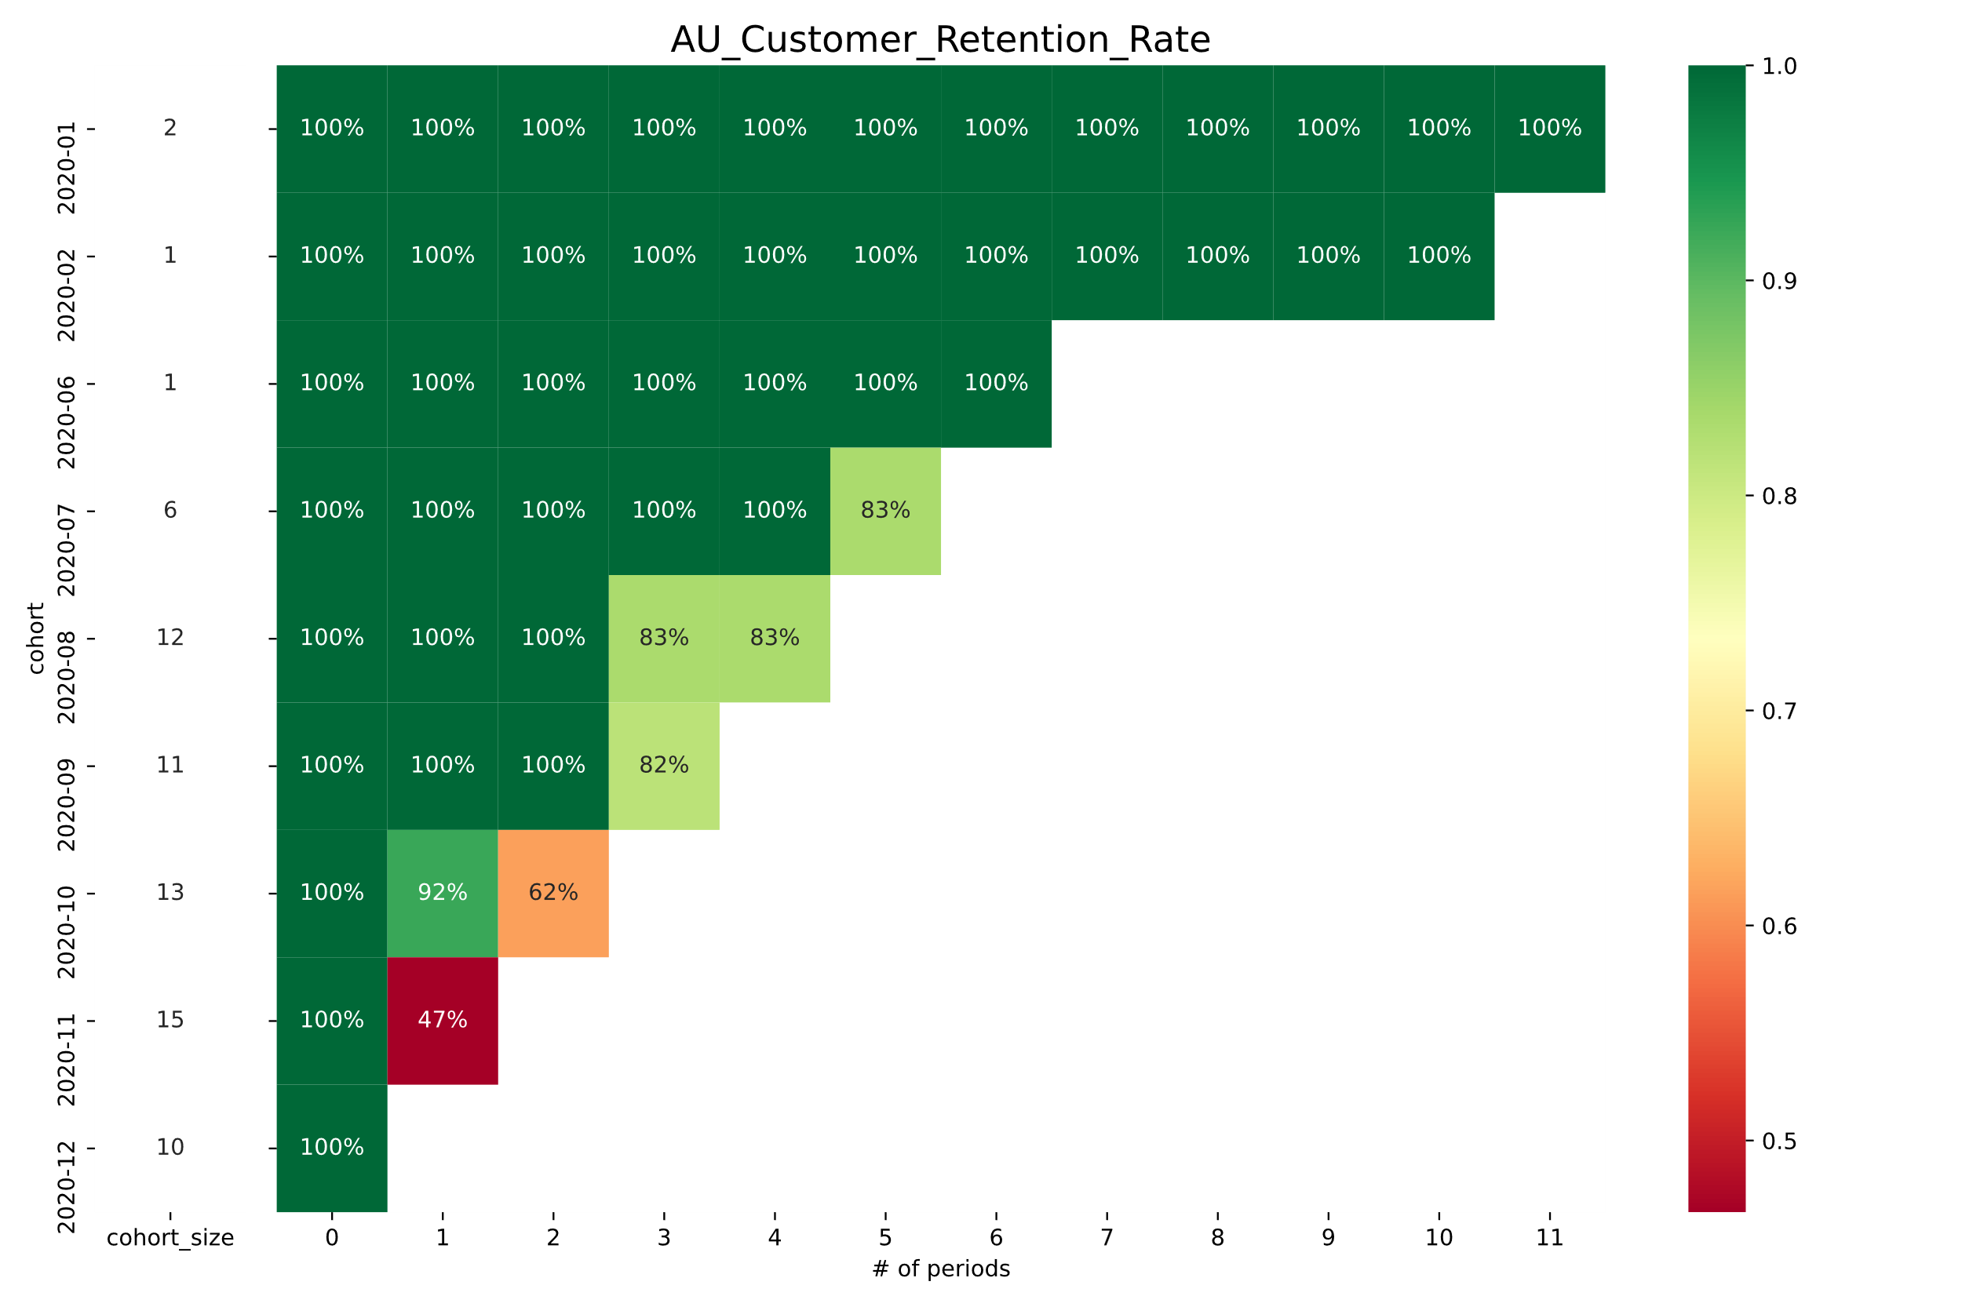
4.2.1 AU Customer Retention Rate
There is no information available for the cohort from the third to the fifth month of 2020.
Very few customers were acquired during the initial months of 2020
Similarly, to the United States, we see a decrease in retention rate for the most recent month, December.
To get an idea, one should discuss it with team members

Slide 13
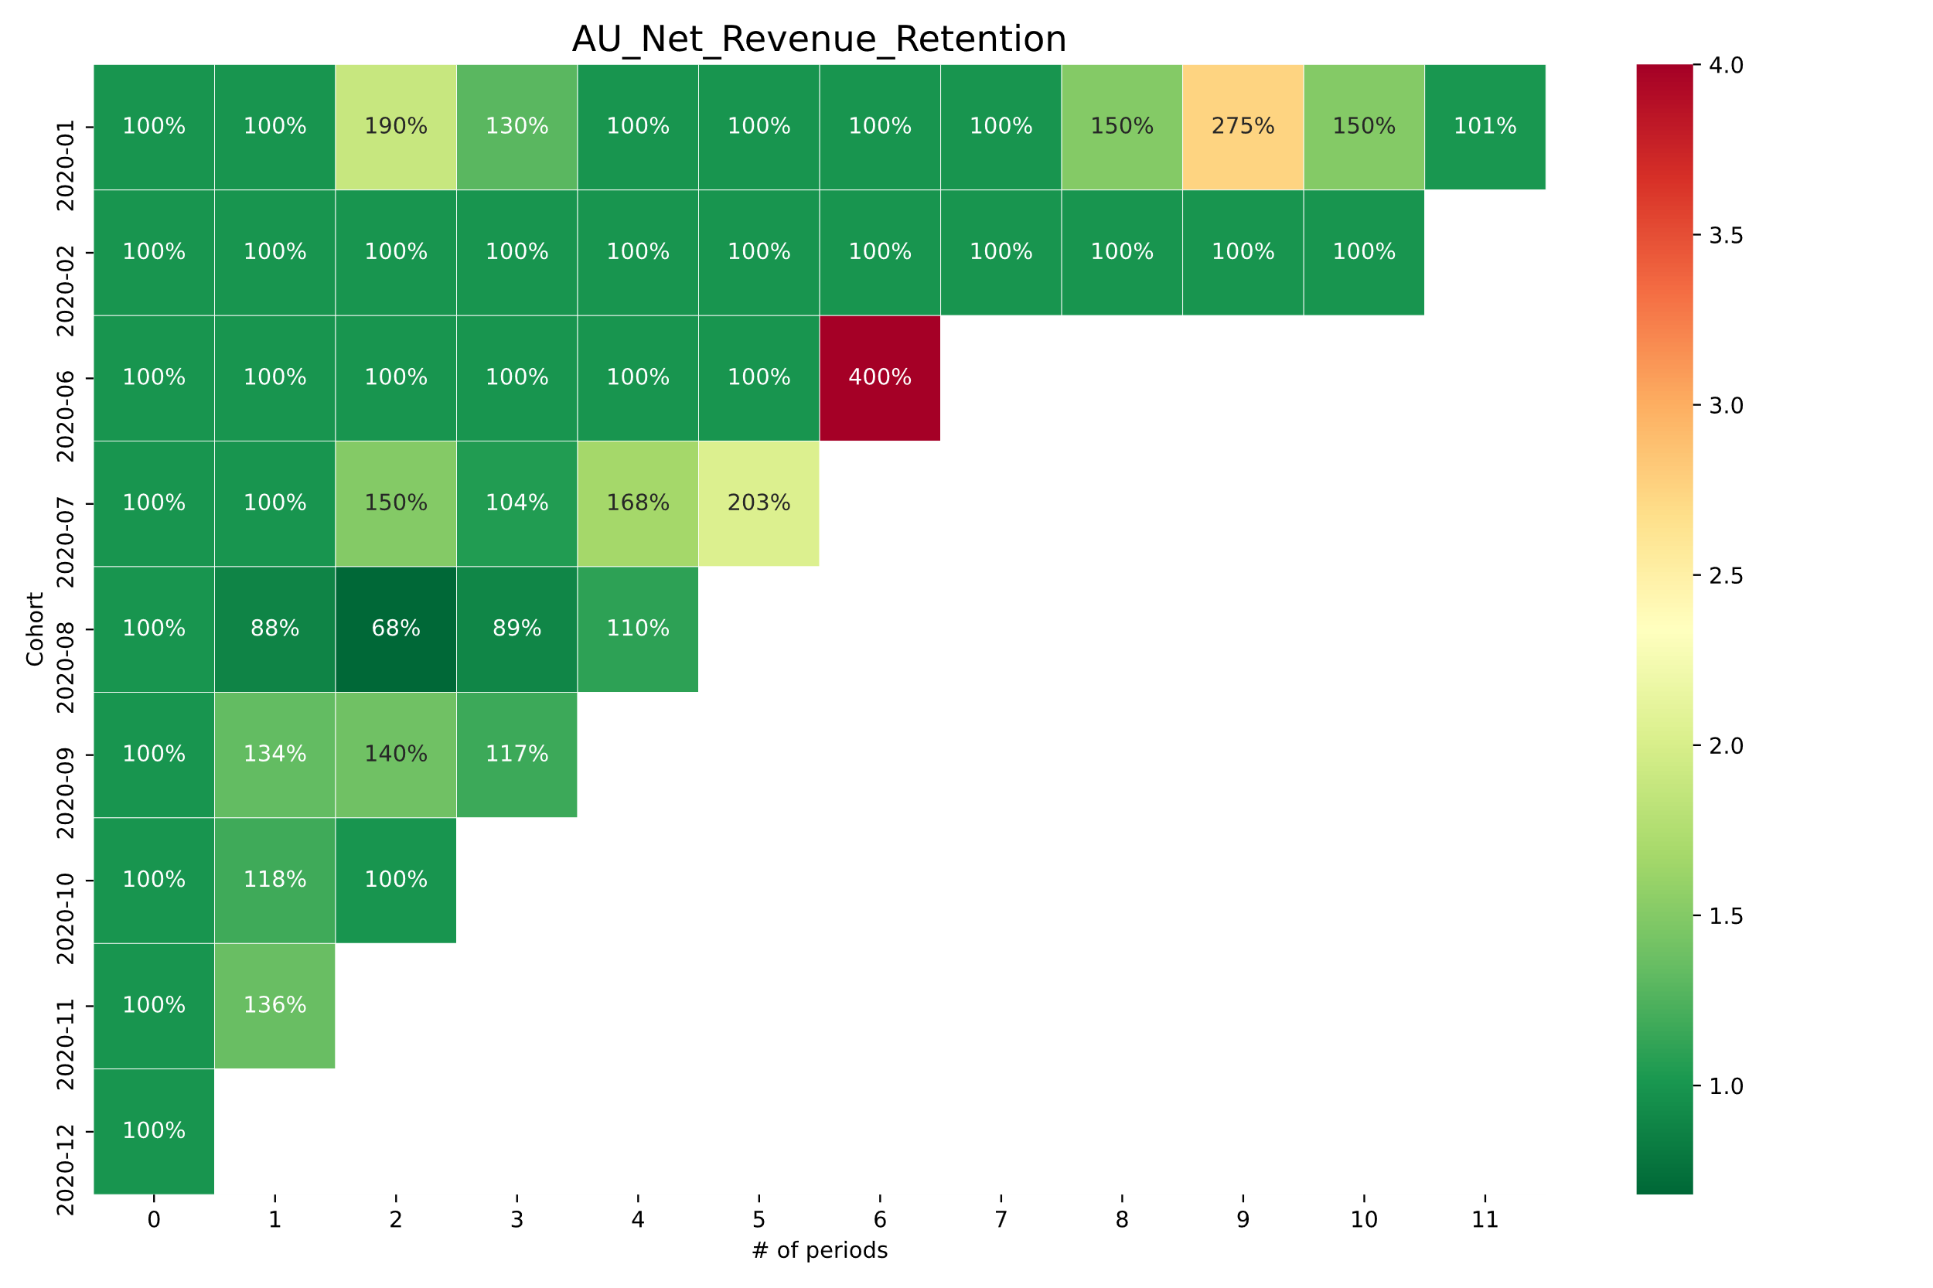
4.2.2 AU Net Revenue Retention
In December, we see an unusual increase in net revenue for the cohort from sixth month.
This cohort may have upgraded their subscription.
Perhaps an offer was made to cohorts from the sixth and seventh months at the end of the year.

Slide 14
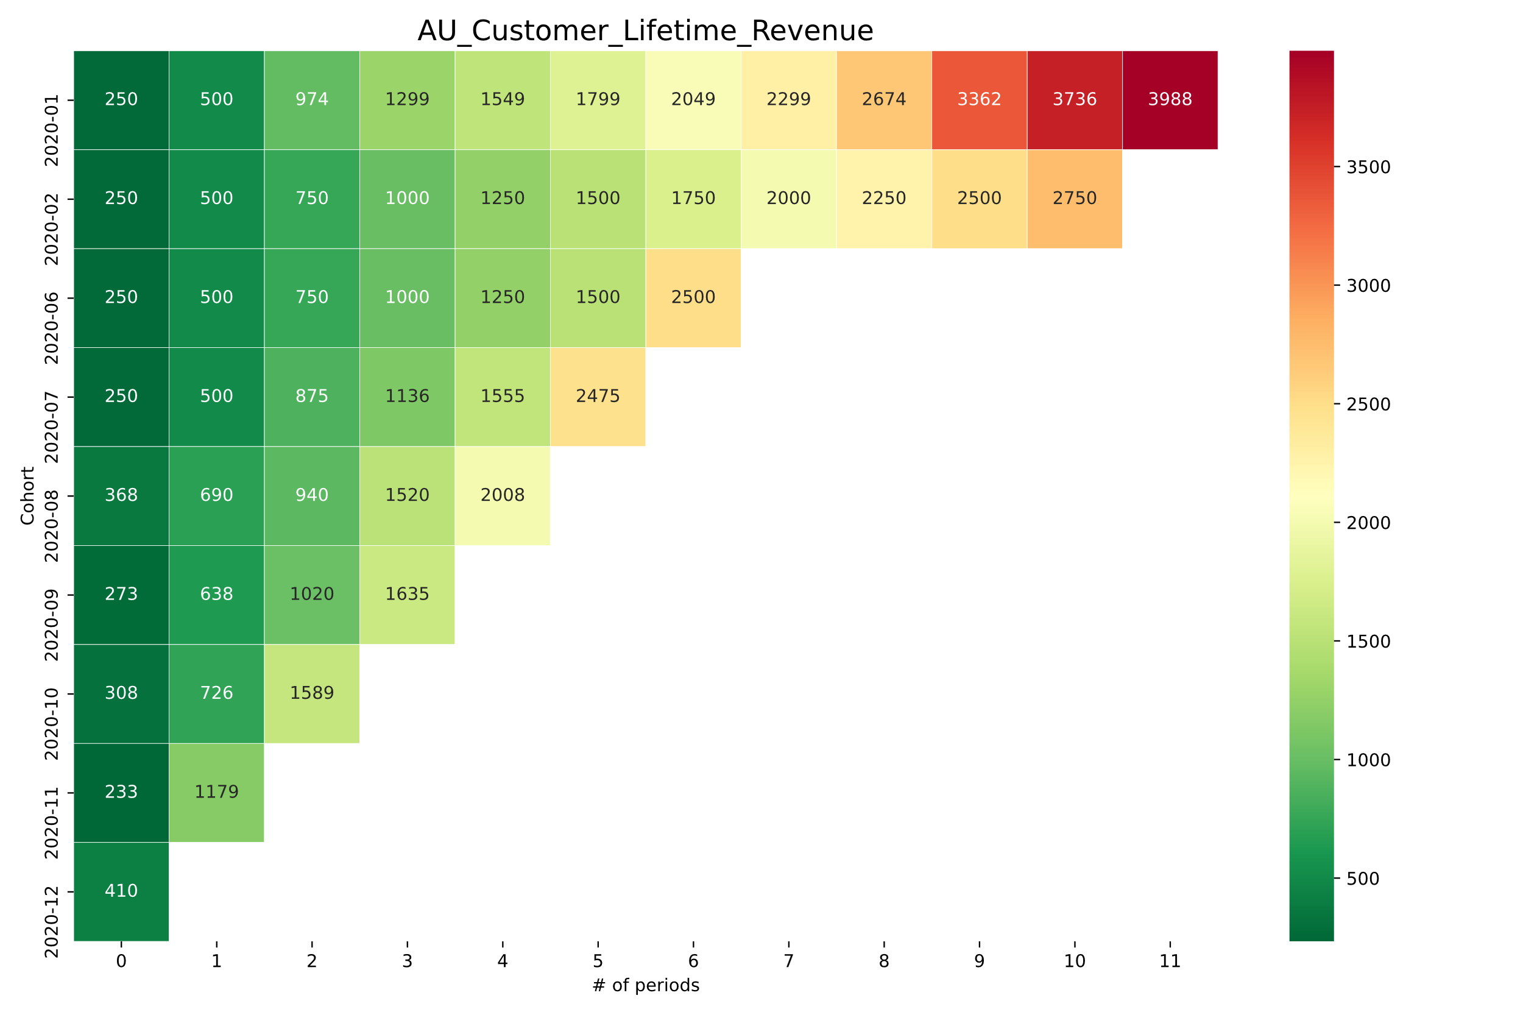
4.2.3 AU Customer Lifetime Revenue
The company earns around $4000 per customer by the end of the first year.

Slide 15
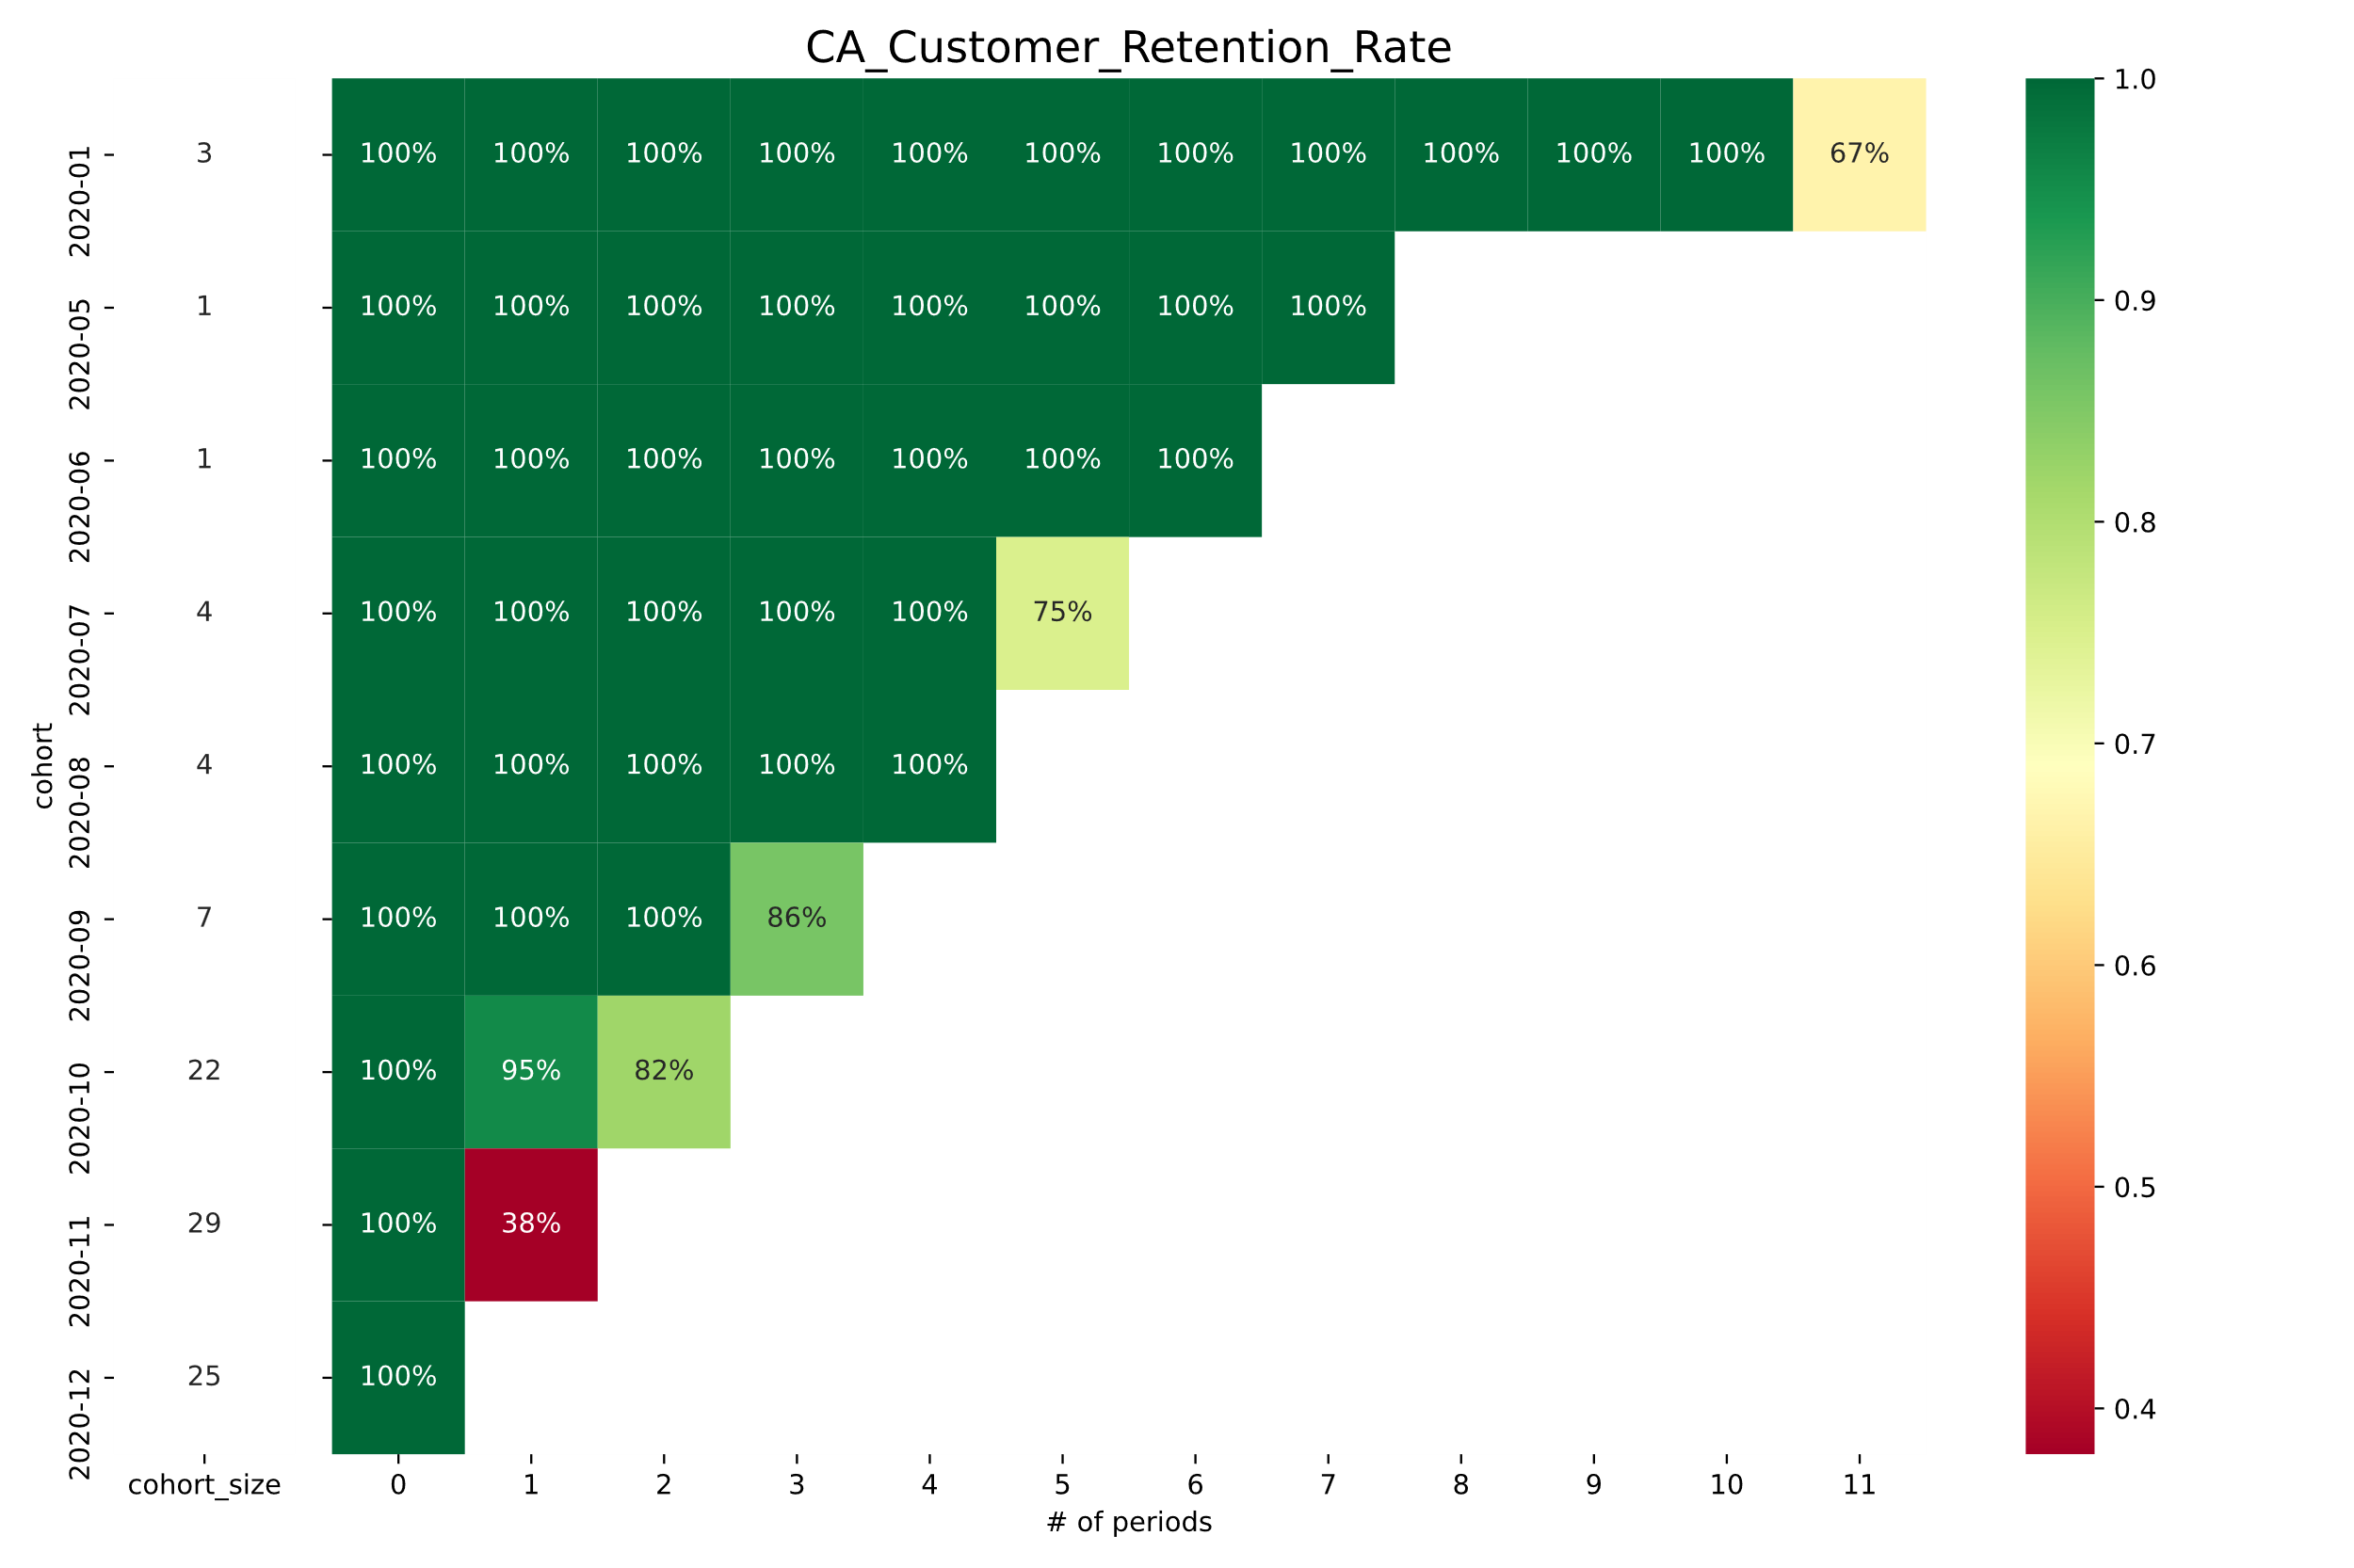
4.3.1 CA Customer Retention Rate
There is no cohort information available for the second, third, or fourth months.
Similarly, the retention rate of cohorts has decreased in the month of December.

Slide 16
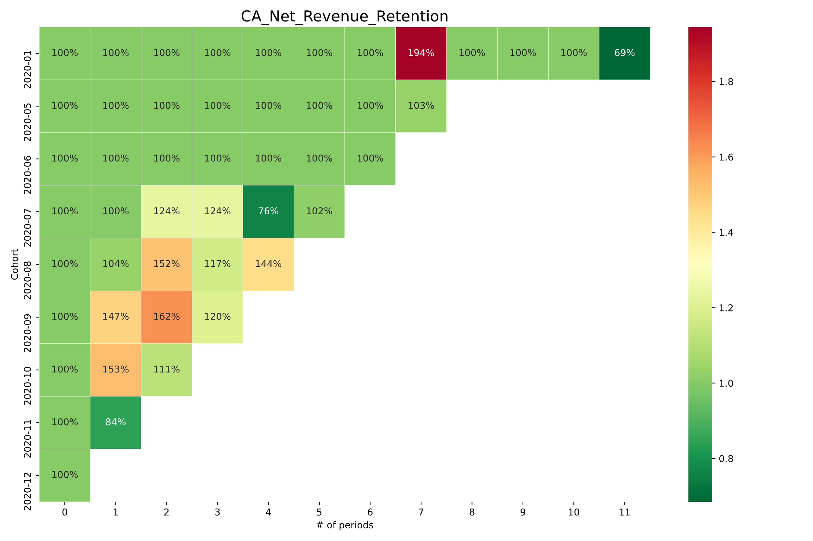
4.3.2 CA Net Revenue Retention
We see a sudden increase in net revenue for the cohort from the first month for the seventh month.
Perhaps that cohort requested an upgrade and then returned to their regular subscription the following month.
Similar reason can be applicable for other observed increase in net revenue.

Slide 17
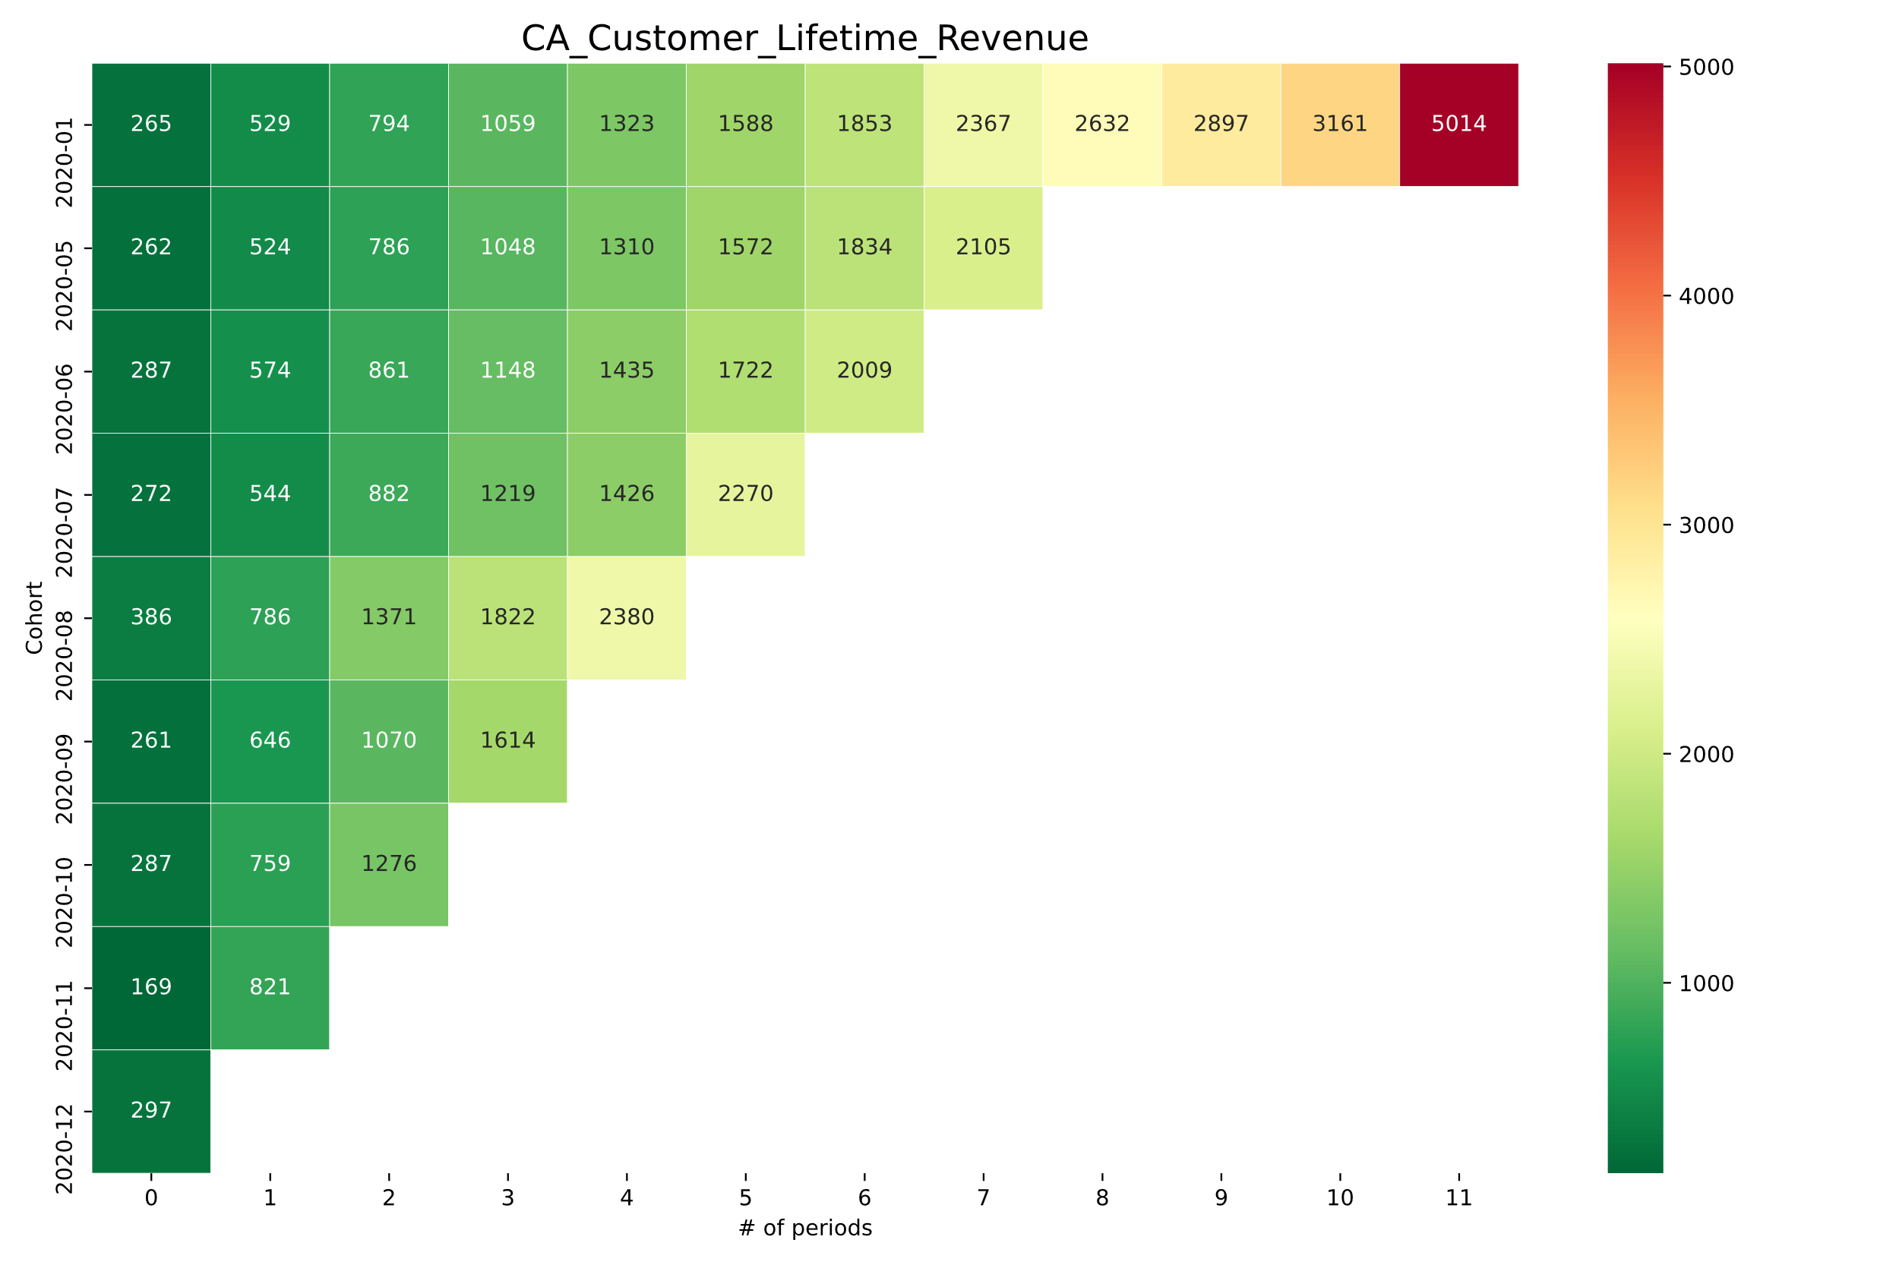
4.3.3 CA Customer Lifetime Revenue
By the end of the year, the company had earned $5,000 from a Canadian customer.
However, there is a significant increase from the eleventh to the twelfth month.
As a result, it might be a good idea to comprehend that abrupt change in one month.

Slide 18
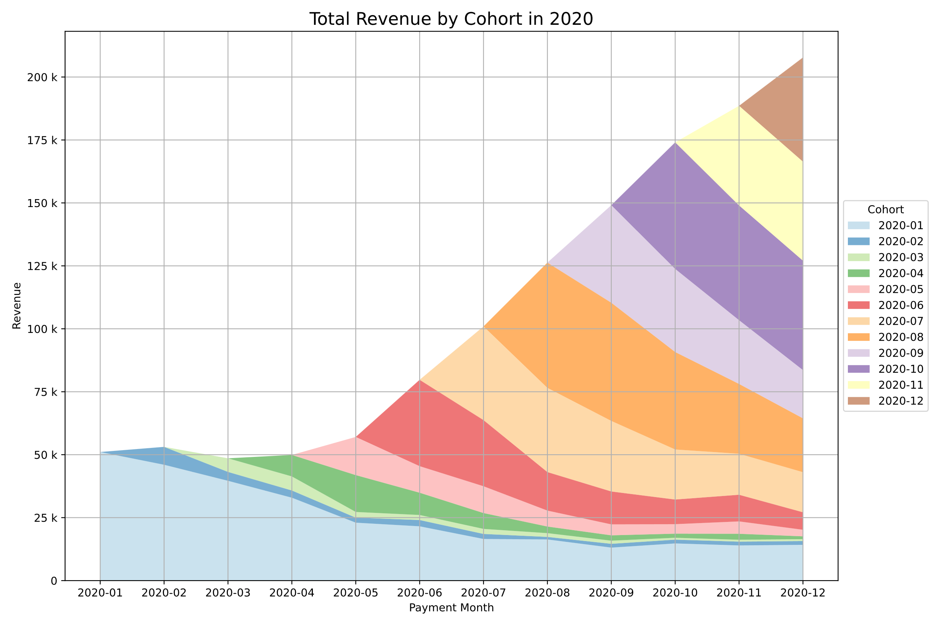
5. Cohort layer cake
Company revenue increased to $200K from $50K by the end of the year.
We can see that the cohort from the second to the fifth month did not contribute significantly to the company's revenue.
One possible explanation is an outbreak of covid-19. Many businesses were impacted by the lockdown.
Perhaps fewer customers were gained during that time, resulting in a low revenue figure for those months.
We also expect a recovery in the coming months.
The decrease in revenue for some cohorts over time, such as the first-month cohort, can be attributed to some customers opting out.

Slide 19
Results and conclusion
During the month of December, cohort retention rates were low in all three countries. To regain customers, one can analyze their behavior and offer them a deal.
In a few cases, we noticed an unexpected increase in net revenue retention. It'd be interesting to learn about the behaviors of those cohorts and see what's going on.
On average, the company made the revenue of $4000 per customer per year.
By the end of the year, the company's revenue had increased from $50,000 to $200,000. We can also see how covid-19 might affect revenue from the cohort layer cake.

