Slide 1
Take Home Test Solution
Prepared by – Ajay Rai
Date- 18 November 2021

Slide 2

Executive Summary
Businesses can gain valuable insights about their customers' behavior by using customer data. It can aid in predicting customer engagement for a specific post. The presentation includes data analysis, insights using temporal dimensions, and prediction model.

Slide 3
Contents
Initial setup
Methodology
Feature Engineering
Data Visualisation
Modeling
Results and conclusion

Slide 4
1. Initial Setup
Used Jupyter notebook (python: pandas) to analyze and manipulate the data
Dataframe had 6999 rows and 16 columns. There were few duplicate entries and some empty columns.
The data was from year 2012 to 2018.
Columns : status type, published time, no. of reactions, comments, and shares

Slide 5
2. Methodology
Assumptions: - No further change in reactions, comments and shares after the data is collected.
Engagement metric: - metrics are : reactions, comments and shares.
- The dataset had reactions columns: like, love, sad etc. and number of reaction column which was the sum of all the reactions. I discarded the reaction columns for the analysis; however, sentiment analysis can be done using them.

Slide 6
3. Feature Engineering
Extracted year, month, weekday, and hour of day from ‘published status’ column. Saved them in new columns.
- Combined the reactions, comments and shares to get a final engagement metric which can determine the engagement of a specific post.

Slide 7
4. Data Visualization
First, we will look at how posts are distributed across different time frames: year, month, weekday, and hour.
I also divided the 24-hour period into six groups. This aids model construction by reducing the number of features.
We will then observe how user engagement changes over the previously mentioned time frames and status type.
We will also look at the correlation among the features.

Slide 8
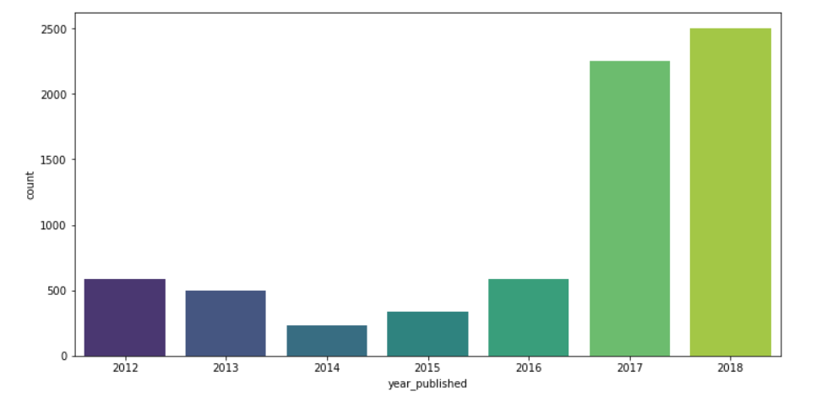
4.1.1 Frequency Plot – Year
We see that most of the post are done in the year of 2017 and 2018.

Slide 9
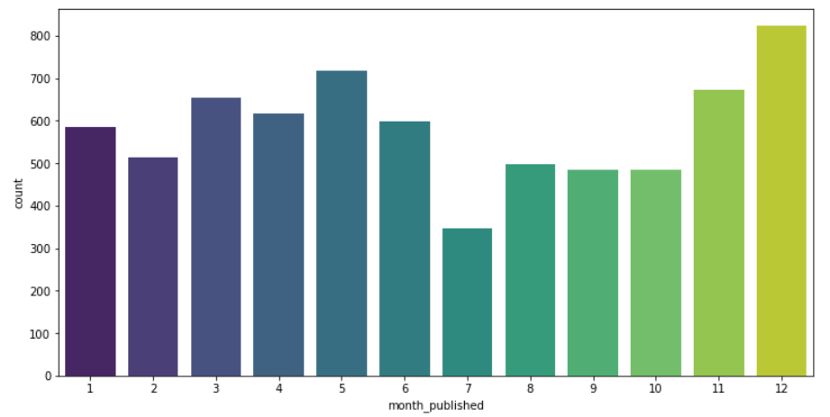
4.1.2 Frequency Plot - Month
We see a greater number of posts during the end of year.

Slide 10
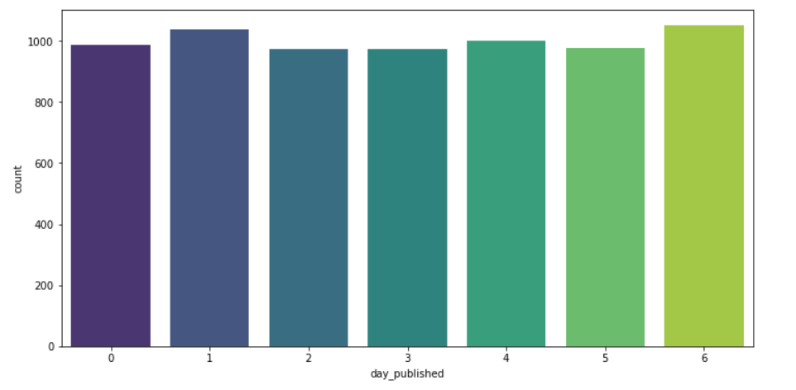
4.1.3 Frequency Plot - Weekday
The day of the week with Monday=0, Sunday=6. No clear trend is observed for a weekday.

Slide 11
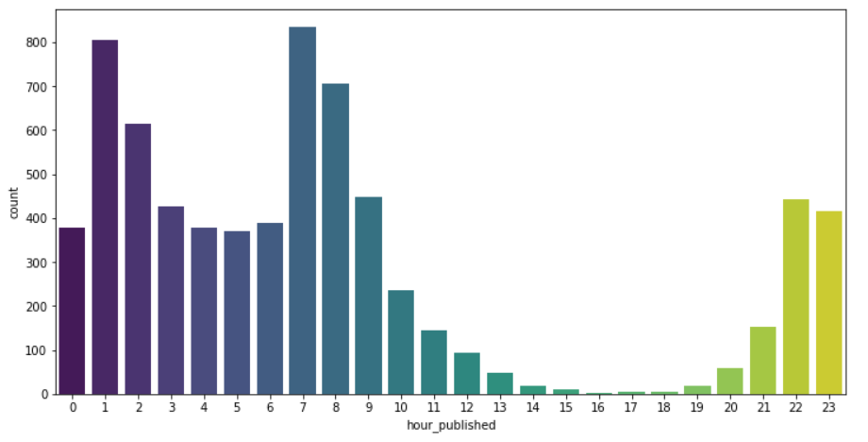
4.1.4 Frequency Plot - Hour
We see almost no posts between 14hr and 20hr. This time is possibly displayed due to a difference in timezones. It is most likely late at night, when businesses are closed.

Slide 12
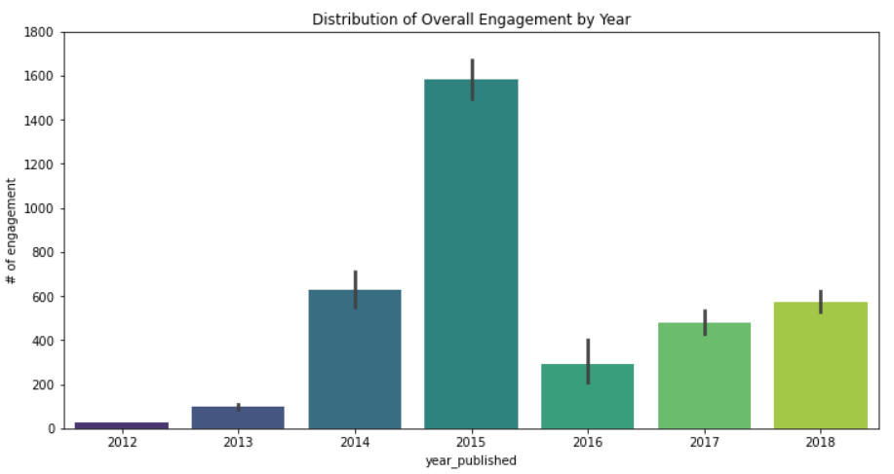
4.2.1 Distribution of Overall Engagement by Year
We can expect an unusually large increase in engagement in 2015.
There is a subsequent drop, followed by a gradual increase in 2017 and 2018. This could have an effect on predicting engagement metrics.
It shouldn't matter which year we post a particular post from a business standpoint.
We will not forecast engagement metrics based on the calendar year.

Slide 13
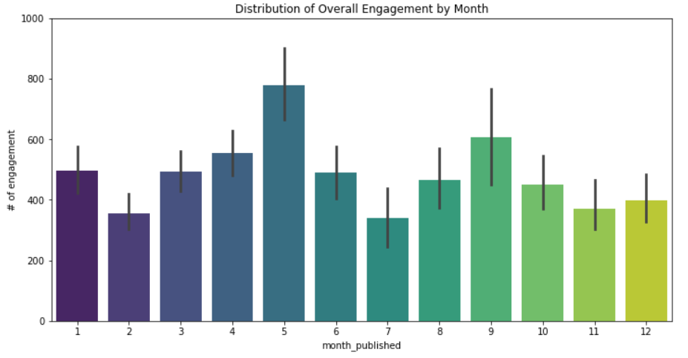
4.2.2 Distribution of Overall Engagement by Month
The month of the year can be a significant factor in engaging a user.
The numbers 1 to 12 correspond to the months of January to December.
Month 5 has a high number of engagements, which may be due to summer vacations. During vacations, more students may be using social media.

Slide 14
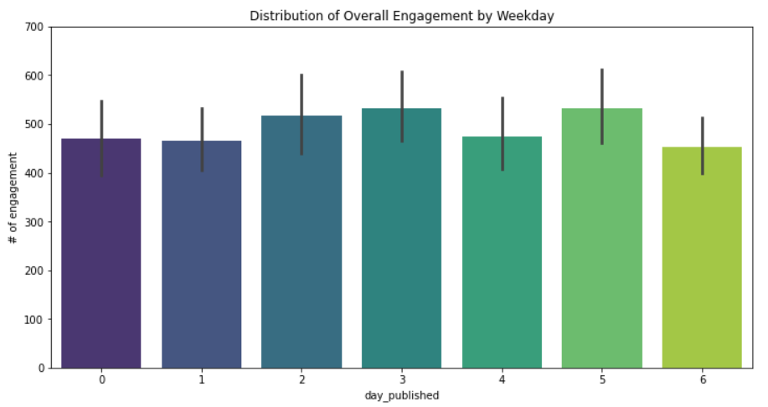
4.2.3 Distribution of Overall Engagement by Weekday
The day of the week, with Monday equaling 0 and Sunday equaling 6. The day can also have an effect on user engagement.
On Saturday and Thursday, we see a higher level of participation. Saturday is the weekend, so perhaps more people will use social media.
More data may be required to fully understand the effect of the time of day. We’ll use them for our model.

Slide 15
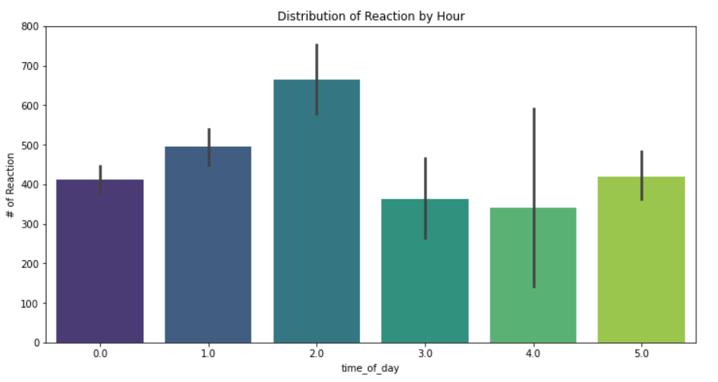
4.2.4 Distribution of Overall Engagement by Hours
0.0 represents [0 to 3hr], 1.0 represents [4hr to 7hr], 2.0 represents [8hr to 11hr], 3.0 represents [12hr to 15hr], 4.0 represents [16hr to 19hr], and 5.0 represents [20hr to 23hr].
We have increased the flexibility for businesses to post by grouping them. We can see a higher number of engagements during the first and second hours of the day, which are from 4am to 7am and 8am to 11am, respectively.

Slide 16
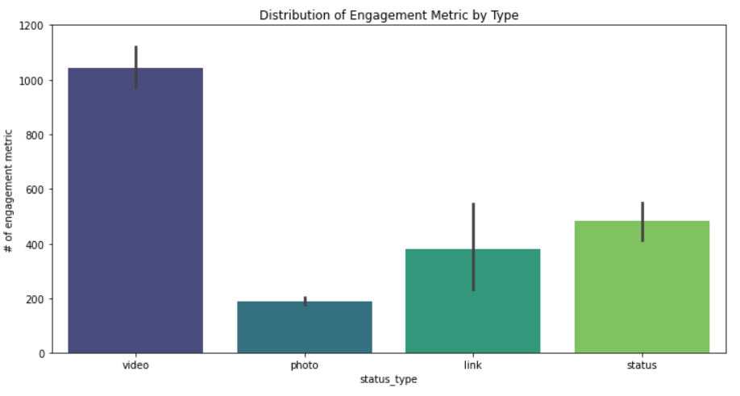
4.2.5 Distribution of Overall Engagement by Status Type
The video clearly shows a higher level of user engagement, followed by a status, link, and photo.

Slide 17
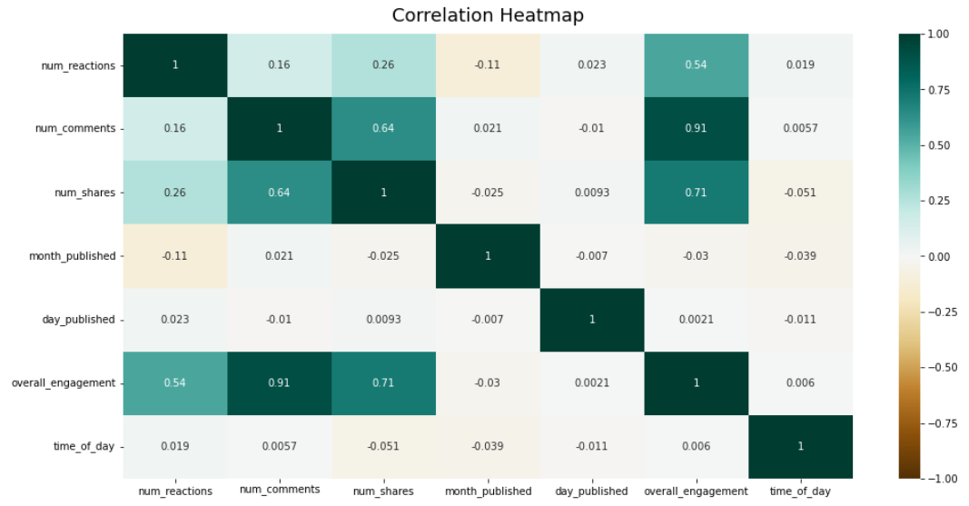
4.3 Correlation Matrix
The number of reactions is highly related to overall engagement, followed by the number of shares, the number of comments, and the month of publication.
The number of comments is also strongly related to overall engagement, followed by the number of shares and reactions.
The number of shares is also strongly related to overall engagement, followed by the number of comments and reactions.
Because total engagement is the sum of reactions, comments, and shares. In terms of correlation, it makes sense. We only used overall engagement as a model prediction metric.

Slide 18
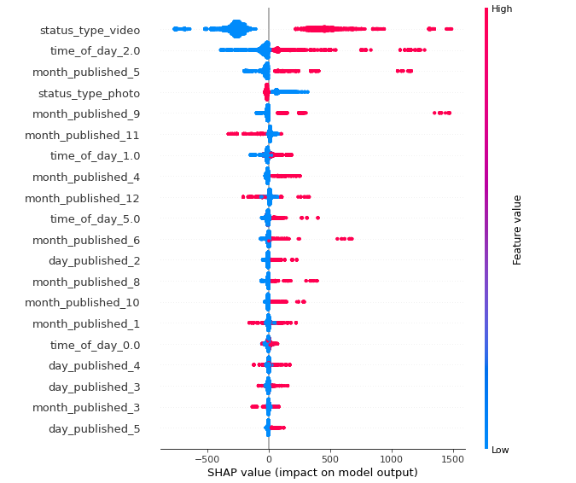
5. Modeling
The dependent variables are the following: status type, month, weekday, and hour.
Overall engagement is an independent/target variable.
Used linear regression model as a base model for predicting the engagement metric.
Random forest was used because decision trees work well with outliers.
Also checked the feature importance for decision tree.
We can see that the status type (video) has the greatest influence on the model. The model is also most affected by the time of day (7 a.m. to 11 a.m.). The fifth month of the year has the greatest impact on overall engagement.
The day has little effect on the output of engagement. However, day 2 (Wednesday) is the best day for posting because it has the greatest impact on the model of any day.

Slide 19
Results and conclusion
The number of reactions column represented the sum of all reactions: likes, loves, sad, and so on. It provided a comprehensive picture of user engagement.
The year, month, weekday, and hour were extracted from the status published(datetime) column. They were used to visualize the behavior of user engagement across time dimensions.
We see a stronger correlation between the columns of reactions, comments, and shares. This is obvious because the more a post engages users, the more they will comment and share, as well as react to the post.
Created a new target variable that accounted for total reactions, comments, and shares of a post.
Random forest gave a better prediction, which is due to presence of outliers/extreme values in our dataset. Decision tree models are not affected by outliers.
The best type of post is video, the best month is May, the best time of day is 7am to 11am, and the best day is Wednesday.
More information, such as geographical location, can assist us in developing a better strategy for a post. We can also analyze a user's sentiment by looking at the type of reaction. Using NLP, we can extract comments and the common topic of discussion. We can also extract the length of the video, which can help us engage a user more effectively.

