Slide 1
R.K. E-Commerce Store
Business Performance Overview (2022)
Presented by Ajay Sharma

Slide 2
Executive Summary
R.K. E-Commerce Store has shown strong growth during 2022. The following presentation highlights sales performance, customer insights, and regional trends to support data-driven business decisions.

Slide 3
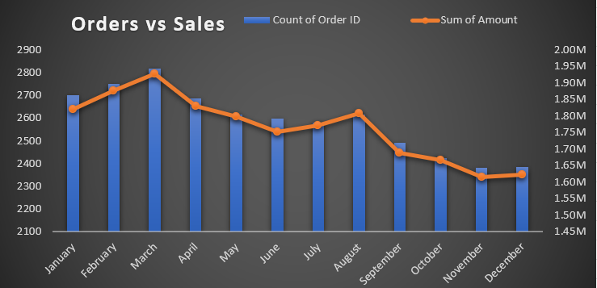
Sales vs Orders
This dashboard shows the monthly comparison between total orders and total sales. Peak sales were recorded between February and April, indicating a seasonal growth trend.

Slide 4
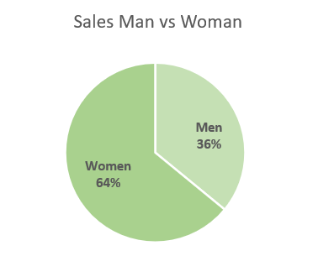
Men vs Women
Women customers contribute 64% of total sales, making them the dominant buyer group for R.K. Store. Targeted marketing campaigns towards women can drive further growth.

Slide 5
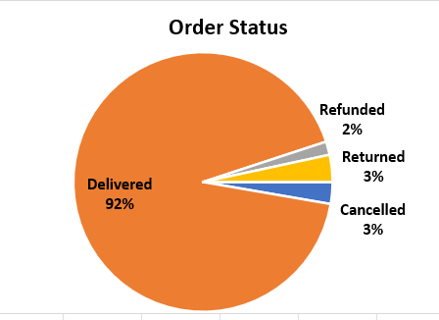
Order Status
More than 90% of orders were successfully delivered. Low return and cancellation rates reflect strong logistics and customer satisfaction.

Slide 6
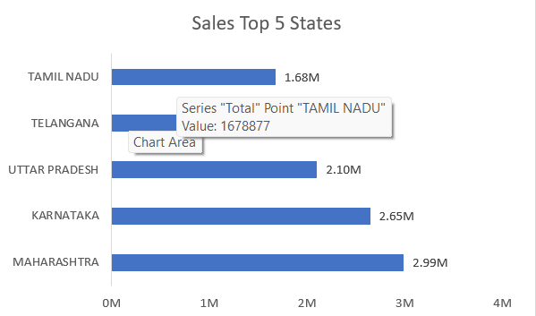
Top 5 States
Maharashtra and Karnataka lead in total revenue, followed by Uttar Pradesh and Telangana. These states represent the strongest market potential for the brand.

Slide 7
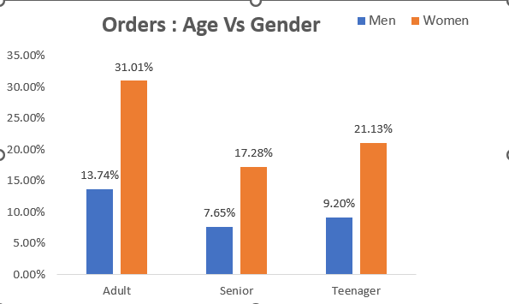
Orders by Age & Gender
Adult women are the most active buyers, contributing a major share of total orders. This insight helps focus product strategy on women’s apparel categories.

Slide 8
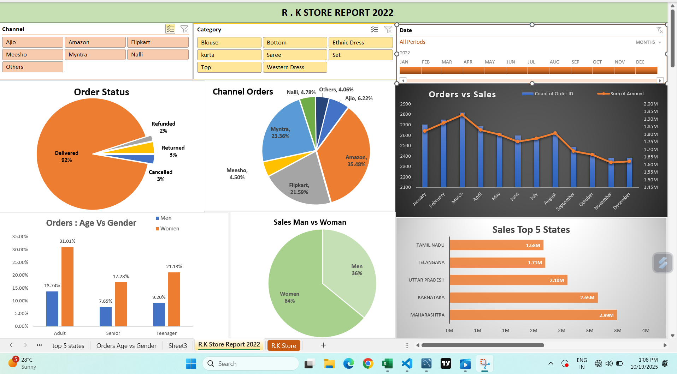
Overall Dashboard
This dashboard consolidates total sales, order volume, and regional distribution KPIs. It provides a comprehensive snapshot of R.K. Store’s overall business performance.

Slide 9
Key Insights
• Amazon drives the highest sales share, followed by Myntra and Flipkart.
• Women dominate purchases, especially in adult age groups.
• Maharashtra and Karnataka are the top- performing states.
• Peak sales occurred between February and April 2022.
• The 'Set' product category achieved the highest revenue.

Slide 10
Conclusion
R.K. Store continues to perform strongly across major e-commerce platforms. Female buyers and top-performing states drive the bulk of sales. To sustain growth, the store should expand its women's product range and focus marketing efforts on high-performing regions.

Slide 11
Thank You
Ajay Sharma
R.K. E-Commerce Store Data Analysis Team

