Slide 1
KPL
AUCTION EVENT

Slide 2
ABSTRACT
The Auction Football System is an online platform designed to facilitate the auctioning and bidding process for football players. The system allows players to register their details and clubs to participate in the bidding process to acquire players for their teams. The system provides a user-friendly interface for players to register by providing their personal information, such as username, email address, mobile number, age, current club, position, and uploading their image. The registration process also includes validation checks to ensure that the provided information is accurate and meets the required criteria. To participate in the bidding process, clubs need to create an account and log in to the system. After logging in, clubs can browse through the available players, view their profiles, and assess their suitability for their team. Clubs can then place bids on desired players by specifying the bid amount.

Slide 3

fuf
NOTE:
To change images on this slide, select a picture and delete it. Then click the Insert Picture icon
in the placeholder to insert your own image.
Functional Requirements
Player Registration and Login
Owner Registration and login
Player profile management
Club profile management
Categories and player listings
Bidding process
Search and filtering
Admin Login
System performance and Scalable

Slide 4
Features And Highlights
1. User login and Registration: The player and the club can register and a different registration form is provided for each user. After successful registration ,they are redirected to the login page and from there they are entered into their respective pages.
2. Profile Management: The users and the clubs can be able to manage their profiles. If they are entered using their email and password they can perform various operations on their pages.
3. Categories and Player listing: When player is registered they are displayed on the home page and also they are also filtered on the basis of position in the categories page.

Slide 5
4. Start Bidding: The admin can start bidding and the particular player of that club would be automatically added on the bidding. Bidding rules and restrictions ensure fair competition.
5. ViewBid : The clubs can also view the different bidding and the players who registered.
6. Add player: The clubs can add their players and the players can participate on the bidding. Player profiles are updated with details of the winning club.
7. Bid amount : Players have a base price which is automatically stored in the database. The clubs can increase the bidding prize of players and the players can approve their request and added to thr clubs

Slide 6
8. Admin panel: The admin can perform various on the project. The admin can add or delete players and clubs . If he wanted surely he will be able to manage bidding like start bidding, view bidding, delete bidding etc.
9.Filtering: The players are filtered on the basis of position. They are classified on the 4 different position such as defenders, goalkeeper, midfielder and forwards. They automatically get separated and added on the database
Third Party Libraries
Django Jazzmin: a drop-in app to jazz up your Django admin site, with plenty of things you can easily customize, including a built-in UI customizer.

Slide 7
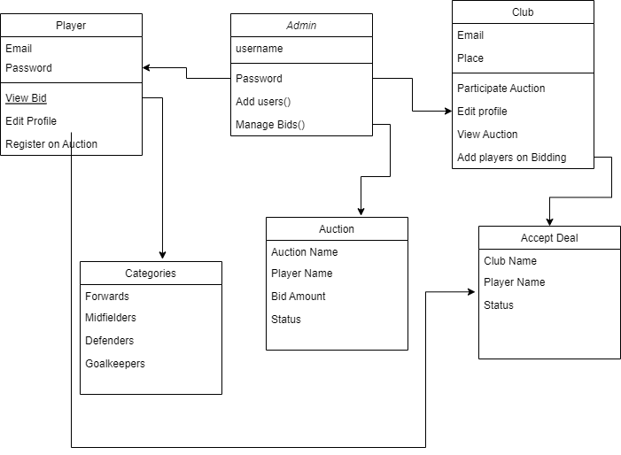
Class Diagram

Slide 8
Challenges Faced
The major challenge faced by me was to plan the process flow of the project. While coming to the coding part I had difficulties in using the Django user for registering player/login as it was new to me. The different functionalities will be added to the database also affect as a threat for developing the project. When registering, the player details has been indicated on the home page and on the categories based on position is also a challenge while creating the project.

Slide 9
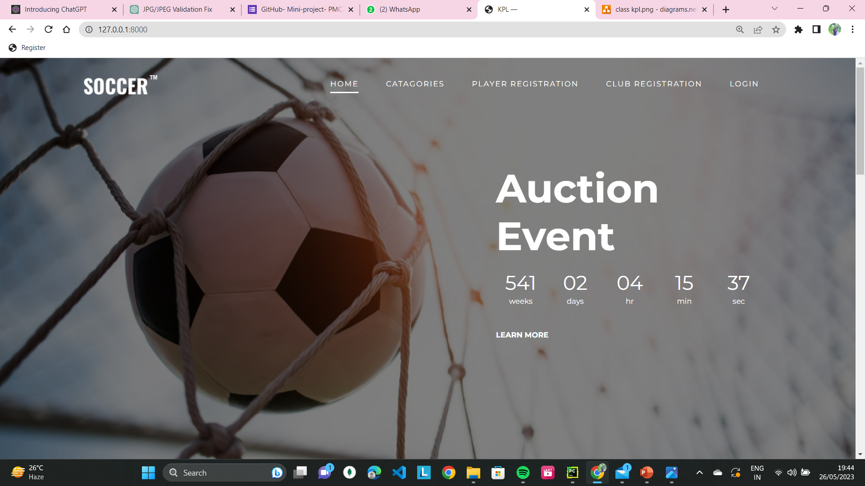
Screenshots
The home page is made dynamic by displaying the details of the packages from the Django admin site for the users.

Slide 10
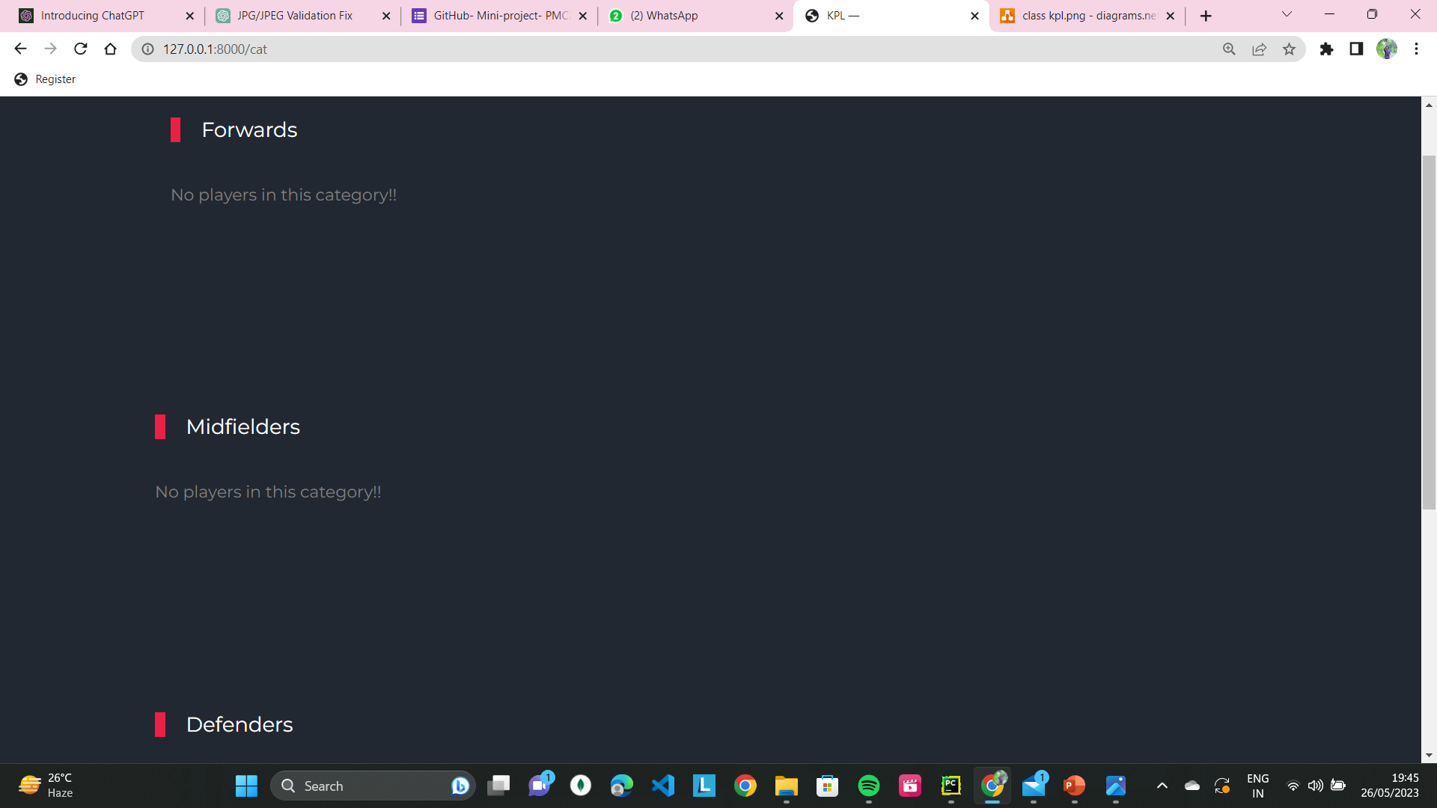
This the page where the players can be categorised on the basis of position. While registering, the players get fillered on the basis of position and added on the specified category.

Slide 11
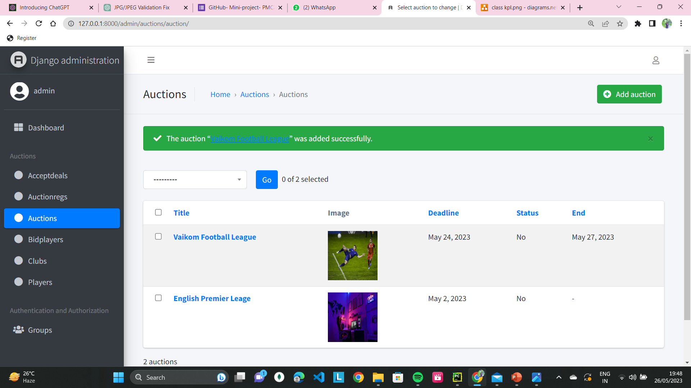
This is the admin interface of conducting auction where admin can start auctions and the different clubs and players can participate on the auctions

Slide 12
Future Enhancement
Conduct League : Conduct football league on the basis of the created team and the registered players.
Payment: A payment portal can be added in the future for buying the players

Slide 13
Conlclusion
In conclusion, developing an auction football system where players can register their details and clubs can participate in the bidding presents various challenges. However, with careful planning and implementation, these challenges can be overcome to create a robust and efficient system. With careful attention to these challenges and a systematic approach to their resolution, you can develop an auction football system that meets the needs of players and clubs, facilitates efficient bidding processes, and enhances the overall experience of all system users.

Slide 14
References
Django Documentation: Django is a popular web framework for building web applications using Python. The official Django documentation provides comprehensive information on various aspects of Django development, including models, views, forms, authentication, database operations, and more. It can serve as a valuable reference for implementing the backend functionality of your auction football system.
https://t4tutorials.com/online-auction-system-using-python-project/
https://youtu.be/rHux0gMZ3Eg

