Slide 1

AI-BASED RESUME SCREENING & JOB RECOMMENDATION SYSTEM
Natural Language Processing (NLP) • TF-IDF Vectorization • Cosine Similarity • Full-Stack Web Architecture
PRESENTED BY:
• Ajay & Team Members
[Roll Nos: __________________]
Department of Computer Science & Engineering
PROJECT MENTOR / GUIDE:
• Guided by: [Insert Mam's Name / Faculty Guide]
Assistant Professor / Department of CSE
[College / University Name]

Slide 2
COLLEGE MINI-PROJECT PRESENTATION
Introduction & Problem Statement
⚠️ The Existing Problem
• High Manual Volume: Recruiters receive hundreds of resumes per job opening, making manual review slow, tedious, and prone to fatigue.
• Human Bias & Fatigue: Manual screening often suffers from subjective evaluation, inconsistent standards, and unconscious hiring biases.
• Keyword Flaws: Traditional keyword filters fail to understand synonyms, lemmatized forms, or technical context.
• No Candidate Feedback: Applicants receive no constructive feedback regarding missing skills or areas for career growth.
💡 Our Proposed AI Solution
• Automated PDF Parsing: Extracts candidate information, contact info, and credentials from unstructured PDFs automatically via pypdf.
• Linguistic Preprocessing: Applies NLTK tokenization, stop-word filtering, and WordNet lemmatization for normalized text representation.
• Mathematical Alignment: Computes high-dimensional vector similarity angles between candidate resumes and 20 industry job profiles.
• Skill-Gap Intelligence: Provides clear visual metrics: Top 5 matching jobs, matched skills (green badges), and missing skills (amber badges).

Slide 3
COLLEGE MINI-PROJECT PRESENTATION
Project Objectives & Scope
🎯 Objective 01
Automated Resume Extraction
Extract raw unstructured text cleanly from PDF resumes using pypdf, isolating name, contact credentials, projects, and education.
🎯 Objective 02
Complete NLP Preprocessing Pipeline
Implement real text normalization using NLTK: tokenization, lowercase conversion, English stopword elimination, and WordNet lemmatization.
🎯 Objective 03
Modular Skill Taxonomy Engine
Scan and identify 50+ modern technical competencies across Programming, AI/ML, Cloud, Databases, and Web Development frameworks.
🎯 Objective 04
Mathematical Vector Similarity
Build a high-performance TF-IDF vectorizer and compute Cosine Similarity scores against 20 benchmark industry tech roles.
🎯 Objective 05
Interactive Full-Stack Web Portal
Deliver a responsive React.js web interface featuring live backend health check, resume score gauges, and transparent skill-gap analysis.

Slide 4
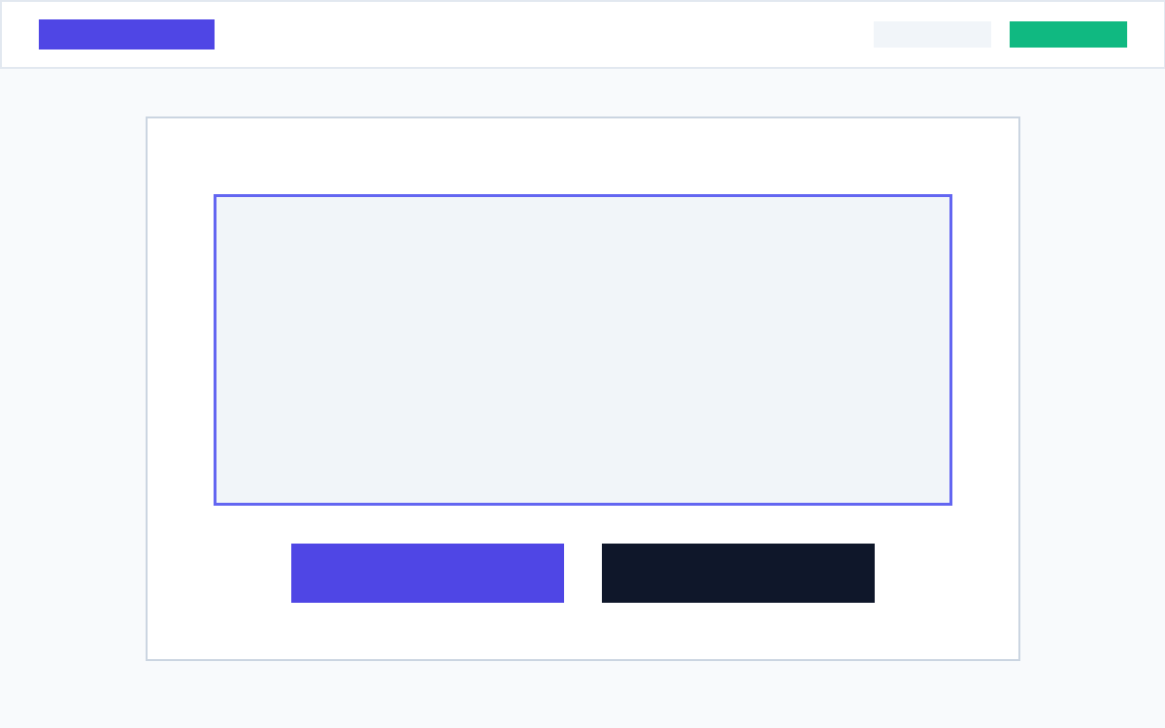
COLLEGE MINI-PROJECT PRESENTATION
System Architecture & Website Flow
🔄 End-to-End Processing Flow
• 1. PDF Upload / Demo: User uploads resume (.pdf) or clicks 'Load Sample Resume' on React UI.
• 2. Text Extraction: pypdf extracts text streams; Regex parses phone, email, and links.
• 3. NLTK Text Cleaning: Lowercased, tokenized, punctuation/stopwords removed, lemmatized to roots.
• 4. Skill Taxonomy Scan: Tokens matched against multi-category 50+ technology dictionary.
• 5. TF-IDF & Cosine Similarity: Vectorized into high-dimensional matrix & calculated against 20 curated jobs.
• 6. Dashboard & Insights: React UI renders score gauges, top 5 ranked jobs, and missing skill advice.
🖥️ Live Application UI (Upload & Demo)
The frontend runs on http://localhost:5173 with direct API communication to the Flask backend on port 5000. Features instant 1-click sample demo testing.

Slide 5
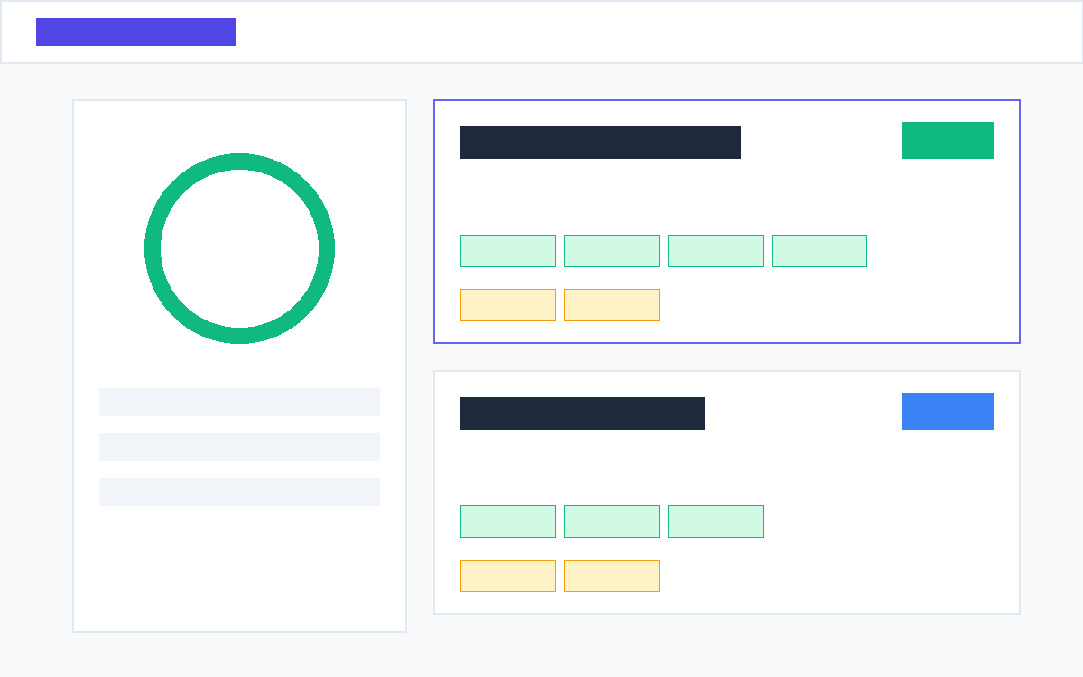
COLLEGE MINI-PROJECT PRESENTATION
Technologies Used & Job Recommendation Results
🛠️ Technologies & Libraries
• Frontend: React 18, Vite, Lucide-React Icons, Responsive CSS Design System
• Backend Server: Python 3, Flask REST API, Flask-CORS, Werkzeug file security
• NLP Engine: NLTK (punkt, stopwords corpus, WordNet Lemmatizer)
• Machine Learning: Scikit-Learn (TfidfVectorizer, cosine_similarity matrix)
• PDF Extraction: pypdf library for robust local PDF document stream extraction
• Dataset & Taxonomy: 20 Curated Tech Role Descriptions & 50+ Structured Skills Taxonomy
📊 Live Recommendation & Skill-Gap Analysis
Calculates exact similarity percentages (e.g. 94% ML Engineer). Clearly displays Matched Skills in Green and Missing Skills in Amber to help candidates upskill.

Slide 6
🚀 Future Scope & Enhancements
• Transformer Models (BERT/LLMs): Upgrade from TF-IDF to contextual embeddings (Sentence-BERT) for deep semantic comprehension.
• Live Job Scraping & API: Integrate LinkedIn and Indeed APIs for real-time live job market synchronization.
• Multi-format Support: Extend parser to accept DOCX, RTF, and scanned image resumes via OCR (Tesseract).
• Automated Feedback Generator: Generate tailored resume improvement suggestions using Generative AI.
THANK YOU!
Any Questions or Suggestions?
AI-Based Resume Screening & Job Recommendation System
Project Demo is available on localhost:5173

