Slide 1
CHALLENGE 03 / GRID RELIABILITY
01/12
GRIDMESH
When clouds cut solar,
who keeps the neighbourhood powered?
Sunlight
Solar
output
Clouds
Supply gap
GRIDMESH
Backup
advice
GridMesh helps local operators turn uncertain solar forecasts
into backup advice within available power and energy limits.
Notes:
Challenge03: neighbourhood grid reliability and renewable intermittency. Product goal: provide solar forecasts and constrained reserve advice to a local operator. The visual is a concept/process sequence, not a guarantee of reliable physical supply.
Evidence: real weather, modelled solar, virtual sites, synthetic demand and assumed backup assets/costs. No Indian field pilot, measured equipment outage hours, live SCADA control or formal privacy guarantee. Federated sites are emulated in one process. Larger-fleet tests use compact repeated-reference data. Deployment/ownership/Schneider handoffs are proposals, not built integrations.
Content source: C:\Users\Admin\Documents\Codex\2026-09-30\i-have-a-hackathon-i-will-3\outputs\plain_language_submission\GridMesh_Explained_Submission_v2.pptx ; SHA256 6a477481ee7c191fb7bb566d03de7b9ad3b4fc20142483487e7605f65e5594e9. Design retains beige/black and Arial/Arial Black from source. Existing public Canva reference: https://www.canva.com/templates/EAFaYPfKRPU/ .
FOCUSED SUBMISSION CLARIFICATION:
The distinction is the local operator decision workflow: uncertain forecast plus limited power/energy produces advisory backup recommendations. No claim of a novel algorithm, universal FL need or superiority over commercial solutions. Physical dispatch remains outside the implemented prototype.

Slide 2
The cloud arrives. The gap doubles.
02/12
Illustration: demand 100 kW. Grid limit 60 kW.
BEFORE CLOUD / EXPECTED GAP
AFTER CLOUD / ACTUAL GAP
10 kW
→
20 kW
Only 10 kW
backup is ready
Solar falls from 30 to 20 kW.
10 kW demand remains unmet.
Backup is limited. Forecasts are uncertain.
Illustrative arithmetic example - not an experimental result.
Notes:
Illustrative source-deck100kW example.100demand,60grid,30forecastsolar gives10expectedgap. Cloud reducesactualsolar20,actualgap20. With10backup10remainsunserved. Stacked columns show100demand accounted for as supplied grid/solar/backup or unmet. This is arithmetic, not a new experiment.
Evidence: real weather, modelled solar, virtual sites, synthetic demand and assumed backup assets/costs. No Indian field pilot, measured equipment outage hours, live SCADA control or formal privacy guarantee. Federated sites are emulated in one process. Larger-fleet tests use compact repeated-reference data. Deployment/ownership/Schneider handoffs are proposals, not built integrations.
Content source: C:\Users\Admin\Documents\Codex\2026-09-30\i-have-a-hackathon-i-will-3\outputs\plain_language_submission\GridMesh_Explained_Submission_v2.pptx ; SHA256 6a477481ee7c191fb7bb566d03de7b9ad3b4fc20142483487e7605f65e5594e9. Design retains beige/black and Arial/Arial Black from source. Existing public Canva reference: https://www.canva.com/templates/EAFaYPfKRPU/ .

Slide 3
GridMesh turns a forecast into a plan
03/12
FEDERATED LEARNING
Separately managed sites learn together while keeping raw histories local.
Sites share model updates. FedAvg combines them into a shared model.
Site A: local training
Central coordinator
aggregates model updates
Shared model
returned to sites
Site B: local training
Site C: local training
The shared forecasts feed one reserve-planning node.
FORECAST
UNCERTAINTY
GAP
RESERVE
Solar output +60 min
Past forecast errors
Demand less grid and solar
Backup within asset limits
100 virtual sites in one process. No formal privacy guarantee, geographic validation or live grid control.
Notes:
FL foundation: https://proceedings.mlr.press/v54/mcmahan17a.html
GridMesh uses reliability-aware parameter averaging, not federated XGBoost. Client objects hold local histories. The coordinator obtains updates/scalar validation reports for training. The simulation evaluator can access held-out arrays within the same process, so no physical privacy boundary is implemented.
Privacy limitation: Vero et al. (2023), TabLeak, https://proceedings.mlr.press/v202/vero23a.html
New India hourly v1 protocol: 100 independently perturbed co-located sites; 20 candidates/round; 12 rounds; five seeds. Shared NASA POWER Bengaluru weather, not geographic fleet validation. Legacy dashboard screenshots remain the separate 30-minute replay.
Supporting definitions and provenance:
The shared model forecasts each site. Combined forecasts feed one reserve-planning node.
100 emulated sites in one process; histories in separate client objects. FedAvg: McMahan et al. (2017), PMLR 54.
Working simulation and dashboard replay. No live control, secure aggregation or formal privacy guarantee.
FOCUSED SUBMISSION CLARIFICATION:
Proposed operational rationale: separately managed sites may prefer retaining histories locally while jointly learning. This is an architectural rationale, not evidence that all communities require federation. Lower mean error in Slide 6 is bounded to the separate chronological Bengaluru baseline experiment with unequal training budgets. Local data retention is not formal privacy; this prototype emulates clients in one process.

Slide 4
GridMesh architecture
04/12
Local data becomes a shared forecast and risk-aware backup recommendation.
Dashed: digital information
DATA
Weather + solar
Model updates
Load + assets
Local history
Learned patterns
Demand + backup limits
INTELLIGENCE
Local models
Shared forecast
Reserve optimizer
Solar prediction
Combined forecast
Error-aware backup plan
DECISION
Operator dashboard
Forecast, risk and backup advice
Physical electricity
ENERGY
Grid + solar + backup
Homes + businesses
Advisory prototype: operators and equipment determine the physical response. No live control integration.
Notes:
Three-layereditablearchitecture. Inputs:localweather/modelledPV,localmodelupdates,syntheticloadandassumedbackupcapacity. LocalMLPmodels→checkedfederatedaggregation→forecast/errorawareconstrainedplanner→operatoradvice. Physicalenergyflowsfromgrid/solar/backuptohomes;noflowcontrolintegration. Pastforecasterrorscalibratetheplanner.Sourcearchitecture/modeldesignfromdeckslides3,5,8.
Evidence: real weather, modelled solar, virtual sites, synthetic demand and assumed backup assets/costs. No Indian field pilot, measured equipment outage hours, live SCADA control or formal privacy guarantee. Federated sites are emulated in one process. Larger-fleet tests use compact repeated-reference data. Deployment/ownership/Schneider handoffs are proposals, not built integrations.
Content source: C:\Users\Admin\Documents\Codex\2026-09-30\i-have-a-hackathon-i-will-3\outputs\plain_language_submission\GridMesh_Explained_Submission_v2.pptx ; SHA256 6a477481ee7c191fb7bb566d03de7b9ad3b4fc20142483487e7605f65e5594e9. Design retains beige/black and Arial/Arial Black from source. Existing public Canva reference: https://www.canva.com/templates/EAFaYPfKRPU/ .
Supporting definitions and provenance:
Current prototype provides advice. Approved operators and equipment determine the physical response.

Slide 5
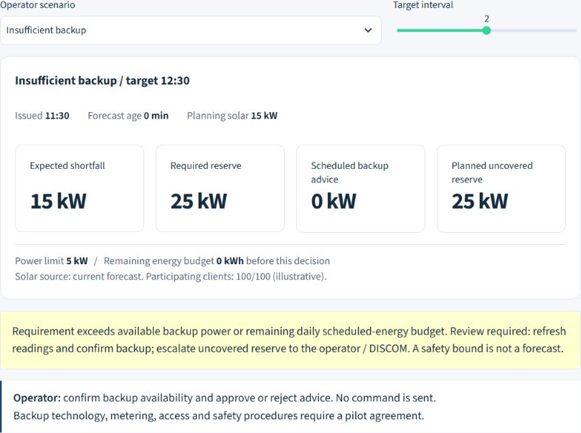
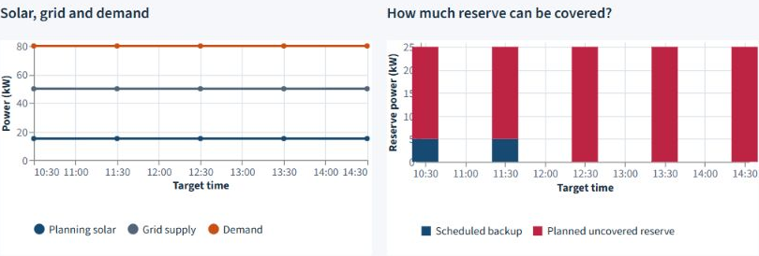
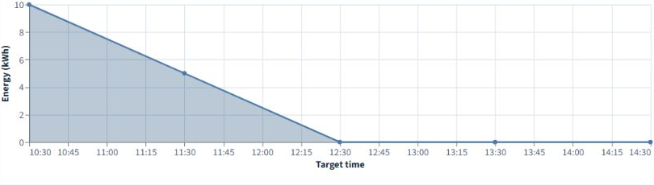
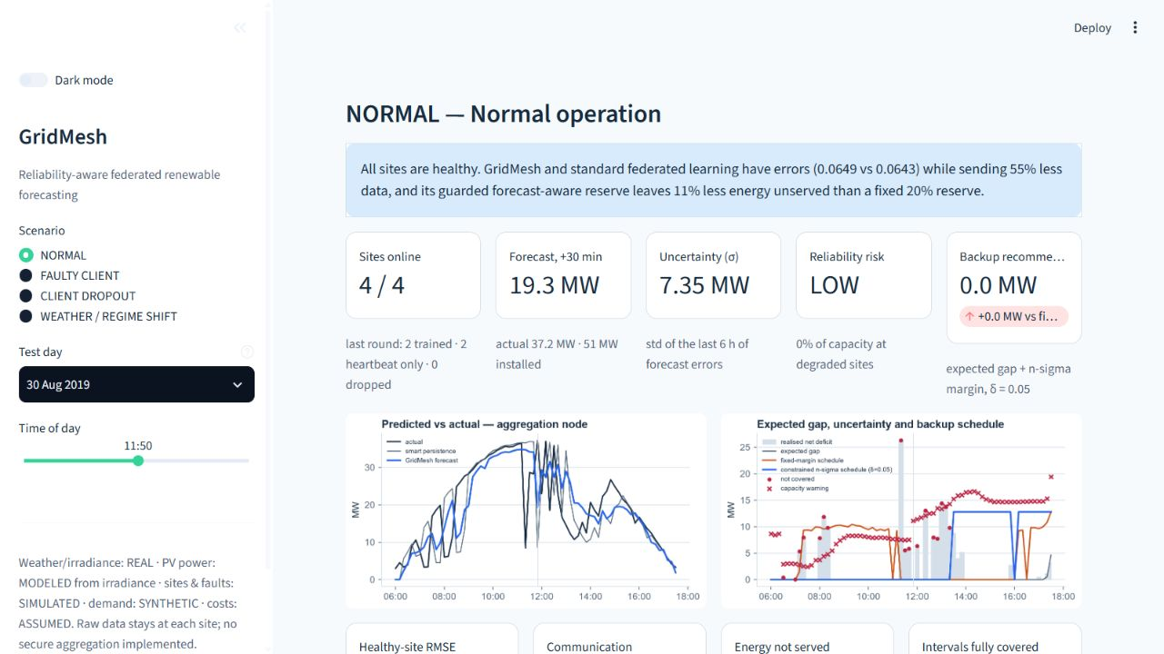
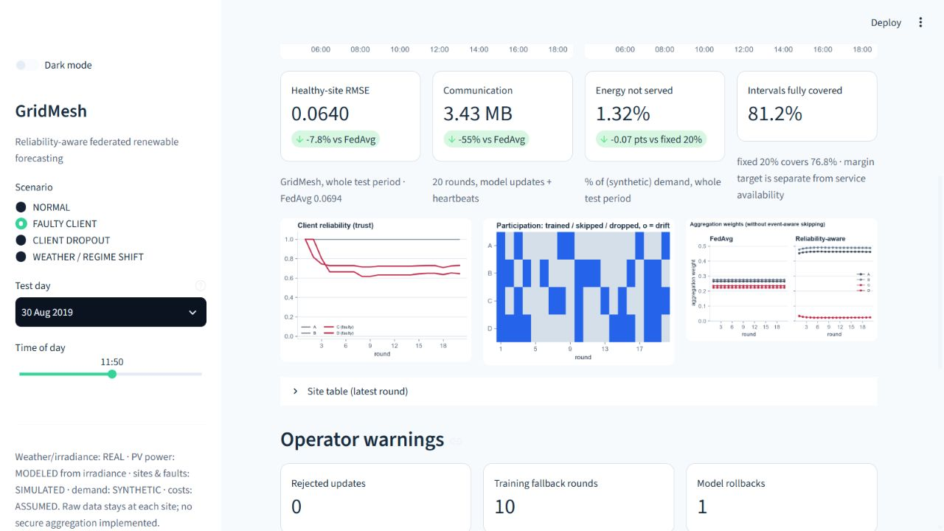
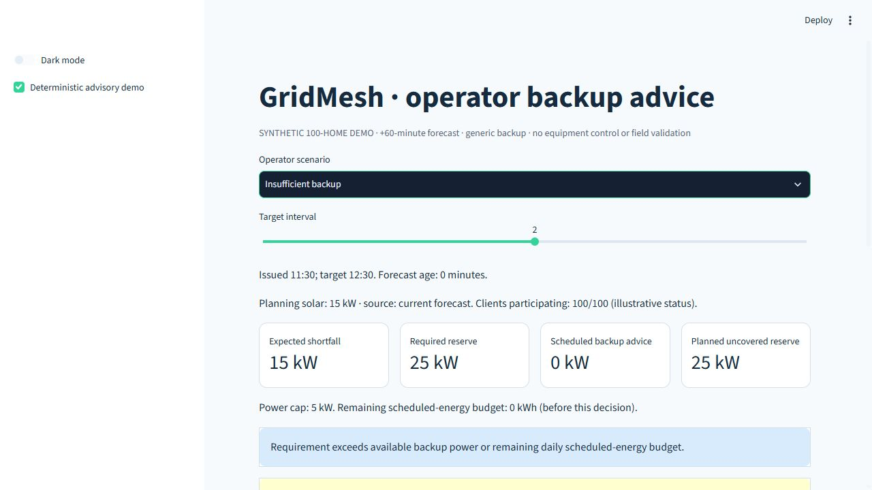
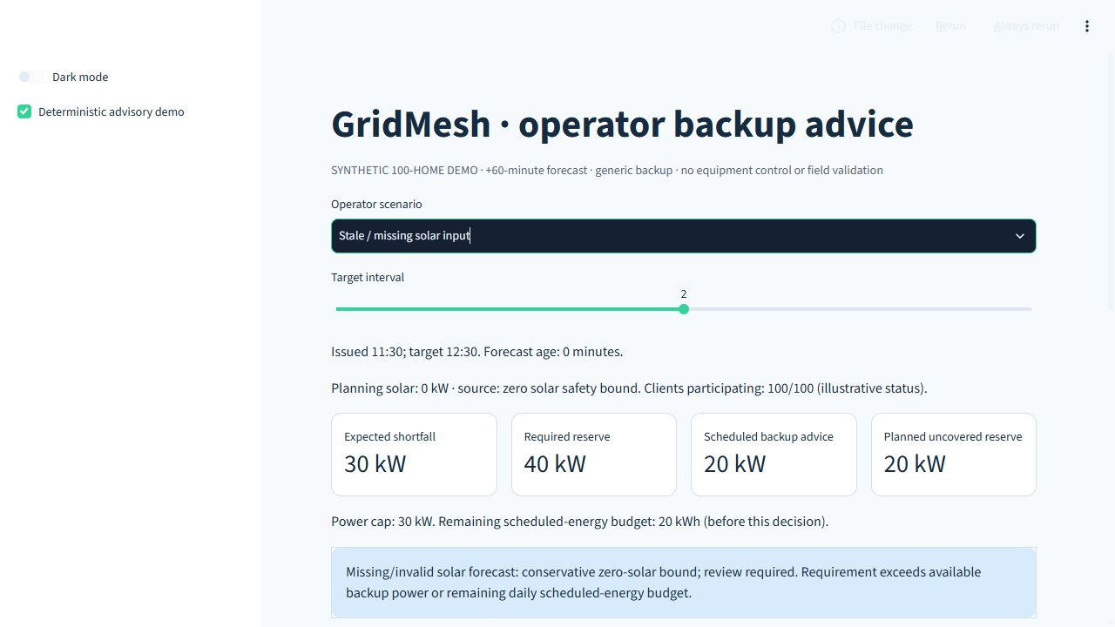
GridMesh recommends.
The local operator decides.
05/12
IMPLEMENTED OPERATOR WORKSPACE
Five scenarios · synthetic 100-home assumptions · +60-minute advice
01 FORECAST, RISK + BACKUP ADVICE
02 SUPPLY + RESERVE GRAPHS
Demand exceeds solar + grid.
Uncovered reserve stays visible.
03 BACKUP-ENERGY BUDGET
Assumed budget, not battery charge.
Synthetic replay and advice only. No equipment commands or field reliability claim.
Notes:
LEGACY PROTOTYPE REPLAY, separate from Slides 6/7/9 communication results. Original light-mode screenshot pixels preserved. Four virtual sites, +30-minute historical replay, seed 42, event-aware guarded reserve policy. Overview and faulty-site health views have different reserve settings. They do not depict the new 100-site chronological experiment or five-seed nominal-policy results. Forecast/risk/backup advice and site health are visible. Operator review and arranging approved backup take place outside the app, with no approval button, live dispatch or equipment integration. A screenshot showing 0 MW scheduled backup does not establish zero need; asset/energy limits can constrain advice, but the cause of that individual screenshot timestamp is not independently established. No timed usability claim.
CURRENT IMPLEMENTED EXTENSION:
Screenshots captured from the actual dashboard on2026-10-04 in light mode: scenario insufficient, interval2 (0kW backup because60-minute allowance is exhausted in this independent5kW/10kWh case); scenario stale_missing, interval2 (missing solar becomes0kW conservative planning bound,20kW scheduled backup,20kW uncovered reserve). Five deterministic100-home scenarios are independent of both legacy4-site and chronological100-site research. Current UI exposes horizon, freshness, expected gap, reserve requirement, scheduled backup, power/energy, explanation and separately evaluated actual outcomes. Clients participating100/80 are illustrative status, not measured deployments. Verification:15 AppTest scenario/interval paths, updated dashboard light/dark checks. No command, approval database, real asset connection or field result.
Actual Streamlit light-mode operator workspace and diagnostic graph screenshots. Same independent insufficient-backup synthetic demo and target12:30: planning solar15kW, expected gap15kW, required reserve25kW, scheduled0kW, planned uncovered25kW. Full controls, advice, limits, warning and operator action are shown in the primary capture. Graphs use decision-time inputs and schedules only. Remaining energy is an assumed scheduling allowance, not measured battery state. Planned uncovered reserve is separate from realized ENS. No change to source-deck technical results, assets or methodology.

Slide 6
Federated learning gave lower forecast error
06/12
LOWER ERROR IN THIS SIMULATED EXPERIMENT
2024 Bengaluru weather, 100 simulated sites, one-hour forecast
Daytime forecast error (RMSE), averaged across 5 runs. Shorter bars are better.
Federated learning (FedAvg)
6.22%
Federated learning (weighted)
6.23%
Sunlight-adjusted estimate
6.97%
Each site learns alone
7.58%
Current output unchanged
9.84%
About 18% lower error than learning at each site alone.
FedAvg: 6.22% error vs local-only: 7.58%.
Weighted averaging performed almost equally (6.23%).
RMSE = forecast error as % of solar capacity. Training budgets differ.
Simulated sites and modelled solar; results do not establish field performance.
Notes:
Source: GridMesh outputs/evidence_improvement/FINDINGS.md, supplied evidence-improvement report. New chronological 2024 Bengaluru experiment: 100 virtual co-located sites, modeled solar, synthetic demand, five seeds 42–46, +60-minute forecasts. No independent field or geographic validation.
NEW CHRONOLOGICAL EXPERIMENT: chronological 70/15/15 train/validation/test. Daytime held-out pooled per-unit RMSE/MAE multiplied by 100 gives percent of installed capacity, not percent of generation. RMSE is root mean square error; MAE is mean absolute error. Five seeds describe run variability, not independent field validation. Table values follow the rounded report summaries, including local-only report RMSE 7.575% displayed as 7.58%.
Report five-seed mean ± sample SD: persistence RMSE 9.843 ± 0.018%, MAE 8.666 ± 0.017%; smart persistence 6.965 ± 0.014%, MAE 5.116 ± 0.010%; local-only 7.575 ± 1.462%, MAE 5.560 ± 1.251%; basic FedAvg 6.221 ± 1.156%, MAE 4.586 ± 0.950%; reliability-weighted FedAvg 6.229 ± 1.157%, MAE 4.581 ± 0.966%. Selective-update reliability-weighted FL, not shown in the baseline table: RMSE 6.391 ± 1.096%, MAE 4.740 ± 0.920%.
Budgets differ: local-only 12 full local epochs/site with validation checkpoint selection. FL 12 rounds, up to 20 sites/round, one local epoch. Persistence methods need no training. Basic FedAvg shares existing safety screening/rollback gates, so this is an aggregation-weighting baseline, not wholly unguarded FL. Reliability-weighted FL is the Slide-7 forecaster, not the accuracy winner. Smart persistence beats FL in seed 43. No universal FL superiority.
SEPARATE FROZEN BLOCKED-MONTH BENGALURU REFERENCE: older MLP/GRU/LSTM equal-protocol comparison used a blocked-month split and retrospective full-day LP. Global RMSE / MAE: MLP 5.24% / 3.37%, GRU 7.34% / 4.55%, LSTM 7.47% / 4.70%. Site-wise median RMSE / P90 RMSE / median MAE / P90 MAE: MLP 5.16 / 5.91 / 3.28 / 3.95%; GRU 7.28 / 7.99 / 4.46 / 5.31%; LSTM 7.26 / 8.43 / 4.29 / 5.91%. These are historical results, not the RMSE values accompanying Slide 7. Sources: outputs/mentor_validation/forecasting_metrics.csv and sitewise_metrics.csv.
NASA POWER hourly gridded weather archive, 8,784 UTC-hour observations for 2024 Bengaluru, modeled PV and perturbed co-located histories. No measured Indian generation or geographic holdout.
FOCUSED SUBMISSION CLARIFICATION:
Only introductory terminology changed. All five native table results and experiment/budget qualifications remain unchanged. RMSE penalizes larger forecast errors; displayed errors are percentages of installed capacity, not percentages of actual generation.

Slide 7
Same forecast, smarter reserves
07/12
CURRENT INDIA / CHRONOLOGICAL SIMULATION
96.89%
→
99.39%
+2.50
percentage points
FULLY SUPPLIED DAYTIME INTERVALS
Approximately 38% less scheduled backup.
Metric | Fixed 20% reserve | GridMesh nominal reserve
Fully supplied intervals | 96.89% | 99.39%
Unserved energy | 0.875 MWh | 0.128 MWh
Scheduled backup | 27.04 MWh | 16.76 MWh
Same reliability-weighted MLP forecasts, causal planner and assets; only the reserve rule changes.
Five-seed chronological simulation. Modelled solar, synthetic demand and assumed backup
—not measured uptime.
Notes:
Source: GridMesh outputs/evidence_improvement/FINDINGS.md, supplied evidence-improvement report. New chronological 2024 Bengaluru experiment: 100 virtual co-located sites, modeled solar, synthetic demand, five seeds 42–46, +60-minute forecasts. No independent field or geographic validation.
NEW CHRONOLOGICAL POLICY COMPARISON: same reliability-weighted MLP forecasts, actual modeled solar, demand, grid, backup power/daily-energy assumptions, evaluation intervals and single-interval causal allocation. Only the margin rule differs: fixed 20% of demand versus nominal n-sigma margin, delta .05, window 6, minimum 3 errors, fixed fallback for insufficient history. The nominal candidate was selected using validation availability AND ENS (no worse than fixed in every validation seed), then minimum scheduled backup, frozen before operational test evaluation. No test tuning.
Exact supplied per-seed means: fixed availability 96.887299%, ENS 0.874822 MWh, scheduled backup 27.035757 MWh, assumed cost score 44.532204. Nominal availability 99.391771%, ENS 0.127576 MWh, scheduled backup 16.760064 MWh, score 19.311590. Report means ± sample SD: fixed 96.8873 ± 0.2040%, ENS .8748 ± .0339 MWh, backup 27.0358 ± 1.0007 MWh, score 44.5322 ± 1.2293; nominal 99.3918 ± .2400%, ENS .1276 ± .0730 MWh, backup 16.7601 ± 3.2420 MWh, score 19.3116 ± 4.4132. Availability difference +2.5045 percentage points rounds +2.50; backup reduction about 38.008%, displayed approximately 38%.
Scheduled backup is committed energy, not actual consumption. Realized ENS uses actual solar after the target interval and is distinct from planned uncovered reserve. Availability counts fully supplied simulated daytime intervals, not measured outage hours or service uptime. Demand and grid are assumed known. No night adequacy evaluation, field reliability or total affordability validation.
SEPARATE LEGACY 4-SITE +30-MINUTE BENCHMARK: fixed 79.8827160494% versus nominal 85.1666666667% fully supplied; ENS 310.0089811255 versus 278.0980947529 MWh; scheduled backup 2420.64 versus 1575.5243041367 MWh. This uses unknown-location legacy weather, assumed year 2019, forecast-balanced grid and retrospective full-day LP with peak-priority weight 2. It is historical evidence, not this slide’s data.
SEPARATE FROZEN BLOCKED-MONTH BENGALURU REFERENCE: 98.46% versus 97.60% had different splitting and retrospective planning protocols. The new experiment is not a direct before/after improvement over that old experiment. Source: evidence-improvement report primary policy table and outputs/evidence_improvement/test_results.csv.

Slide 8
A reserve that responds to uncertainty
08/12
 | FIXED RESERVE | GRIDMESH
Reserve logic | 20% of reference demand at each interval | Margin from past forecast errors
Uncertainty response | No adjustment to errors | Larger spread can increase margin
Confidence response | Same percentage rule | Smaller spread can reduce margin
Constraints | Same power + daily energy limits | Same power + daily energy limits
Reserve margin: extra backup for forecast uncertainty.
Margin = max(0, 1.645σ − μ)
μ: mean error. σ: error spread. Error = actual solar − forecast.
Nominal statistical coverage does not guarantee achieved supply availability.
Notes:
Source: GridMesh outputs/evidence_improvement/FINDINGS.md, supplied evidence-improvement report. New chronological 2024 Bengaluru experiment: 100 virtual co-located sites, modeled solar, synthetic demand, five seeds 42–46, +60-minute forecasts. No independent field or geographic validation.
RESERVE MECHANISM: uncertainty margin m=max(1.645*sigma-mu,0), error=actual-forecast, nominal delta .05. Only earlier observable errors enter rolling statistics, shifted by forecast horizon. The Slide-7 nominal candidate uses a 6-observation rolling window, min 3 observations and fixed 20% initialization. Required backup = forecast demand/grid/solar gap + uncertainty margin. Both rules face identical power and daily scheduled-energy limits. Larger error spread can increase margin, but bias also matters. Finite assets, non-Gaussian/correlated errors and limited history prevent a statistical tail interpretation from guaranteeing achieved supply availability. q=scheduled backup; u=planned uncovered reserve. Realized ENS uses actual solar afterward, separately from u.
Research motivation retained from the source: Khaing, Kannan & Rao (2026), Clean Energy, doi:10.1093/ce/zkag018, https://academic.oup.com/ce/article/10/4/46/8670126 . GridMesh uses a simplified constrained allocation, not the paper’s complete OPF.
FOCUSED SUBMISSION CLARIFICATION:
Reserve margin is an extra backup allowance for forecast uncertainty, not the complete scheduled-backup decision and not a supply guarantee. Formula and native fixed/adaptive comparison unchanged.

Slide 9
Robust aggregation and communication-efficient FL
09/12
Reliability-aware parameter averaging and selective client uploads
1. RELIABILITY-AWARE AGGREGATION
2. SELECTIVE MODEL TRANSMISSION
Stale or degraded client updates can distort the global model.
Prioritise changed clients; stable clients skip large model uploads.
Normalised protocol bytes: basic FedAvg = 100%
Local model
parameters
Screen +
weight
Aggregate +
validate
Basic FedAvg
100%
Validation failure triggers model rollback / fallback.
Selective FL
54.45%
NO CONSISTENT RMSE ADVANTAGE
45.55% fewer protocol bytes
Stress tests: stale clients and 50% client dropout.
Reliability weighting remains experimental.
Accuracy trade-off: +2.72% relative test RMSE
versus basic FedAvg.
100 virtual clients, 3 paired random seeds.
Single-process simulation. Protocol bytes are modelled, not measured network traffic. Forecast robustness does not establish supply availability.
Notes:
Source: GridMesh outputs/evidence_improvement/FINDINGS.md, supplied evidence-improvement report. New chronological 2024 Bengaluru experiment: 100 virtual co-located sites, modeled solar, synthetic demand, five seeds 42–46, +60-minute forecasts. No independent field or geographic validation.
TRUST: separate legacy four-site stress test, two sites stale in 24-step blocks (severity 2), five paired seeds, 20 rounds. Healthy-site RMSE reduction 8.8879326076% versus basic FedAvg, displayed 8.9%. Separate 50% client-dropout legacy result: +0.5629382312% relative RMSE. These establish prediction robustness under that stress protocol, not electricity-service reliability or broad current-India superiority. Sources: outputs/mentor_validation/legacy_verification.json and robustness_results.csv.
COMMUNICATION: selective-update reliability-weighted FL in the NEW chronological experiment, five seeds, 100 virtual sites, 12 rounds, cap 20 clients/round. Mean modeled protocol bytes/run: basic FedAvg 6.00864 MB, selective FL 3.271800 MB. Reduction 45.55% after rounding. RMSE means: basic FedAvg approximately 6.221%, selective approximately 6.391%, ratio-of-means relative increase 2.72%. Accounting includes model transfers, gate metadata and heartbeat/status reports, not measured physical links or TLS/WAN overhead. This is a different method from the non-selective reliability-weighted forecaster in Slide 7. No geographic/network validation.
SECONDARY CURRENT-INDIA LIMITS: healthy-data reliability weighting does not improve mean forecast accuracy over basic FedAvg. The one-seed 100-site stale/dropout checks cannot establish consistent superiority; stale-20-site healthy RMSE basic FedAvg 5.413%, reliability weighting 5.500%, selective 5.441%. At 50% dropout: 5.438%, 5.406%, 5.536%. No consistent superiority claim.
SEPARATE HISTORICAL SCALE TESTS: 100/500 logical-site stress used repeated reference histories, not deployments. Old 43.3% payload reduction and +1.03% RMSE change are not the new communication values on this slide.
FOCUSED SUBMISSION CLARIFICATION:
Readable column heading replaces SCALE. The 45.55% modeled-protocol-byte reduction and 2.72% relative RMSE increase remain unchanged. Protocol bytes include model transfers and status/gate accounting, not measured physical network traffic.
CURRENT IMPLEMENTED EXTENSION:
New source: outputs/hackathon_robustness_v1/failure_results.csv. Three paired seeds42–44,100virtual sites,12rounds,cap20,20stale sites or50%dropout. Healthy RMSE means%: stale basic6.3219,weighted6.7038,selective6.2310; dropout basic6.6541,weighted6.6823,selective6.4928. Per-seed weighting both wins and loses. Stale operational means availability98.9267->99.5826% and ENS.2971->.0749MWh show forecast accuracy and operational impact can differ; no universal weighting advantage. Clean-run validation policy stays frozen, no fault-specific tuning. Existing legacy8.9% historical finding remains in notes only and is not currentIndia evidence. Communication column unchanged five-seed chronological source.

Slide 10
Prototype implementation roadmap
10/12
IMPLEMENTED IN THE SIMULATION-BASED PROTOTYPE
01 DATA
02 FORECAST
03 RESERVE
04 TEST + UI
Bengaluru weather
100 virtual sites
Chronological split
→
Local training
Shared model updates
Solar output +60 min
→
Past-error uncertainty
Demand + grid gap
Power + energy limits
→
Advisory dashboard
Fault / shortage tests
Fixed-reserve comparison
Built: forecasts, constrained backup advice and an operator dashboard.
NEXT: FIELD VALIDATION
Measured local data → confirm assets + costs → operator shadow pilot
PROPOSED COMPLEMENT TO SCHNEIDER
Local forecasts + reserve advice for existing operator / DISCOM workflows.
Simulation and advice only. No live control, implemented integration or field deployment.
Notes:
PROPOSED LOCAL PILOT, not existing deployment. Initial target: low-income communities with existing solar and backup assets. Shadow-mode evaluation uses measured solar/load, then operator review and an approved backup arrangement. Operator/DISCOM review handles insufficient reserve; software does not create backup capacity. Confirm asset technology, owner access, usable power/energy, efficiency, replenishment, dispatch latency, safety and escalation before any real action. Replication requires measured benefit and complete affordability checks.
Proposed utility handoff: forecast, uncertainty, expected shortfall, reserve requirement, site-health signals. Schneider context retained from the source: https://www.se.com/ww/en/work/solutions/electric-utilities/ and https://blog.se.com/infrastructure-and-grid/smart-grid/2019/04/30/how-derms-support-the-utility/ . GridMesh proposes an advisory locally trained signal layer complementing existing utility/DERMS workflows; no integration, partnership or superiority claim. Hardware/control integration, protection, authenticated communications and deployment agreements remain unconfirmed.
The evidence-improvement work now includes a causal single-interval simulated planner and deterministic advisory demo. This does not establish a live feed, hardware control or a field pilot. Observation availability, interval closure and publication latency must be validated in the pilot.
FOCUSED SUBMISSION CLARIFICATION:
Official source checked 2026-10-04: https://www.se.com/ww/en/work/solutions/electric-utilities/ . The page lists grid management with intelligent monitoring/control, substation automation, power monitoring/control software and microgrid energy management. This supports the broad Schneider capability description only. GridMesh proposes local forecast, uncertainty and backup-advice signals for operator/DISCOM workflows. No integration, interface, partnership, commercial inferiority or missing Schneider capability is asserted. Shadow mode means testing advice before operational use. Existing solar/backup and confirmed safe asset access remain necessary.
CURRENT IMPLEMENTED EXTENSION:
Concrete service design: docs/PILOT_AND_OPERATIONS.md. Assumed100homes100kWsolar80kWload50kWgrid30kWgenericbackup60kWh/day. These demo-scale assumptions are NOT research asset values or an actual installation. Existing asset owner/ESCO, access, replenishment, response time, qualified maintainer, safe operator procedures, payer/funding and DISCOM approval remain to be confirmed. Four-week shadow proposal pre-registers no-worse supplied daytime intervals/ENS than fixed20 plus reduced scheduled backup;99%availability is proposed conditional target, not achieved field result. Manual timestamped DISCOM signals first. Official Schneider capability rechecked2026-10-04 at https://www.se.com/ww/en/work/solutions/electric-utilities/smart-grid/ . Existing grid monitoring/control/DER offerings; GridMesh proposed neighbourhood advice workflow. No partnership or fabricated API.
PROTOTYPE BUILD ROADMAP: This slide describes four implemented simulation/prototype workstreams, not future work falsely presented as already completed field deployment. Data: Bengaluru weather, modeled PV and100 virtual sites with chronological splits. Forecasting: local model training and shared updates with a one-hour forecast. Planning: historical observable-error uncertainty plus demand/grid gap, constrained by backup power and remaining daily scheduled energy. UI/testing: advisory dashboard, fault/shortage scenarios and retrospective fixed-reserve comparison. No new results or durations. Next steps remain measured local data, confirmed asset access/limits/costs and operator-reviewed shadow pilot. Local forecasting and advice are proposed signals for existing operator/DISCOM workflows, not a Schneider partnership/integration. Original pilot assumptions and safety responsibilities remain in source notes above.

Slide 11
Can a neighbourhood afford it?
11/12
ILLUSTRATIVE SERVICE BUDGET
PROPOSED OWNERSHIP + O&M
₹15,268 / month
Stakeholder | Role
Community cooperative / local energy company | Owns the service
Local operator | Reviews forecasts and reserve advice
Technician | Maintains sensors
Software partner | Models, software, security
DISCOM | Approves grid coordination
Cloud + connectivity
₹3,615.52
Paid operation + support
₹9,060.00
Setup recovery (36 months)
₹601.39
15% contingency
₹1,991.54
≈₹153 / paying home / month
100 payers · before any funding
≈₹76 with 50% co-funding, if secured.
Planning estimate, not a quote. Funding and willingness to pay remain unconfirmed.
Existing assets assumed. Hardware, retrofit, backup energy and asset-access costs excluded / TBD.
₹15,268 is the rounded covered service budget, not an all-in price or validated affordability.
Notes:
Current itemised existing-assets base service estimate from configs/affordability_costs.yaml and outputs/affordability_v1/scenarios.json. Covered monthly cost: hosting/archive3026.70 + connection588.82 =3615.52 INR; operator3750 + software support3540 + data-health maintenance1770 =9060 INR; setup21650/36 =601.3888889 INR; contingency15% on12675.52 recurring +601.3888889 recovery =1991.5363333 INR. Total15268.4452222 INR, headline rounded15268. Displayed two-decimal components total15268.45. Covered cost-recovery only, zero commercial margin. Supplier-rate inputs plus assumed paid hours/rates; not an all-in quotation. At100 paying homes152.68445 per month rounds153. Hypothetical50% recurring co-funding leaves76.34223 per home, rounded76; it requires7634.22/month external support. No government entitlement, programme eligibility, agreement or commitment identified. One-time grants do not establish recurring funding. Hardware, retrofit, installation, owner asset access/maintenance, backup energy and financing remain unquoted or outside covered service scope. Tax increments on specified supplier items are included in the source assumptions; this is not an all-tax deployment quote. Existing community/local-energy-company ownership, operator, technician, software and DISCOM responsibilities remain proposed. Affordability and willingness to pay unvalidated. Replaces obsolete4650/month software illustration without changing experiments.

Slide 12
Reserve optimization: from forecast to decision
12/12
CURRENT INDIA · 100 VIRTUAL SITES · +60 MIN
Chronological 70/15/15 split; single-interval planning.
FORECAST
UNCERTAINTY
MARGIN
CONSTRAINED BACKUP
RECOMMENDATION
→
→
Current solar forecast
Past observable errors
Available power +
remaining daily energy
Primary benchmark assumes known load / grid. New stresses vary both.
8 operating scenarios × 5 seeds: expose asset and forecast limits.
Experimental guard misses its target under several stresses.
TEAM BP
Bhavesh M · Ajay Javali · Pragun kirani · Varshith M gowda
Mentors: Prof. Aswin Kannan · Prof. Shrisha Rao
Simulation only. Field reliability and total affordability remain unvalidated.
Notes:
Source: GridMesh outputs/evidence_improvement/FINDINGS.md, supplied evidence-improvement report. New chronological 2024 Bengaluru experiment: 100 virtual co-located sites, modeled solar, synthetic demand, five seeds 42–46, +60-minute forecasts. No independent field or geographic validation.
NEW CHRONOLOGICAL OPERATIONS: 70/15/15 chronological target split, no lookback windows across split boundaries, training-only standardization. Model checkpoint/policy selection uses validation. Policies are frozen before operational test evaluation. Margin adaptation uses only earlier observable errors; no current/future actual solar. Synthetic demand and fixed grid availability are assumed known at decision time. Archived weather rows have modeled availability assumptions; real timestamp/ingestion latency and load uncertainty need field validation.
Single-interval constrained allocation, solved analytically for constant uncovered penalty above backup cost: q=min(required reserve, available power, remaining daily scheduled-energy/duration). This is a myopic single-interval LP, not a globally optimal whole-day plan. Scheduled energy debits the daily allowance even if later unused. No night adequacy or equipment control.
Supporting equations: g=max(D-G-forecastSolar,0); r=g+M; min sum((c_backup*q+c_uncovered*u)*dt), subject to q+u>=r, 0<=q<=Pmax, cumulative daily scheduled backup energy<=Emax, u>=0. q=scheduled backup power; u=planned reserve requirement left uncovered. Realized ENS=max(D-G-actualSolar-q,0) evaluated separately after the target interval. Cost score is scheduled backup MWh + 20*realized ENS MWh in assumed units, never INR.
NEW MODEL-TO-OPERATIONS, all nominal_05 rule, five-seed means (fully supplied %, realized ENS MWh, scheduled backup MWh, cost score): basic FedAvg 99.3918 / .1302 / 17.0342 / 19.6376; reliability-weighted FL 99.3918 / .1276 / 16.7601 / 19.3116; selective-update FL 99.4275 / .1277 / 16.2421 / 18.7954; local-only 99.4633 / .1229 / 17.6564 / 20.1140; persistence 96.9231 / .8725 / 26.5753 / 44.0247; smart persistence 97.2093 / .8129 / 26.2573 / 42.5160. Separately selected persistence fixed_10 policy has lower mean ENS than selected FL but lower availability and higher backup. Forecast accuracy alone does not determine every operational outcome.
SEPARATE FROZEN BLOCKED-MONTH BENGALURU REFERENCE, retrospective full-day LP: fixed MLP 98.4644195% fully supplied, .2050440 MWh ENS, 23.8047648 MWh backup, cost 27.9056450; nominal MLP 97.6029963%, .2689149 MWh ENS, 18.2621555 MWh backup, cost 23.6404540. Less backup but lower reliability, preserved as historical reference, not a before/after comparator for the new protocol. Older nominal model-to-operations RMSE / scheduled backup / realized ENS / score: MLP 5.24% / 18.26 / .269 / 23.64; GRU 7.34% / 20.06 / .583 / 31.71; LSTM 7.47% / 19.74 / .516 / 30.06. GRU lower RMSE than LSTM but higher backup/cost. Never combine these older RMSEs with the new chronological operations results.
NEXT VALIDATION: synchronized measured load/solar/grid data, actual backup availability and owner access, complete cost quotations/funding responsibilities, operator/DISCOM approval and shadow-mode comparison. Success criteria need pre-registration and measured paired reliability/cost outcomes. No achieved field reliability, total affordability, formal privacy or geographic generalization.
Team BP: Bhavesh M, Ajay Javali, Pragun kirani, Varshith M gowda. Mentors: Prof. Aswin Kannan and Prof. Shrisha Rao.
FOCUSED SUBMISSION CLARIFICATION:
Visible team/mentor credits added without removing the known-demand/grid assumption, chronological protocol, constrained advisory sequence or next field-validation statement. All supporting equations and separate historical model-to-operations evidence retained in notes. No new results or operational claims.
CURRENT IMPLEMENTED EXTENSION:
New separate operating sensitivity: outputs/operating_sensitivity_v3. Engineering assumptions, not empirically fitted field errors.5seeds42–46,8scenarios,paired actuals and assets;280validationrows/160testrows,validationfreezebeforetest. Joint net-error quantile uses prior observable errors plus stale/missing safety bound.99%every-validation-seedtarget and ENS<=fixed20; minimumbackupqualifierelsefixed20. Original nominal default untouched. Normal newguard99.678%/.052422MWhENS/11.36095MWhbackup versusexistingnominal99.3918%/.127576/16.76006. Target fails in demand/grid/delivery/half-energy/cloud scenarios; fallback notguarantee. Gridlossnominalavailability88.8014vsfixed87.7996butnominalENS5.91541vsfixed5.85718MWh, a preserved trade-off. RestrictedenergyENS.509847MWh. No universalbenefit,nightadequacy orfieldreliability. v2 calendar-eventevaluation superseded by v3 predefineddaytime events; preserved for audit. Ex-post uses actual demand/grid/solar and available fraction of scheduled backup. qscheduledbackup; uplanneduncoveredreserve, notrealizedENS. Analytic single-intervalLP unchanged, notwhole-day optimum. Fieldcosts/owneragreementstillTBD.

