Slide 1

Design and Simulation of Ge-pocket DG-TFET as LIF Neuron
Presented By
Saksham Shukla (20205132)
Ajay Patel (20205014)
Ashirvad Patel (20205044)
Under the Guidance of Dr. Kumari Nibha Priyadarshani
Department of Electronics and Communication Engineering,
Motilal Nehru National Institute of Technology Allahabad, Prayagraj (211004)
1

Slide 2


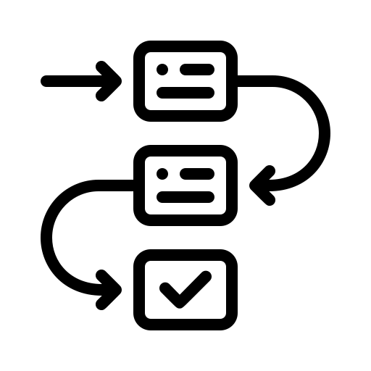




Contents
Motivation
Introduction
Structure and Simulation
Results and Conclusion
Future Scope
Applications
References
2

Slide 3
Motivation
The silicon based Ge-pocket Double Gate tunnel field effect transistor (DG-TFET) demonstrates artificial neuromorphic property for leaky-integrate-fire (LIF) neurons.
DG-TFET based LIF neuron is a potential solution for implementing large-scale spiking neural networks (SNN) because of its compact circuitry and better efficiency.
DG-TFET Effectively minimizes energy consumption in LIF neurons, excelling in both low-power operation and idle states, making them a highly efficient choice for power-conscious applications.
TFET provides advantage for LIF neurons by providing enhanced precision for tiny signals which is crucial in neural networks.
3

Slide 4
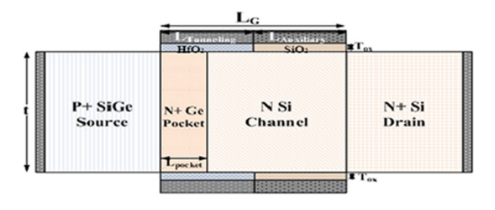
Introduction
Ge-Pocket DG-TFET
Fig 1. Structure of TFET with hetero dielectric gate (HfO₂ + SiO₂)
In DG-TFET metal electrodes are used for source and drain terminals are chosen to induce n+ drain and p+ source in the intrinsic silicon film to realize the p+-i-n+ structure.
4

Slide 5
Introduction
DG-TFET
A DG-TFET has three terminals: a drain, gate, and source, just like a MOSFET.
The gate is positioned over the channel and separated from the drain and source by a dielectric substance.
The doping of the drain and source of a DG-TFET is what makes it unique. The doping of the drain and source in a typical MOSFET is similar, but in a TFET, it is different.
The channel region is intrinsically doped, while the drain and source are doped as n-type and p-type, respectively.
5

Slide 6
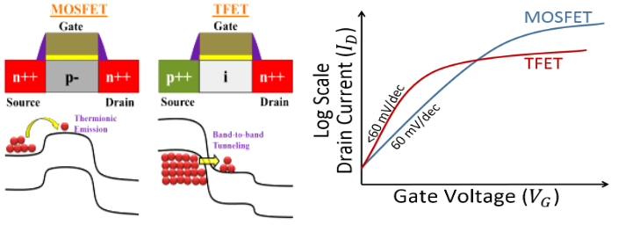
Introduction
Why TFET over MOSFET
Fig. 2: TFET vs MOSFET comparison
Reduced Short Channel Effects: MOSFETs are limited by the various short-channel effects (SCEs) such as velocity saturation, hot carrier effect ,and drain induced barrier lowering (DIBL), which adversely affects the low power performance of MOSFET devices. TFET deploying the band-to-band tunneling (BTBT), has emerged as the most acceptable approach to reduce this.
6

Slide 7
Introduction
Why TFET over MOSFET ?
Low Power Consumption: TFETs operate at lower voltages than MOSFETs, leading to reduced power consumption. This makes them more energy-efficient for applications where power efficiency is crucial.
Subthreshold Slope Improvement: TFETs exhibit a steeper subthreshold slope compared to MOSFETs. This means TFETs can switch on and off more quickly, enabling faster and more precise control of the transistor.
Enhanced Performance at Low Supply Voltages: TFETs are effective at low supply voltages, providing reliable operation even in scenarios where power resources are limited.
7

Slide 8
Introduction
TFET Mechanism
Band to Band Tunneling (BTBT)
TFET’s conduction mechanism is based upon band to band tunneling (BTBT) which is controlled by gate voltage and reverse biasing of p-i-n structure helps in reducing leakage.
In this mechanism, electrons travel from the valence band of the semiconductor to the conduction band by tunneling across a potential barrier. At sufficient gate bias, band-to-band tunneling (BTBT) occurs when the conduction band of the intrinsic region aligns with the valence band of the P region.
Electrons from the valence band of the p-type region tunnel into the conduction band of the intrinsic region and current can flow across the device.
As the gate bias is reduced, the bands become misaligned and current can no longer flow. The device turns on when sufficient gate voltage is applied such that electrons can tunnel from the source valence band to the channel conduction band.
8

Slide 9
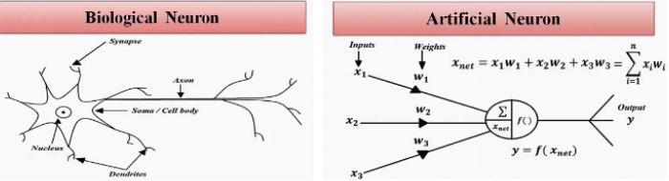
Introduction
: LIF Neuron
Fig. 3: Analogy of Biological Neuron vs LIF Neuron
LIF neurons mimic natural neurons, guiding the development of artificial systems for advanced cognitive tasks, mirroring the human brain.
Dendrites, serving as receptive branches in LIF neurons, gather and transmit impulses, while the connections to the cell body, analogous to synaptic weights, influence the neuron's response, reflecting the role of synapses in biological neurons.
Synaptic weights in LIF neurons determine connection strength, mimicking biological synapses in signal transmission.
Artificial neurons, inspired by LIF neurons, employ algorithms for signal integration, resembling the summation process from dendrites to the cell body, mirroring the biological activation state.
9

Slide 10
Introduction
DG-TFET as LIF Neuron
The DG-TFET device working as a LIF neuron reported around 0.6 THz spiking frequency which is approximately 9 orders higher as compared to that of a biological neuron (f0 = 10 Hz).
DG-TFET exhibits a very low threshold voltage of 0.289 V and minimum energy of 1.5aJ to fire a spike signal which is very low approximately 4 orders lower power consumption as compared to the actual neuron (∼10−14 J/spike).
The TFET LIF neuron relies on the band-to-band tunneling mechanism for signal processing. This tunneling process contributes to the device's ability to transmit signals efficiently, enabling the TFET to function as a neuromorphic element with reduced energy consumption compared to traditional transistor-based neurons.
The DG-TFET LIF neuron operates efficiently in the subthreshold range, utilizing tunneling processes and consuming around four orders of magnitude less power compared to a real neuron.
10

Slide 11
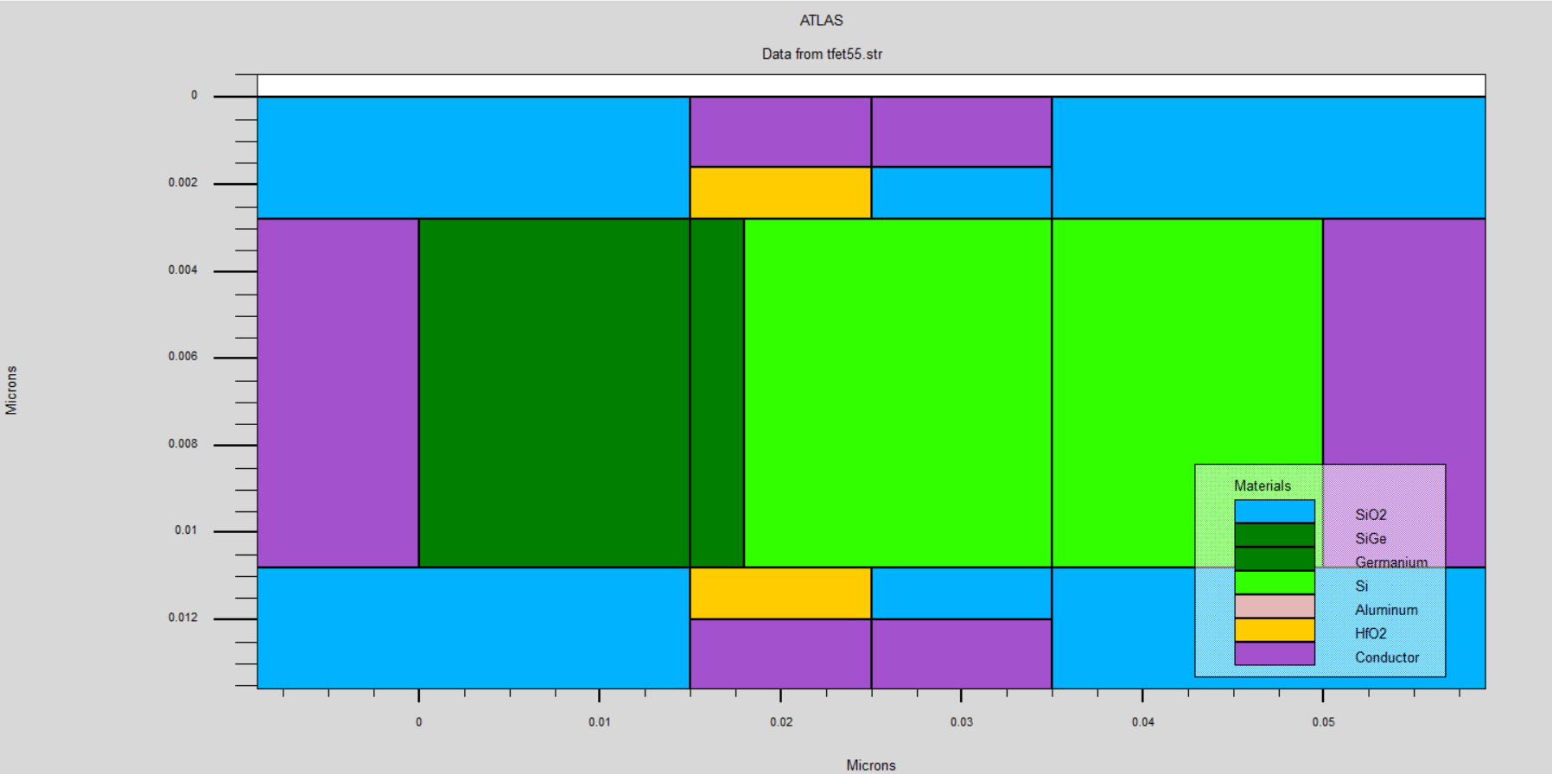
Structure and Simulation
Ge-Pocket DG-TFET Structure
Fig. 4: Device structure of DG-TFET
11

Slide 12
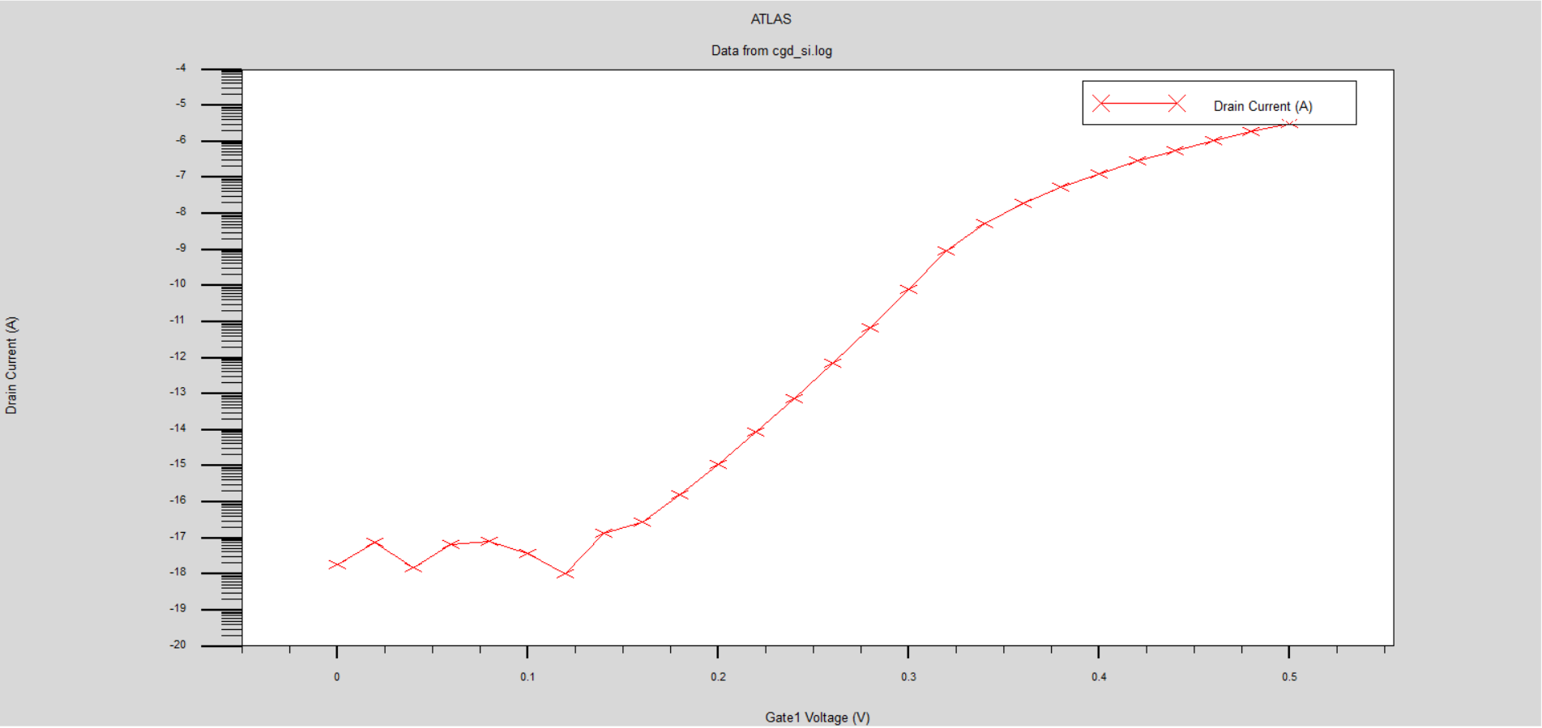
Results and Conclusion
We did the simulation of DG-TFET in Silvaco TCAD and then plotted the drain current vs gate voltage graph to understand the behaviour DG-TFET, further will study spiking behavior of TFET which mimic the property of biological neuron.
Fig. 5: Drain current vs Gate Voltage plot
12

Slide 13
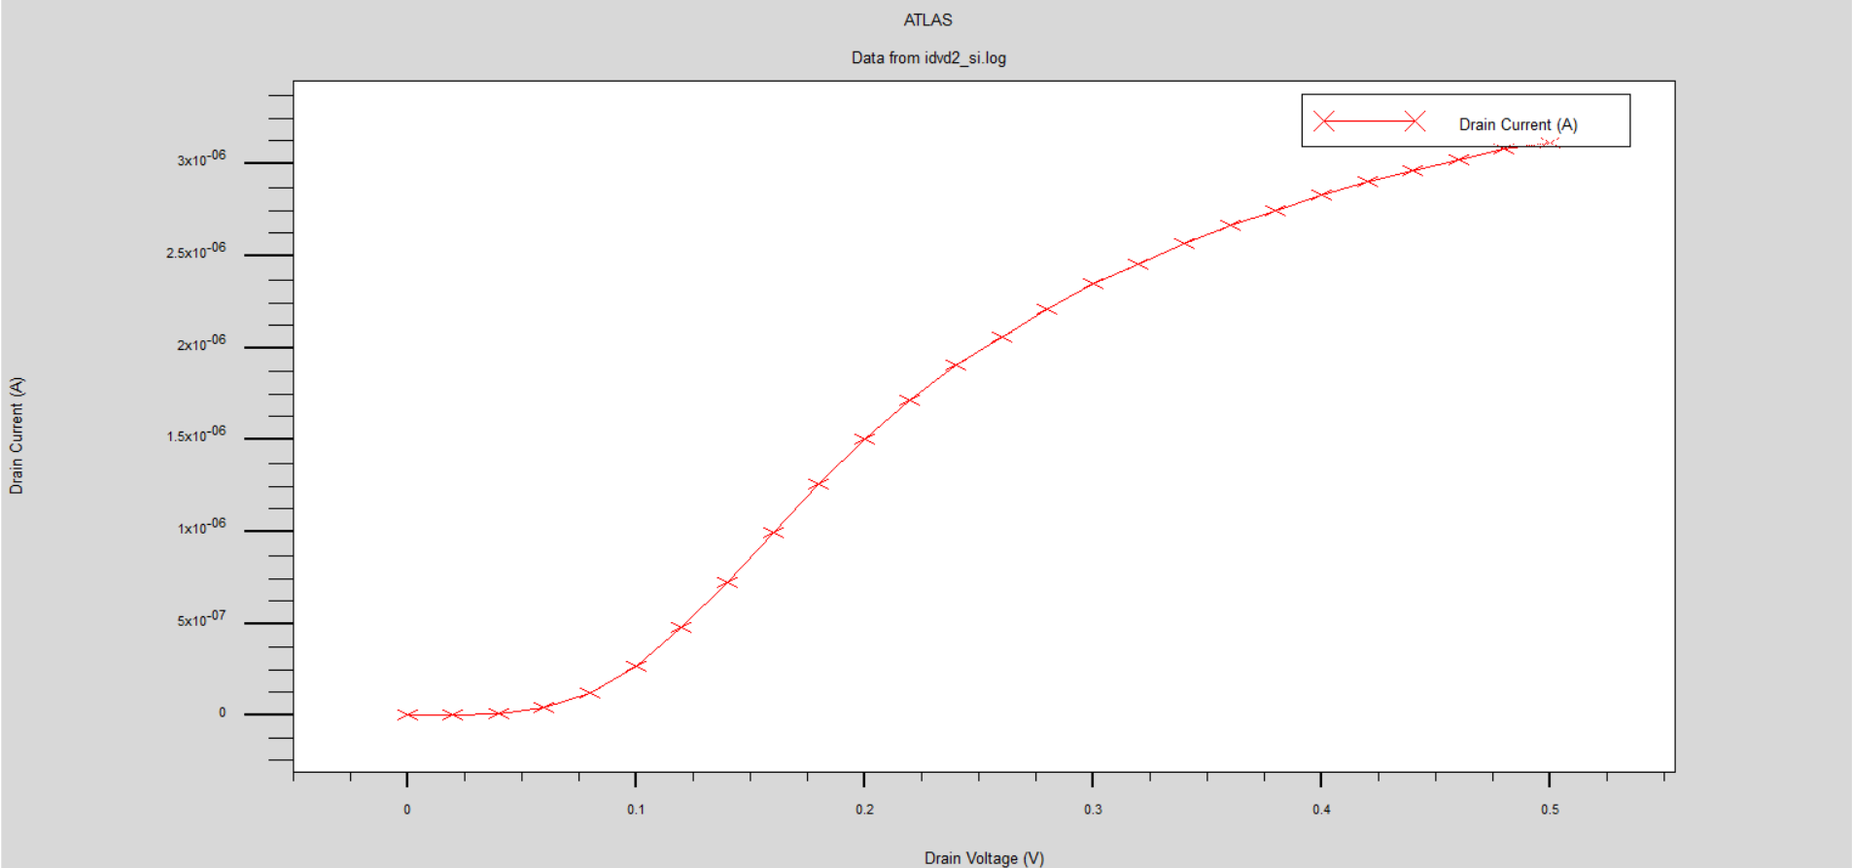
Results and Conclusion
Fig. 6: Drain Current vs Drain Voltage
13

Slide 14
Future Scope
The future scope of our Double Gate Tunnel Field-Effect Transistor (DG TFET) is with a focus on its application as a Leaky Integrate-and-Fire (LIF) neuron and mixed-mode transient analysis.
Mixed-Mode Transient Analysis: Extend the simulation to include mixed-mode transient analysis, exploring the device's response to both analog and digital signals.
Hybrid Neuromorphic Systems: Investigate the potential integration of DG TFET LIF neurons with other neuromorphic computing elements, such as conventional CMOS neurons, to create hybrid systems with improved capabilities.
Real-world Applications: Explore real-world applications for DG TFET-based LIF neurons, such as pattern recognition, sensor signal processing, and edge computing tasks, and assess their practical feasibility.
14

Slide 15
Applications
Neural Network Implementations
Low-Power Edge Computing
Internet of Things (IoT) Devices
Real-Time Signal Processing
15

Slide 16
References
Priyanka, S. Singh and M. Panchore , "Dopingless -TFET Leaky-Integrated-Fire (LIF) Neuron For High-Speed Energy Efficient Applications," in IEEE Transactions on Nanotechnology, vol. 21, pp. 110-117, 2022, doi: 10.1109/TNANO.2022.3151241.
Neha Kamal and Jawar Singh , “A Highly Scalable Junctionless FET Leaky Integrate-and-Fire Neuron for Spiking Neural Networks”, IEEE TRANSACTIONS ON ELECTRON DEVICES, VOL. 68, NO. 4, APRIL 2021.
Neha Kamal , Jawar Singh ,Avinash Lahgere , Pramod Kumar Tiwari , “Ultra-Low Power Reconfigurable Synaptic and Neuronal Transistor for Spiking Neural Network”, IEEE TRANSACTIONS ON NANOTECHNOLOGY, VOL. 22, 2023.
Alok Kumar Kamal and Jawar Singh ,”Simulation-Based Ultralow Energy and High-Speed LIF Neuron Using Silicon Bipolar Impact Ionization MOSFET for Spiking Neural Networks,” IEEE TRANSACTIONS ON ELECTRON DEVICES, VOL. 67, NO. 6, JUNE 2020.
Kumari Nibha Priyadarshani, Sangeeta Singh, Alok Naugarhiya ,”Dual Metal Double Gate Ge-Pocket TFET (DMG-DG-Ge-Pocket TFET) with Hetero Dielectric: DC & Analog Performance Projections”, Springer Nature B.V. 2021.
16

Slide 17
Thank You!
17

