Slide 1
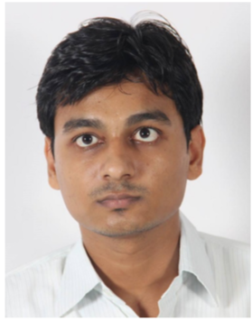

Ajay Nehra
Senior Analyst , Capabilities and Insights
Introduction
Ajay joined McKinsey in Nov, 2019
Prior to this, he was working with Ernst & Young as an Senior Consultant in Financial Risk management team ,specializing in credit risk modelling and analytic, before that he as also worked for Mastercard and Fractal Analytics on advanced analytics projects
His area of focus is developing data driven solution for the clients , he has worked in banking domain to develop credit risk scorecards for the retail portfolios and forecast Expected Credit loss for the loans. He is also familiar with the Basel 1, II and III regulations. Apart from banking domain he also has very good knowledge of payment industry from his Mastercard tenure where he worked on consumer behavior and analytics, also in Fractal Analytics he has worked on pricing Analytics. He has extensively worked on big data tools like R, python , SAS, SQL, Hadoop & spark. He is also familiar with various cloud based platforms like git and AWS
Role: Senior Analyst
Office: Gurgaon, India
McKinsey experience: 0+6
Recent Engagements at McKinsey
Total experience: 5 Years
Price Elasticity Modeling for Apparel Client (2 month) –Created a module in R to develop price elasticity models for various categories and products groups at once using Mixed Models
Purchase Structure Development (2 month) – Built Purchase Structure for different product category for a leading Beverage client. Understood market and used advanced analytics techniques to develop shoppers buying behavior hierarchy. Handled client/CST communication and presented result.
Technical expertise:
Price and promotion Modelling
Credit Risk Modelling
Customer Behavior Analytics
Purchase Structure
Machine Learning and Advanced Analytics
Prior work experience
Tools expertise:
R , Python , SAS, SQL
Hadoop & Spark
Alteryx, Excel
Cloud platforms : Git and AWS framework
Ernst & Young – Risk Modelling and risk management
Mastercard – Customer behavior analytics
Fractal Analytics – pricing and promotion Analytics.
Education
B.Tech from IIT Kanpur

