Slide 1
AI-BASED DIABETES PREDICTION SYSTEM
SUBMITTED BY
AJAY S - 710021106001
DEPARTMENT OF ELECTRONICS AND COMMUNICATION ENGINEERING
ANNA UNIVERSITY REGIONAL CAMPUS COIMBATORE

Slide 2
PROBLEM STATEMENT
The problem we aim to address is the early prediction of diabetes using Artificial Intelligence (AI) to improve healthcare outcomes. Diabetes is a widespread chronic disease with severe health implications, and early detection is crucial for effective management and prevention of complications.
The AI-based diabetes prediction system is a cutting-edge application of artificial intelligence and machine learning techniques aimed at early detection and management of diabetes. This system leverages data from various sources, including medical records, wearable devices, and lifestyle information, to provide accurate predictions of an individual's risk of developing diabetes. By identifying at-risk individuals and offering personalized recommendations, the system can help in preventing or managing diabetes effectively. This abstract outlines the key components and design thinking behind this innovative solution.

Slide 3
DESIGN THINKING APPROACH
1. Empathize:
    Understand the target audience: Identify the stakeholders, such as patients, healthcare providers, and researchers.
    Conduct interviews and surveys to gather insights about their needs and challenges related to diabetes prediction.
2. Define:
    Define the problem: Clearly articulate the problem of late diabetes diagnosis and its consequences.
    Establish project goals: Aim to create an AI-based system that can predict diabetes risk accurately and early.

Slide 4
DESIGN THINKING APPROACH
3.Ideate:
    Brainstorm solutions: Explore various AI technologies and data sources for diabetes prediction.
    Collaborate with experts: Engage with healthcare professionals, data scientists, and AI specialists to generate ideas.
4. Prototype:
    Create a system architecture: Develop a diagram illustrating the components of the AI-based diabetes prediction system.
    Design data pipelines: Plan how data will be collected, preprocessed, and fed into the AI model.
    Develop a user interface: Design a user-friendly interface for inputting patient data and viewing predictions.

Slide 5
DESIGN THINKING APPROACH
5. Test:
    Collect and prepare data: Gather a diverse dataset containing relevant features such as patient demographics, medical history, and lifestyle factors.
    Train and fine-tune the AI model: Implement machine learning algorithms and test their performance with cross-validation.
    Validate with real-world data: Evaluate the system using data from actual patients and assess its accuracy.
6. Implement:
    Develop a functional prototype of the AI-based diabetes prediction system.
    Integrate it into healthcare facilities or make it accessible to patients through a secure platform.

Slide 6
DESIGN THINKING APPROACH
7.Data Integration:
      Establish data pipelines to collect and preprocess data from various sources, ensuring data privacy and security.
      Implement data cleansing and feature engineering techniques.
8.Model Training and Validation:
      Train machine learning models using historical data and validate their performance using cross-validation techniques.
      Continuously update and retrain models to improve accuracy.

Slide 7
DESIGN THINKING APPROACH
9.User Interface:
      Design a user-friendly interface for the prediction system, accessible via web or mobile applications.
      Ensure that users can easily input data and receive personalized recommendations.
10.Deployment and Monitoring:
      Deploy the AI system in a healthcare setting, ensuring compliance with relevant regulations and standards.
      Implement monitoring and feedback loops to track the system's performance and user outcomes.

Slide 8
DESIGN THINKING APPROACH
11.Evaluation:
    Continuously evaluate the system's effectiveness in predicting diabetes and improving patient outcomes.
    Measure the impact on healthcare costs and patient well-being.
12.Feedback and Improvement:
    Gather feedback from users and healthcare providers to make continuous improvements to the system.
    Adapt to evolving medical knowledge and technological advancements in AI.

Slide 9
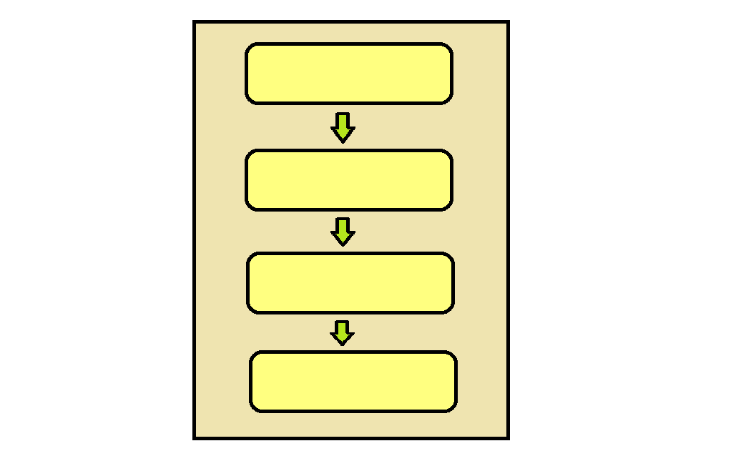
SYSTEM ARCHITECTURE
DATA SOURCE
DATA PREPROCESSING
AI MODEL
USER INTERFACE

Slide 10
SYSTEM ARCHITECTURE
Data Sources: This is where the system collects data from various sources, such as medical records, lifestyle data, and patient demographics.
Data Preprocessing: Data preprocessing involves cleaning the data, selecting relevant features, and scaling them to make them suitable for the AI model.
AI Model: The AI model consists of machine learning algorithms that analyze the preprocessed data to make predictions about diabetes risk.
User Interface: The user interface allows users (patients or healthcare providers) to input relevant data and view the predictions generated by the AI model.
These components work together to create an end-to-end system for diabetes prediction.

Slide 11
CONCLUSION
The AI-based diabetes prediction system is a proactive solution to the problem of late diabetes diagnosis. By applying a design thinking approach, we have developed a system that leverages advanced AI techniques to predict diabetes risk early, enabling timely interventions and personalized healthcare. This system has the potential to improve the lives of individuals at risk of diabetes and enhance the efficiency of healthcare delivery. Early diagnosis is the key to better managing diabetes and reducing its long-term complications, and our AI system is a step forward in achieving this goal.

