Slide 1
Wireframe For Visualization
By: AJAY SINGH

Slide 2
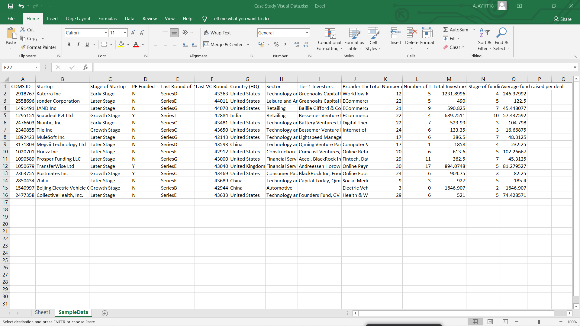
Sample Data :

Slide 3
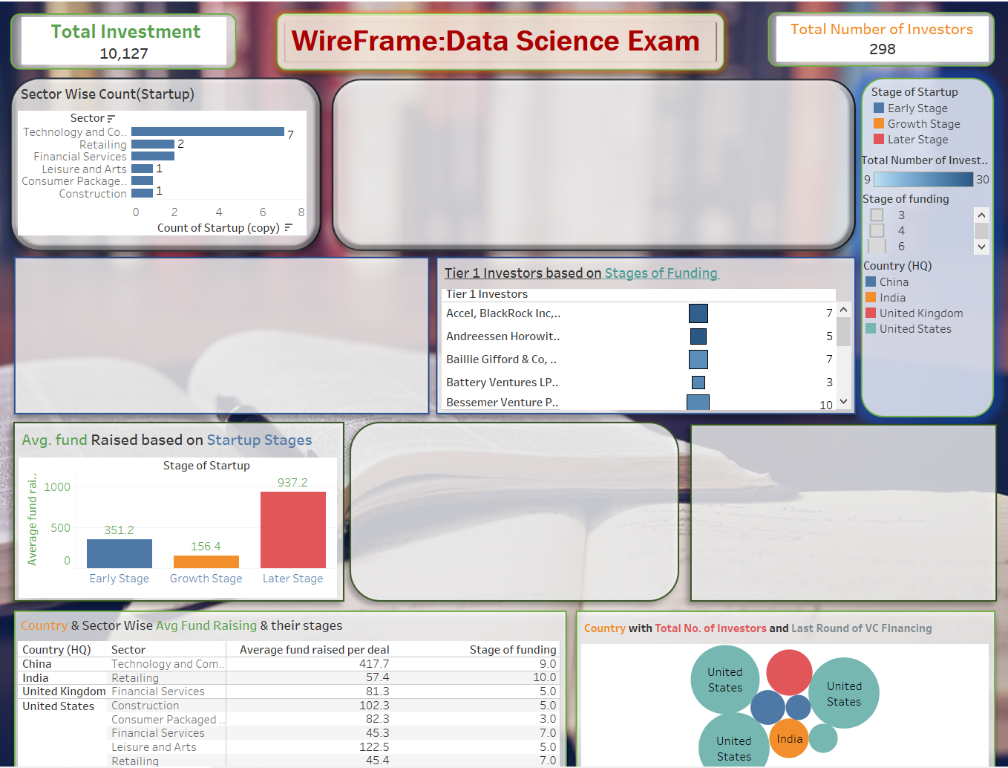
Wireframe

Slide 4
KPI’s: 1. Total Investment: 10,127 2. Total No. of Investors: 298
Charts based on The sample data :
Sector wise Count(Startup)
Tier 1 Investors based on stages of Funding
AVG. fund Raised based on Start up of stages and etc.

Slide 5
Estimate of Project:
By Top-Down Estimation : Breaking into parts by work
Project Estimation based on these :
Dashboards
Story
Insights of the dashboards
Creative Viz of Dashboards
Multiple No. of Sheets
Creative Designing of sheets
Wireframe
Data Cleaning

Slide 6
18% G.S.T Is not included in this estimate.
Steps to Perform | Hours Taken by specific Task | Cost of 1 hour for specific Task (Rs) | Total cost
Gathering of data & Cleaning | 1.5 hours | 400 | 600
Data Analysing | 2 hours | 450 | 900
Creating KPI | 1 hour | 300 | 300
Creating Wireframe | 4 hours | 700 | 2800
Creating Sheets | 5.5 hours | 450 | 2475
Creating interactive Dashboards | 5 hours | 650 | 3250
Creating Stories | 2 hours | 400 | 800
Insights & Conclusion | 3 hours | 500 | 1500
Total Estimate | 24 hours |  | Rs 12,625 /-

