Slide 1
Employee Data Analysis using Excel
STUDENT NAME: S.AJAY
REGISTER NO:User ID-autunm110312201220
1E729D29C990F449255480D1B38252FD
DEPARTMENT:III B.COM(GENERAL)
COLLEGE : D.R.B.C.C.C.HINDU COLLEGE

Slide 2
PROJECT TITLE
Employee Performance Analysis using Excel

Slide 3
AGENDA
Problem Statement
Project Overview
End Users
Our Solution and Proposition
Dataset Description
Modelling Approach
Results and Discussion
Conclusion

Slide 4

PROBLEM STATEMENT
Organizations need to effectively monitor and evaluate employee performance across various departments to ensure consistent productivity and identify areas that require improvement. However, it can be challenging to track, analyze, and compare performance levels across different teams. The primary issue is determining how to categorize and quantify these performance levels to make informed management decisions.

Slide 5

PROJECT OVERVIEW
.
This project aims to analyze employee performance levels across different departments within an organization. By categorizing performance into four levels—HIGH, LOW, MED, and VERY HIGH—the analysis provides a clear understanding of the distribution of performance across the teams. This data-driven approach helps identify patterns, trends, and potential areas of concern, allowing management to make informed decisions to enhance overall performance.

Slide 6

WHO ARE THE END USERS?
The end users of this project include:HR Managers: To identify teams that may need additional support or resources.Department Heads: To gain insights into their team's performance.Top Management: To make strategic decisions regarding workforce optimization.Employee Development Teams: To target specific training programs based on performance gaps.

Slide 7

OUR SOLUTION AND ITS VALUE PROPOSITION
Our solution involves creating a detailed dataset that categorizes employee performance levels across various departments. We used data visualization techniques to represent this information clearly. By using a pivot table and line chart, we can quickly identify trends, outliers, and potential areas of improvement. We propose using this analysis to guide decisions related to employee development, resource allocation, and overall organizational strategy.

Slide 8
Dataset Description
The dataset consists of performance data categorized into four levels—HIGH, LOW, MED, and VERY HIGH—across different departments labeled as BPC, CCDR, EW, MSC, etc. The data captures the frequency count of employees at each performance level within these departments, providing a comprehensive view of team performance across the organization.

Slide 9
MODELLING APPROACH
Steps to Create the Table and Chart in Excel:
**Open Excel**: - Launch Microsoft Excel and open your file "NM project" to work with the data.
2. **Input the Data**: - In the first step, ensure that your data is entered correctly in a table format. Each category (e.g., BPC, CCDR, EW, etc.) should be in one column, with corresponding values for "HIGH," "LOW," "MED," and "VERY HIGH" in the rows.
3. **Create a Pivot Table (if needed)**: - **Select your data**: Highlight the data you want to include. - **Insert Pivot Table**: Go to the `Insert` tab on the ribbon, then select `PivotTable`. Choose whether to place it in a new worksheet or the existing one. - **Configure the Pivot Table**: Drag and drop the necessary fields to the `Rows`, `Columns`, and `Values` areas to display counts for each category under the "HIGH," "LOW," "MED," and "VERY HIGH" labels.
4. **Insert the Chart**: - **Select your data range**: Highlight the range of cells that include the data you want to visualize. - **Insert a Line Chart**: Go to the `Insert` tab, select `Line or Area Chart`, and choose the line chart option. This will plot your data with the different categories on the X-axis and their corresponding values on the Y-axis. - **Customize the Chart**: - Add a title by clicking on the chart title and typing in "Employee Data Set" or your desired title. - Customize the chart lines and markers if necessary by right-clicking on them and choosing "Format Data Series.
9

Slide 10
MODELLING APPROACH
"5. **Add Data Labels** (optional): - You can add data labels to your chart to show exact values by right-clicking on the lines in the chart and selecting `Add Data Labels`.
6. **Linear Trendline**: - If you want to include a linear trendline for any of the series (e.g., "VERY HIGH"), click on that line in the chart, then select `Add Trendline`. Choose `Linear` from the options.
7. **Save Your Work**: - Ensure you save the Excel file frequently to avoid losing any data.###
Additional Tips:- **Filtering Data**: You can filter your data by using the drop-down menus in your pivot table or by applying filters in the original data range.- **Formatting**: Use cell formatting to make the table and chart more visually appealing (e.g., adjusting font size, color, and border styles).If you need more specific help with your project, you can describe the exact part you're working on, and I can guide you further!

Slide 11
THE "WOW" IN OUR SOLUTION
•The formula used in the solution is •=IFS(Z8>=5, “VERY HIGH" ,z8>=4, “HIGH " Z8>-3, “MED", “TRUE", "LOW") 10

Slide 12
RESULTS
The analysis reveals significant variations in performance levels across different departments. Some departments have a balanced distribution across performance levels, while others have more extreme variations. The trend analysis for the VERY HIGH performance level shows a linear pattern, indicating a need for strategic focus on departments with consistently low performance levels.
.
12

Slide 13
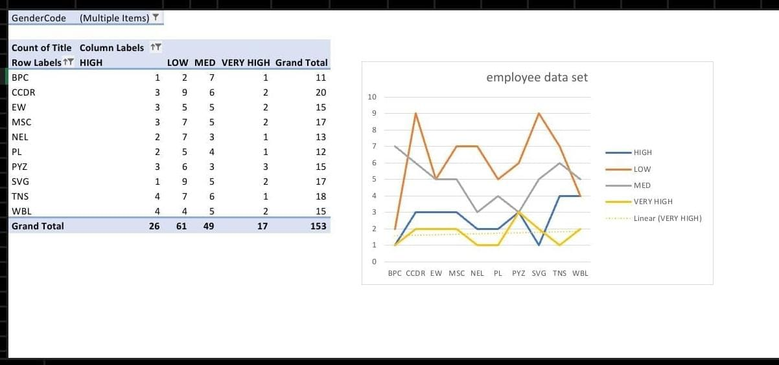
RESULTS

Slide 14
conclusion
The project successfully identifies the performance distribution across departments, highlighting areas that require attention. The results suggest that while some departments excel, others may need targeted interventions to boost performance. This data-driven approach provides actionable insights for HR and management, ultimately leading to improved organizational performance.

