Slide 1
Multivariate Analysis
Ajay Attuchirayil Krishnankutty

Slide 2
Applying various statistical techniques, on the data that consists of multiple varying factors.
The output of such techniques help us in gaining good insight into the data, which can later on help us for tasks such as prediction or classifications.
Few Terms:
SVD, Eigen Values, Eigen Vectors
Factor Scores, Loadings, Latent Variables, Partial Factor Scores, Saliences
Quantitative, Qualitative, Nominal, Ordinal
Scree Plots, Factor Map, Correlation Plot, Heat Map, Contribution Graphs, Bootstrap Bars
Binning, Contingency Tables, Mean, Confidence Interval, Convex Hull

Slide 3
Data: IBM Employees With Attrition
Details of IBM Employees who faced attrition.
Rows: Total of 238 Employees
Columns: Variables measured 32
Research Question : How different variables affect employees captured in this data?
Quantitative:
Age
Monthly Income
Daily Rate
Hourly Rate
Distance From Home
Num of Companies Worked
Percent Salary Hike
Nominal:
Marital Status
Education
Department
Job Role
Overtime
Gender
Ordinal:
Performance Rating
Job Satisfaction
Relationship Satisfaction
Job Level
Environment Satisfaction

Slide 4
Data
Qualitative
Quantitative
PCA
PLSC
BADA
MFA
MCA
PLSC
DiCA
Binning
Design

Slide 5
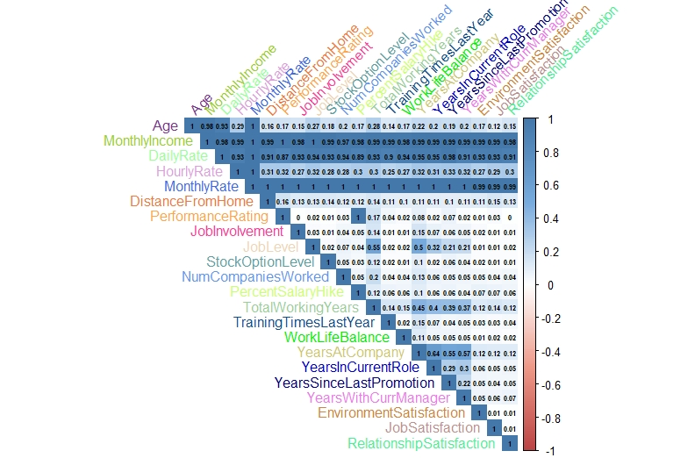
HEAT MAP
Performance Rating & Percent SalaryHike
Job Level vs Years at Company & Total Working Years

Slide 6
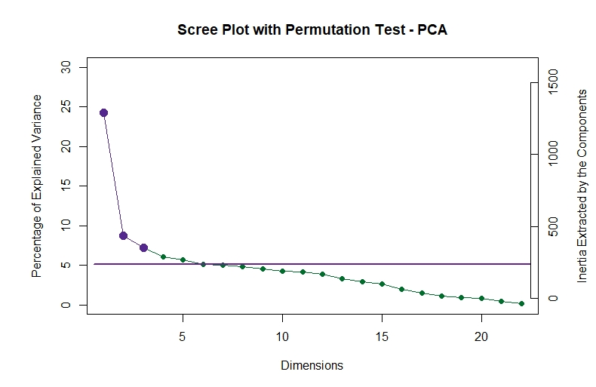
PCA

Slide 7
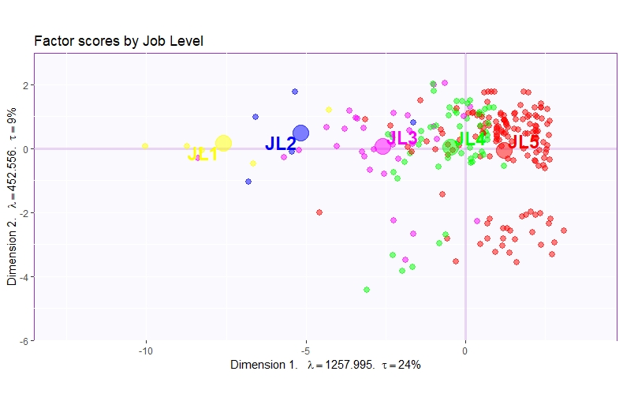
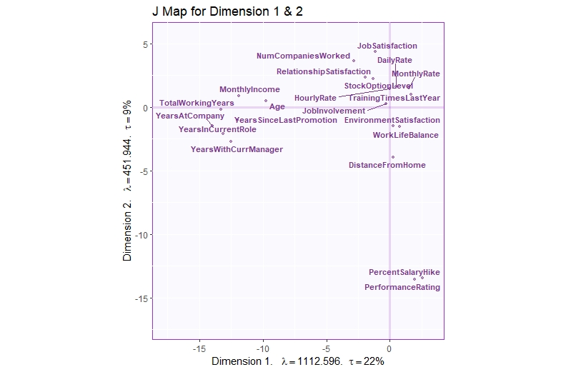
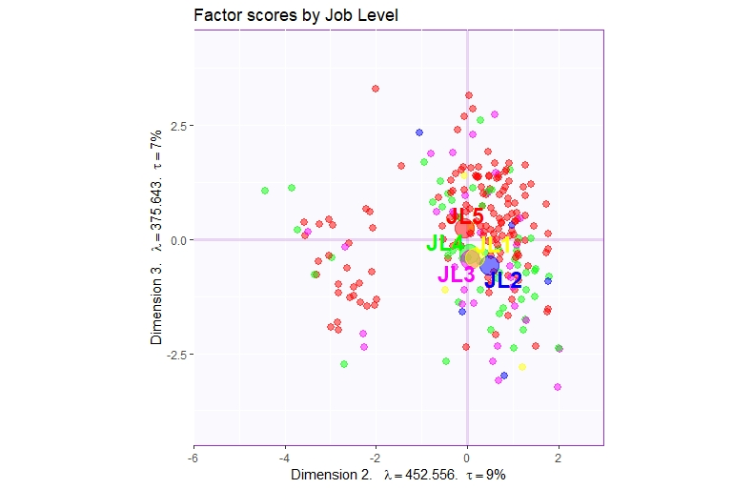
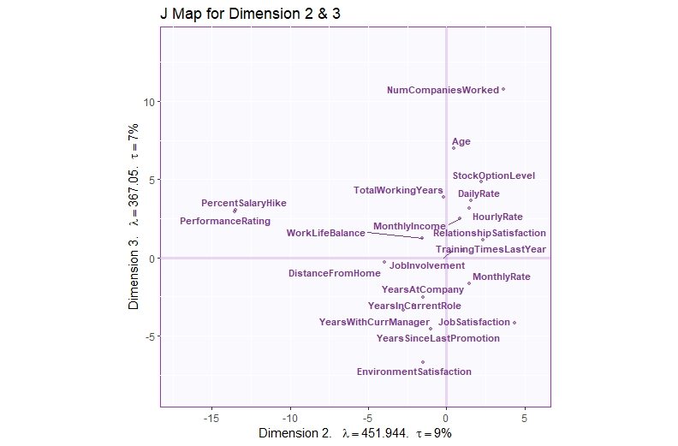
Job Level 1
Job Level 2
Job Level 3
Job Level 4
Job Level 5

Slide 8
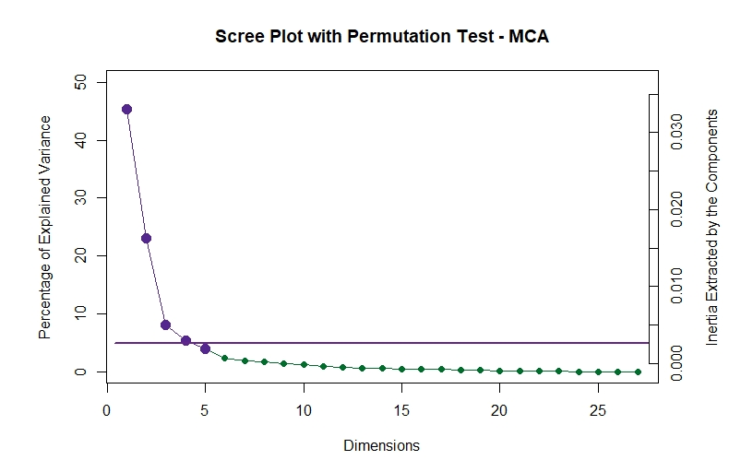
Ordinal
MCA
Nominal
As Factor
Binning
Quantitative Data

Slide 9
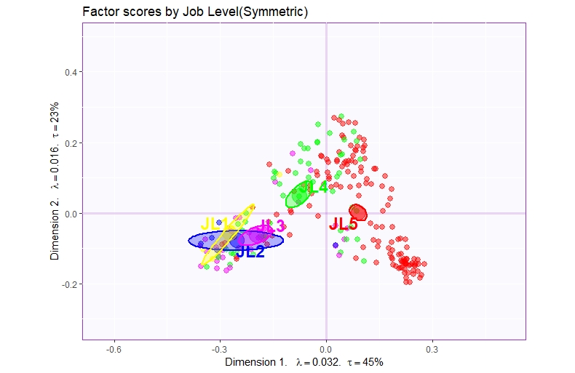
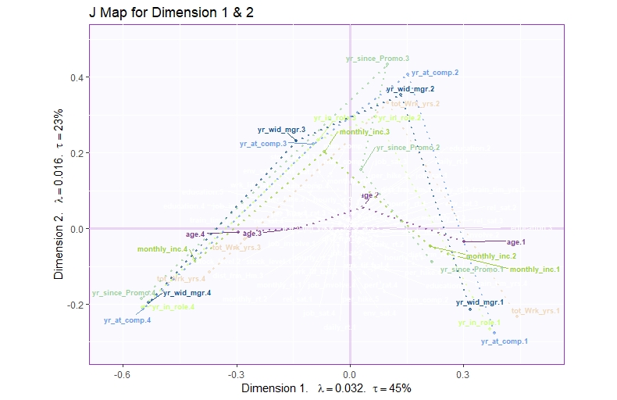
I & J map combined (Symmetric)
Job Level 1
Job Level 2
Job Level 3
Job Level 4
Job Level 5

Slide 10
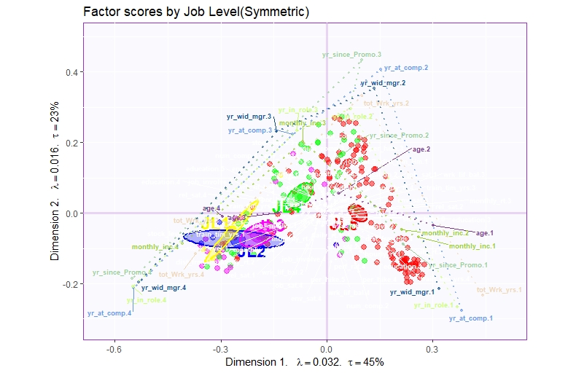
Job Level 1
Job Level 2
Job Level 3
Job Level 4
Job Level 5

Slide 11
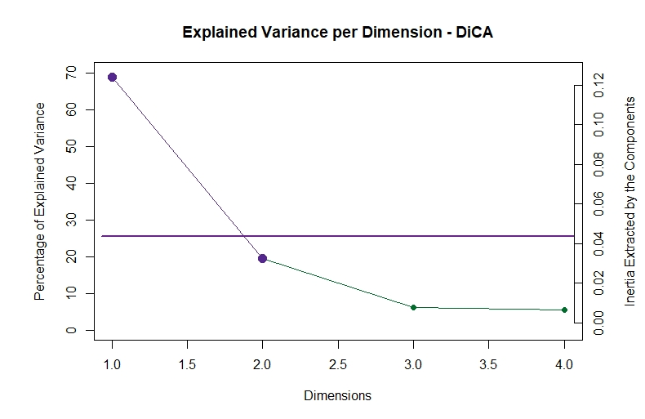
DiCA
Again we bin the data as done during MCA

Slide 12
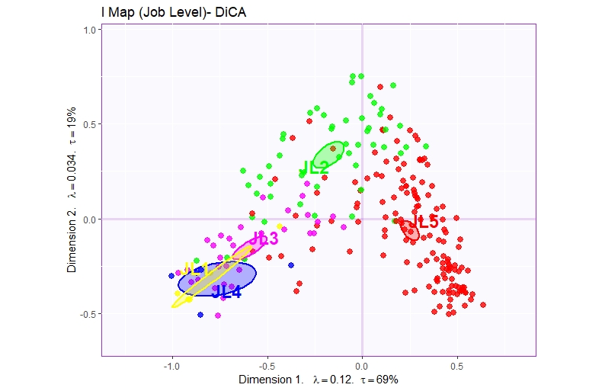
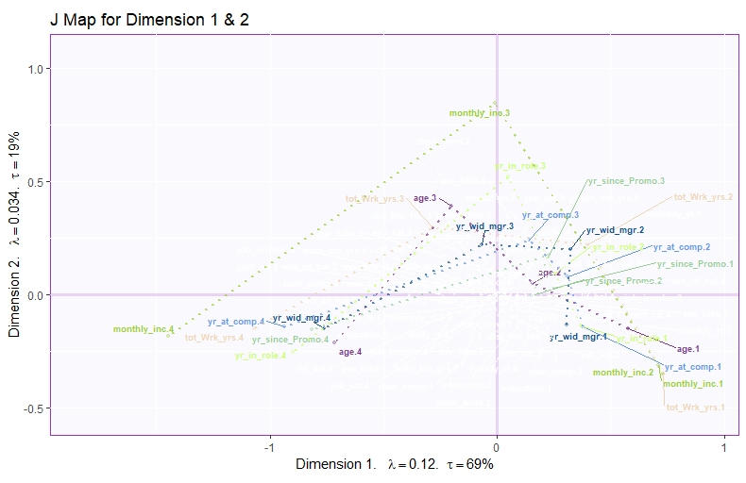
Job Level 1
Job Level 2
Job Level 3
Job Level 4
Job Level 5

Slide 13
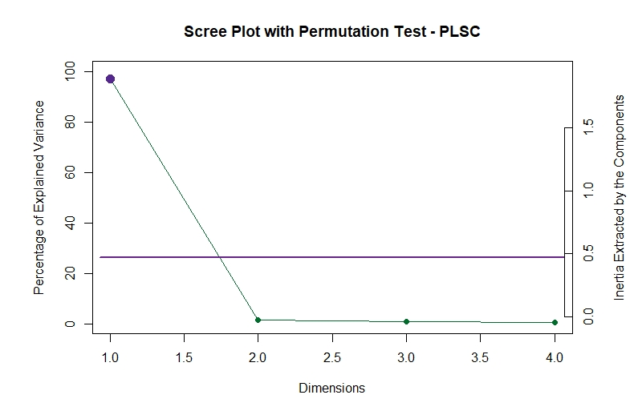
Num Of Companies
Percent Salary Hike
Total Working Years
Training Time Since Last Year
Years at Company
Years In Current Role
Years Since Last Promotion
Years Wit Curr Manager
PLSC
Data
Monthly Income
Daily Rate
Hourly Rate
Monthly Rate

Slide 14
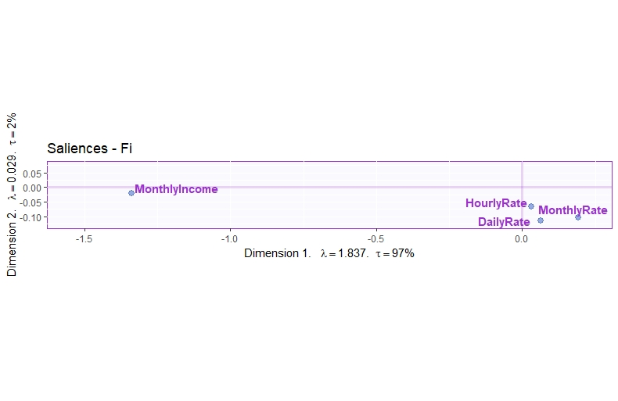
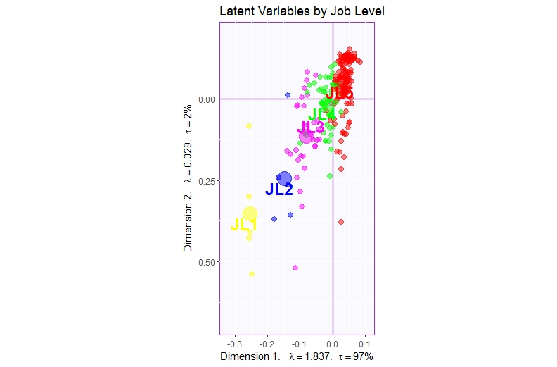
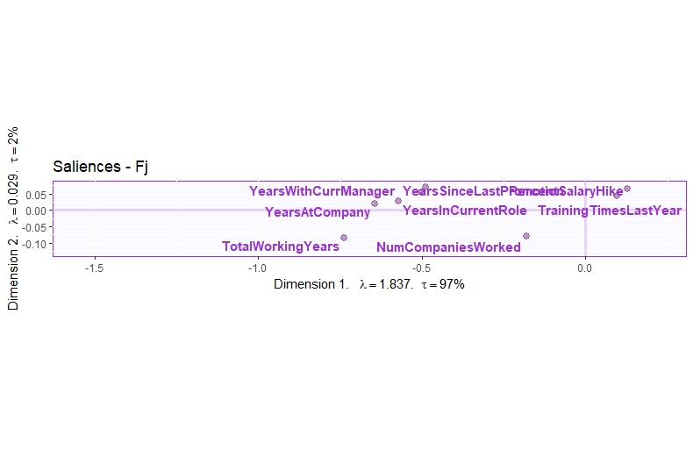
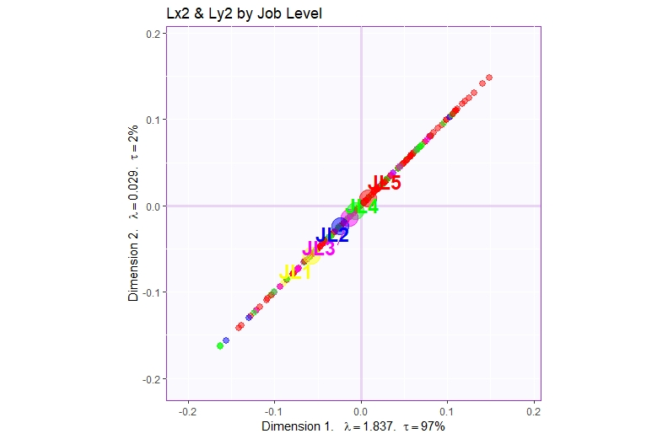
Job Level 1
Job Level 2
Job Level 3
Job Level 4
Job Level 5

Slide 15
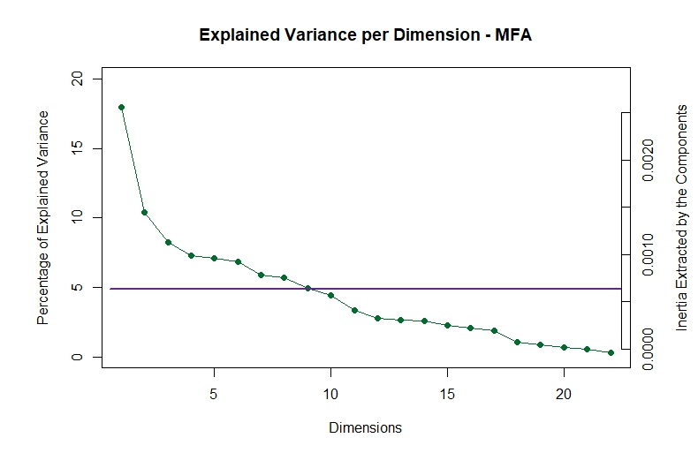
MFA

Slide 16
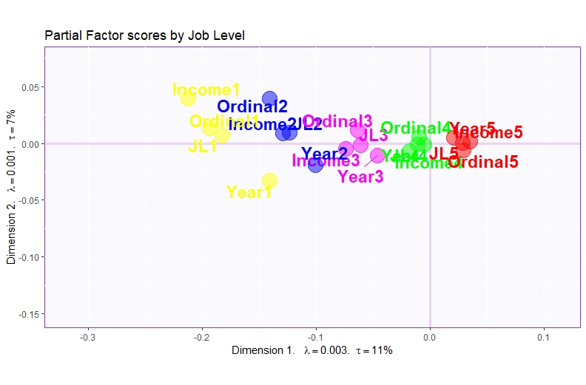
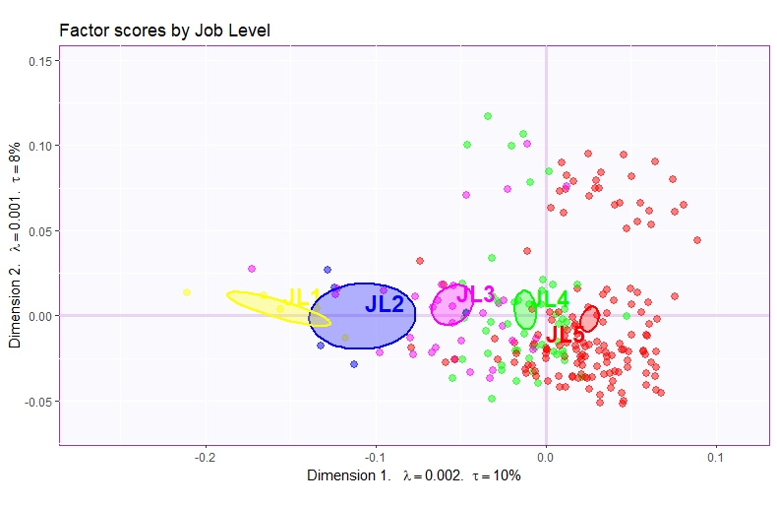
Job Level 1
Job Level 2
Job Level 3
Job Level 4
Job Level 5
Ordinal
Performance Rating
Education
Job Involvement
Stock Option Level
Num Companies Worked
Percent Salary Hike
Work Life Balance
Environment Satisfaction
Relationship Satisfaction
Job Satisfaction
Year
Income
Total Working Years
Training Time Since Last Year
Years At Company
Years In Current Role
Years Since Last Promotion
Years With Current Manager
Age
Monthly Income
Monthly Rate
Daily Rate
Hourly Rate
Distance From Home

Slide 17
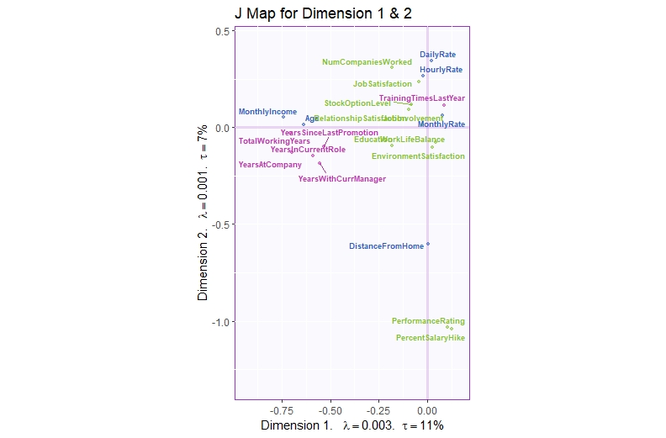

Slide 18
Conclusions
PCA : Dimension 1 showed difference amongst Factor score when colored by Job Level.
Dimension 2 (+ve) : Job Satisfaction, Num of Companies Worked.
Dimension 2 (-ve) : Percent Salary Hike, Performance Rating
Dimension 1 (-ve) : Year (at Company, Current manager, Current Role)
MCA : Also showed difference for Job Levels, and on plotting the loadings after binning, Years (at company, with manager) showed similar pattern as Job Level. (Job Level Increased as years passed on)
DiCA : Similar plots and results as for the MCA
PLSC : Saliences Fi() when considered with factor score plot, showed higher Job Levels coincided with higher monthly income.
Saliences Fj() when considered with factor score plot, showed similar trend as above with all the year related variables.
MFA : As Job Level increased, the table with year variables had more inertia as compared to the Ordinal and the Income ones.
PCA showed a pattern with Job Level and the same pattern was seen through till MFA, and MFA showed some new insights on employees on higher positions.

Slide 19
Questions or comments?

