Slide 1
Term project
Bank Management System
We have used mysql database

Slide 2
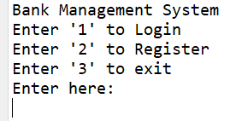
If we enter 1 we will go to login If we enter 2 we will go to register(new account) If we enter 3 we will terminate the program Now we will register a new account.(enter 2)

Slide 3
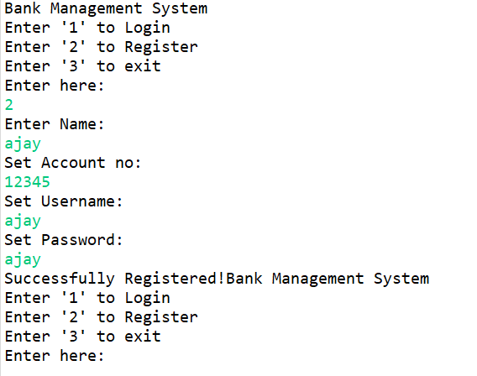
After you enter 2; you will find the details to create a new account. After you create the account you will go to home once again. Now if you want to create another account enter 2 or if you want see balance, deposit, withdraw enter 2

Slide 4
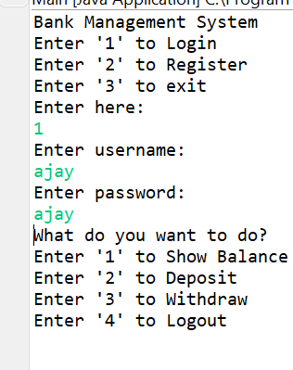
As you have entered in your account if you enter 1 you will see balance enter 2 to deposit your money enter 3 to withdraw your money if you want to exit enter 4

Slide 5
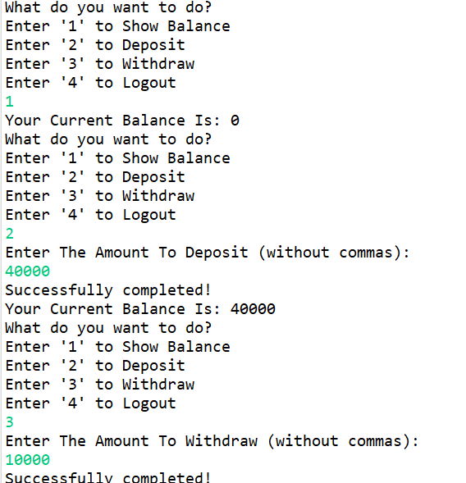
The operation are performed here.

Slide 6
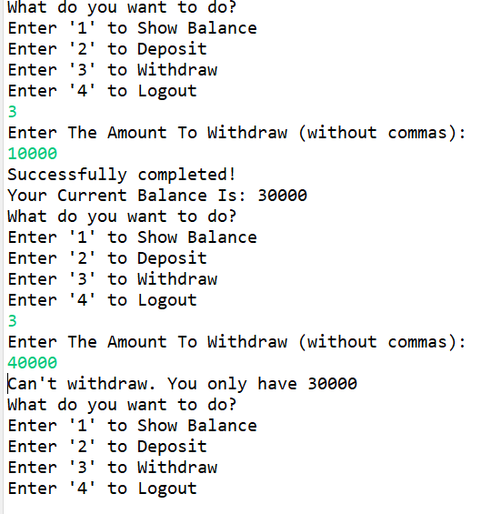
If you enter the money more than you have in the account to withdraw then you will get the following message

Slide 7
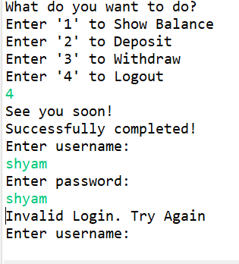
If you to logout enter 4. You may get a doubt that if you don't create and login what will happen it will show the following message.

Slide 8
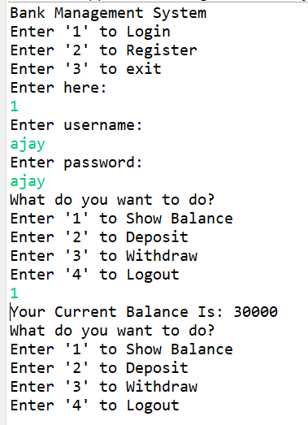
After you logout and login you see the exact balance that where you have left. We have use JDBC to store and execute data.

Slide 9
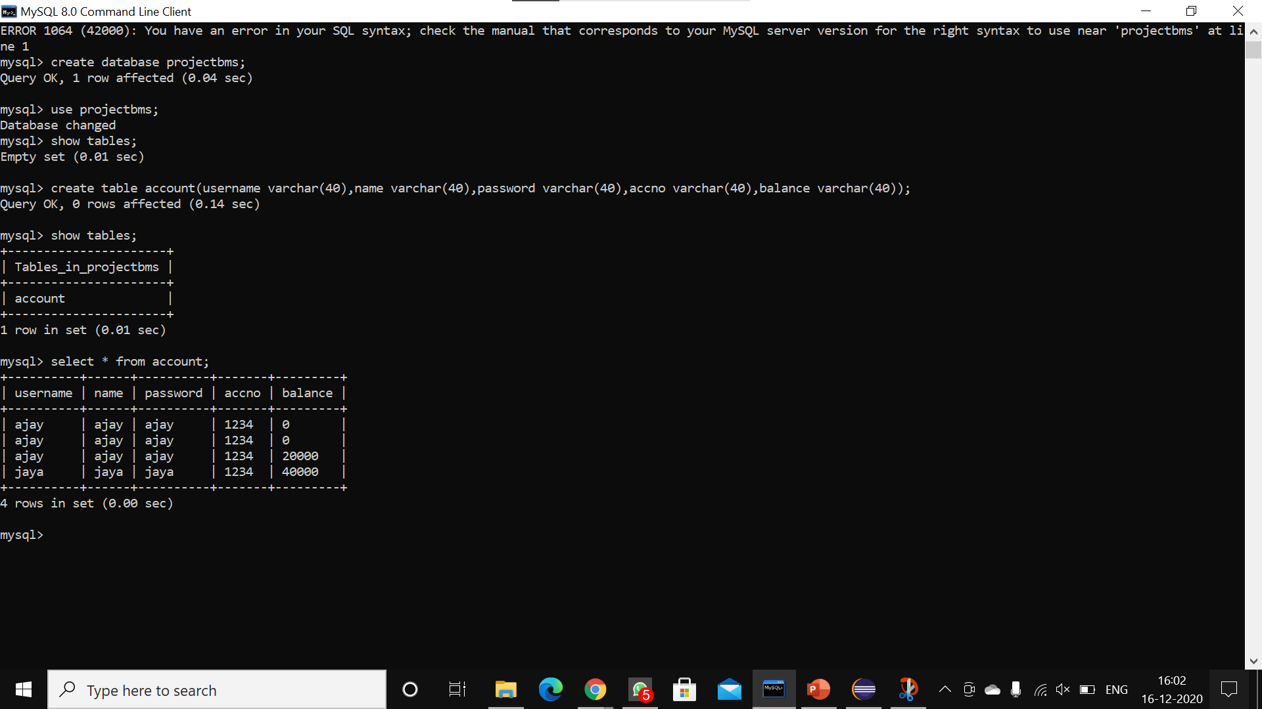
At starting the mysql database look like the picture shown . And you can see the commands that have I have used of mysql data implementation.

Slide 10
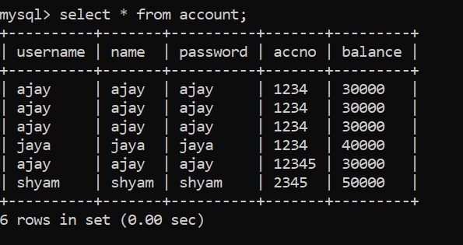
After we tasks as shown in the presentation the final database will look like as shown.

Slide 11
Thank you

