Slide 1
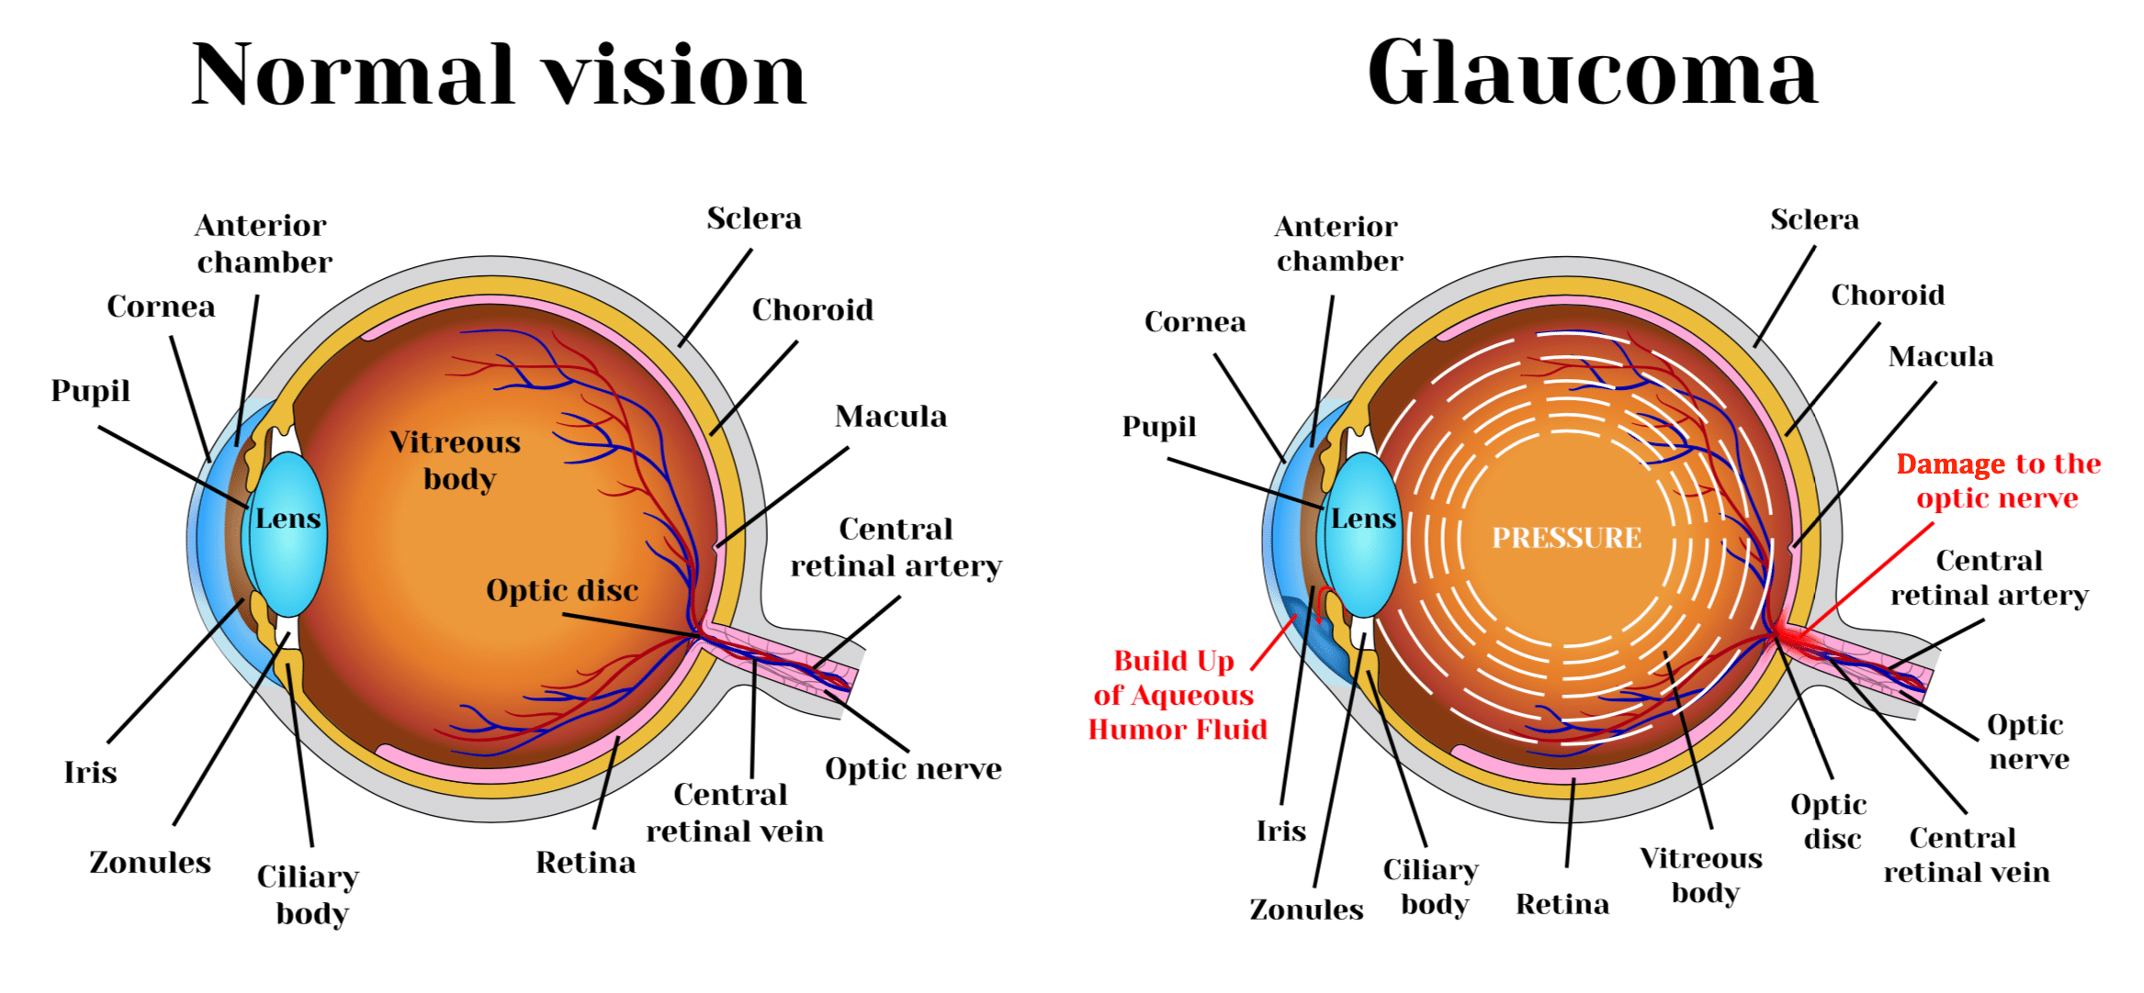
Chronic Glaucoma

Slide 2
Glaucoma
Glaucoma is a group of eye diseases that cause damage to the optic nerve, leading to progressive vision loss.
Second most eye disease after cataract but it is irreversible unlike cataract.
Risk Factors: Age, family history, high intraocular pressure, and certain medical conditions increase the risk of developing glaucoma.
Glaucoma typically occurs due to increased intraocular pressure that damages the optic nerve, but other factors may contribute to its development.
Datasets: UZL, REFUGE, LAG, SIGF etc

Slide 3
Deep learning on fundus images detects glaucoma beyond the optic disc
Uses UZL dataset with Train: 9541 Val: 1368 Test: 2643 images for glaucoma detection.
Uses Train:16,799 Val:2366 Test:4765 for VCDR(Vertical Cup to Disk Ratio) regression.
Uses ResNet-50 model for both and uses cropping interior and peripheral ranging 10-60%.
Models that were trained on images with absence of the ONH(Optic Nerve Head) are still able to obtain significant performance (0.88 [95% CI 0.85–0.90] AUC for glaucoma. detection and 37% [95% CI 0.35–0.40] R2 score for VCDR estimation in the most extreme setup of 60% ONH crop).
First irrefutable evidence that deep learning can detect glaucoma from fundus image regions outside the ONH.

Slide 4
SIGF Dataset used in DeepGF and GLIM-Net models
This is a dataset that consists of sequential images of a patient with irregular intervals
SIGF contains 3671 fundus images in total and consists of 405 sequential fundus images.
Contains 37 time-variant sequences and 368 time-invariant sequences.
Samples used for training (300), validation (35) and test (70) sets used in DEEPGF and continued by GLIM-Net to assess performance.
There are 264 patients in total in the dataset, with 192 patients, 23 patients and 49 patients in the training set, validation set and test set, respectively

Slide 5
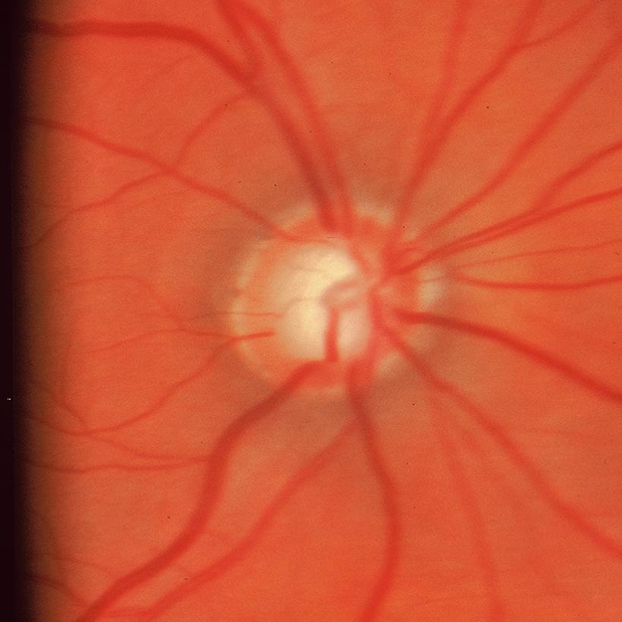
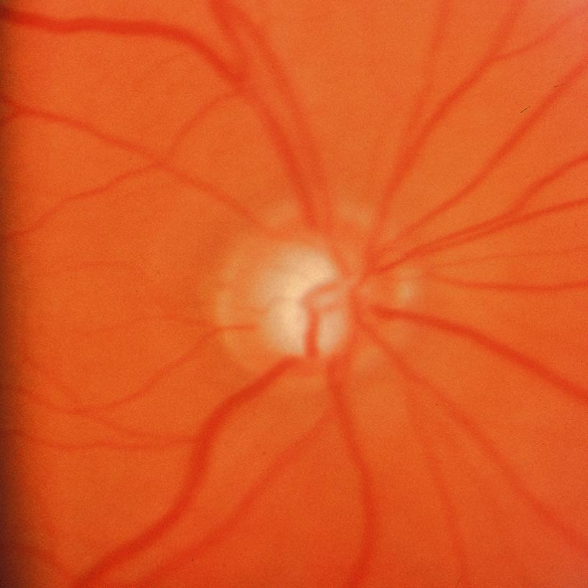
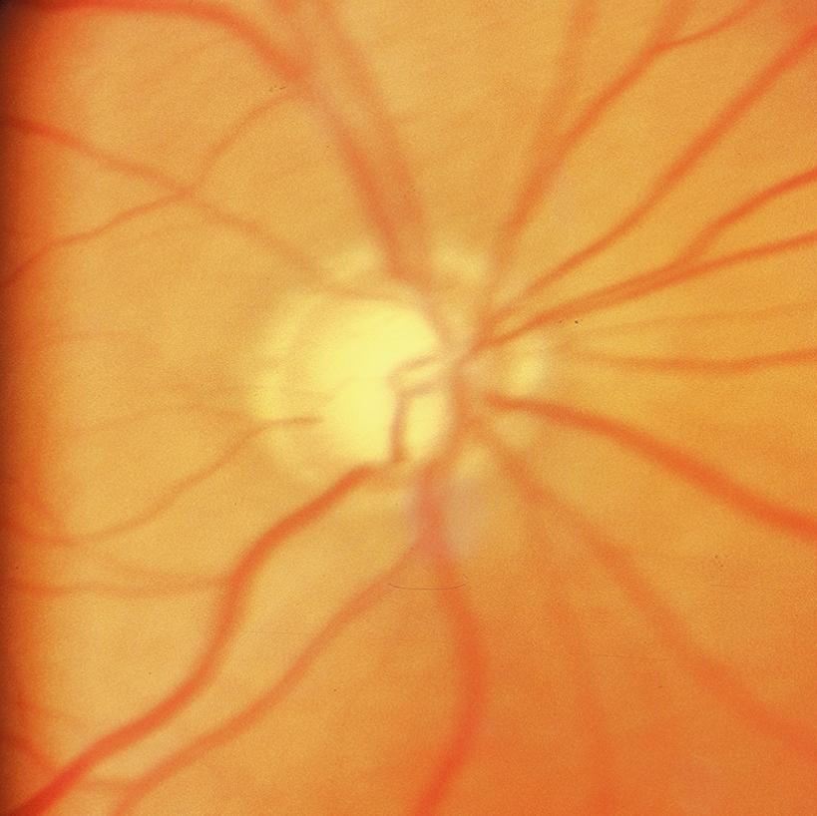
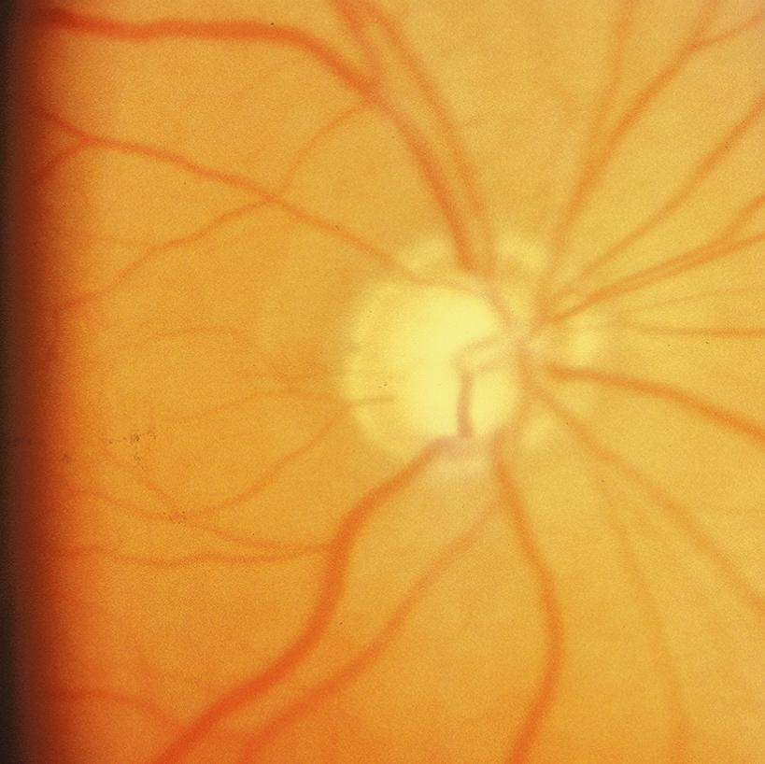
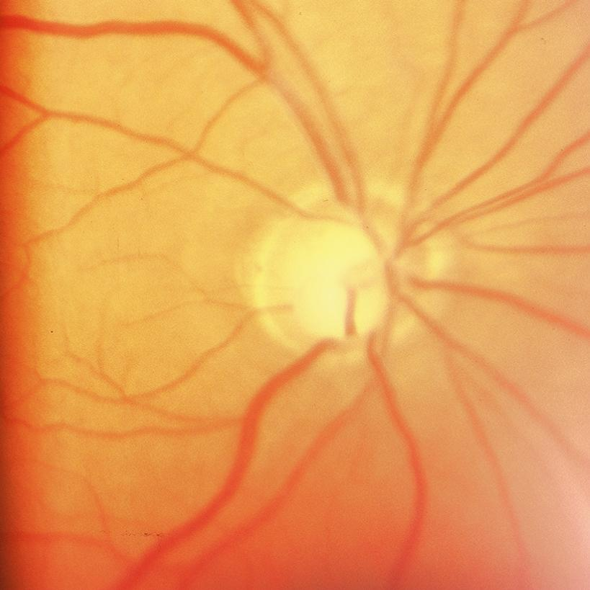
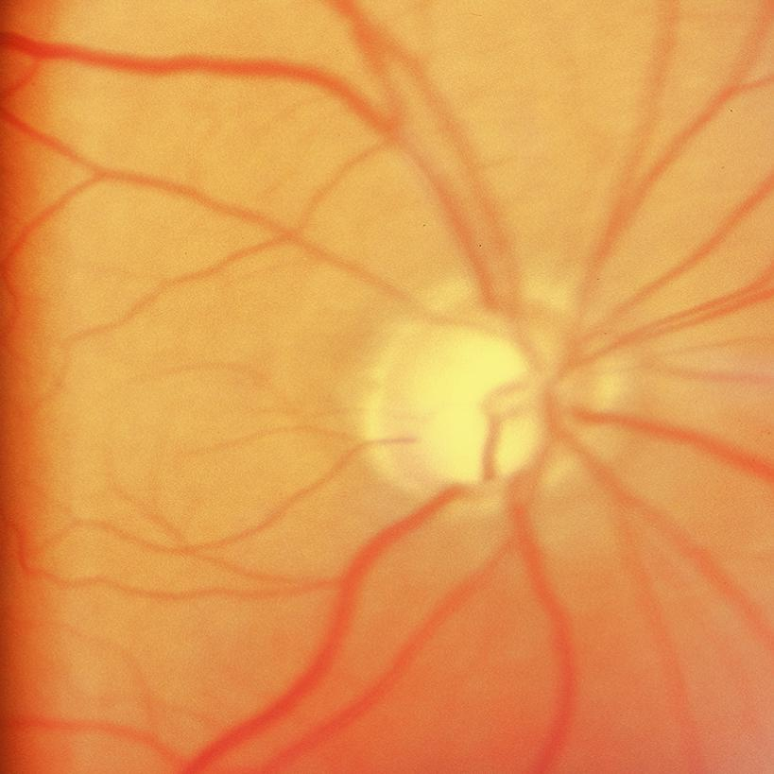
1990-07 NO
1992-04 NO
1992-11 NO
1994-11 YES
1995-11 YES
1999-01 YES

Slide 6
DeepGF: Glaucoma Forecast Using the Sequential Fundus Images
Trained on SIGF dataset but dataset is small, to overcome use instead of linear transformation, use polar convolutional neural network used in to extract low-level features to enable the model to converge even if the scale of dataset is small.
Consists of an attention-polar convolution neural network (AP-CNN) and a variable time interval long short-term memory (VTI-LSTM) network
Predicts only the possibility of glaucoma but not the timeframe.
GLIM-Net: Chronic Glaucoma Forecast Transformer for Irregularly Sampled Sequential Fundus Images
Uses DEEPGFs polar coordinated CNN and uses encoder-decoder structure.
First transformer-based glaucoma forecast network named GLIM-Net with time positional encoding and time-sensitive MSA modules to better address the irregularly sampled data.
Time condition is incorporated in both the encoder and the decoder of GLIM-Net

Slide 7
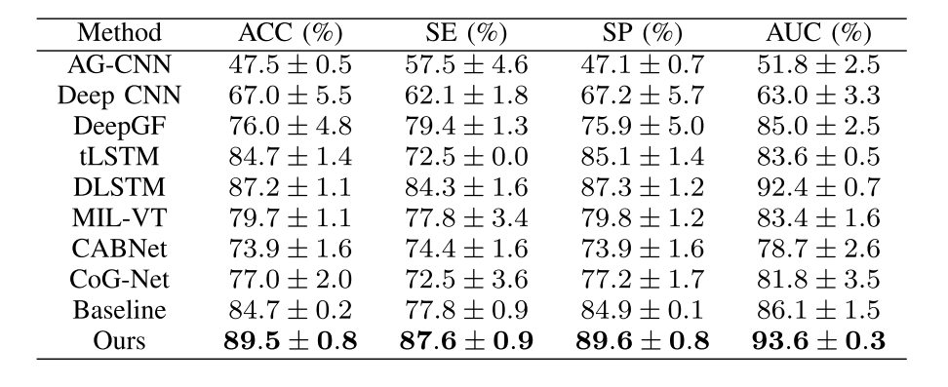
Accuracy Reported in GLIM-Net
ACC: Accuracy
SE: Sensitivity
SP: Specificity
AUC: Area Under the Curve

