Slide 1


Complyance Hackathon 2026
ClearGlass: An Explainable, Hybrid ML Invoice Anomaly Detection Engine
Problem statement ID: 1
Team Name: Ctrl+Alt+Delete
Team Members: Ajay R, Raagul N, Mohammed Isa S A

Slide 2
PROPOSED SOLUTION
ClearGlass is a hybrid pipeline combining statistical feature engineering and unsupervised classical machine learning to flag irregular invoices. First, we utilize a robust synthetic data generator to create a highly realistic, privacy-compliant dataset of buyers, sellers, and invoices. Then, we engineer temporal and financial features to train an Isolation Forest model. Instead of relying on LLMs, the system assigns a continuous anomaly score to incoming invoices and uses Explainable AI (SHAP) to translate the mathematical outliers into concrete, human-readable reason codes (e.g., "Tax Mismatch", "Unusual Submission Time").
How it addresses the problem:
Contextual Understanding: It moves beyond rigid "if-then" ERP rules by learning the "normal" variance and behavioral patterns of specific seller-buyer pairs.
Neutral Flagging: It strictly outputs an anomaly score and a "review recommended" flag, avoiding absolute fraud accusations, perfectly aligning with compliance workflows.
Constraint Adherence: It entirely bypasses heavy LLMs for the core logic, ensuring fast, deterministic, and computationally cheap processing.
Uniqueness of the solution: The primary differentiator is our focus on Auditability via Explainable AI. We don't just output a red flag; we mathematically deconstruct the model's decision using SHAP values. The system tells the reviewer exactly why it was flagged (e.g., "Anomaly Score 85/100: Driven primarily by the submission time being 4 hours outside the seller's usual window, combined with an abnormal line count").
© Complyance Inc 2021 - 2026
02

Slide 3
TECHNICAL APPROACH
Technologies to be used:
Data Synthesis: Python, Pandas, NumPy, Faker, SDV (Synthetic Data Vault).
Feature Engineering & ML: Scikit-Learn (Isolation Forest, Local Outlier Factor).
Explainable AI (XAI): SHAP (SHapley Additive exPlanations).
Serving/API: FastAPI (for lightweight inference endpoints).
Justification of the mentioned tech stack:
Python Ecosystem: The industry standard for robust statistical modeling and classical ML.
Isolation Forest: Specifically chosen because it is highly efficient for unsupervised anomaly detection. It excels at finding outliers in high-dimensional datasets without requiring perfectly balanced, pre-labeled data.
SHAP: Fulfils the "explain why" requirement flawlessly. It provides exact feature contribution metrics without the hallucinations or high latency associated with LLMs.
SDV & Faker: Allows us to programmatically generate the 80/20 ratio of normal to anomalous data, perfectly adhering to the 8 required anomaly types constraints.
© Complyance Inc 2021 - 2026
03

Slide 4
IMPLEMENTATION FLOW
Methodology and process for the implementation:
Data Generation Phase: Build scripts to generate 50 sellers and 200 buyers. Generate 5,000 training invoices (80% normal behavior). Inject 20% anomalies mapping exactly to the 8 required classes (e.g., amount_outlier, invoice_burst).
Feature Engineering: Transform raw data into trainable features (e.g., converting dates into cyclical sine/cosine time features, calculating subtotal_to_tax_ratio, mapping historical buyer-seller frequencies).
Model Training: Train the Isolation Forest model strictly on the engineered features to learn the baseline multidimensional "normal".
Scoring & Thresholding: Pass the 1,000 test invoices through the model. Normalize the outputs into an intuitive 0-100 Anomaly Score.
Reason Extraction: Pass flagged anomalies through the SHAP explainer to extract the top 2-3 deviating features to present to the human reviewer.
© Complyance Inc 2021 - 2026
04

Slide 5
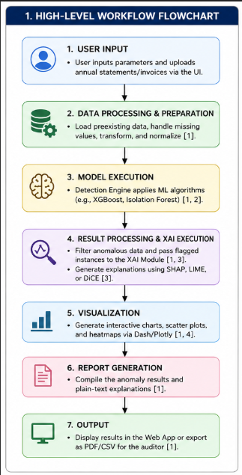
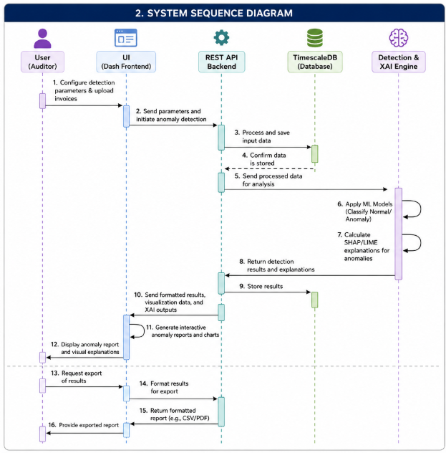
FLOWCHART & SEQUENCE DIAGRAM
© Complyance Inc 2021 - 2026
04

Slide 6
WHATS THE PLUS POINT OF YOUR APPROACH
Analysis of the proposed solution: The solution successfully balances predictive accuracy with operational interpretability. Pure rule-based systems suffer from massive false-positive rates, while Deep Learning models act as "black boxes" that finance teams cannot blindly trust. By utilizing classical Unsupervised ML paired with XAI, we achieve high accuracy with full transparency.
What is the plus point / advantage of this approach:
High Generalizability: Because the core logic relies on statistical divergence rather than overfitting to the quirks of our specific synthetic data, the model will generalize exceptionally well against the hidden organizer dataset during the final evaluation.
Operational Velocity: It drastically reduces the time analysts spend investigating. By pointing the finance team exactly to the anomalous fields (e.g., highlighting just the tax rate instead of the whole invoice), we streamline the manual review process.
Lean & Cost-Effective: By completely avoiding LLMs for the detection logic, the system requires minimal compute power, can run locally on standard hardware, and has near-zero latency.
© Complyance Inc 2021 - 2026
05

