Slide 1
JukeBox
Created by Ajay Chavan
Under guidance :
Vaibhav Diwan
Charul Bapna

Slide 2
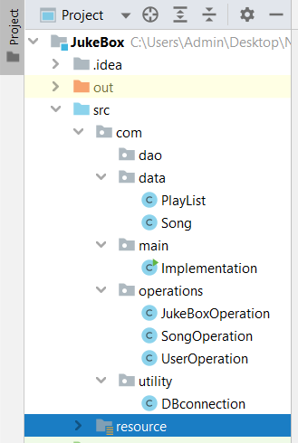
Classes Structure :-

Slide 3
Song -------------------- Id SongName Duration ArtistName Genre-Type SongPath
PlayList ------------------------ playListId playListName
JukeBoxOperation ------------------------------------------ displayAllSongs displayArtistName displayGenreType searchSongByName getDetailsOfExistingPlaylist displayAllPlaylist getSongIdInPlaylistContent searchSongInPlaylist
SongOperation ------------------------- playSong songListname
UserOperation ------------------------ createSongPlayList addSongtoPlayList

Slide 4
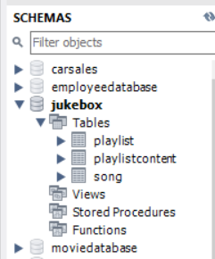
Database Structure :-

Slide 5
Song --------------------------------- songId songName songDuration artistName genreName songPath
PlayList ------------------------- playListID playListName
PlayListContent ------------------------------ playListID songId

Slide 6
Methods :-
displayAllSongs : It is a method which is displaying song table
displayArtistName : It is a method to get the details of Artist like songId, songName, ArtistName, Duration and GenreType.
displayGenreType : It is a method to get a type of genre which is present in songTable
searchSongByName : It is a method to get a particular songName which will contaion songID, songName, Duration, Artist and genre Type.
getDetailsOfExistingPlaylist : It is a method to get the Existing playlist which is present in Playlist Table.

Slide 7
Methods :-
getSongIdInPlaylistContent : It is a method where user will get the songId from playlistcontent which is a relationship table between playlist table and song table.
searchSongInPlaylist : It is a method where user can get song details from playlist.
createSongPlayList: It is a method for user to create a new playlist.
addSongtoPlayList: It is a method which allows user to add songs into that created Playlist

Slide 8
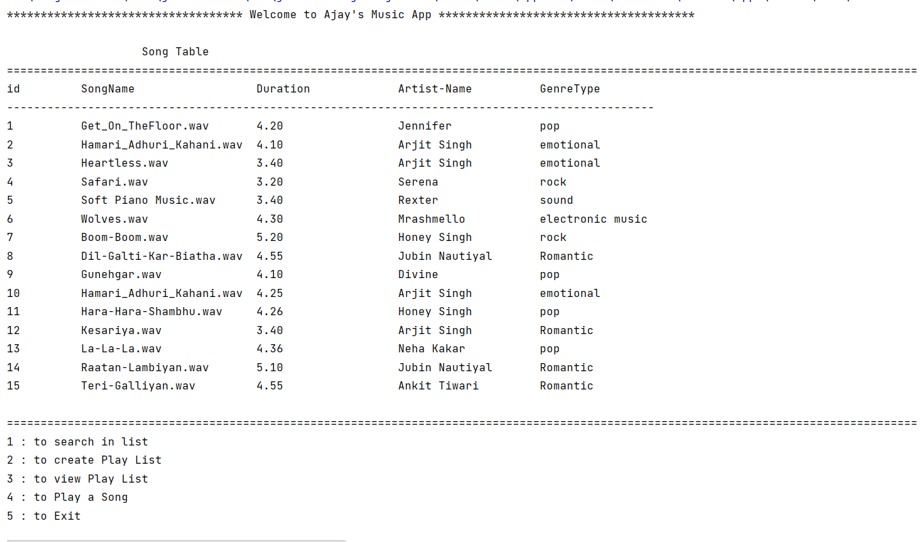
OutPut :-

Slide 9
Thank you

