Slide 1

VIDYAVARDHINI’S COLLEGE OF ENGINEERING AND TECHNOLOGY
____________________________________________________________________________________________
DEPARTMENT OF COMPUTER ENGINEERING
2023-2024

Slide 2
INTELLIGENT SYSTEM FOR IDENTIFICATION OF MALICIOUS WEBSITES

Slide 3
ABSTRACT
Phishing, the act of impersonating reputable websites to steal user information, presents a serious cybersecurity challenge. To combat this, an intelligent system utilizing data mining techniques is developed to detect phishing attacks. Feature mining was used to categorize websites as legitimate or phishing, employing various classifiers. The Chrome browser extension employs machine learning for precise URL detection and web content analysis. The advanced algorithms efficiently identify URLs and categorize links within buttons and HTML content, enhancing user navigation and interaction. Results indicated that Random Forest achieved the highest accuracy, making it the preferred choice. This project involves the creation of a Chrome extension that leverages machine learning, including the Random Forest algorithm to extract URL features and web content analysis.

Slide 4
PROBLEM STATEMENT
Existing browser extensions struggle to deliver precise URL detection and effective web content analysis, particularly when dealing with links embedded in buttons and HTML content. There is a pressing need for a extension that employs advanced machine learning techniques to overcome these limitations, ensuring accurate URL identification and enhancing the overall user experience during web navigation.

Slide 5
LITERATURE SURVEY
Many systems employ URL filtering and reputation-based techniques to assess the legitimacy of sender domains and URLs. They compare these with known lists of malicious entities to block or flag suspicious emails and websites. Phish Net is one such Predictive blacklisting approach. In existing systems, plug-ins use either a rule-based approach or a server-side ML-based approach. The rule-based approach does not seem to work well compared to ML-based approaches. This project aims to implement the same in a browser extension, removing the need for an external web service and improving user privacy.
A web crawler was developed using Visual Basic.NET in Microsoft Visual Studio, equipped with the HTML Agility Pack, to extract information from both online and locally stored websites. The crawler extracted data from two training datasets: Phish Tank, an online repository of active phishing websites, and Phish Monger, containing over 252,000 phishing websites collected from November 2015 to May 2017. The extracted information includes website contents, links, logos, data between tags, and additional heuristics based on the extracted data.

Slide 6
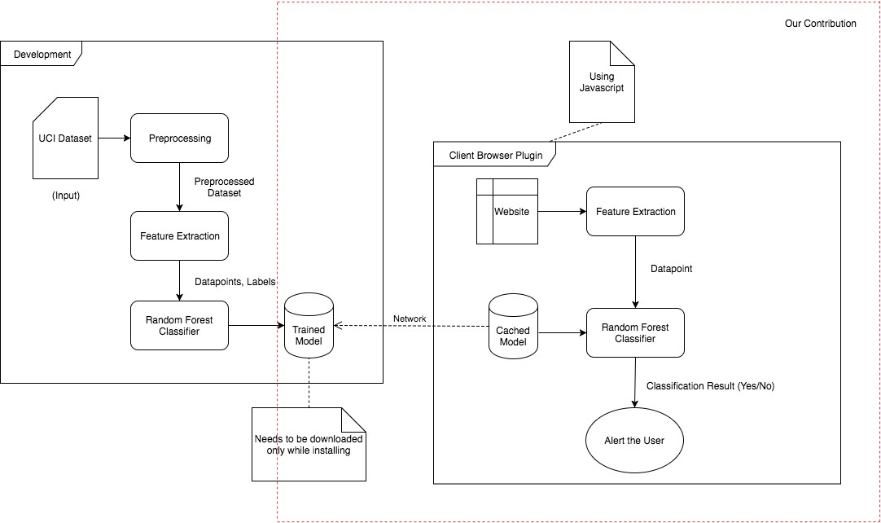
ARCHITECTURE

Slide 7
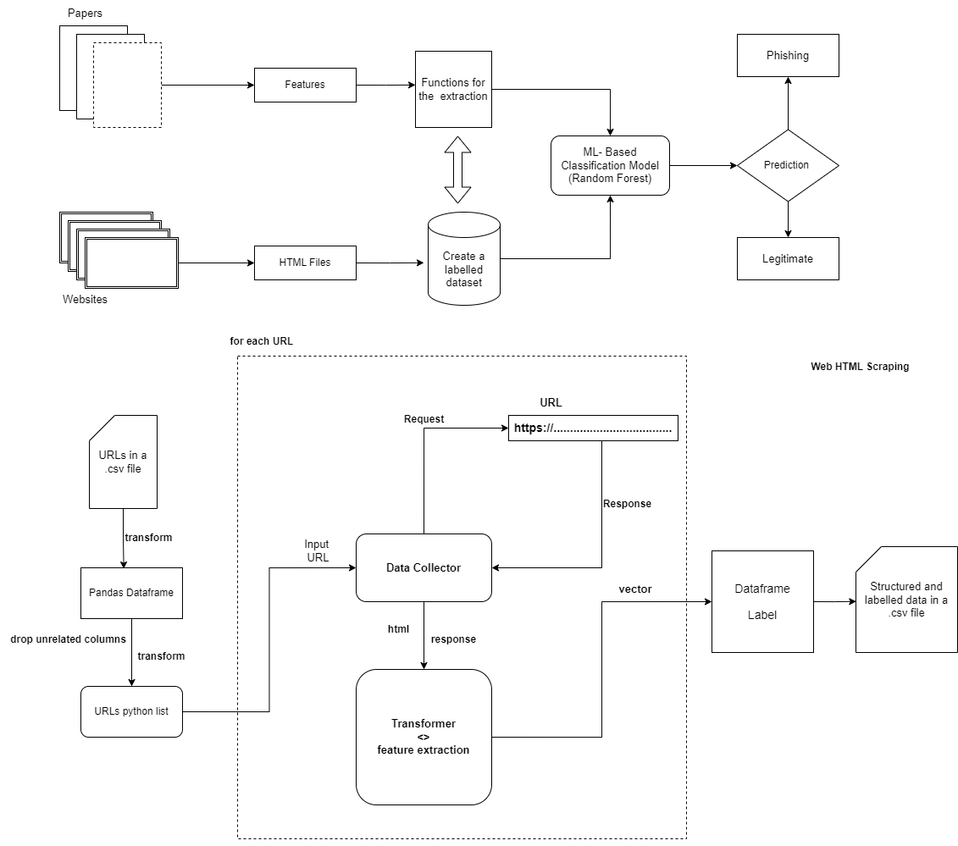

Slide 8
DESIGN METHODOLOGY
Data Collection
The initial step is to gather data. Data collection involves the collection of a large dataset of both legit and fraudulent websites.
Data Pre-processing
Once the data has been collected, the subsequent step involves pre-processing it. Data pre-processing encompasses cleaning and transforming the data to make it ready for analysis. The pre-processing step entails removing duplicates, managing missing values, and transforming the data into a format that is appropriate for machine learning algorithms.
Features : IP address , URL length , URL shortener , @ in URL , Redirection with ‘//’ , ‘-’ in domain , degree of subdomain , HTTPS , Favicon domain , TCP Port , HTTPS in domain , Cross domain requests etc

Slide 9
DESIGN METHODOLOGY
Model Selection
Model selection involves choosing the algorithm that can directly classify legit and fraud websites. For this project, we trained the model using various algorithms. For each the accuracy, F1-score, precision, recall was calculated. The algorithm which provided the best values was Random Forest Algorithm
Model Training
After selecting the algorithm, the next step involves training the model. Model training involves feeding the model with the pulled features and their corresponding labels. The data to be trained from the preprocessing module is loaded from the disk. A random forest classifier is trained on the data using scikit-learn library.
Exporting Model
This module takes the learned Random Forest classifier object and recursively generates its JSON representation which is written to file in disk. In this basically the trained model is exported to implement extension.

Slide 10
SYSTEM REQUIREMENTS
Hardware Requirements
Processor: Quad Core
Hard Disk: 120 GB
RAM: 4/8 GB
Software Requirements
Tech: Python, HTML/CSS/JavaScript.
Operating system: Windows
Library : scikit-learn, NumPy, liac-arff , Beautiful Soup
Software tools: Chrome
IDE: Jupyter Notebook. Visual Studio Code, Google Collab

Slide 11
CONCLUSION
It is a phishing detection system that focuses on client-side implementation with fast detection to warn users before phishing .This system uses only features that are possible to extract on the client side and thus it is able to provide rapid detection and better privacy. On the other hand, the system not able to detect the malicious content embedded inside HTML content. The next enhanced system will able to detect the malicious content embedded inside html to provide effective protection in real time.

Slide 12
FUTURE SCOPE
The classifier is currently trained on 17 features which can be increased provided that, they don’t make the detection slower or result in loss of privacy. The extension can made to cache results of frequently visited sites and hence reducing computation. Strengthen security against interactive phishing elements. The project involves advancing malicious website detection in the Chrome browser by integrating sophisticated machine learning models, real-time threat intelligence, and dynamic sandboxing techniques. Further API’s of this entire system can be created to protect against threat in any backend system.

Slide 13
REFERENCES
Intelligent phishing website detection using random forest classifier. (2017, November 1). IEEE Conference Publication | IEEE Xplore. https://ieeexplore.ieee.org/abstract/document/8252051
Phishing Detection and Prevention using Chrome Extension. (2022, June 6). IEEE Conference Publication | IEEE Xplore. https://ijcrt.org/papers/IJCRT2305779
A Guide to Convolutional Neural Networks — the ELI5 way | Saturn Cloud Blog. (2023, October 4). https://saturncloud.io/blog
R, S. E. (2023, October 26). Understand Random Forest Algorithms With Examples (Updated 2023). Analytics Vidhya. https://www.analyticsvidhya.com/blog/2021/06/
Content Based Phishing Detection with Machine Learning. (2020, Nov 09). IEEE Conference Publication | IEEE Xplore. https://ieeexplore.ieee.org/document/9249892

