Slide 1

VIDYAVARDHINI’S COLLEGE OF ENGINEERING AND TECHNOLOGY
____________________________________________________________________________________________
DEPARTMENT OF COMPUTER ENGINEERING
2023-2024

Slide 2
Team Members :
14 Ajay Shitkar
38 Prathmesh Malvi
53 Yash Davare
Guide – Dr. Dinesh Patil

Slide 3
INTELLIGENT SYSTEM FOR IDENTIFICATION OF MALICIOUS WEBSITES

Slide 4
ABSTRACT
Phishing, the act of impersonating reputable websites to steal user information, presents a serious cybersecurity challenge. To combat this, an intelligent system utilizing data mining techniques was developed to detect phishing attacks. Feature mining was used to categorize websites as legitimate or phishing, employing various classifiers. Results indicated that Random Forest achieved the highest accuracy, making it the preferred choice. This project involves the creation of a Chrome extension that leverages machine learning, including the Random Forest algorithm to extract URL features. The extension collects URLs from multiple sources and continuously monitors user web activity. If a visited website is identified as phishing, a pop-up alert is displayed. Websites deemed legitimate remain unaffected. This approach offers advanced protection by processing URLs through a Strict Mode Module.

Slide 5
PROBLEM STATEMENT
With the increasing risk of phishing attacks in today's digital world, there is a need to develop a Chrome browser extension that can instantly detect phishing websites in real time as users browse the web. This extension must prioritize user privacy by performing all analyses locally without sending URLs to external servers. The solution should offer a user-friendly interface for clear and immediate warnings when suspicious websites are encountered, reducing the risk of falling victim to phishing attacks.

Slide 6
Literature Survey
Many systems employ URL filtering and reputation-based techniques to assess the legitimacy of sender domains and URLs. They compare these with known lists of malicious entities to block or flag suspicious emails and websites. Phish Net is one such Predictive blacklisting approach. In existing systems, plug-ins use either a rule-based approach or a server-side ML-based approach. The rule-based approach does not seem to work well compared to ML-based approaches. This project aims to implement the same in a browser extension, removing the need for an external web service and improving user privacy.

Slide 7
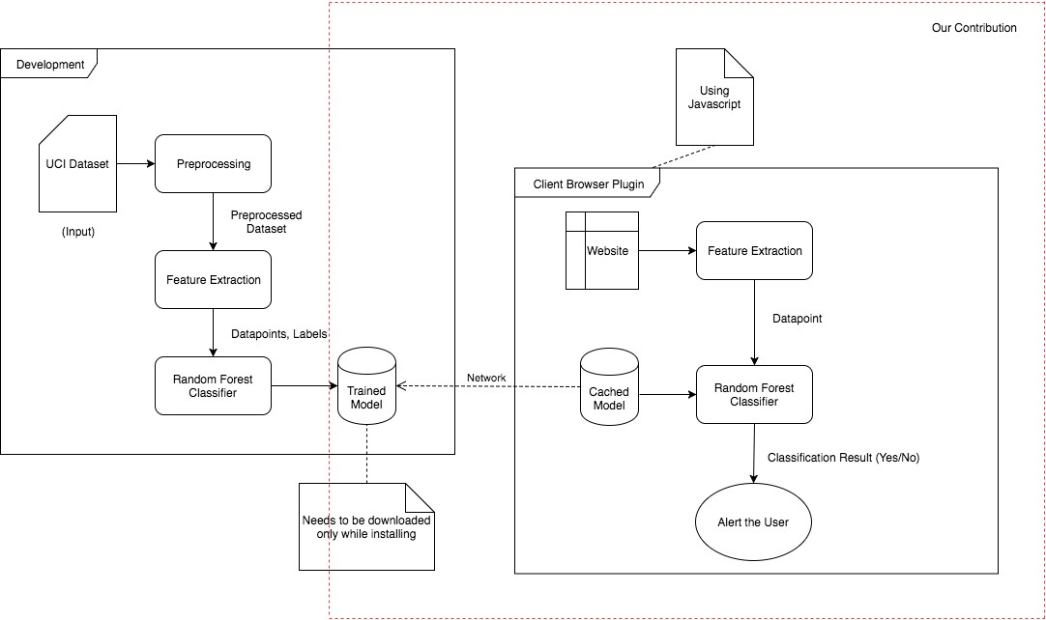
ARCHITECTURE

Slide 8
ALGORITHM
Exporting Random Forest to JSON
TREE_TO_JSON(NODE) :
RANDOM_FOREST_TO_JSON(RF):
1. tree_json ← {}
2. if (node has threshold) then
3. tree_json[“type”] ← “split”
4. tree_json[“threshold”] ← node.threshold
5. tree_json[“left”] ← TREE_TO_JSON(node.left)
6. tree_json[“right”] ← TREE_TO_JSON(node.right)
7. else
8. tree_json[“type”] ← “leaf”
9. tree_json[“values”] ← node.values
10. return tree_json
1. forest_json ← {}
2. forest_json['n_features'] ← rf.n_features_
3. forest_json['n_classes'] ← rf.n_classes_
4. forest_json['classes'] ← rf.classes_
5. forest_json['n_outputs'] ← rf.n_outputs_
6. forest_json['n_estimators'] ← rf.n_estimators
7. forest_json['estimators'] ← []
8. e ← rf.estimators
9. for (i ← 0 to rf.n_estimators)
10. forest_json[‘estimators’][i] ← TREE_TO_JSON(e[i])
11. return forest_json

Slide 9
DESIGN METHODOLOGY
Data Collection
The initial step is to gather data. Data collection involves the collection of a large dataset of both legit and fraudulent websites.
Data Pre-processing
Once the data has been collected, the subsequent step involves pre-processing it. Data pre-processing encompasses cleaning and transforming the data to make it ready for analysis. The pre-processing step entails removing duplicates, managing missing values, and transforming the data into a format that is appropriate for machine learning algorithms.
Features : IP address , URL length , URL shortener , @ in URL , Redirection with ‘//’ , ‘-’ in domain , degree of subdomain , HTTPS , Favicon domain , TCP Port , HTTPS in domain , Cross domain requests etc

Slide 10
DESIGN METHODOLOGY
Model Selection
Model selection involves choosing the algorithm that can directly classify legit and fraud websites. For this project, we trained the model using various algorithms. For each the accuracy, F1-score, precision, recall was calculated. The algorithm which provided the best values was Random Forest Algorithm
Model Training
After selecting the algorithm, the next step involves training the model. Model training involves feeding the model with the pulled features and their corresponding labels. The data to be trained from the preprocessing module is loaded from the disk. A random forest classifier is trained on the data using scikit-learn library.
Exporting Model
This module takes the learned Random Forest classifier object and recursively generates its JSON representation which is written to file in disk. In this basically the trained model is exported to implement extension.

Slide 11
SYSTEM REQUIREMENTS
Hardware Requirements
Processor: Quad Core
Hard Disk: 120 GB
RAM: 4/8 GB
Software
Tech: Python, HTML/CSS/JavaScript.
Operating system: Windows
Library : scikit-learn, numpy, liac-arff
Software tools: Chrome
IDE: Jupyter Notebook. Visual Studio Code, Google Collab

Slide 12
CONCLUSION
It is a phishing detection system that focuses on client-side implementation with fast detection to warn users before phishing. On the other side, this system uses only features that are possible to extract on the client side and thus it is able to provide rapid detection and better privacy.The main application ports the Random Forest classifier to JavaScript. Similar works often use web page functions that cannot be extracted from the client side and this leads to network-dependent detection. On the other hand, this system only uses features that can be extracted from the client side and thus can provide fast detection and better privacy.

Slide 13
FUTURE SCOPE
The classifier is currently trained on 17 features which can be increased provided that, they don’t make the detection slower or result in loss of privacy. The extension can made to cache results of frequently visited sites and hence reducing computation. Phishing website detection can greatly benefit from advances in multi-modal analysis, allowing the system to effectively identify threats in multimedia content and user interactions. Extend the model to incorporate various data modalities, including images and user interactions, to enhance detection capabilities for phishing websites that use multimedia content and interactive elements. The future of this approach lies in its adaptability, resilience, and effectiveness in countering the ever-evolving tactics employed by phishers, ultimately safeguarding users from online threats.

Slide 14
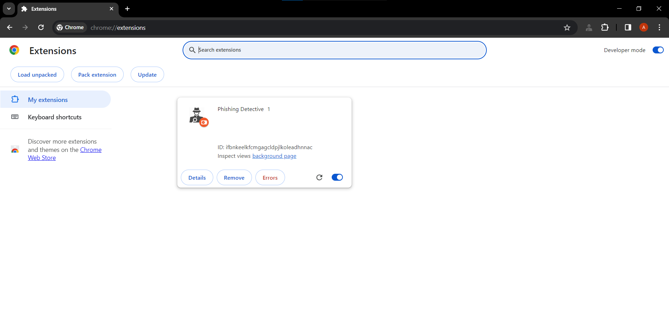
RESULTS

Slide 15
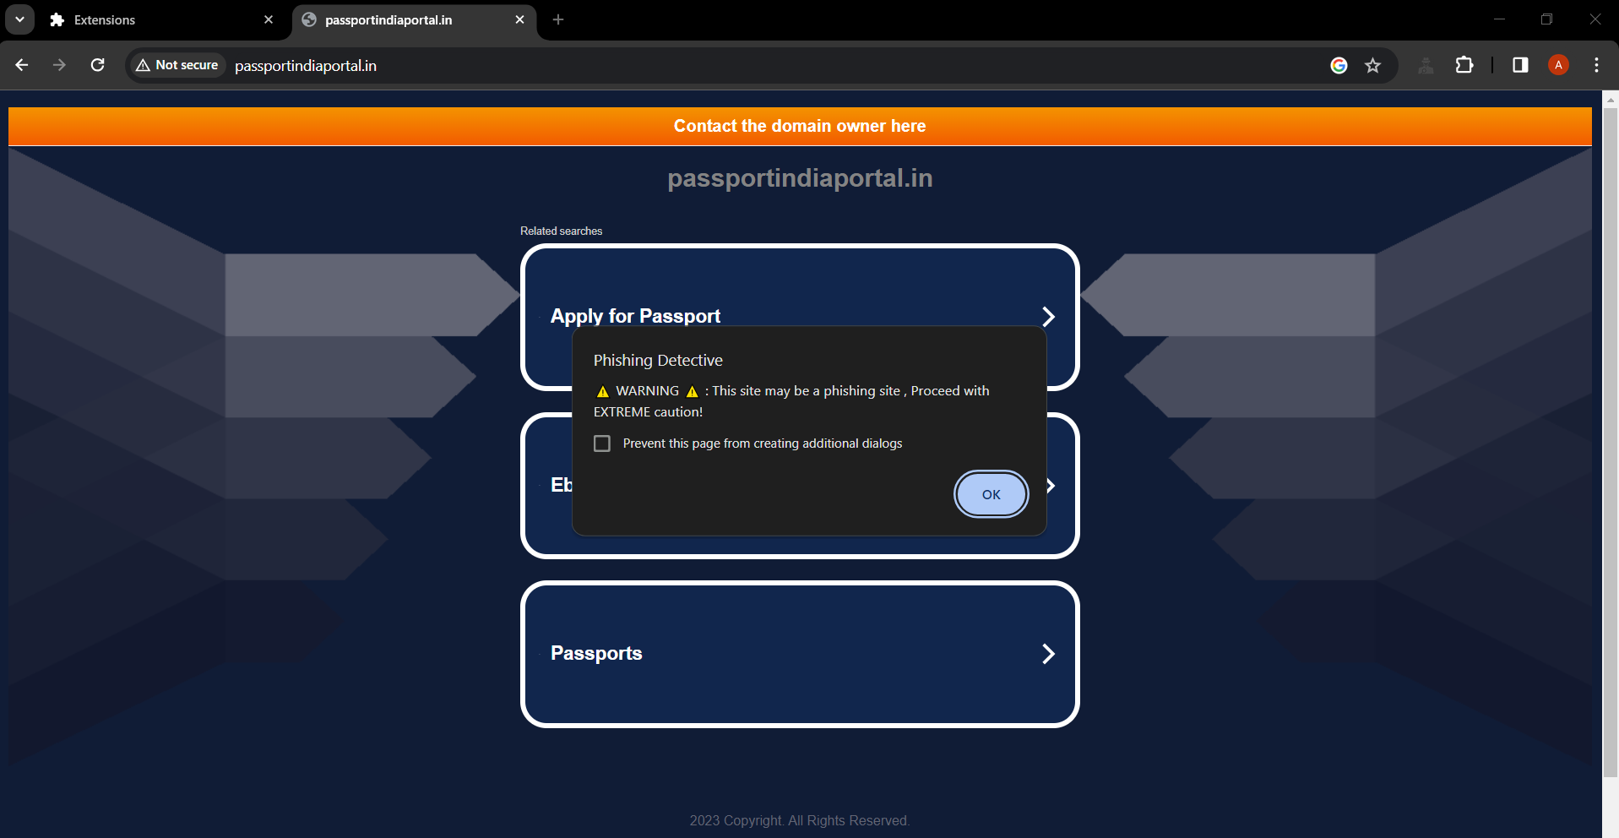
RESULTS

Slide 16
REFERENCES
Intelligent phishing website detection using random forest classifier. (2017, November 1). IEEE Conference Publication | IEEE Xplore.
https://ieeexplore.ieee.org/abstract/document/8252051
Phishing Detection and Prevention using Chrome Extension. (2022, June 6). IEEE Conference Publication | IEEE Xplore.
https://ijcrt.org/papers/IJCRT2305779
A Guide to Convolutional Neural Networks — the ELI5 way | Saturn Cloud Blog. (2023, October 4).
https://saturncloud.io/blog
R, S. E. (2023, October 26). Understand Random Forest Algorithms With Examples (Updated 2023). Analytics Vidhya.
https://www.analyticsvidhya.com/blog/2021/06/

