Slide 1
Introduction to C

Slide 2
What is c language:-
C is mother language of all programming language.
It is a popular computer programming language.
It is procedure-oriented programming language.
It is also called mid level programming language.

Slide 3
History of c language:-
C programming language was developed in 1972 by Dennis Ritchie at bell laboratories of AT&T(American Telephone & Telegraph), located in U.S.A.
Dennis Ritchie is known as founder of c language.
It was developed to be used in UNIX Operating system.
It inherits many features of previous languages such as B and BPCL.

Slide 4
History of c programming
Language | year | Developed By
ALGOL | 1960 | International Group
BPCL | 1967 | Martin Richards
B | 1970 | Ken Thompson
Traditional C | 1972 | Dennis Ritchie
K & R C | 1978 | Kernighan & Dennis Ritchie
ANSI C | 1989 | ANSI Committee
ANSI/ISO C | 1990 | ISO Committee
C99 | 1999 | Standardization Committee

Slide 5
Features of C Language:-
There are many features of c language are given below.
Machine Independent or Portable
Mid-level programming language
structured programming language
Rich Library
Memory Management
Fast Speed
Pointers
Recursion
Extensible

Slide 7
Preprocessor
Invoked automatically by C compiler
-- I pass: invokes C preprocessor
--II pass: invokes compiler on resulting C code.
Preprocessor directives are lines included in the code that are not program statements but directives for preprocessor. These lines are always preceeded by # sign.
Preprocessor processes the code before it passes to the compiler. It operates under the control of preprocessor command line and directives.

Slide 8
Preprocessor directives
Directive | Function
#define | Defines a macro substitution
#undef | Undefines a macro
#include | Specify a file to be included
#ifdef | Tests for macro definition
#endif | Specifies the end of #if
#if | Tests a compile time condition
#else | Specify alternatives when #if fails.

Slide 9
Preprocessor directives
Preprocessor directive is divided into 3 categories:
Macro Substitution division
File Inclusion division.
Compiler control division.

Slide 10
Macros
Process where an identifier in a program is replaced by predefined string.
Simple Macro substitution
---- # define AREA 12.36
2. Macro as an argument:
--- #define CUBE(Y*Y*Y)
volume=CUBE(side);
volume=(side*side*side);
3. Nesting of Macros:
#define SQUARE (Y)((Y)*(Y))

Slide 11
Structure of C Program
Every C Program consists of one or more modules called function.
One of the function must be “main”
Program will always begin by executing main function.
# include<stdio.h>
int main()
{
---statements;
}

Slide 12
Header files
Header files are included in the include section. Eg. # include<stdio.h>
Precompiled files that has some functions defined in them.
We can call those functions by supplying parameters.
Header files is given an extension as “.h”
“C” source file is given an extension “.c”.

Slide 13
Main function
Entry point of any C program.
When a program is executed start point is main function.
From main function the flow goes as per programmers choice.
Main function is compulsory for any C Program.

Slide 14
First Program of C Language:-
#include <stdio.h>
#include <conio.h>
void main(){
printf(“JavaTpoint”);
getch();
}

Slide 15
Describe the C Program :-
#include <stdio.h> includes the standard input output library functions. The printf() function is defined in stdio.h .
#include <conio.h> includes the console input output library functions. The getch() function is defined in conio.h file.
void main() The main() function is the entry point of every program in c language. The void keyword specifies that it returns no value.
printf() The printf() function is used to print data on the console.
getch() The getch() function asks for a single character. Until you press any key, it blocks the screen.

Slide 16
Output of Program is:-
JavaTpoint

Slide 17
Keywords in C Language:-
Keywords are certain reserved words, that have standard predefined meanings in C.
All keywords are in lowercase .
There are 32 keywords in C language as given below:
auto | break | case | char | const | continue | default | do
double | else | enum | extern | float | for | goto | if
int | long | register | return | short | signed | sizeof | static
struct | switch | typedef | union | unsigned | void | volatile | while

Slide 18
Identifiers and Variables
Identifier : A name has to be devised for program
elements such as variables or functions.
Variable:
Variables are memory regions you can use to hold data while your program is running.
Thus variable has an unique address in memory region.
For your convenience, you give them names (instead of having to know the address)
Because different types of data are different sizes, the computer needs to know what type each variable is – so it can reserve the memory you need

Slide 19
Rules for Identifiers
Contains only letters, digits and under score characters,
example amount, hit_count
Must begin with either a letter of the alphabet or an underscore character.
Can not be same as the keywords, example it can not be void, int.
Uppercase letters are different than lowercase, example amount, Amount and AMOUNT all three are different identifiers.
Maximum length can be 31 characters.
Should not be the same as one already defined in the library, example it can not be printf/scanf.
No special characters are permitted. e.g. blank space,period, semicolon, comma etc.

Slide 20
Example
Check whether given variable names are valid or not:
1.num
2.Num
3.Num1
4.Num1_num2
5.number 2
6._num1
7.1num
8.1_num

Slide 21
Valid:-- 1,2,3,4,6
Invalid:-- 5,7,8
Check for valid and invalid identifier
int
Char
continue
iNt
Valid:-- 2,4
Invalid:--1,3

Slide 22
Data types in C language:-
There are four types of data types in C language.
Types | Data Types
Basic Data Type | int, char, float, double
Derived Data Type | array, pointer, structure, union
Enumeration Data Type | enum
Void Data Type | void

Slide 23
Basic datatypes
int - data type
int is used to define integer numbers.
{
int Count;
Count = 5;
}
float - data type
float is used to define floating point numbers.
{
float Miles;
Miles = 5.6;
}

Slide 24
double - data type
double is used to define BIG floating point numbers. It reserves twice the storage for the number. On PCs this is likely to be 8 bytes.
{
double Atoms;
Atoms = 2500000;
}
char - data type
char defines characters.
{
char Letter;
Letter = 'x';
}

Slide 25
Modifiers
The modifiers define the amount of storage allocated to the variable.
The data types explained above have the following modifiers.
--short
--long
--signed
--unsigned

Slide 26
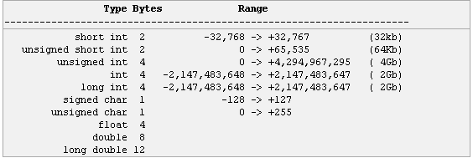
modifiers

Slide 27
Variables
A variable definition means to tell the compiler where and how much to create the storage for the variable. A variable definition specifies a data type and contains a list of one or more variables of that type as follows:
type variable_list;
int i, j, k;
char c, ch;
float f, salary;
double d;

Slide 28
Variables can be initialized (assigned an initial value) in their declaration. The initializer consists of an equal sign followed by a constant expression as follows:
type variable_name = value;
int d = 3, f = 5;
char x = 'x';

Slide 29
Input and output in c
Input : In any programming language input means to feed some data into program. This can be given in the form of file or from command line. C programming language provides a set of built-in functions to read given input and feed it to the program as per requirement.
Output : In any programming language output means to display some data on screen, printer or in any file. C programming language provides a set of built-in functions to output required data.

Slide 30
printf() function
This is one of the most frequently used functions in C for output.
printf() function is used to print the “character, string, float, integer, octal and hexadecimal values” onto the output screen.
We use printf() function with %d or %i format specifier to display the value of an integer variable.
Similarly %c is used to display character, %f for float variable, %s for string variable, %lf for double and %x for hexadecimal variable.
To generate a newline,we use “\n” in C printf() statement.

Slide 31
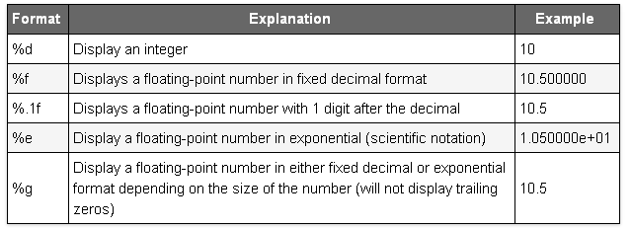
format

Slide 32
Multiple Format specifiers
You could use as many format specifiers as you want with printf-just as long as you pass the correct number of arguments.
The ordering of the arguments matters. The first one should corresponding to the first format specifier in the string and so on. Take this example:
printf( “a=%d,b=%d, c=%d\n”, a , b, c);
If a,b and c were integers,this statement will print the values in the correct order.
Rewriting the statement as
printf( “a=%d,b=%d, c=%d\n”, c,a,b);
Would still cause the program to compile OK, but the values of a,b and c would be displayed in the wrong order.

Slide 33
Printf() example
#include <stdio.h>
main()
{
int dec = 5;
char ch = 's';
float pi = 3.14;
printf("%d %f %c\n", dec, pi, ch);
}

Slide 34
result
The output of the above would be:
5 3.140000 c

Slide 35
Determine the output
printf("%s\n","TechOnTheNet.com");
printf("%s is over %d years old.\n","TechOnTheNet.com",10);
printf("%s is over %d years old and pages load in %f seconds.\n","TechOnTheNet.com",10,1.4);
printf("%s is over %d years old and pages load in %.1f seconds.\n","TechOnTheNet.com",10,1.4);

Slide 36
result
TechOnTheNet.com
TechOnTheNet.com is over 10 years old.
TechOnTheNet.com is over 10 years old and pages load in 1.400000 seconds.
TechOnTheNet.com is over 10 years old and pages load in 1.4 seconds.

Slide 37
Determine the output
#include<stdio.h>
main()
{
int a,b;
float c,d;
a = 15;
b = a / 2;
printf("%d\n",b);
printf("%3d\n",b);
printf("%03d\n",b);
c = 15.3; d = c / 3;
printf("%3.2f\n",d);
}

Slide 38
result
1.7
2. 7 ( we use a width (%3d) to say that we want three digits (positions) reserved for the output.The result is that two “space characters” are placed before printing the character)
3.007 (In the third printf statement we say almost the same as the previous one. Print the output with a width of three digits, but fill the space with 0.)
4. 5.10 (In the fourth printf statement we want to print a float. In this printf statement we want to print three position before the decimal point (called width) and two positions behind the decimal point (called precision).

Slide 39
Escape sequence
\n (newline)
\t (tab)
\v (vertical tab)
\f (new page)
\b (backspace)
\r (carriage return)

Slide 40
Predict the output
#include<stdio.h>
main()
{
printf("The color: %s\n", "blue");
printf("First number: %d\n", 12345);
printf("Second number: %04d\n", 25);
printf("Third number: %i\n", 1234);
printf("Float number: %3.2f\n", 3.14159);
printf("Hexadecimal: %x\n", 255);
printf("Octal: %o\n", 255);
printf("Unsigned value: %u\n", 150);
}

Slide 41
result
The color: blue
First number: 12345
Second number: 0025
Third number: 1234
Float number: 3.14
Hexadecimal: ff
Octal: 377
Unsigned value: 150

Slide 42
Determine the output
#include<stdio.h>
main()
{
printf(":%s:\n", "Hello, world!");
printf(":%15s:\n", "Hello, world!");
printf(":%.10s:\n", "Hello, world!");
printf(":%-10s:\n", "Hello, world!");
printf(":%-15s:\n", "Hello, world!");
printf(":%.15s:\n", "Hello, world!");
printf(":%15.10s:\n", "Hello, world!");
printf(":%-15.10s:\n", "Hello, world!");
}

Slide 43
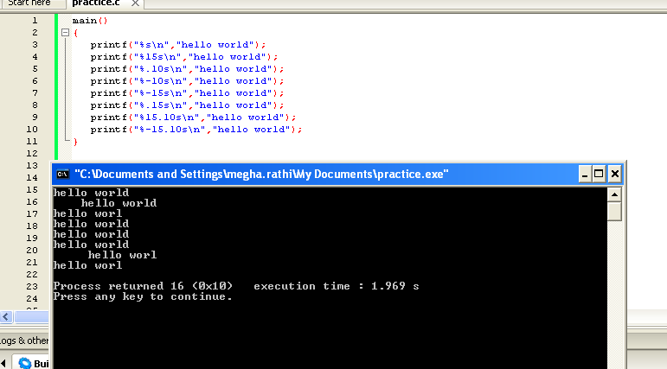

Slide 44
The printf(“:%s:\n”, “Hello, world!”); statement prints the string (nothing special happens.)
The printf(“:%15s:\n”, “Hello, world!”); statement prints the string, but print 15 characters. If the string is smaller the “empty” positions will be filled with “whitespace.”
The printf(“:%.10s:\n”, “Hello, world!”); statement prints the string, but print only 10 characters of the string.
The printf(“:%-10s:\n”, “Hello, world!”); statement prints the string, but prints at least 10 characters. If the string is smaller “whitespace” is added at the end.
The printf(“:%-15s:\n”, “Hello, world!”); statement prints the string, but prints at least 15 characters. The string in this case is shorter than the defined 15 character, thus “whitespace” is added at the end .
The printf(“:%.15s:\n”, “Hello, world!”); statement prints the string, but print only 15 characters of the string. In this case the string is shorter than 15, thus the whole string is printed.
The printf(“:%15.10s:\n”, “Hello, world!”); statement prints the string, but print 15 characters. If the string is smaller the “empty” positions will be filled with “whitespace.” But it will only print a maximum of 10 characters, thus only part of new string (old string plus the whitespace positions) is printed.
The printf(“:%-15.10s:\n”, “Hello, world!”); statement prints the string, but it does the exact same thing as the previous statement, accept the “whitespace” is added at the end.

Slide 45
Scanf() function
This is the function which can be used to to read an input from the command line.
scanf() function is used to read character, string, numeric data from keyboard

Slide 46
#include<stdio.h>
int main()
{
int myvariable;
printf("Enter a number:"); scanf("%d",&myvariable); printf("%d",myvariable);
}
Output:--

Slide 47
scanf( )
This function returns the number of data items that have been entered successfully
#include<stdio.h>
int main()
{
int n;
clrscr();
printf("enter the value");
printf("%d”, scanf("%d’’,&n));
getch();
return 0;
}
In C, printf() returns the number of characters successfully written on the output
scanf() returns number of items successfully read.

Slide 48
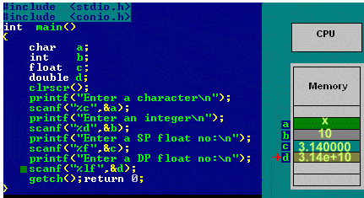

Slide 49
Exercise
Write a Program in C to print an integer.
Write a Program in C to add two numbers.
Write a C Program for addition, subtraction, multiplication and division of two numbers.

Slide 50
Solution (1)
#include <stdio.h>
void main()
{ int a;
printf("Enter an integer\n");
scanf("%d", &a);
printf("Integer that you have entered is %d\n", a);
}

Slide 51
Solution (2)
#include<stdio.h>
int main()
{
int a, b, c;
printf("Enter two numbers to add\n");
scanf("%d%d",&a,&b);
c = a + b;
printf("Sum of entered numbers = %d\n",c);
}

Slide 52


Slide 53
ASCII codes

Slide 54
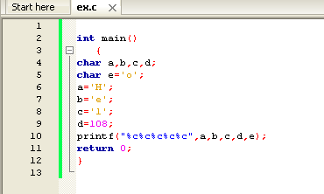
Exercise 1 (Determine output)

Slide 55
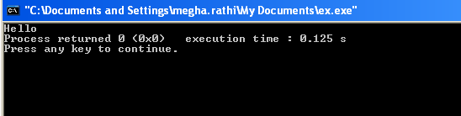
Sol (ASCII value of l is 108)

Slide 56
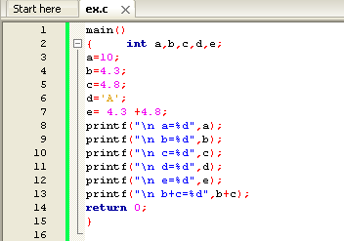
2

Slide 57
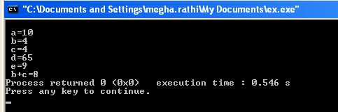
Output (ASCII value of A=65)

