Slide 1
Database Design Theory

Slide 2
Introduction
Levels at which we can discuss goodness of relation schemas
Logical (or conceptual) level
Implementation (or physical storage) level
Approaches to database design:
Bottom-up or top-down

Slide 3
Informal Design Guidelines for Relation Schemas
Measures of quality
Making sure attribute semantics are clear
Reducing redundant information in tuples
Reducing NULL values in tuples
Disallowing possibility of generating spurious tuples

Slide 4
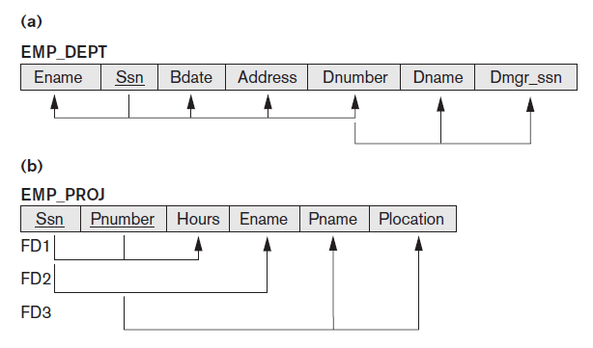
Guideline 1
Design relation schema so that it is easy to explain its meaning
Do not combine attributes from multiple entity types and relationship types into a single relation

Slide 5
Guideline 2
Design base relation schemas so that no update anomalies are present in the relations
If any anomalies are present:
Note them clearly
Make sure that the programs that update the database will operate correctly

Slide 6
Redundant Information in Tuples and Update Anomalies
Anything we try to do with a database that leads to unexpected and/or unpredictable results is an anomaly.
Types of update anomalies:
Insertion
Deletion
Modification

Slide 7
Insertion Anomaly
When we want to enter a value into a data cell but the attempt is prevented, as another value is not known.
e.g. We have built a new Room (e.g. B), but it has not yet been timetabled for any courses or members of staff.
Notes:
5
5
21
7
7

Slide 8
Deletion Anomaly
When a value we want to delete also means we will delete values we wish to keep.
e.g. CoNo 351 has ended, but Room C will be used elsewhere.
Notes:
6
6
22
8
8

Slide 9
Modification Anomaly
When we want to change a single data item value, but must update multiple entries
e.g. Room H has been improved, it is now of RSize = 500.
Notes:
7
7
23
9
9

Slide 10
EXAMPLE
Consider the relation:
EMP_PROJ ( Emp#, Proj#, Ename, Pname, No_hours)
Update/Modify Anomaly
Changing the name of project number P1 from “Billing” to “Customer-Accounting” may cause this update to be made for all 100 employees working on project P1
Insert Anomaly
Cannot insert a project unless an employee is assigned to .
Inversely- Cannot insert an employee unless he/she is assigned to a project.
Delete Anomaly
When a project is deleted, it will result in deleting all the employees who work on that project.
Alternately, if an employee is the sole employee on a project, deleting that employee would result in deleting the corresponding project.

Slide 11
Check Relations for Anomalies!
every Tuple unique?
data cells atomic?
for Relations with single-attribute keys:
every Attribute depends upon the Primary Key?
for Relations with composite primary keys:
every Attribute depends upon all of the Composite Key?
Notes:
14
14

Slide 12
What if the checks fail?
If any Relation fails ‘checks’:
especially those checking dependency.
we MUST split that Relation into multiple Relations:
until they pass the tests.
but MUST remember to leave behind a Foreign Key:
to ‘point’ forwards to the Primary Key of the ‘new’ split-off Relation.
Notes:
15
15

Slide 13
Guideline 3
Avoid placing attributes in a base relation whose values may frequently be NULL
If NULLs are unavoidable:
Make sure that they apply in exceptional cases only, not to a majority of tuples

Slide 14
NULL Values in Tuples
May group many attributes together and
Can end up with many NULLs
Problems with NULLs
Wasted storage space
Problems understanding meaning, it can be known but absent or unknown
Problem in running aggregate queries like count, sum

Slide 15
Guideline 4
Design relation schemas to be joined with equality conditions on attributes that are appropriately related
Guarantees that no spurious tuples are generated
A spurious tuple is a record in database that get created when two tables are joined badly. Spurious tuples are created when two tables are joined on attributes that are neither primary keys nor foreign keys.
Avoid relations that contain matching attributes that are not (foreign key, primary key) combinations

Slide 16
Generation of Spurious Tuples
NATURAL JOIN
Result produces many more tuples than the original set of tuples in EMP_PROJ
Called spurious tuples
Represent spurious information that is not valid
No spurious tuples should be generated by doing a natural-join of any relations

Slide 17
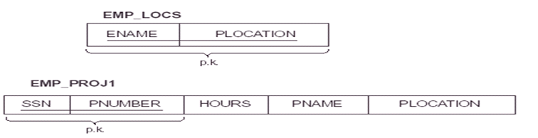

Slide 18
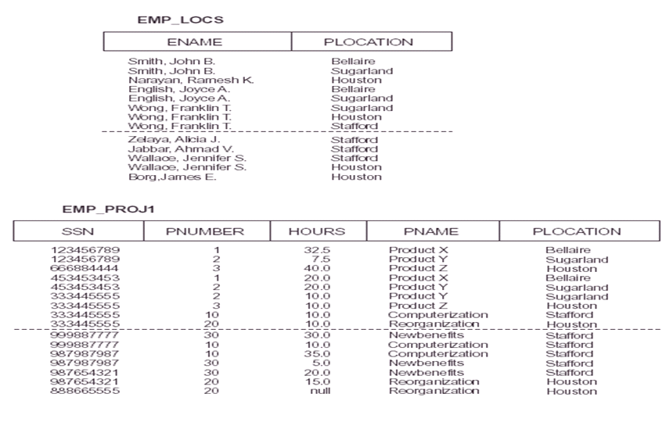

Slide 19
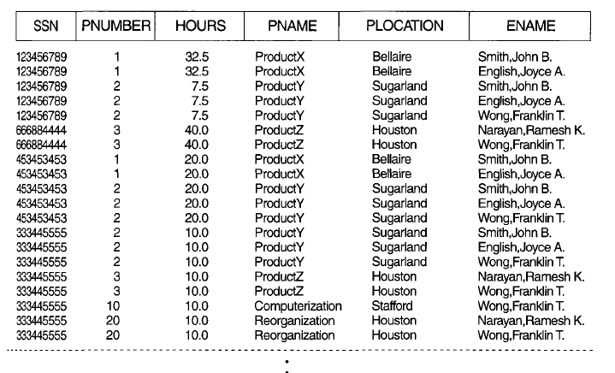
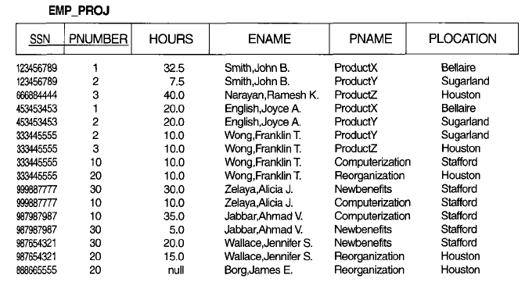
Spurious tuples
After Join
Actual
Table

Slide 20
Summary and Discussion of Design Guidelines
Anomalies cause redundant work to be done
Waste of storage space due to NULLs
Difficulty of performing operations and joins due to NULL values
Generation of invalid and spurious data during joins

Slide 21
Functional Dependency

Slide 22

Functional Dependence
In a relation including attribute A and B, B is functional dependent on A if, for every valid occurrence, the value A determines the value B
If B is ‘Functional Dependent on’ A, then A ‘is the determinant of B’
All fields are functionally dependent on the primary key – or indeed any candidate key – be definition.

Slide 23
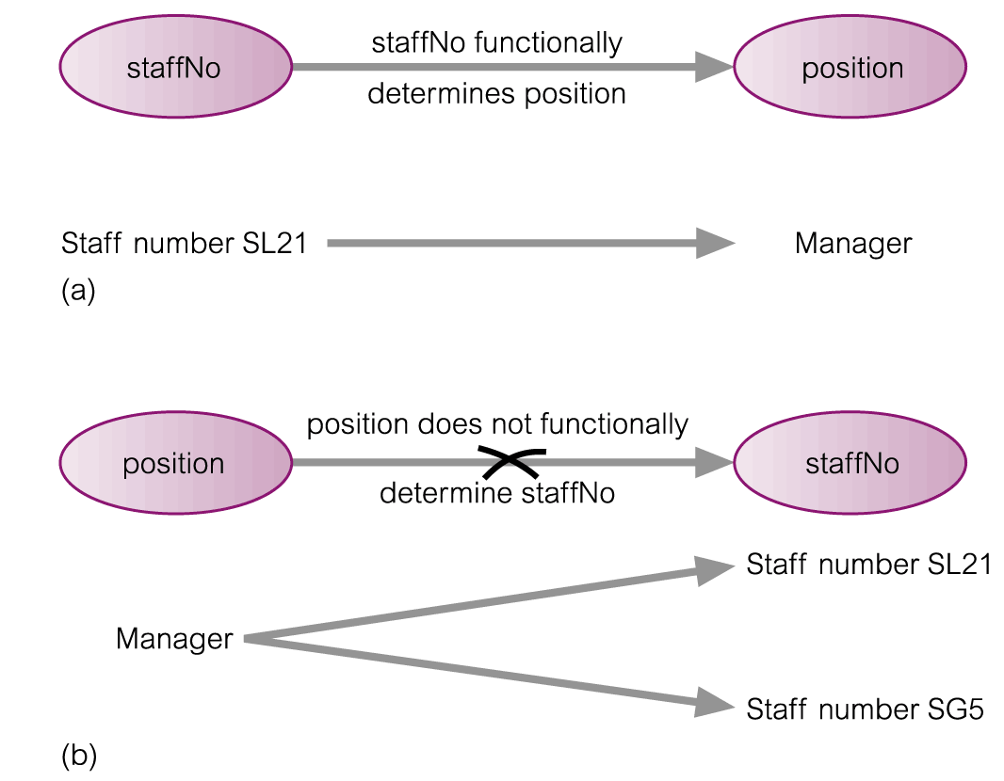
Example: Functional Dependency

Slide 24
Examples
loan-number → amount loan-number → branch-name loan-number → customer-name
×

Slide 25
Functional Dependency
Compound Determinants: If more than one attribute is necessary to determine another attribute in an entity, then such a determinant is termed a composite determinant.
Full Functional Dependency:
Only of relevance with composite determinants.
This is the situation when it is necessary to use all the attributes of the composite determinant to identify its object uniquely.
Example:
Full Functional Dependencies
order# line# qty price
A001 001 10 200
A002 001 20 400
A002 002 20 800
A004 001 15 300
(Order#, line#) → qty
(Order#, line#) → price

Slide 26
Functional Dependency
Partial Functional Dependency: This is the situation that exists if it is necessary to only use a subset of the attributes of the composite determinant to identify its object uniquely.
Example:
Full Functional Dependencies
student# unit# room grade
9900100 A01 TH224 2
9900010 A01 TH224 14
9901011 A02 JS075 3
9900001 A01 TH224 16
(student#, unit#) → grade
Partial Functional Dependencies
unit# → room
Repetition of data!

Slide 27
Examples of FD constraints
Social Security Number determines employee name
SSN → ENAME
Project Number determines project name and location
PNUMBER → {PNAME, PLOCATION}
Employee SSN and project number determines the hours per week that the employee works on the project
{SSN, PNUMBER} → HOURS

Slide 28
Trivial Dependencies
A functional dependency A₁A₂…A_{n}→B is said to be trivial if B is one of A’s.
For example: title, year →title is a trivial dependency.
We say that a dependency A₁A₂…A_{n}→B₁B₂…B_{m} is:
Trivial if the B’s are subset of A’s.
Nontrivial if at least one of the B’s is not among the A’s.
Completely nontrivial if none of the B’s is also one of the A’s.
Thus title, year → year ,length is nontrivial but not completely nontrivial.

Slide 29
Keys
A functional dependency allows us to express constraints that uniquely identify the values of certain attributes.
Whereas a key is a set of attributes that uniquely identifies an entire tuple.
However, a candidate key is always a determinant, but a determinant doesn’t need to be a key.

Slide 30
Closure
Let a relation R have some functional dependencies F specified.
The closure of F (usually written as F+) is the set of all functional dependencies that may be logically derived from F.
Often F is the set of most obvious and important functional dependencies.
F+, the closure, is the set of all the functional dependencies including F and those that can be deduced from F.

Slide 31
Axioms
To determine closure of the relation we need to learn some rules.
Developed by Armstrong in 1974.
There are six rules (axioms), using these RULES all possible functional dependencies may be derived.

Slide 32
Armstrong’s Axioms
1. Reflexivity Rule :
If Y ⊆ X,
then X → Y
each subset of X is functionally dependent on X.
2. Augmentation Rule :
If X → Y holds and
W is a set of attributes,
then WX → WY holds.
3. Transitivity Rule :
If X → Y and Y → Z holds,
then X → Z holds.

Slide 33
Derived Theorems from Armstrong’s Axioms
4. Union Rule :
If X → Y and X → Z holds,
then X → YZ holds.
5. Decomposition Rule :
If X → YZ holds,
then so do X → Y and X → Z.
6. Pseudotransitivity Rule :
If X → Y and WY → Z hold then so does WX → Z.

Slide 34
Examples of Armstrong’s Axioms
We can find all of F⁺ by applying :
if Y ⊆ X, then X → Y (reflexivity) loan-no → loan-no loan-no, amount → loan-no loan-no, amount → amount
if X → Y, then WX → WY (augmentation) loan-no → amount (given) loan-no, branch-name → amount, branch-name
if X → Y and Y → Z , then X → Z (transitivity) loan-no → branch-name (given) branch-name → branch-city (given) loan-no → branch-city

Slide 35
Example: Closure of set F of functional dependencies
R = (A, B, C, G, H, I) F = { A → B A → C CG → H CG → I B → H }
Find Closure of F: some members of F ⁺
A → H
by transitivity from A → B and B → H
AG → I
by augmenting A → C with G, to get AG → CG and then transitivity with CG → I
CG → HI
from CG → H and CG → I : “union rule”
GIVEN

Slide 36
Example:
Compute the closure of the following set F of functional dependencies for relation schema R = (A, B, C, D, E).
A →BC
CD →E
B→ D
E→ A
Solution:
A → BC, we can conclude: A → B and A → C. (decomposition)
A → B and B → D ➔ A → D (transitive)
A → CD and CD → E, A → E (union, decomposition, transitive)
A → A, we have (reflexive)
A → ABCDE from the above steps (union)
Since E → A, E → ABCDE (transitive)
Since CD → E, CD → ABCDE (transitive)
Since B → D and BC → CD, BC → ABCDE (augmentative, transitive)
Also, C → C, D → D, BD → D, etc.

Slide 37
Computing the Closure of Attributes - Algorithm
Starting with the given set of attributes, repeatedly expand the set by adding the right sides of FD’s as soon as we have included their left sides.
Eventually, we cannot expand the set any more, and the resulting set is the closure.
Let X be a set of attributes that eventually will become the closure.
First we initialize X to be {A₁, A₂, …, A_{n}}.
Now, repeatedly search for some FD in S:
B₁B₂…B_{m}→C
such that all of B’s are in the set X, but C is not. We then add C to X.
Repeat step 2 as many times as necessary until no more attributes can be added to X.
Since X can only grow, and the number of attributes is finite, eventually nothing more can be added to X.
The set X after no more attributes can be added to it is the: {A₁, A₂, …, A_{n}}⁺.

Slide 38
Closure
R(A,B, C)
FD: A->B, B->C
A⁺ ={A, B, C}
B⁺ = {B, C}
C⁺ = {C}

Slide 39
Closure
R(A,B, C, D, F, G)
FD: A->B, BC->DE, ABG->G
Find AC⁺ ?
AC⁺ = {A, B, C, D, E}

Slide 40
What is {A,B}⁺?
AB→C,
BC→AD,
D→E,
CF→B.
Solution:
{A, B}⁺ ⁼ {A, B, C, D, E}

Slide 41
Example
QUES. Given this FD for this R(A,B,C,D,E,F)
AB→ C
AD→ E
B→D
AF→B
Check if AB+ is a key for this relation?
AB+ is key if AB+ can find all the attribute of R
Solution:
AB→AB
B→D so B ⊆AB → AB+→ABD
AD→E so AD ⊆ABD→AB+→ABDE
AB→C so AB ⊆ABDE →AB+→ABCDE
AF→B so AF Not ⊆ABDE → AB+→ABCDE
AB not a key because it does not contain all attributes such as F

Slide 42
Example
R = (A, B, C, G, H, I) F = { A → B A → C CG → H CG → I B → H}
(AG) ⁺ ?
1. result = AG
2. result = ABCG (A → C and A → B)
3. result = ABCGH (CG → H and CG ⊆ AGBC)
4. result = ABCGHI (CG → I and CG ⊆ AGBCH
Is (AG) a candidate key ?
(A+) = BC, (G+) = G.
YES.

Slide 43
Other
Finding keys of the relation
Minimal Cover
Equivalence

Slide 44
Example
Given this FD for this R(A,B,C,D,E,F,G)
A→ D
D→ CG
B→E
E→F
AB→F
What are all the keys for this relation?

Slide 45
Example
Given this FD for this R(A,B,C,D,E,F,G)
A→ D
D→ CG
B→E
E→F
AB→F
What are all the keys for this relation?
Solution:
we look to the right side of FD and take all the attribute which are not there in the FD
Here is AB
Then find AB+ = ABCDEFG → AB is a key

Slide 46
Functional Dependency
Equivalence of Sets of FDs
Minimal Sets of FDs or canonical cover

Slide 47
Equivalence of Sets of FDs
Two sets of FDs F and G are equivalent if:
Every FD in F can be inferred from G, and
Every FD in G can be inferred from F
Hence, F and G are equivalent if F⁺ =G⁺
Definition (Covers):
F covers G if every FD in G can be inferred from F
(i.e., if G⁺ subset-of F⁺)
F and G are equivalent if F covers G and G covers F
There is an algorithm for checking equivalence of sets of FDs

Slide 48
Example 1:
R(ABC)
F= { A B, B C, C A }
G={C B, B A, A C }
First find closure F⁺ , G⁺
Calculate F ⊆ G⁺
Calculate G ⊆ F⁺

Slide 49
Example 2
F=(A→BC, A→D,CD→E}
G={A→BCE, A →A B D, C D →E }
Find if F and G are equivalent?
G ‘= {A → BCDE}
Find if F and G’ are equivalent?

Slide 50
Minimal Sets of FDs
A set of FDs is minimal if it satisfies the following conditions:
Every dependency in F has a single attribute for its RHS.
We cannot remove any dependency from F and have a set of dependencies that is equivalent to F.
We cannot replace any dependency X -> A in F with a dependency Y -> A, where Y proper-subset-of X ( Y subset-of X) and still have a set of dependencies that is equivalent to F.

Slide 51
Algorithms
Algorithm 15.2 Finding a minimal cover G for F
1. Set G := F.
2. Replace each FD X{A₁, A₂, ..., A_{k}} in G by the n functional dependencies XA₁, XA₂ , …, XA_{k}.
3. For each FD XA in G
For each attribute B that is an element of X
if ((G -{XA}) ∪ {(X-{B})A}) is equivalent to G,
then replace XA with (X-{B})A in G.
4. For each remaining FD XA in G,
if (G-{XA}) is equivalent to G, then remove XA from G.

Slide 52
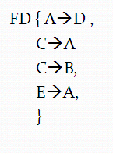
Steps
Only single attribute on RHS
Remove extraneous attribute in LHS
Eliminate redundant FDs
R(A,B,C,D,E)
FD { A→D ,
BC→AD , Minimal cover
C→B,
E→A,
E→D}

Slide 53
Examples
{A→C, A→B} is a minimal cover for {AB→C, A→B}
What about {AB→C, B → AB, D→BC}?
Every set of FDs has an equivalent minimal set
There can be several equivalent minimal sets
There is no simple algorithm for computing a minimal set of FDs that is equivalent to a set F of FDs
To synthesize a set of relations, we assume that we start with a set of dependencies that is a minimal set.
Notes:
Synthesize: combine separate elements into a single unit

Slide 54
Algorithms
Example:
{A→B, ABCD→E, EF→GH, ACDF→EG}
Make RHS a single attribute:
{A→B, ABCD→E, EF→G, EF→H, ACDF→E, ACDF→G}
Minimize LHS: ACD→E instead of ABCD→E
Eliminate redundant FDs
Can ACDF→G be removed?
Can ACDF→E be removed?
Final answer: {A→B, ACD→E, EF→G, EF→H}

Slide 55
Example
R = (A, B, C) F = {A → BC, B → C, A → B,AB → C}
Combine A → BC and A → B into A → BC
Set is now {A → BC, B → C, AB → C}
Is B extraneous in A → BC
{A → BC, B → C, AB → C} ? {A → C, B → C, AB → C} NO
Is C extraneous in A → BC
{A → BC, B → C, AB → C} ? {A → B, B → C, AB → C} Yes
Set is now {A → B, B → C, AB → C}
Is A is extraneous in AB → C
{A → B, B → C, AB → C} ? {A → B, B → C, B → C} Yes
Set is now {A → B, B → C}
The canonical cover is: {A → B, B → C}

