Slide 1
NORMALIZATION

Slide 2
NORMALIZATION
Normalization: The process of analyzing the given relation based on FDs and primary keys to achieve the desirable properties of:
-Minimizing redundancy
-Minimizing anomalies (insertion, deletion, updation)
Process of decomposing unsatisfactory "bad" relations by breaking up their attributes into smaller relations to achieve above desirable properties.
Two additional properties with normalization should be achieved for good database design.
    Lossless join or nonadditive join: No spurious tuples
    Dependency preservation: All FD’s are maintained

Slide 3
NORMAL FORMS
Normal form: refers to the highest normal form condition that it meets, and hence indicates the degree to which it is normalized.
Condition using keys and FDs of a relation to certify whether a relation schema is in a particular normal form
  First Normal Form (1NF)
  Second Normal Form (2NF)
  Third Normal Form (3NF)
  Boyce-Codd Normal Form (BCNF)
  Fourth Normal Form (4NF)
  Fifth Normal Form (5NF)
2NF, 3NF, BCNF based on keys and FDs of a relation schema

Slide 4
FIRST NORMAL FORM
To move to First Normal Form a relation must contain only atomic values at each row and column.
  Disallows composite attributes, multivalued attributes, and nested relations;

Slide 5
1NF STORAGE ANOMALIES
Dlocation in multivalued in department table.
So make it another relation.

Slide 6
SECOND NORMAL FORM
A relation is said to be in Second Normal Form when every nonkey (nonprime attribute is fully functionally dependent on the key.
  That is, every nonkey (nonprime) attribute needs the full candidate key for unique identification

Slide 7
SECOND NORMAL FORM
A Prime attribute (key Attribute) must be a member of some candidate key
A Nonprime attribute (nonkey) is not a prime attribute—that is, it is not a member of any candidate key.

Slide 8
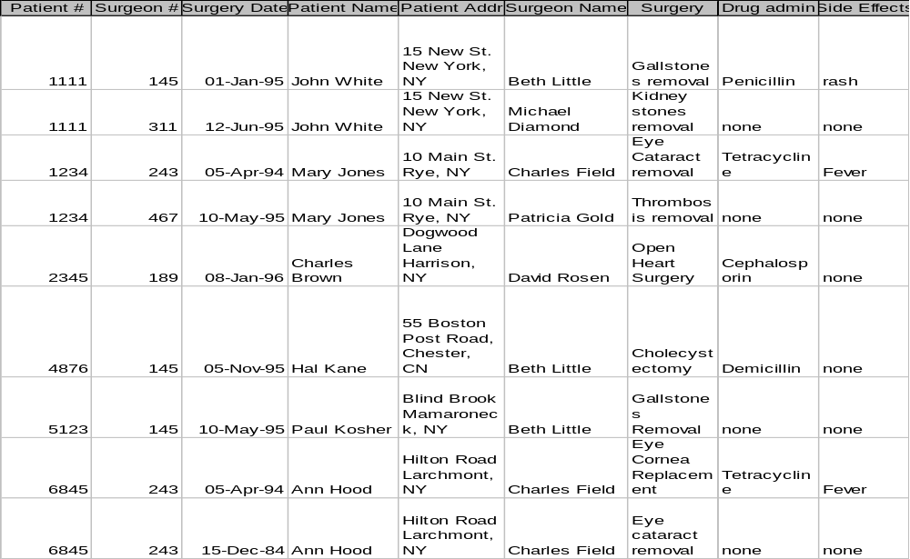
FIRST NORMAL FORM

Slide 9
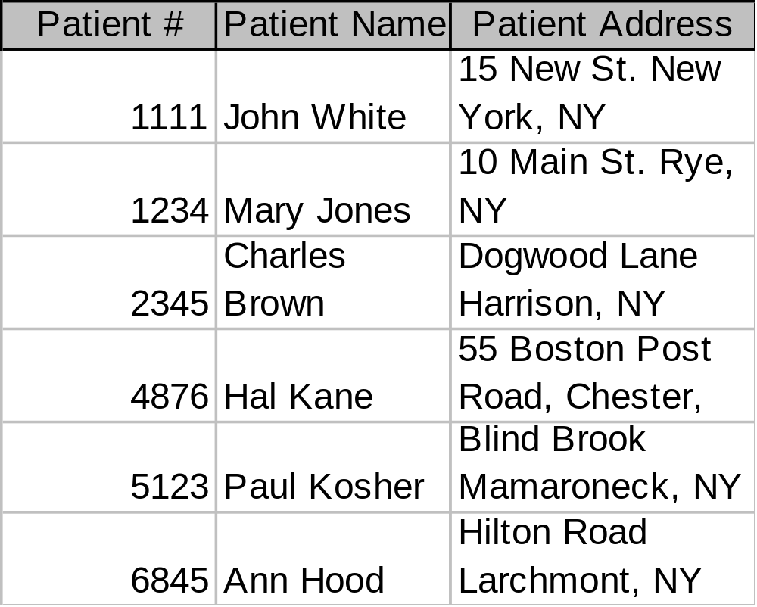
SECOND NORMAL FORM

Slide 10
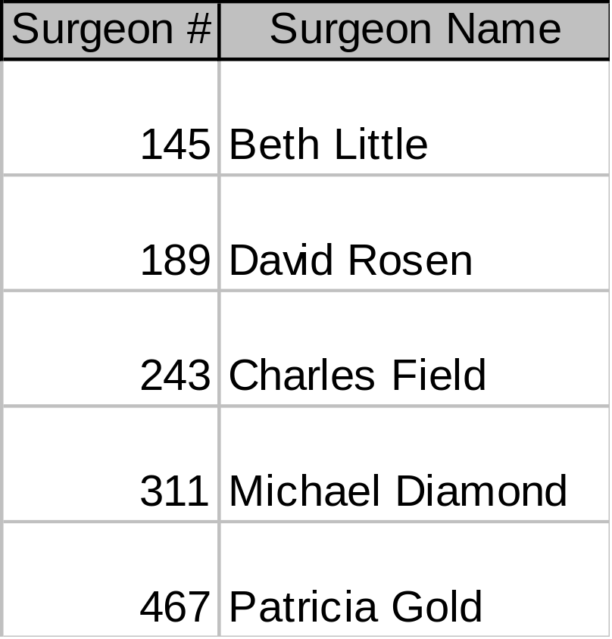
SECOND NORMAL FORM

Slide 11
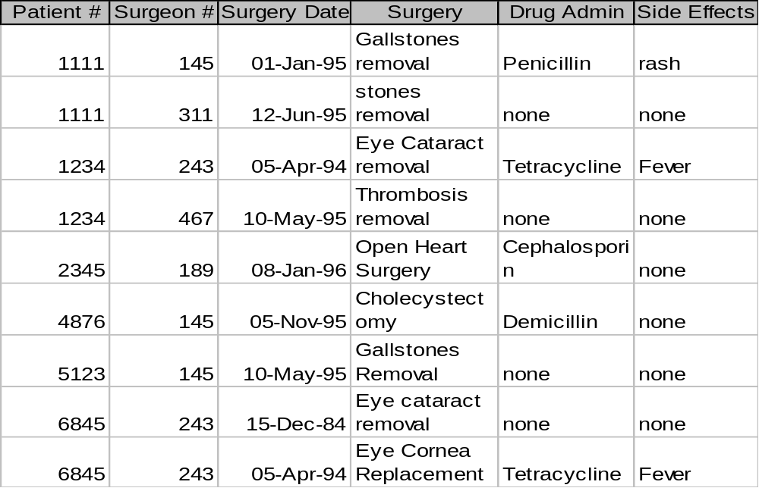
SECOND NORMAL FORM

Slide 12
2NF STORAGE ANOMALIES
Insertion: Cannot enter the fact that a particular drug has a particular side effect unless it is given to a patient.
Deletion: If John White receives some other drug because of the penicillin rash, and a new drug and side effect are entered, we lose the information that penicillin can cause a rash
Update: If drug side effects change (a new formula) we have to update multiple occurrences of side effects.

Slide 13
THIRD NORMAL FORM
A relation is said to be in Third Normal Form if it satisfies:
1. 2NF
2. A relation schema R is in third normal form (3NF) if whenever a FD nontrivial X -> A holds in R, then :
X is a superkey of R, if A is non-prime

Slide 14
THIRD NORMAL FORM
The side effect column in the Surgery table is determined by the drug administered
  Side effect is transitively functionally dependent on drug so Surgery is not 3NF
  R can be decomposed into 3NF relations via the process of 3NF normalization

Slide 15
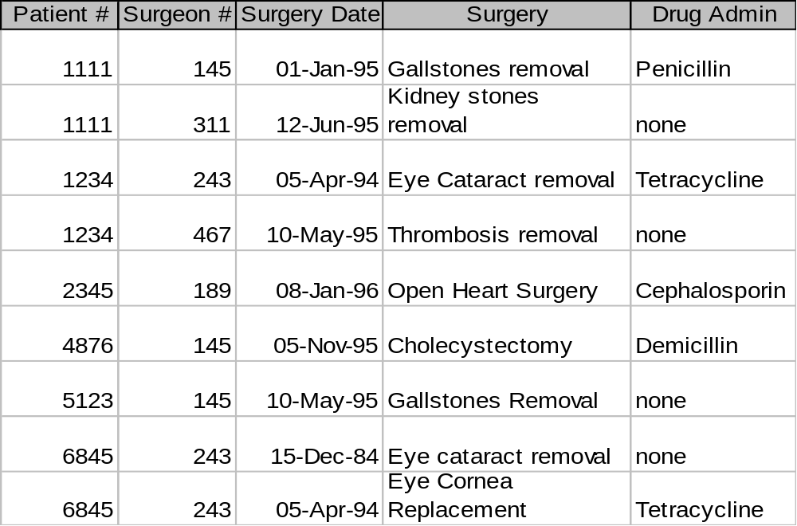
THIRD NORMAL FORM

Slide 16
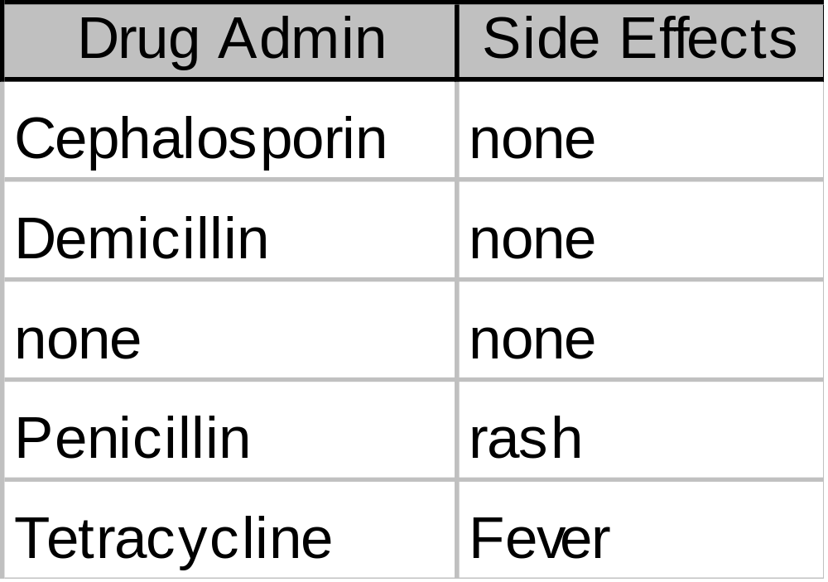
THIRD NORMAL FORM

Slide 17
2NF STORAGE ANOMALIES REMOVED
Insertion: We can now enter the fact that a particular drug has a particular side effect in the Drug relation.
Deletion: If John White recieves some other drug as a result of the rash from penicillin, but the information on penicillin and rash is maintained.
Update: The side effects for each drug appear only once.

Slide 18
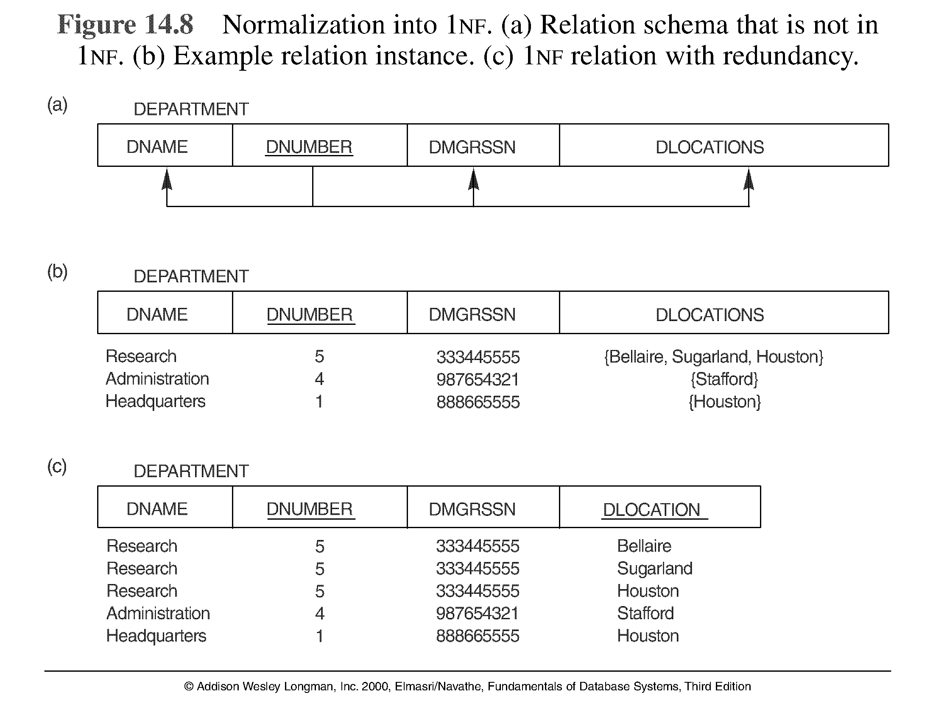
NORMALIZATION INTO 1NF

Slide 19
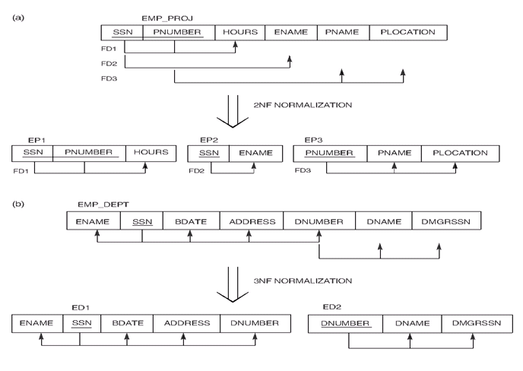

Slide 20
BCNF (BOYCE-CODD NORMAL FORM)
A relation schema R is in Boyce-Codd Normal Form (BCNF) if whenever an FD X -> A holds in R, then X is a superkey of R.
Each normal form is strictly stronger than the previous one
  Every 2NF relation is in 1NF
  Every 3NF relation is in 2NF
  Every BCNF relation is in 3NF
The goal is to have each relation in BCNF (or 3NF) .
Some FD may be lost in BCNF decomposition.

Slide 21
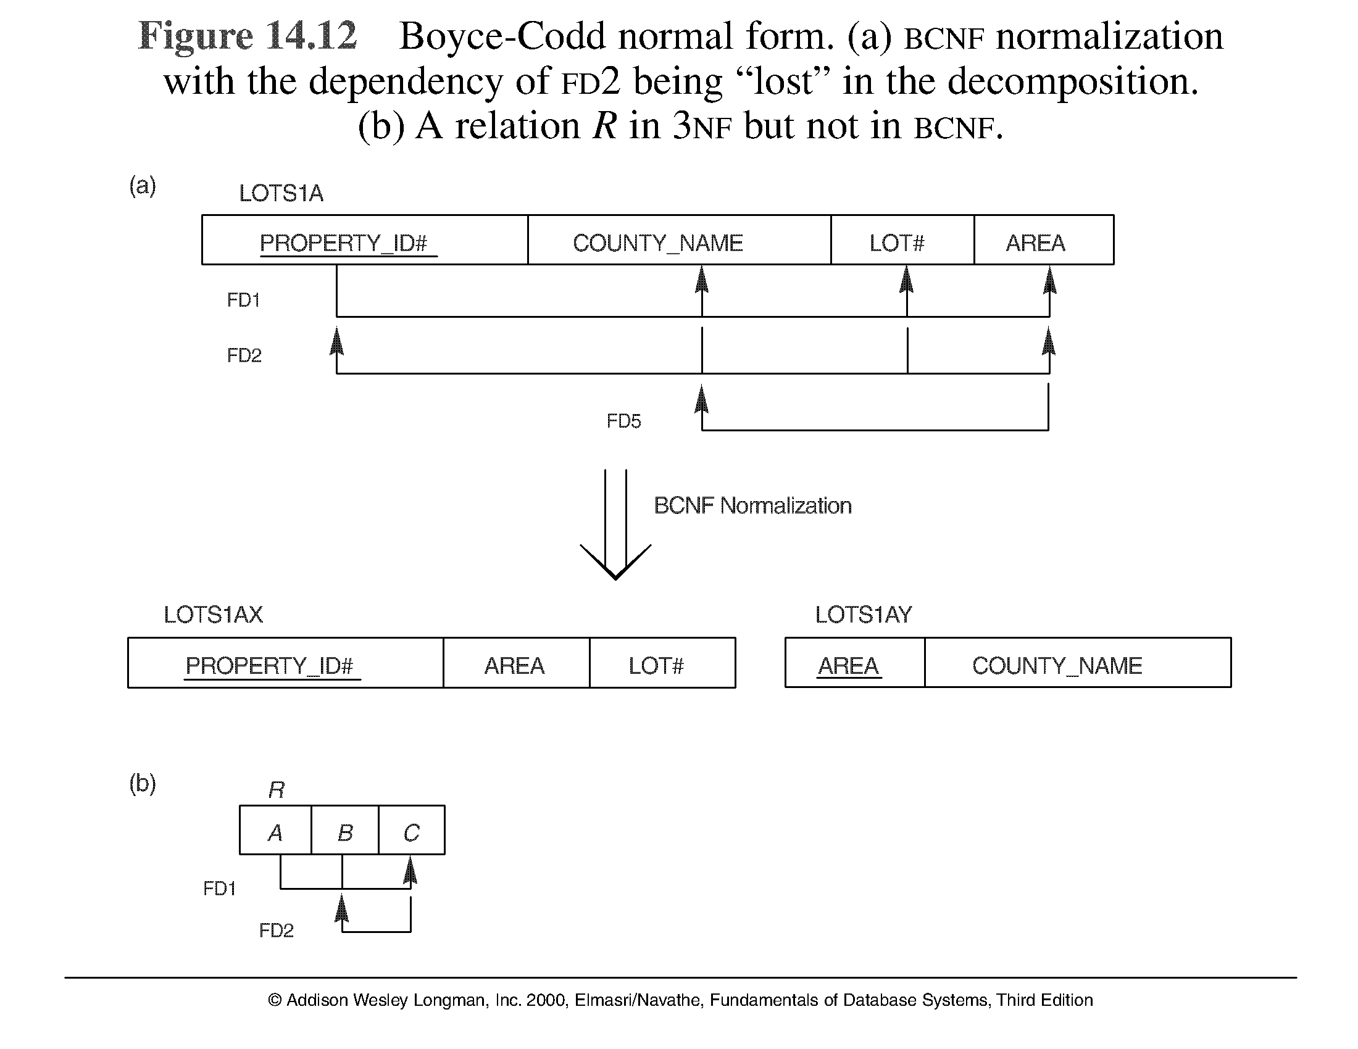
FIGURE 10.12 BOYCE-CODD NORMAL FORM

Slide 22
DIFFERENCE B/W 3NF & BCNF
In 3NF:
X -> A holds in R, then
X is a super key of R, if A is non-prime
In BCNF
  X is always a super key for every FD
  Whereas in 3NF we don’t care about X if A is a prime attribute.

